Slide 1
Medical Insurance Expense
Shashank Shekhar|C20024

Slide 2
Introduction
Increasing cost of healthcare continues to be one of the world's biggest challenges
According to WHO, personal expenditure on medical and healthcare has been increasing faster than the overall economy globally.

Slide 3
Problem Statement
The goal of this project is to predict the future healthcare cost of individuals based on their past medical and cost information.

Slide 4
About the Data
The Dataset we use here is the annual insurance premium of the people (‘Charges’).
Column | Description
Age | Age of primary beneficiary
Sex | Insurance contractor gender. female/ male
BMI | Body mass index, provides an understanding of body.
Children | Number of children covered by insurance
Smoker | If Insurance primary smokes
Region | The beneficiary’s residential area in the US.
Charges | Individual medical costs billed by health insurance
There are total 1338 people in the dataset with 0 missing values

Slide 5
Recommendations
By keeping track of the customer Age, habits like smoking, regular health checkups, report analysis and the old cost expenses, we can get to know if the customer expenditure on the insurance in the future.
The future healthcare revenue could be accurately predicted for the company, which can help in targeting different customers based on their habits (smoking) or the certain healthcare parameters.

Slide 6
Data Exploration

Slide 7
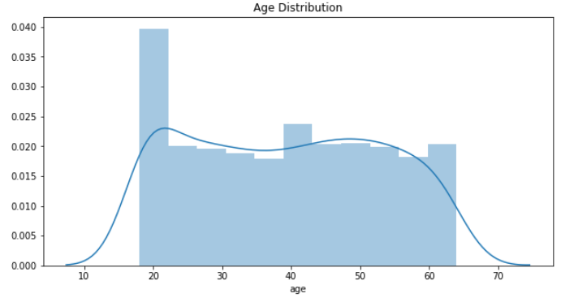
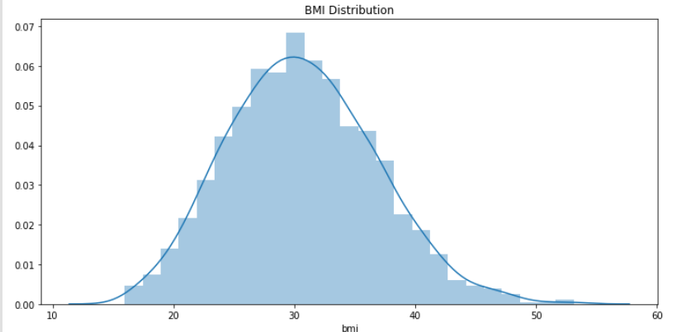
Univariate Analysis
BMI is normally distributed
For the plot it can be inferred that the Age does not show skewness

Slide 8
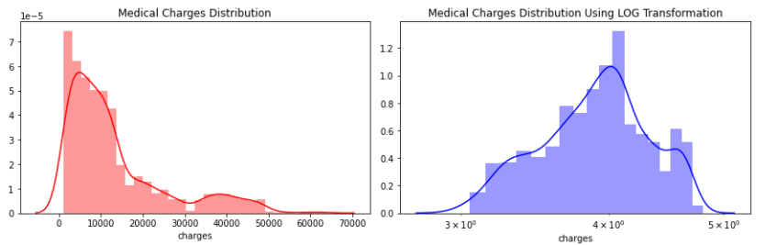
The distribution for the Charges is skewed. Moreover in the second plot after using the log values the charges distribution looks similar to normal distribution to an extent.

Slide 9
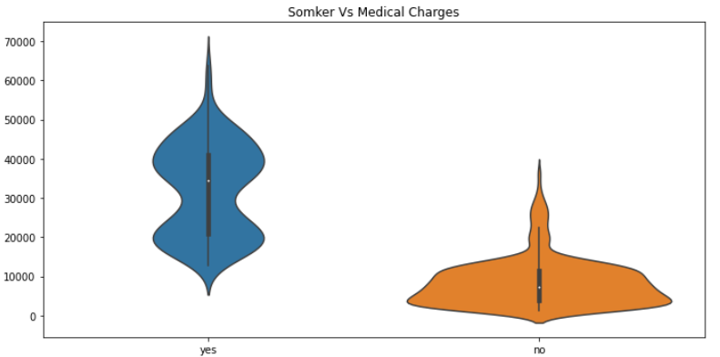
Bivariate Analysis
From the plot and the min-max-mean value for the medical charges table we can infer that the as the number of children increases, minimum charges increases whereas in case for the maximum charge is shows the inverse trends.
Correlation between the number of children and charge shows a mild relation

Slide 10
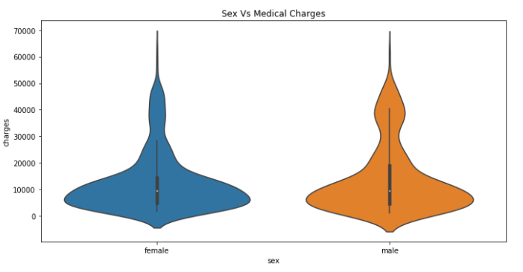
The insurance charge for male and female is approximately in same range.
Gender seems to have next to no influence on the charge as the mean medical expenses of both sexes seems nearly equal.

Slide 11
Model Selection:
We will use Linear regression , Decision Tree to predict the insurance price.
We have used multiple models in order to predict the best result for the dataset.
We have divided the dataset into train and test split to fit the model in train data and test the fitted model with the test data.

Slide 12
Model Evaluation

Slide 13
Linear Regression
Multiple linear regression is used when there is more than one independent variable used for the prediction of a response variable.
Analysis:-
The value for the adjusted R square shows that 77.79% variation is explained by the model.
The RMSE value is low (5729.57) when we consider the range for charges (predicted variable)

Slide 14
Decision Tree Regressor
Decision Tree is one of the most commonly used, practical approaches for supervised learning. It can be used to solve both Regression and Classification tasks with the latter being put more into practical application.
Analysis:
The RMSE value for the decision tree is almost similar to the linear Regression 5788.45.

Slide 15
Conclusion:
In our analysis we find that region and gender do not bring significant difference on the charges among its peers.
Age, BMI number of the children and smoking are the ones that drive the charges.
The smoking habit of the people have most influence on the medical charges.

Slide 16
Why this model ?..:
We have selected Linear Regression as our model, to predict the medical charges as it gives slight better result than decision tree in this case.
The future healthcare revenue could be accurately predicted as our model still explains 77% of the variation and the RMSE shows low value.
This also explains the importance of all the attributes contributing to the charge prediction.

Slide 17
THANK YOU

