Slide 1
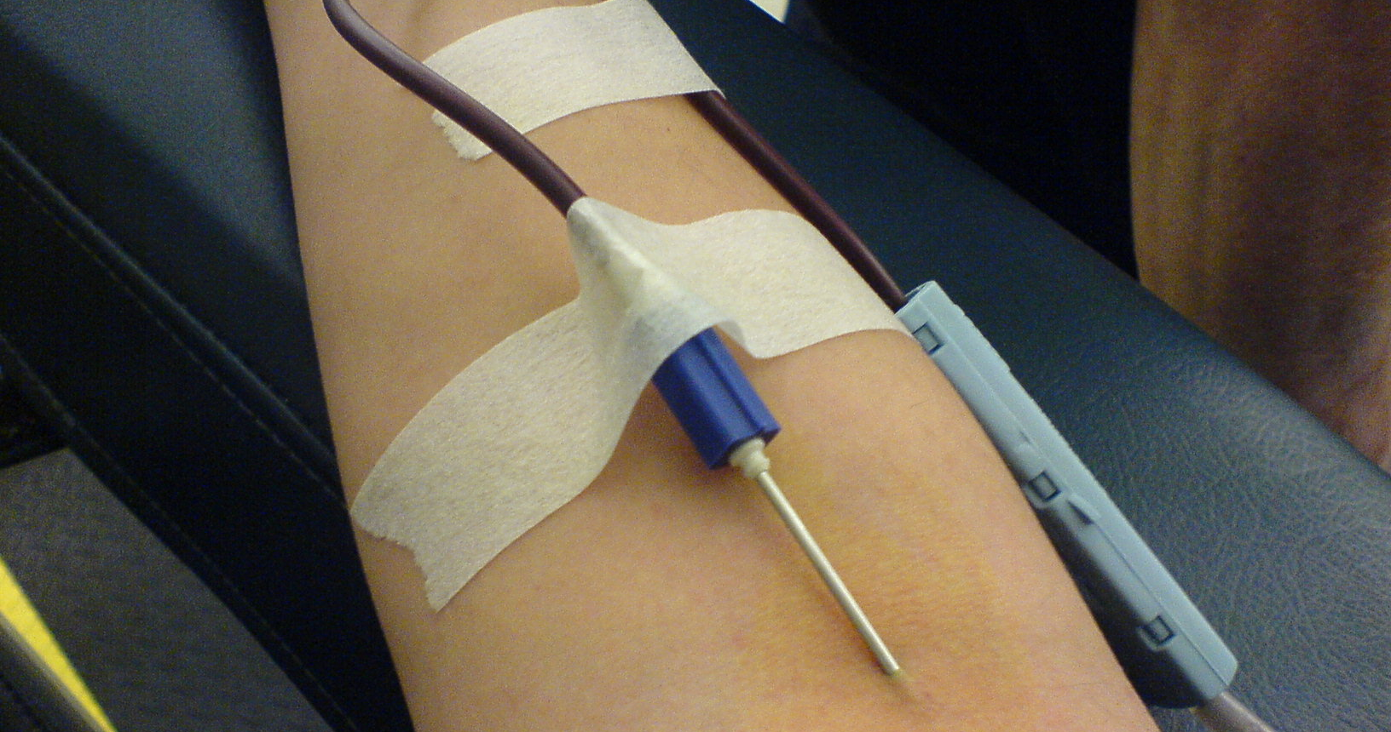
BLOOD DONORS
Web application to connect Blood donors with the patients
TEAM-
P.SHASHANK 1602-16-737-043
K.SRIKAR 1602-16-737-049
P.VARSHITH 1602-16-737-056

Slide 2

DESCRIPTION:
Online web portal which allows users to register as blood donors or request blood

Slide 3
Problem:
Unavailability of blood during emergency.
Less awareness among people about blood donation and blood transfusion.
Death due to lack of blood during operations.
The Blood Bank project aims to make all the procedures automated and it can more fast and accurate.
This project is a high quality software to manage all these cumbersome jobs.

Slide 4
Objectives:
Maintain records of blood groups.
Keep records of blood group available.
Order of blood groups finished.
Request for blood.
Donate blood.

Slide 5
High Level Design: (technologies implemented to solve above problem)
Front End - HTML5,CSS3,JavaScript
Bootstrap3
Back End - NodeJS
Database - MongoDB
Framework - ExpressJS

Slide 6
Use Case:
Handling of emergency situations.
Donate, request blood.

