Slide 1
FAIR Data Engineering · Group 16
FAIRifying the World Bank Projects & Operations data
Shashank Kumar Amanana & Saket Dronamraju
University of Twente · 2026

Slide 2
Introduction
World Bank Projects & Operations
Lending projects: country, status, dates, costs, themes, financiers
Open data (CC BY 4.0), but only a plain CSV
2,000
156
14
projects
countries
columns
Project ID | Country | Status | Approval date | Commitment | Financier Name
P000035 | Angola | Closed | 07-01-1992 | 52600000 | IDA Credit | NORWAY: Norwegian…
P000037 | Angola | Closed | 19-06-1991 | 23000000 | IDA Credit
P000044 | Angola | Closed | 03-09-1992 | 21000000 | IDA Credit
Group 16 · FAIR Data Engineering
2

Slide 3
FAIRification planning
Goals
Stakeholders
Existing FAIR support
• Persistent identifiers (W3ID)
• Rich DCAT metadata in a FAIR Data Point
• RDF with our own ontology, reusing schema.org and FOAF
• Countries linked to Wikidata
• Clear licence and provenance
• Development researchers
• Policy makers in borrowing countries
• Donors and other development banks
• Journalists and NGOs
• Open licence: CC BY 4.0
• Unique World Bank Project IDs
• Catalogue page for the full dataset
• No metadata for our sample
Group 16 · FAIR Data Engineering
3

Slide 4
Competency questions and answers
CQ1
CQ2
CQ3
CQ4
Kenya projects 2010–2020: how many, which status?
Which country received the largest commitment?
Which development theme received the most?
Which active projects close before 2027?
8 projects
India 5.06 bn
77.3 bn USD
59 projects
7 closed, 1 active
USD; then Mexico, Turkey
Private Sector Development
still active, closing soon
Country · Approval date · Status
Country · Total commitment
Theme · Total commitment
Status · Closing date
CQ5
CQ6
CQ7
CQ8
Who co-finances projects together with IDA?
Which lending instrument runs the longest?
Projects co-financed by a bilateral agency?
Which projects were dropped, and on which themes?
156 financiers
6.7 years
177 projects
9 projects
most often Borrower/Recipient
Sector Inv. & Maintenance Loan
total cost 30.0 bn USD
e.g. P119225, Paraguay
Financier name · Country
Lending instrument · Duration
Financial type · Current cost
Status · Theme
Group 16 · FAIR Data Engineering
4

Slide 5
Columns used for the FAIRification
Column | In the RDF
Project ID | the project IRI …/data#P000035 + g16:projectID
Project Name | g16:projectName, rdfs:label
Project Status | g16:hasStatus → Active / Closed / Dropped / Pipeline
Country | g16:hasSpatialCoverage → Country, linked to Wikidata
Board Approval Date | g16:approvalDate (xsd:date)
Project Closing Date | g16:closingDate (xsd:date)
Project Duration | g16:durationInYears (xsd:decimal)
Column | In the RDF
Current Project Cost | g16:currentCostUSD (xsd:decimal)
Total Commitment | g16:totalCommitmentUSD (xsd:decimal)
Lending Instrument | g16:hasLendingInstrument → LendingInstrument
Theme | g16:hasTheme → DevelopmentTheme (split)
Financier Name | g16:providedByFinancier → Financier (split)
Amount USD | g16:allocationAmountUSD + currency "USD"
Project Financial Type | g16:hasFinancialType → FinancialType (split)
Group 16 · FAIR Data Engineering
5

Slide 6
Data preparation (OpenRefine)
1
Renamed
Columns in snake_case, with units in the name (_usd, _years)
2,000 rows and 14 columns kept
No values guessed or corrected
Source issues documented, not hidden
64 recorded operations: replayable
2
Standardised
Dates to ISO 8601; amounts as exact decimals, no scientific notation
3
Split
Themes, financiers and financier types: one value per entity
4
Repaired
Broken characters and double spaces fixed
5
Reconciled
156 countries matched to Wikidata (ISO 3166-1 code)
Group 16 · FAIR Data Engineering
6

Slide 7
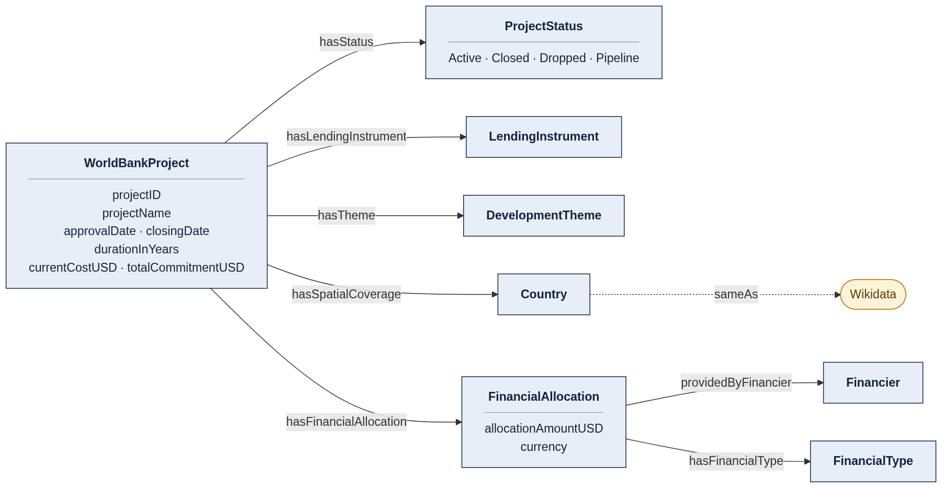
Semantic data model (Protégé)
Own OWL ontology
8 classes, 16 properties, 4 statuses
HermiT: consistent, OWL 2 DL
Aligned to schema.org and FOAF
Each financing record is a FinancialAllocation
Countries linked to Wikidata
Group 16 · FAIR Data Engineering
7

Slide 8
Triplification and identifiers
CSV
OpenRefine
RDF
W3ID
2,000 rows
64 operations
47,451 triples
persistent IRIs
Identifiers (W3ID, base https://w3id.org/FAIR-course-UT/2026/group16/)
…/ont
Ontology
…/data/clean
FAIRified CSV
…/data
FAIRified data (RDF)
…/metadata
Dataset metadata (DCAT)
…/data/original
Original CSV
Group 16 · FAIR Data Engineering
8

Slide 9
From a CSV row to linked data
One row of the CSV
The same project as RDF (Turtle)
Project ID
P000035
data:P000035 a g16:WorldBankProject ;
g16:projectID "P000035" ;
g16:hasStatus g16:Closed ;
g16:approvalDate "1992-01-07"^^xsd:date ;
g16:totalCommitmentUSD 52600000.0 ;
g16:hasSpatialCoverage data:country-angola ;
g16:hasFinancialAllocation data:P000035-allocation .
data:country-angola schema:sameAs wd:Q916 .
Country
Angola
Status
Closed
Approval date
07-01-1992
Commitment
52600000
Theme
Environment…
Financier
IDA Credit | …
Group 16 · FAIR Data Engineering
9

Slide 10
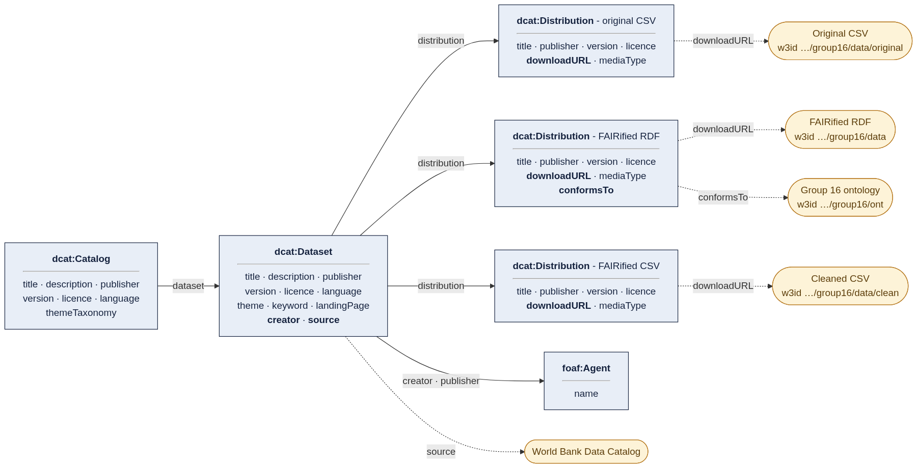
Metadata schema and FAIR Data Point
Schemas (SHACL)
FDP defaults + creator and source; download URL required
Public copy
The FDP is local, so the record is also published under …/metadata
Catalog → Dataset → 3 distributions (original CSV, RDF, cleaned CSV); DCAT, DCMI Terms, FOAF, PROV-O
Group 16 · FAIR Data Engineering
10

Slide 11
How we checked the result
✓
SHACL · data
47,451 triples conform
0
✓
SHACL · metadata
All records conform
SHACL violations
17/17
✓
Ontology
HermiT: consistent, no unsatisfiable classes, OWL 2 DL
PID tests passed
✓
Reproducible
Replaying the 64 OpenRefine steps gives the same graph
5 / 5
✓
PIDs
Relay tests 17/17; all 5 PIDs return the exact repo file
PIDs return the exact file
Group 16 · FAIR Data Engineering
11

Slide 12
FAIRness: before and after
F
Findable
A
Accessible
I
Interoperable
R
Reusable
0 → 6 of 7
0 → 3 of 4
0 → 3 of 3
0 → 4 of 4
W3ID PIDs, rich DCAT metadata, the data's PID inside its metadata
Everything resolves over HTTPS; metadata stored apart from the data
RDF and OWL, standard vocabularies, countries linked to Wikidata
CC BY 4.0, PROV-O provenance, DCAT standard, SHACL-validated
Partial: F4, not in a public search engine
Partial: A2, no long-term archive
Overall: 0 of 18 → 16 of 18 criteria fully met, for both the data and the metadata
Group 16 · FAIR Data Engineering
12

Slide 13
Limitations and challenges
Challenges
Limitations
Messy source data
Several values per cell; financier types do not line up with financiers. Solved with one FinancialAllocation per project
Country matching
30 countries needed a manual choice in Wikidata (historical states, territories)
Linking to Wikidata
Wikidata refuses queries without a descriptive User-Agent; configured in GraphDB
Local FAIR Data Point
Not reachable from the internet, so not indexed by search engines (F4)
No long-term archive
No Zenodo deposit or DOI yet (A2)
Scope of the sample
2,000 projects, nominal USD, one amount per project (no per-financier split)
Financiers not linked
Many are generic (e.g. Trust Funds), so only countries link to Wikidata
Group 16 · FAIR Data Engineering
13

Slide 14
Thank you
Questions?
github.com/Shashank-Amanana/fairdataproject-group16-worldbankdata

