Slide 1

CNN Technique for the Mammographic Analysis

Slide 2
Group Members Information
Kavya Daggubati 700761986
Shashank Arva 700756617
Chinthareddy Akshaya 700760631
Poornesh Madugula 700745192

Slide 3
Roles , Responsibilities and Contribution
Kavya Daggubati - Project Proposal and Dataset Creation:
This phase involves defining the problem statement for breast cancer detection using a Convolutional Neural Network (CNN) approach. Specific objectives will be outlined, including the classification of mammogram images as benign or malignant. The dataset creation process will involve gathering mammogram images from reputable medical sources, ensuring proper labeling and annotation for supervised learning, and utilizing relevant references to validate the dataset's quality and authenticity.
Shashank Arva - Data Analysis and Preprocessing:
In this phase, the imported mammogram dataset will be analyzed to understand its structure and characteristics. Necessary Python modules such as TensorFlow, Keras, and Pandas will be listed for data manipulation and model development. Null values in the dataset, if any, will be identified, and strategies for handling them, such as imputation with mean values, will be implemented to ensure the integrity of the data for training the CNN model.
Chinthareddy Akshaya - Model Implementation and Code Development:
The chosen algorithm for breast cancer detection is a Convolutional Neural Network (CNN) implemented using the Sequential model architecture in TensorFlow/Keras. However, for image classification tasks like mammogram analysis, CNNs are better suited due to their ability to capture spatial patterns. The code will be developed in Python using Flask to deploy the CNN model as a web service.
Poornesh Madugula - Exploratory Data Analysis and Visualization:
During this phase, all columns of the mammogram dataset will be carefully examined to understand the distribution and characteristics of the data. Graphs and visualizations will be produced to explore the relationships between different features and the target variable (benign/malignant). Additionally, correlation charts and heatmaps will be generated to identify significant correlations between image features, aiding in feature selection and model optimization for the CNN.

Slide 4
Motivation
Breast cancer is a significant health concern globally, particularly among women. Early detection is crucial for improving treatment outcomes and reducing mortality rates.
However, manual interpretation of mammogram images by radiologists can be subjective and time-consuming.
Therefore, there is a need for automated methods to assist in early breast cancer detection.

Slide 5
Objectives
The primary objective of this project is to develop a Convolutional Neural Network (CNN) model implemented with the Sequential architecture in TensorFlow/Keras for accurate breast cancer detection from mammogram images. Specific objectives include:
Gathering and preprocessing a large dataset of mammogram images.
Building and training the CNN model for binary classification of benign and malignant cases.
Evaluating the performance of the model on a separate validation set.
Comparing the performance of the CNN model with existing methods for breast cancer detection.

Slide 6
Related Work
Previous research has extensively investigated the application of deep learning techniques, notably Convolutional Neural Networks (CNNs), in the realm of medical image analysis, with a specific focus on breast cancer detection. Numerous studies have showcased the efficacy of CNNs in accurately classifying mammogram images, thereby aiding in the early diagnosis of breast cancer.
These investigations have delved into diverse architectural designs and training methodologies, aiming to enhance the performance and efficacy of CNN models in the context of mammogram classification. The exploration of different CNN architectures, including variations in layer configurations and parameter tuning, has been a focal point of research efforts.
Additionally, investigations have been conducted to optimize training strategies, such as data augmentation, transfer learning, and ensemble methods, to further improve the accuracy and robustness of CNN models for breast cancer detection. Collectively, these studies have laid a foundation for the development of advanced CNN-based approaches for mammogram analysis, with the ultimate goal of improving patient outcomes and advancing the field of medical imaging diagnostics.

Slide 7
Problem Statement
Breast cancer is one of the most prevalent forms of cancer worldwide, making early detection crucial for effective treatment and improved patient outcomes. Convolutional Neural Networks (CNNs) have demonstrated remarkable success in various medical image analysis tasks, including breast cancer detection [3]. This study aims to investigate the efficacy of CNNs in detecting breast cancer from mammographic images. We propose a comprehensive evaluation of different CNN architectures and training methodologies to determine their performance in terms of sensitivity, specificity, and overall accuracy. Additionally, we explore the potential of transfer learning techniques to leverage pre-trained models for improved detection results. The findings of this study could provide valuable insights into the application of deep learning techniques for enhancing breast cancer screening and diagnosis.

Slide 8
Proposed Solution
We present a CNN-based solution for breast cancer detection, utilizing TensorFlow/Keras' Sequential model architecture. Our model employs convolutional layers for feature extraction, followed by max-pooling layers to downsample the extracted features.
To enhance generalization and prevent overfitting, batch normalization and dropout layers are integrated into the network. The model culminates in a dense layer with a sigmoid activation function, enabling binary classification of mammogram images as benign or malignant. This architecture aims to leverage deep learning techniques to achieve accurate and efficient breast cancer detection from medical images.

Slide 9
Results/Simulations
Loading the Libraries: We begin by importing the necessary libraries and frameworks, including TensorFlow, Keras, and scikit-learn, to facilitate model development and evaluation.
Data Loading: The mammogram dataset, comprising both benign and malignant cases, is loaded into memory for training and validation purposes.
Data Preprocessing: Prior to model training, the dataset undergoes preprocessing steps such as resizing, normalization, and augmentation to ensure uniformity and enhance model performance.
Label Encoding: Labels corresponding to benign and malignant cases are encoded into numerical values to facilitate model training and evaluation.
Model Training: The CNN model, constructed using the Sequential architecture in TensorFlow/Keras, is trained on the preprocessed dataset to learn discriminative features for classifying mammogram images.
Evaluation Metrics: Various evaluation metrics, including accuracy, precision, recall, and F1-score, are computed on the validation set to assess the model's performance in classifying images as benign or malignant.
Final Confusion Matrix: The final confusion matrix is generated, providing a visual representation of the model's classification performance, including true positives, true negatives, false positives, and false negatives.
By following these steps, we demonstrate the effectiveness of the proposed CNN model in accurately classifying mammogram images, thereby contributing to the early detection and diagnosis of breast cancer.

Slide 10
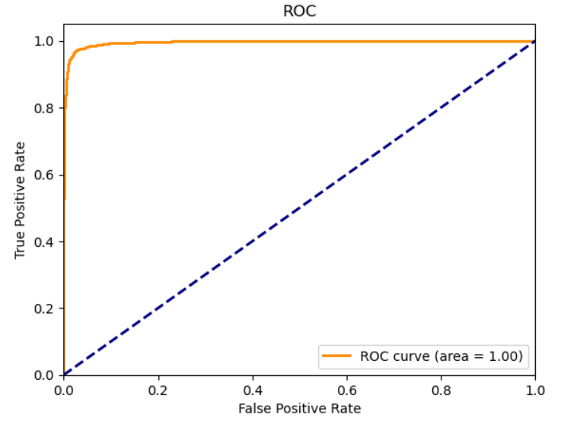
ROC For Evaluated Model

Slide 11
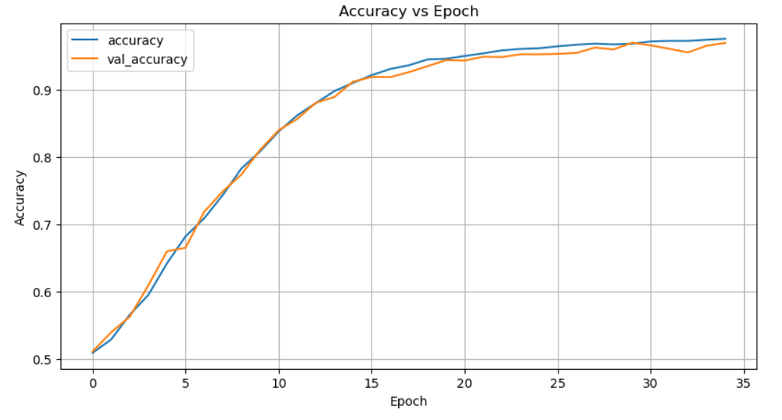
Accuracy VS Epoch

Slide 12

User Signup : Users must register to the application by providing their First name, Last name, email address and the password in order to login to the application

Slide 13

User Login : Users must provide the username and password in order to login to the application

Slide 14

Home Page : Drag and drop features help the users to add a file or the users also have an option to manually add a file.

Slide 15

Prediction:
The prediction result provides the probability percentage of the tumour occurrence. so that, the user can consult a health professional for proper evaluation, diagnosis and medication.

Slide 16
References
Hela, B., Hela, M., Kamel, H., Sana, B., & Najla, M. (2013). Breast cancer detection: A review on mammograms analysis techniques. 10th International Multi-Conferences on Systems, Signals & Devices 2013 (SSD13). doi:10.1109/ssd.2013.6563999
Gu, X., Shi, Z., & Ma, J. (2018). Multi-view Learning for Mammogram Analysis: Auto-Diagnosis Models for Breast Cancer. 2018 IEEE International Conference on Smart Internet of Things (SmartIoT). doi:10.1109/smartiot.2018.00035
Singh, O. V., & Choudhary, P. (2019). A Study on Convolution Neural Network for Breast Cancer Detection. 2019 Second International Conference on Advanced Computational and Communication Paradigms (ICACCP). doi:10.1109/icaccp.2019.8882993
Omonigho, E. L., David, M., Adejo, A., & Aliyu, S. (2020). Breast Cancer:Tumor Detection in Mammogram Images Using Modified AlexNet Deep Convolution Neural Network. 2020 International Conference in Mathematics, Computer Engineering and Computer Science (ICMCECS). doi:10.1109/icmcecs47690.2020.240870
Wadhwa, G., & Kaur, A. (2020). A Deep CNN Technique for Detection of Breast Cancer Using Histopathology Images. 2020 Advanced Computing and Communication Technologies for High Performance Applications (ACCTHPA). doi:10.1109/accthpa49271.2020.9213192

Slide 17
Thank You

