Slide 1
Bitmonks
Team Members
Umang Metri
Shashank Shetti
Krutika Ghadi
Vedant Sinai

Slide 2
PaathShala - An Educational Website
An e- learning website for all age group.
Platform start your learning process, work your learnings and have discussions with those who share a common interest.
Complete each task and get amazing points as rewards.
And Don't forget to check your position on the leaderboard.

Slide 3
Tech Stack
Front-end - React
Back-end - Firebase

Slide 4
Challenges
Transforming learning into Amazing e-learning Experiences.
Lack Of Learner Motivation And Engagement.
Staying Up-To-Date With Modern Tech.
Designing e-learning Courses For Different Generations.
Measurable learning outcomes.
Adaptive learner models to accommodate different learner needs.

Slide 5
How We Think of Solving It
PaathShala - a mobile first website
The UI is easy, simple and mobile responsive.
Have to register only once on signup with all details and while Registering any courses just submit the auto generated form.
Amazing points system will encourage students to do the assignment and read notes daily.
Discussion forum will make you aware of trending topics in your course and earn points answering others questions.
Well sorted assignments and test as submitted, missing and Done .
Gives a reminder to check your next online class

Slide 6
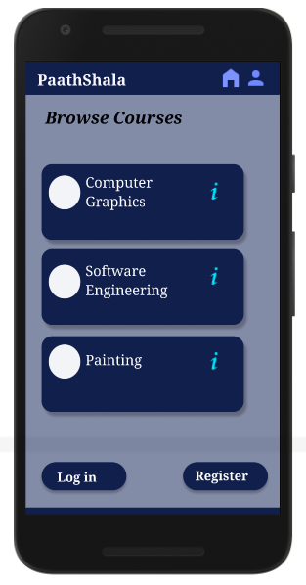
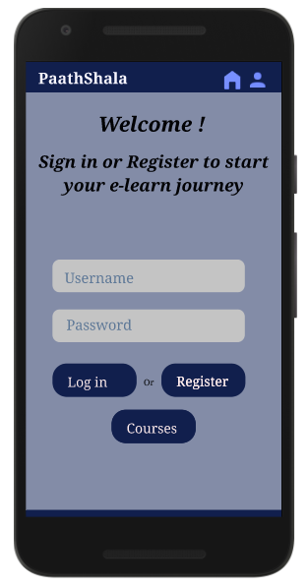
Let’s Get Started
Site loaded , Login with your username and password if u have already registered it on your last visit.
If not then Let’s Register

Slide 7
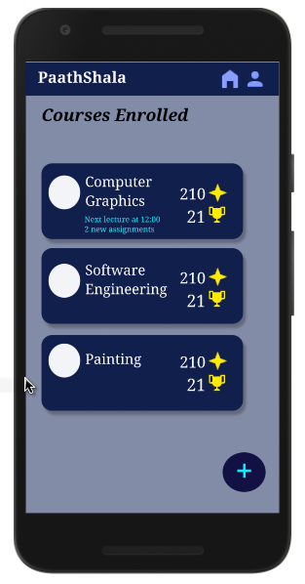
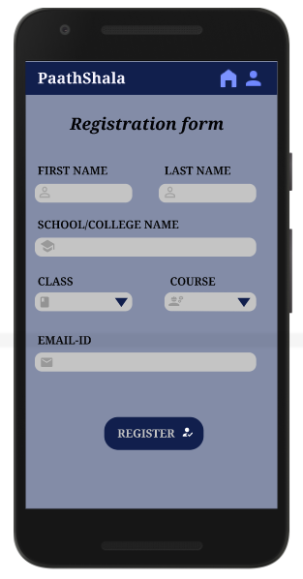
Register
Once registered , you have to do it again for getting registered for any course.
On registering, it will take you to the main home screen.

Slide 8
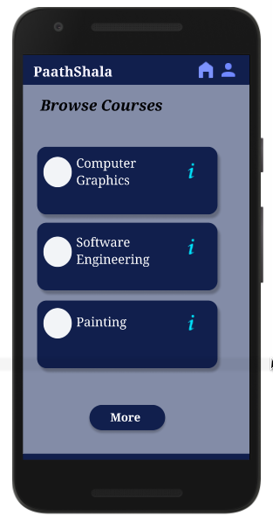
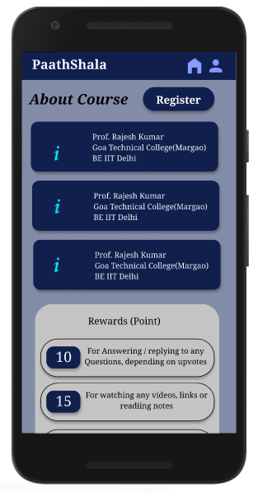
Take up new Courses
On pressing ‘+’ it will take u to the Browse courses where u can select the course
It will open the about course page where you can Register in a single click .

Slide 9
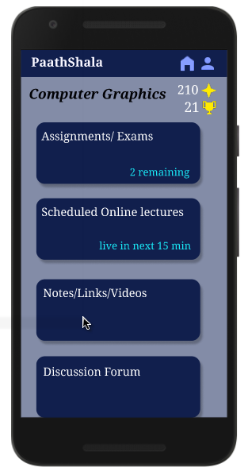
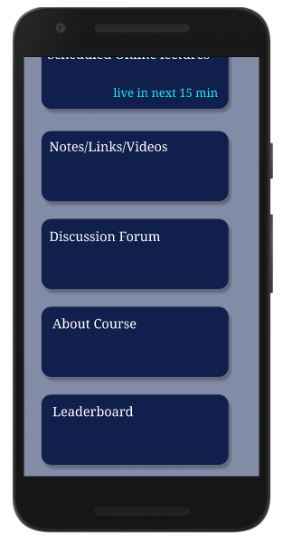
What’s Inside Courses
Each Course will have
Assignments/ Exams
Scheduled Online Lectures
Notes/ Videos/ Links
DiscussionForum
About Course
LeaderBoard

Slide 10
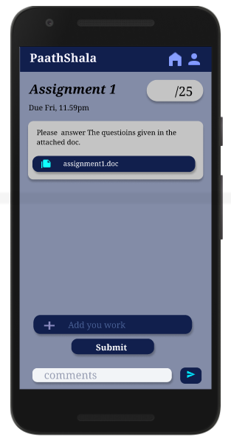
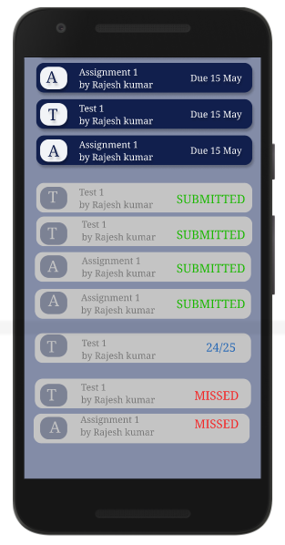
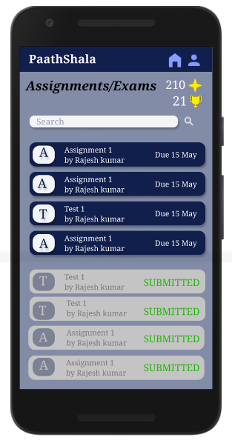
Assignments/ Exams
Here we can submit assignments and take up Exams.
You get points on submission of assignments and exams.

Slide 11
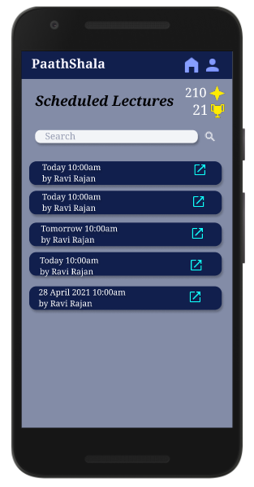
Scheduled Online Lectures
We will be notified about our next Online lecture.

Slide 12
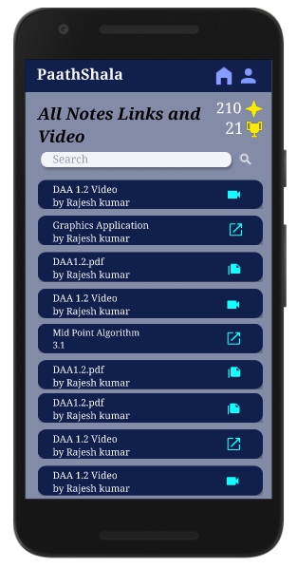
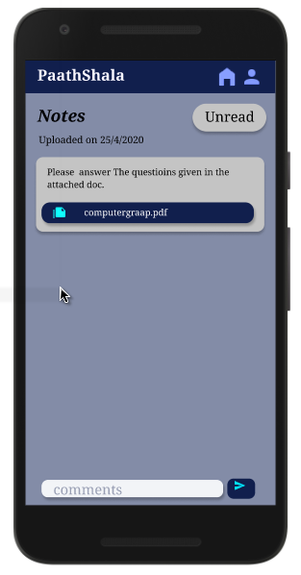
Notes/ Videos /Links
Here you will get the notes, recorded lectures and links to the external reference material .
You get points on completing each notes , videos .

Slide 13
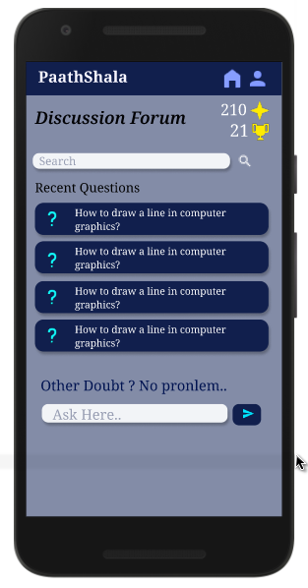
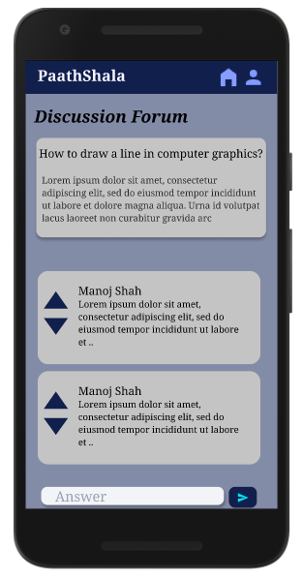
Discussion Forum
Here you can interact with the students and solve your doubts or answer them.
On getting upvotes to your answer u get additional points.

Slide 14
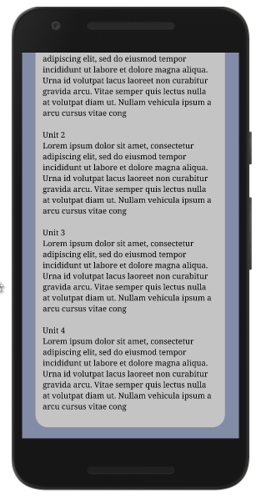
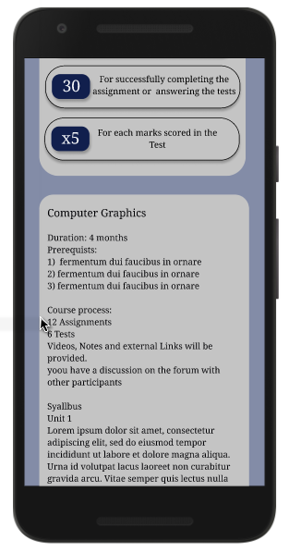
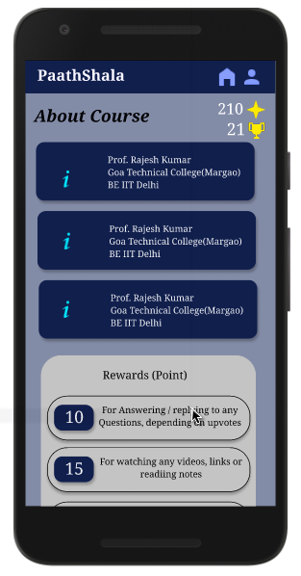
About Course
Here you can get your course faculty Details and Syllabus .

Slide 15
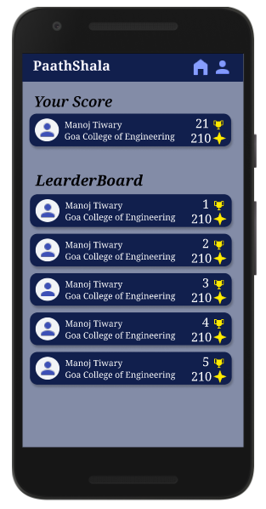
Leaderboard
Here you can check out your rank and compare it with your other course participants .

Slide 16
Thank You

