Slide 1

PROJECT SYNOPSIS
Title: Speech Emotion Recognition
Team Members
Vishal | 3GN20CS054
Shashank Gowda R | 1DB20CS098
Supreeth Raj | 1DB20IS146
Nitin Dasapalli | 2RH20CS017

Slide 2
ALGORITHM

Slide 3
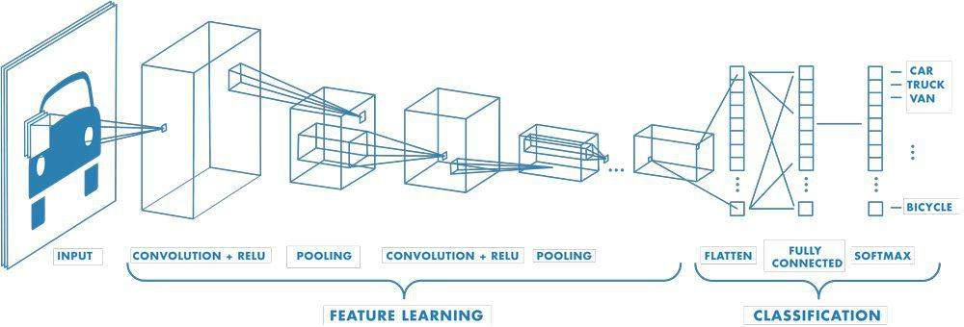
CNN (Convolution Neural Networks)
CNNs use a unique architecture with convolution layers that allow them to learn local patterns and features from the input data and pooling layers that reduce the spatial dimensionality of the features
This makes CNNs well-suited for tasks such as image classification, object detection, and image segmentation.

Slide 4
RNN (Recurrent Neural Network)
A Recurrent Neural Network(RNN) is a type of artificial neural network (ANN) that is designed to work with sequential data such as time series or natural language text.
The basic idea behind RNNs is to use feedback loops to propagate information from one time step to the next with the output of each time step serving as input to the next.
RNNs have found numerous applications in areas such as speech emotion recognition, language translation, and time series forecasting.

Slide 5
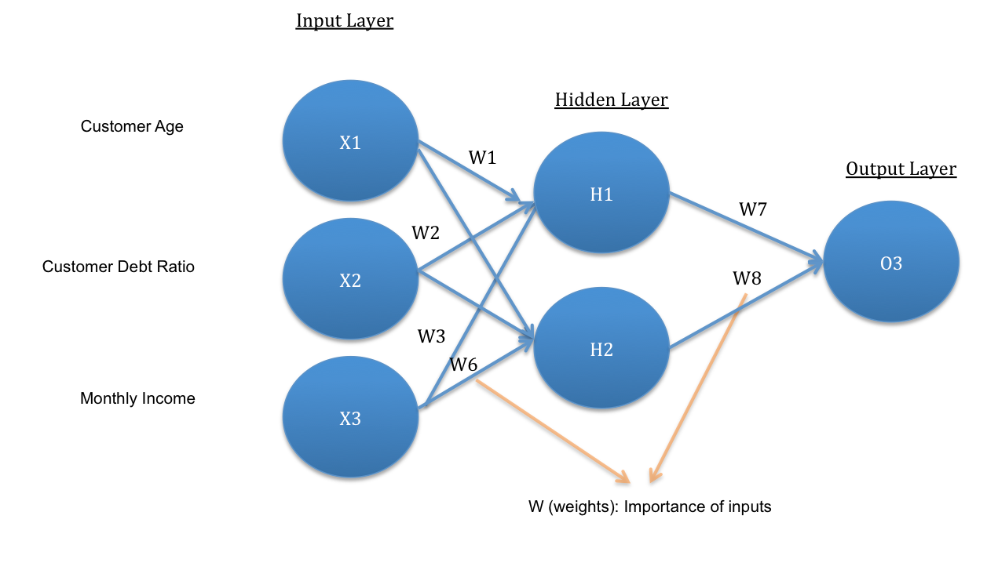
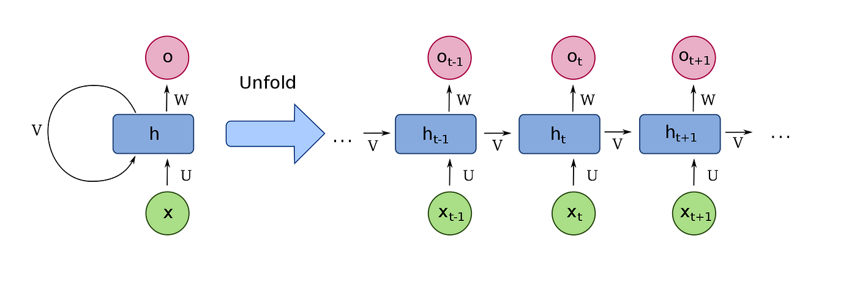
Artificial Neural Network (ANN)
Recurrent Neural Network (RNN)

Slide 6
Drawbacks of RNN
Vanishing Gradient Problem :
When training an RNN, the gradient of the loss function with respect to the parameters of the network needs to be propagated back through time, which can lead to the problem of vanishing gradients.
This occurs when the gradient becomes very small as they are backpropagated through many time steps, making it difficult to update the parameters of the network efficiently.
Exploding Gradient Problem:
In contrast to vanishing gradients, exploding gradients occur when the gradients become very large during backpropagation, causing the parameters of the network to update too quickly and leading to instability in the training process.

Slide 7
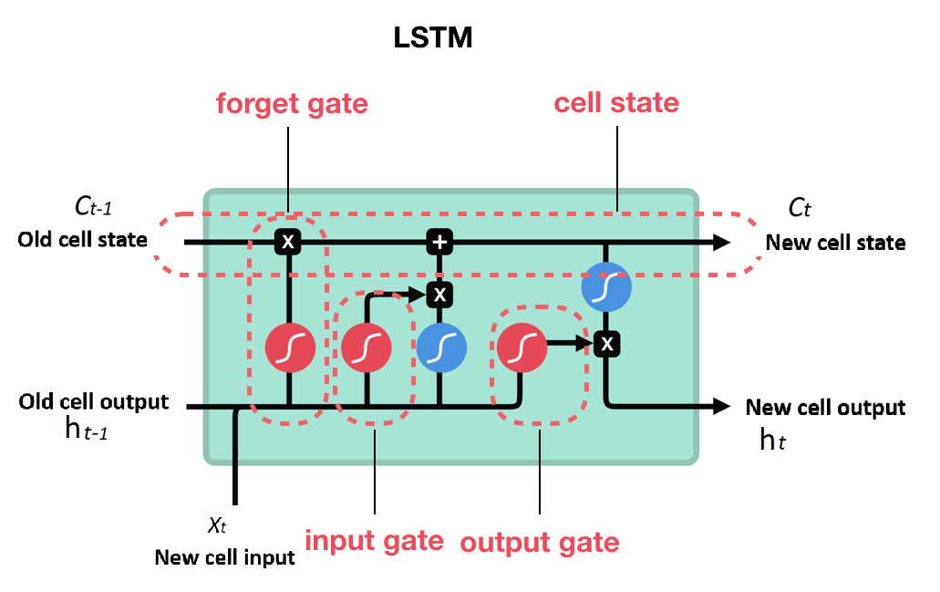
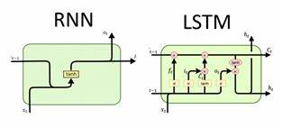
LSTM (LONG SHORT TERM MEMORY)
To solve the problem of Vanishing and Exploding Gradients in a Recurrent Neural Network(RNN).
One of the famous model used is LSTM.
LSTM stands for Long Short Term Memory Networks, used in the field of Deep Learning.
It is a variety of recurrent neural networks (RNNs) that are capable of learning long term dependencies, especially in sequence prediction.

Slide 8
Modules
Pandas: Pandas are used for data manipulation and analysis. It provides data structures like DataFrames that make it easy to work with structured data.
Numpy: NumPy is used for numerical and mathematical operations. It offers powerful arrays and functions for scientific computing.
OS: The OS module is used for interacting with the operating system, and allows us to perform tasks like file and directory operations.
Seaborn: Seaborn is a data visualization library built on top of Matplotlib. It provides a high-level interface for creating informative and attractive statistical graphics.
Matplotlib.pyplot: Matplotlib is a versatile plotting library. The pyplot submodule is commonly used for creating static, animated, or interactive plots and graphs.
Librosa: Librosa is primarily used for audio and music analysis. It offers tools for feature extraction, analysis, and manipulation of audio data.

Slide 9
Audio: It is used to play audio files.
Warnings: The warnings module helps control how warning messages are displayed or handled in your Python code, allowing you to manage unexpected behaviors or issues.
Scikit-Learn (sklearn): Scikit-Learn is a machine learning library that provides tools for various machine learning tasks, including classification, regression, clustering, and more. We have used it to encode the label of the audio files(OneHotEncoding).
Keras(Sequential, Dense, LSTM,Dropout): Keras is a high-level neural networks API. We have used it to build neural network models.
Sequential is used to create a linear stack of layers.
Dense defines fully connected layers in neural networks.
LSTM is used for building Long Short-Term Memory networks, which are a type of recurrent neural network (RNN).
Dropout is a regularization technique used to prevent overfitting in neural networks.

Slide 10
Data Flow Diagrams

Slide 11
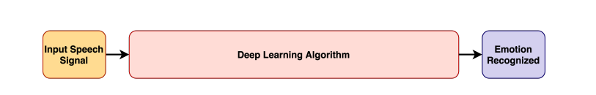
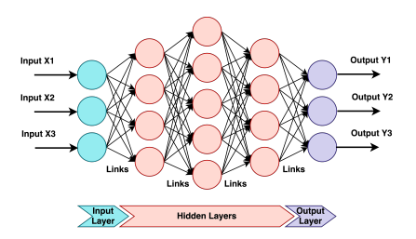
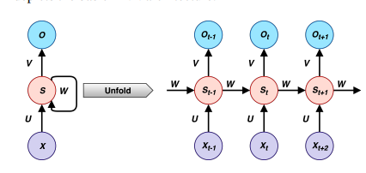
DL PROCESS OVERVIEW

Slide 12
I/P
Processing
MFCC
Model
Prediction
Output
Feature Extraction
RNN Model

Slide 13
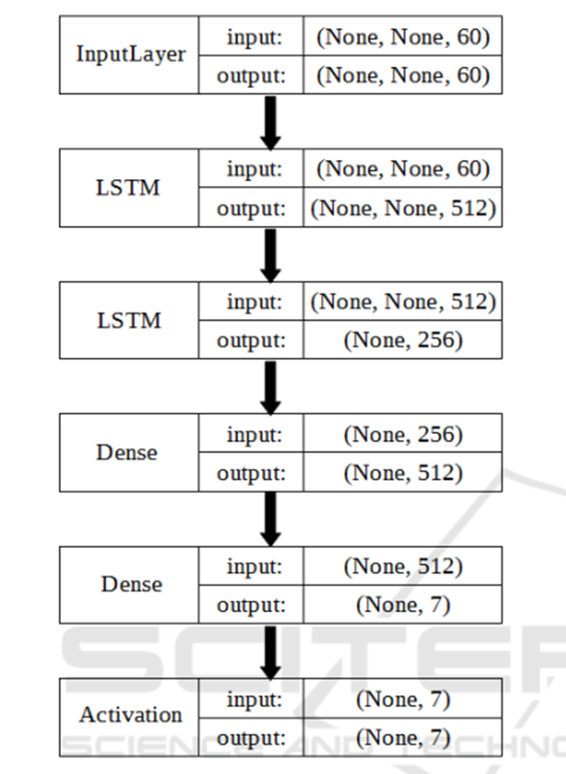
MODEL OVERVIEW

Slide 14


