Slide 1

PROJECT SYNOPSIS
Title: Speech Emotion Recognition
Team Members
Vishal | 3GN20CS054
Shashank Gowda R | 1DB20CS098
Supreeth Raj | 1DB20IS146
Nitin Dasapalli | 2RH20CS017

Slide 2
Speech Emotion Recognition Using Deep Learning
Speech Emotion Recognition (SER) is a fascinating field in the intersection of ML/DL and signal processing. This project focuses on building a Deep Learning model, specifically a Recurrent Neural Network (RNN) with Long Short-Term Memory (LSTM) units, to recognize emotions from speech audio data. The goal is to develop a system that can automatically classify a speaker’s emotional state based on their voice.

Slide 3
About the Project
In today's digital age, understanding and interpreting human emotions are essential for a wide range of applications, from improving customer service in call centers to enhancing user experiences in virtual assistants and entertainment systems. One of the most expressive mediums for conveying emotions is through speech. However, accurately detecting and categorizing emotions in speech data is a complex task that requires advanced technology.

Slide 4
The primary reason for selecting the project
Mental Health and Well-being: Emotion recognition in speech can have applications in mental health. It can help individuals monitor and manage their emotional states and provide valuable insights to therapists and counselors.
Human-Robot Interaction: Emotion-aware robots can be more effective in assisting and collaborating with humans, especially in scenarios where understanding and responding to emotional cues are crucial.
Human Interaction with Alexa or any virtual assistant devices

Slide 5
Project Flow
Data Collection: Gathering a dataset of audio recordings containing speech segments and features. we are using a dataset the Toronto emotional speech set (TESS) emotional Speech.
Data Preprocessing: Prepare and preprocess the audio data. This involves tasks such as audio feature extraction (e.g., MFCCs - Mel-Frequency Cepstral Coefficients), data augmentation, and splitting the data into training and validation sets.
Model Architecture: An RNN-LSTM model architecture suitable for sequential data like speech. LSTM layers are chosen for their ability to capture temporal dependencies in the audio signal.

Slide 6
Model Training: Train the RNN-LSTM model on the preprocessed dataset. The training process involves feeding the audio features into the network and adjusting model weights to minimize a chosen loss function (e.g., categorical cross-entropy).
Validation and Hyperparameter Tuning: Validate the model's performance using a separate validation dataset. Fine-tune hyperparameters such as the number of LSTM layers, units per layer, dropout rates, and learning rates to optimize model performance.
Model Evaluation: Evaluate the trained model on a test dataset to assess its generalization capability. Metrics like accuracy, F1-score, or confusion matrices are used to measure its performance.
Deployment: If possible, deploy the trained model as part of a larger application, such as a voice assistant or emotion-aware customer service system.

Slide 7
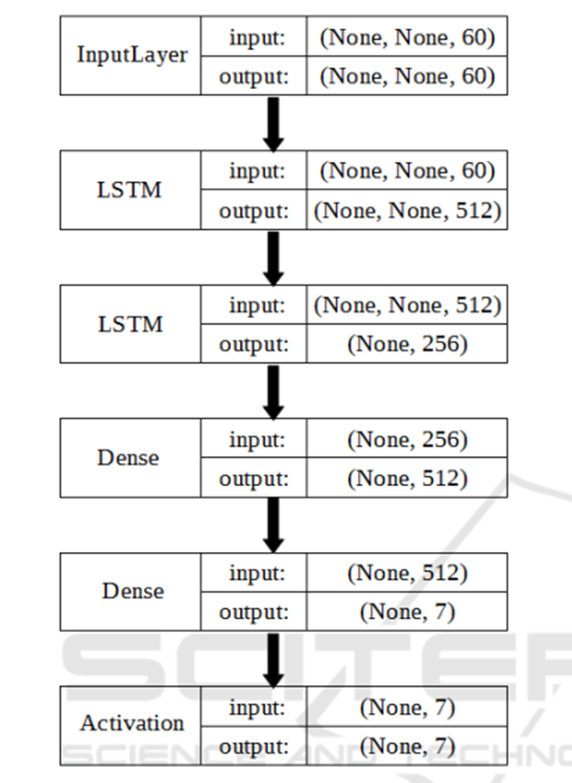
MODEL OVERVIEW

Slide 8
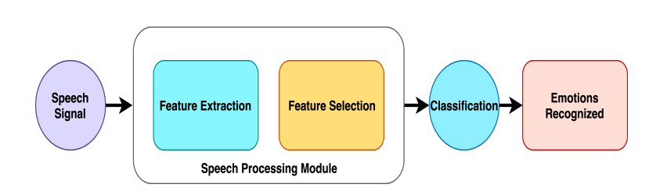
ML PROCESS OVERVIEW

Slide 9
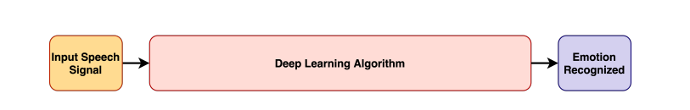
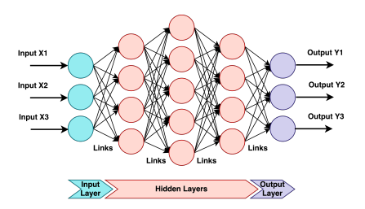
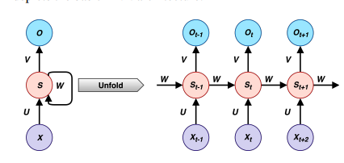
DL PROCESS OVERVIEW

Slide 10
Hardware Requirements
HARDWARE | SPECIFICATION
RAM | 4GB and Above
Software Requirements
SOFTWARE | Version
Python Interpreter | 3.11.5
Jupyter Notebook | 1.0.0
Flask / Streamlit (Web Frame works) | 2.3.3/ 1.26.0

Slide 11
Applications
Virtual Assistants: SER can enhance virtual assistants like Siri, Alexa, and Google Assistant by enabling them to respond more empathetically to user queries and requests.
Chatbots: Emotional chatbots can provide better customer support by recognizing and responding to user emotions effectively.
SER can be used in speech therapy to analyze and provide feedback on the emotional expression of patients with speech disorders.
SER can make AI systems more emotionally intelligent, enabling them to respond empathetically to user queries and needs, making interactions more natural and human-like.
It can also help detect driver drowsiness or stress.
Streaming platforms like Netflix and Spotify can use SER to recommend content that matches the user's mood, enhancing the user experience.
SER can also be implemented in authentication

Slide 12
CONCLUSION

Slide 13


