Slide 1

CLP System Integration POC
April 13th, 2021
Interactive Workshop

Slide 2
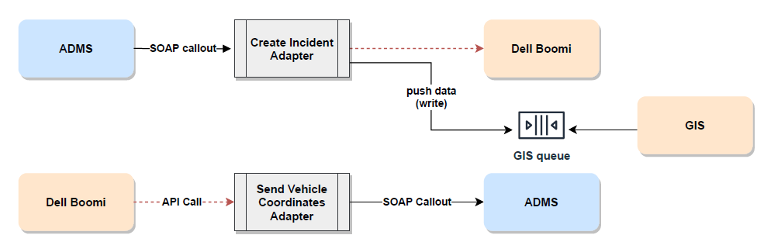
ADMS and Dell boomi(CLP & GIS) Integration Adapters
Flow design

Slide 3
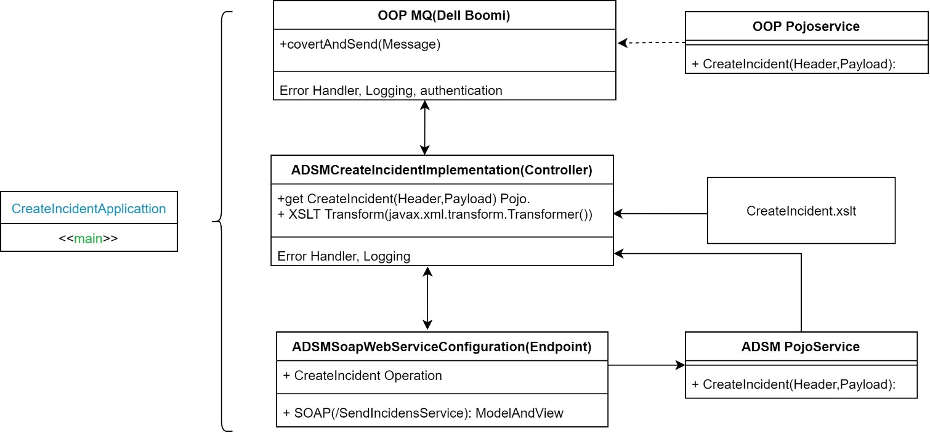
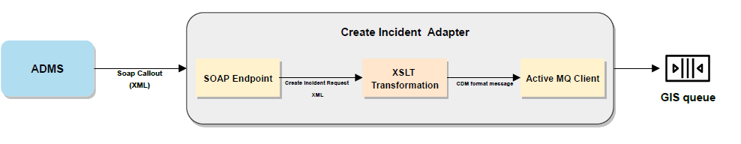
Create Incident Adapter
Flow design

Slide 4
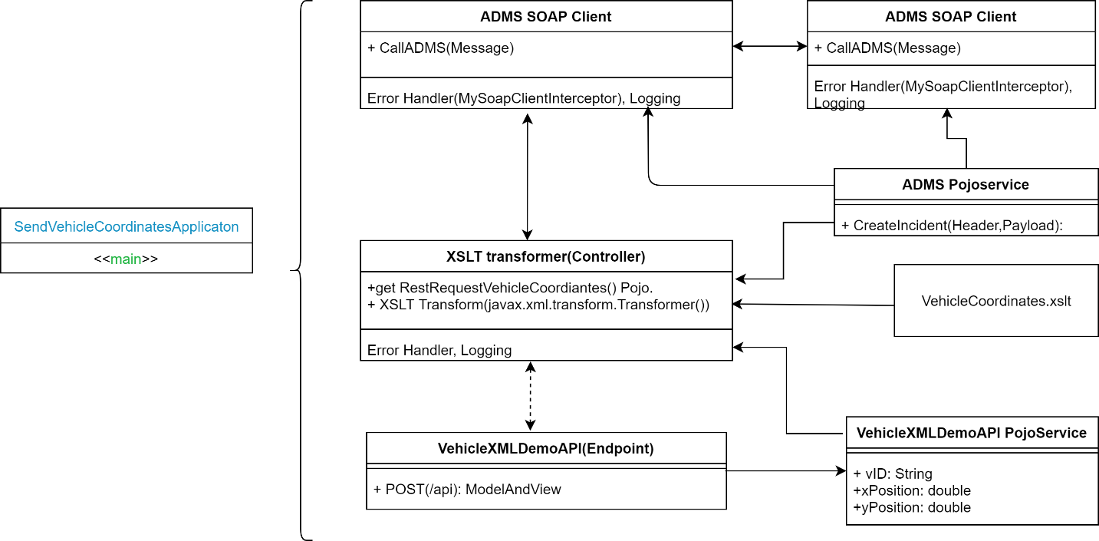
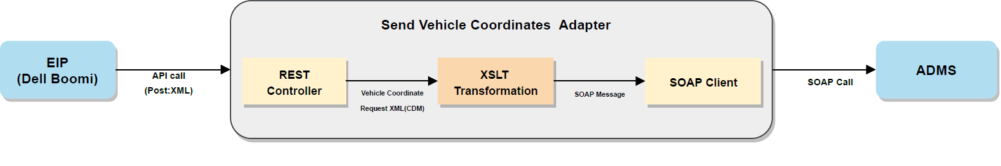
Vehicle Coordinates Adapter
Flow design

Slide 5
Thank You
Any feedback? Let us know

