Slide 1


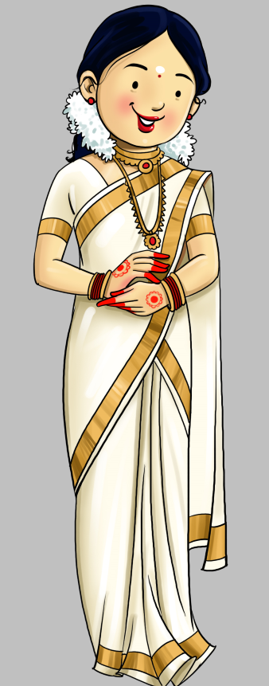
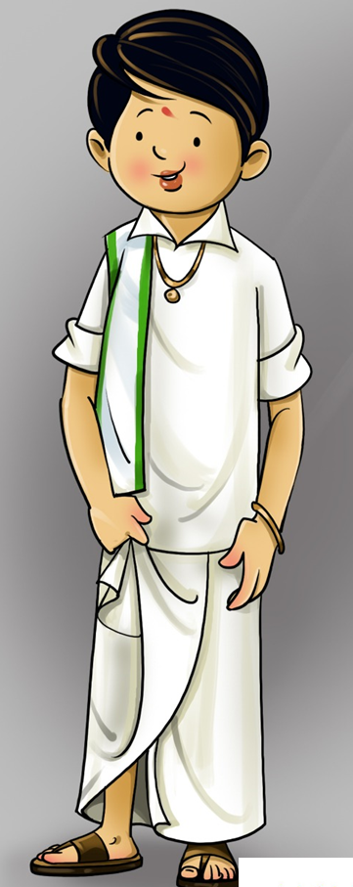



Where ?
When ?
Hi,
I am Manjunath
Hi,
I am Shruthi
We are getting married
We graciously invite you to honour us with your presence & blessings on auspicious occasion of the Weeding Ceremony
29th
Sri Samudaya Bhavana,
Hirisave,
Channarayapatna, Hassan

