Slide 1


1. The data exchange between ADMS and other systems (other than GIS) via ESB
Technical lead for overall system integrations
Extensive integration capabilities
ADMS and GIS connectors to EIP
Multiple references
Extensive integration capabilities
Knowledge of CLP IT infrastructure
Other side of the EIP integration

Slide 2
Dell Boomi EIP (IEC 61968-100 compliant messages)
1. The data exchange between ADMS and other systems (other than GIS) via ESB
CIMXML
ArcFM
Tetra GPS
EWMS
PQMS
SMP
CCMS
PSDW
MIRS
EDMS
DNAS
FSS
OOP
PON
CSAC
PGIP
Network Exporter
Tetra Adapter
EWMS
Adapter
PQMS
Adapter
SMP Adapter
CCMS Adapter
PSDW Adapter
MIRS Adapter
EDMS Adapter
DNAS Adapter
FSS Adapter
OOP Adapter
PON Adapter
CSAC Adapter
PGIP Adapter
SFTP
Network Model
IEC 61970/61968
CIMXML circuit-based
SOAP
SOAP
SOAP
SOAP
ADMS COMPUTING ENVIRONMENT
SMTP
SOAP
SOAP
SOAP
DB Access
DB Transfer
AVL Adapter
OMN Adapter
Staging&QA Services
Network Importer
ADMS Network Exporter
Integration Services
File
CRM/IVR
Email
AMI/MDM
OSR
ONT
WFM
PQMS
SQL Engine
PI
AVL
OMN
WCF
ACCESS SERVICES (DMZ)
SE DMS scope
System Integrator (Deloitte) scope

Slide 3
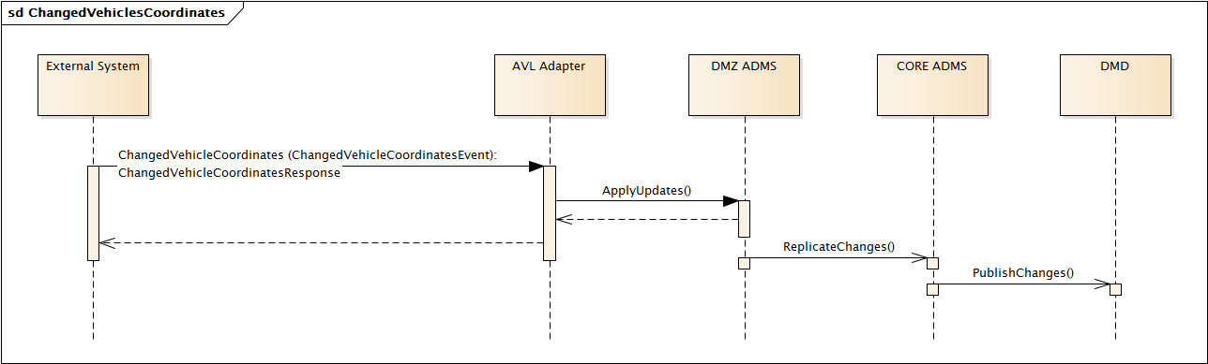
1. The data exchange between ADMS and other systems (other than GIS) via ESB
EcoStruxure ADMS AVL (Automatic Vehicle Location) adapter – ChangedVehicleCoordinates interface
Integration with TETRA GPS

Slide 4
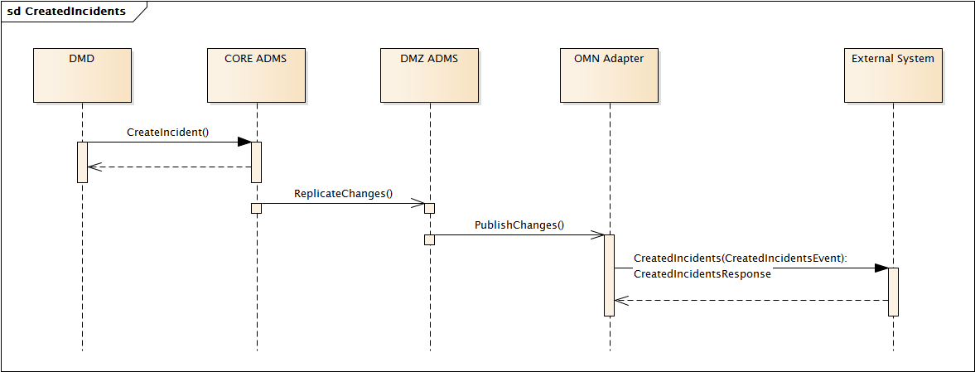
1. The data exchange between ADMS and other systems (other than GIS) via ESB
EcoStruxure ADMS OMN (Outage Management Notification) adapter message flow – CreatedIncidents interface
Integration with OOP

Slide 5
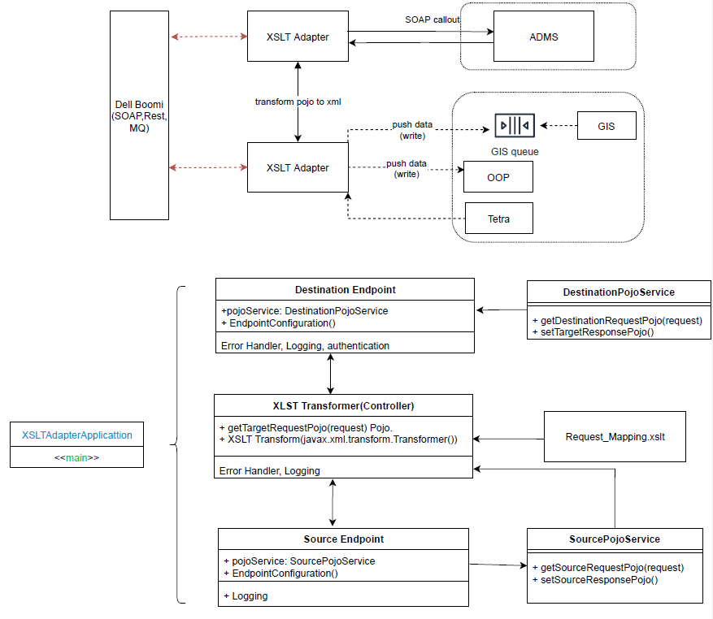
1. The data exchange between ADMS and other systems (other than GIS) via ESB
Integration Approach:

Slide 6
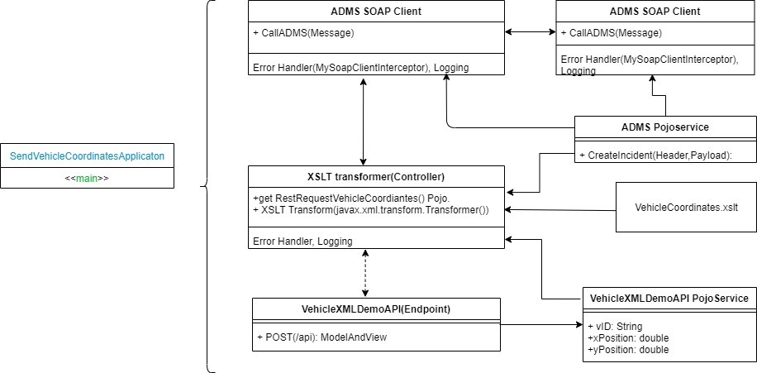
1. The data exchange between ADMS and other systems (other than GIS) via ESB
Use Case 1: Vehicle Coordinates Adapter

Slide 7
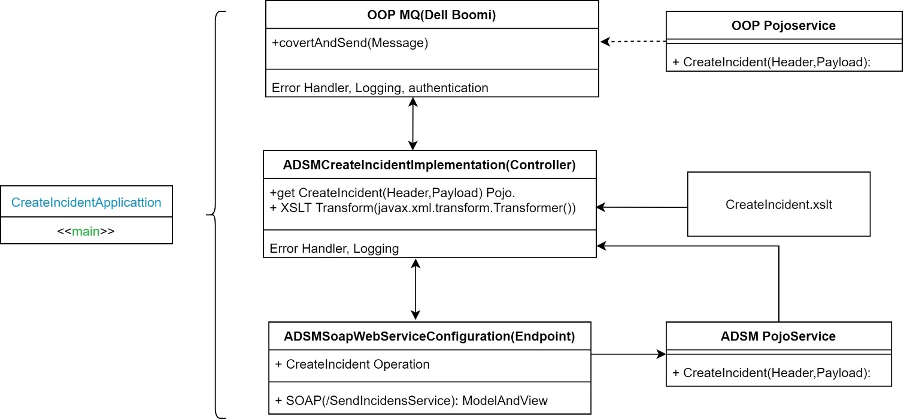
1. The data exchange between ADMS and other systems (other than GIS) via ESB
Use Case 1: Create Incident Adapter

