Slide 1


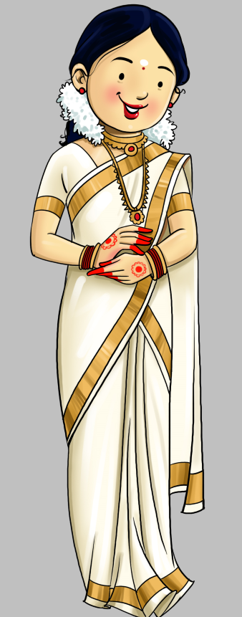
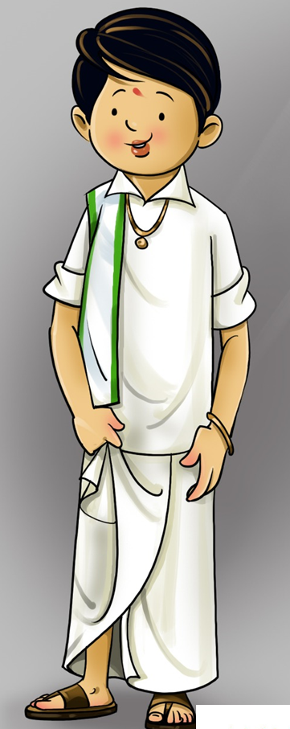
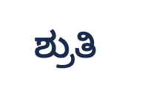

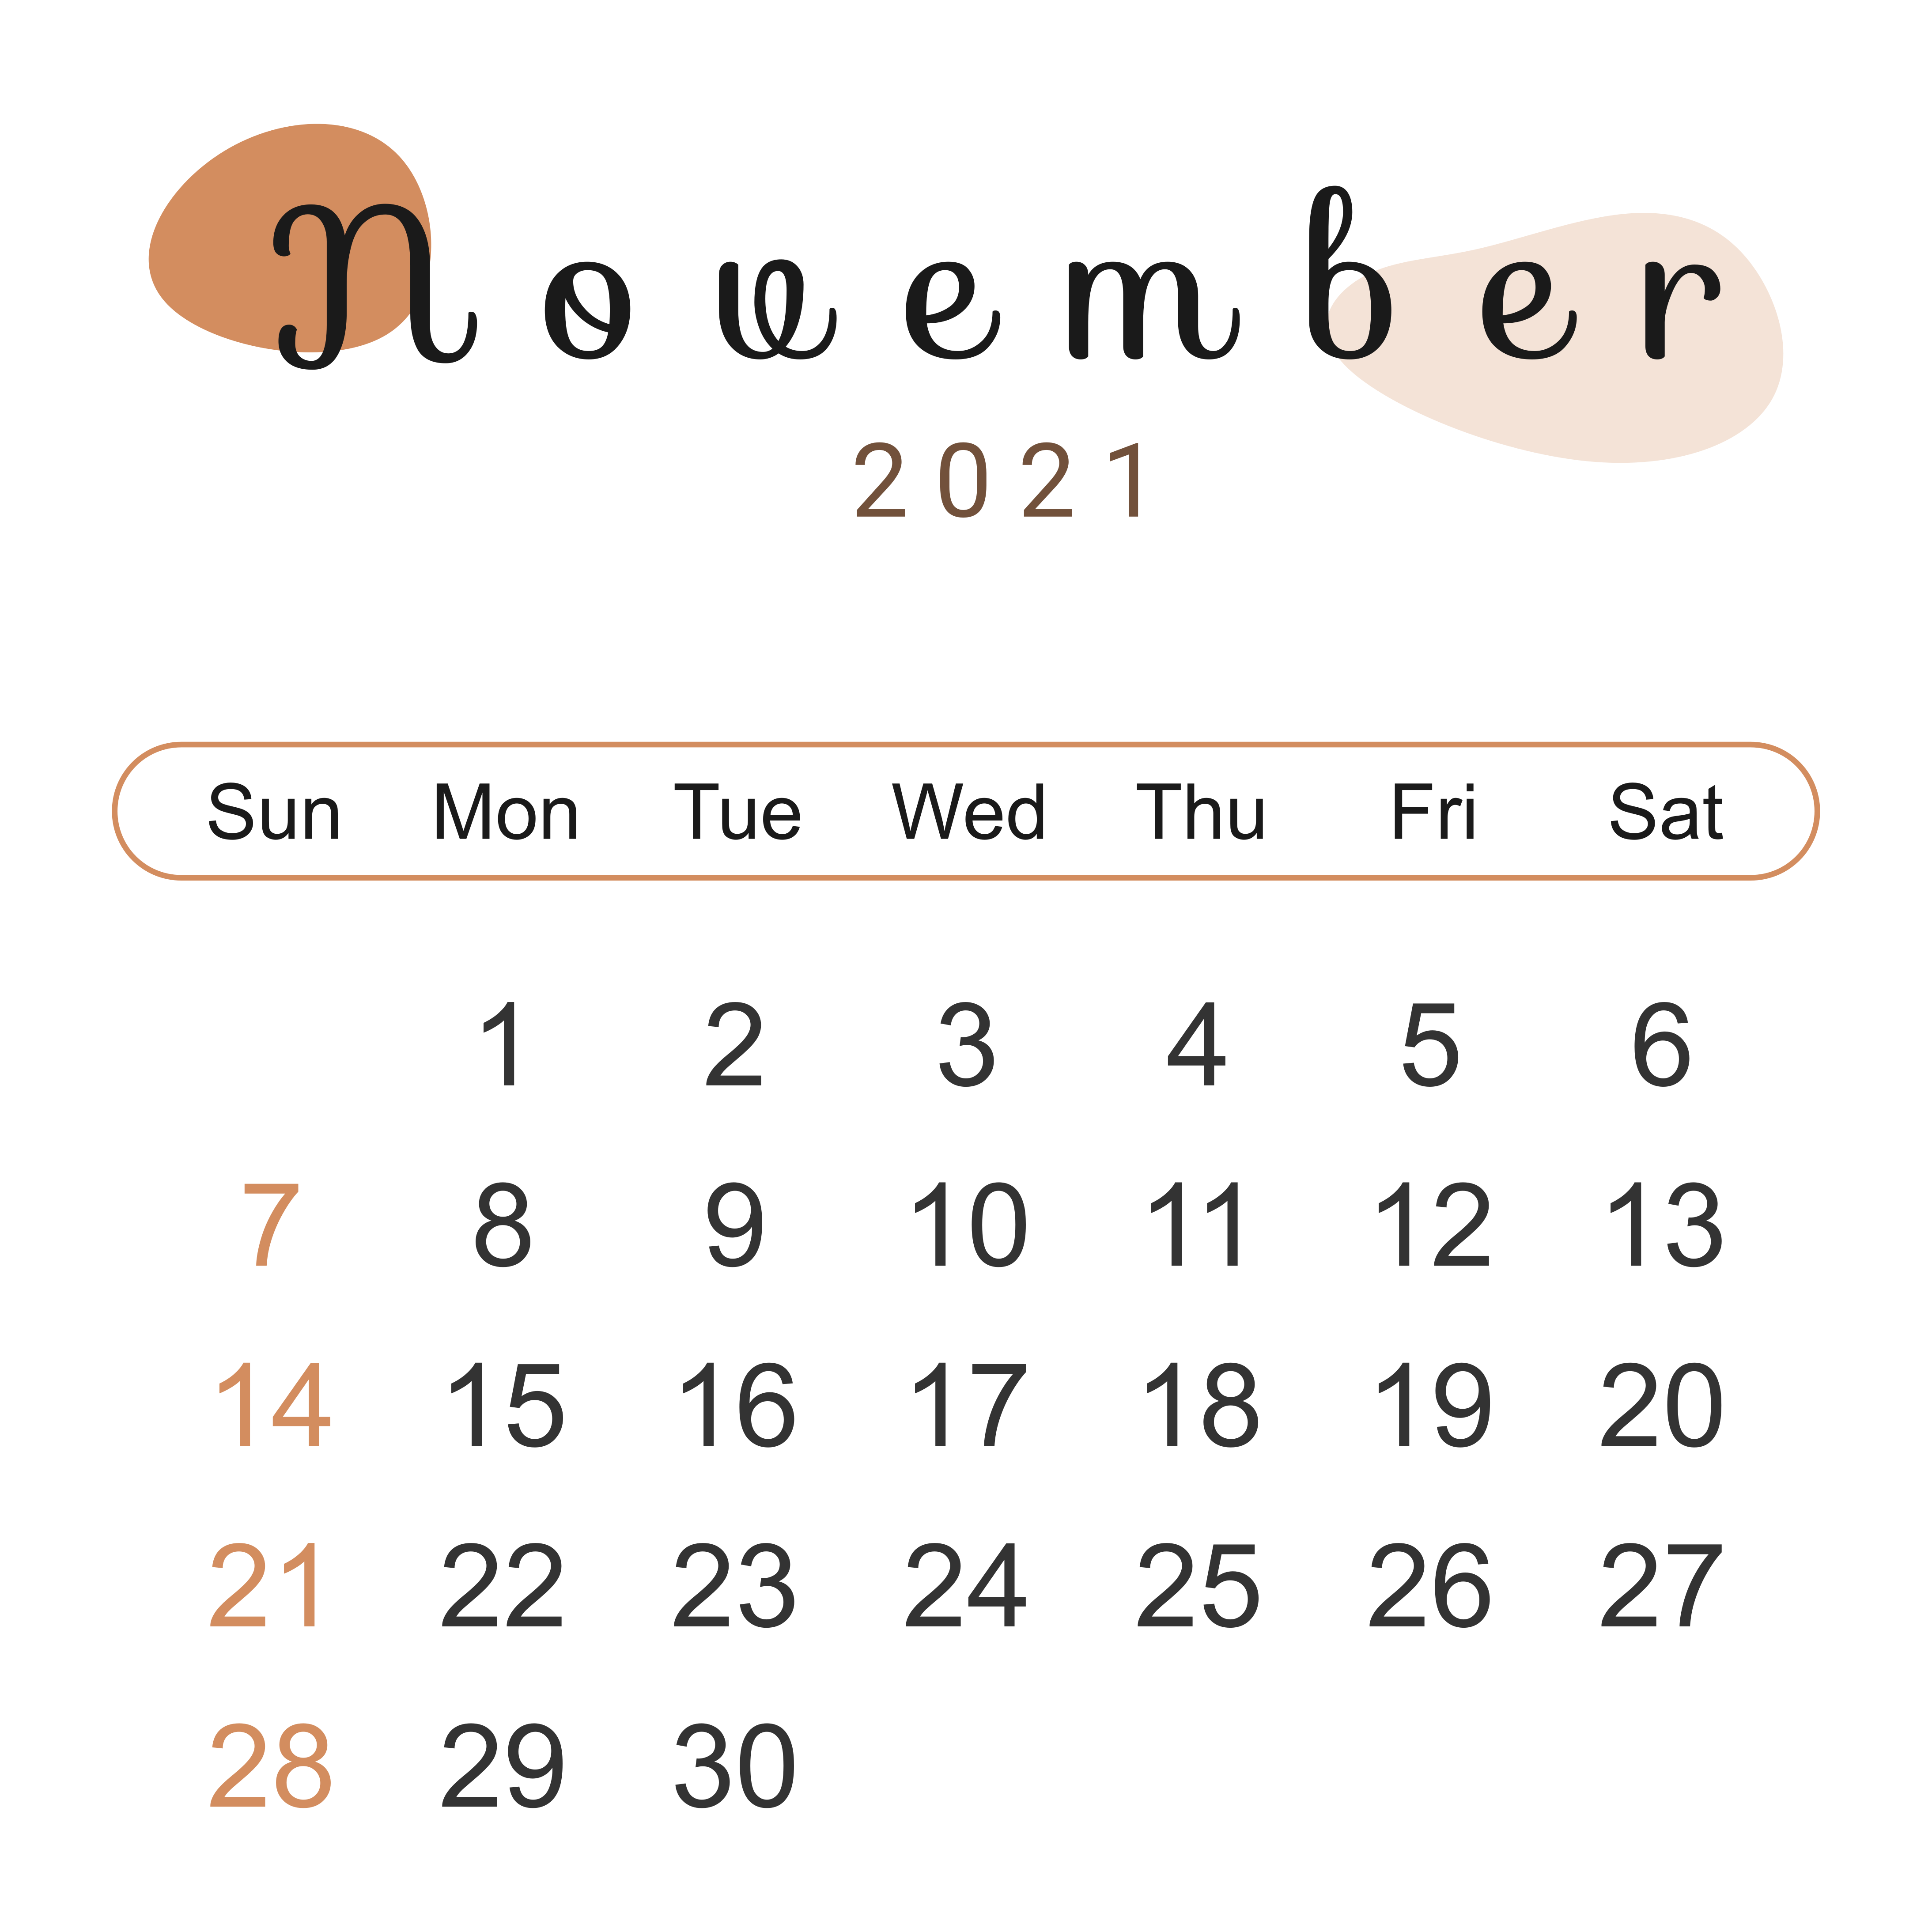

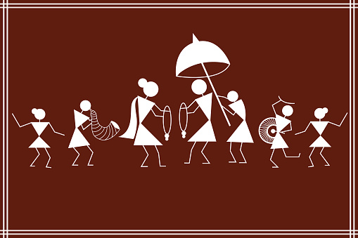
Where ?
When ?
We are getting married
Hi,
I am Manjunath
Hi,
I am Shruthi
We graciously invite you to honour us with your presence & blessings on auspicious occasion of the Wedding Ceremony.
29th
10:30 AM
Sri Samudaya Bhavana,
Hirisave,Channarayapatna, Hassan
Reception to follow.....

