Slide 1

Driving Uﬂy Rewards Enrollment with Data Analytics
Team Sun Savers
Josh Everly | Narae Kang | Mingming Zhang | Wen-Ling Ku | Shashank Magdi

Slide 2
Business Objective
How can we help drive the enrollment of customers in uﬂy reward program by understanding diﬀerent segments of customer proﬁles?
Do online booking channels meet the expectations?
2

Slide 3
Exploratory Data Analysis
EDA Recommendations
Provide Recommendations w.r.t. the entire data based on EDA
/01
/02
Derive peculiar insights from data
Clustering Recommendations
Provide Recommendations based on Clusters
Clustering Results
Observe Results from Clustering on Individual Granularity data
/03
/04

Slide 4
Exploratory Data Analysis
EDA Recommendations
Provide Recommendations w.r.t. the entire data based on EDA
/01
/02
Derive peculiar insights from data
Clustering Recommendations
Provide Recommendations based on Clusters
Clustering Results
Observe Results from Clustering on Individual Granularity data
/03
/04

Slide 5
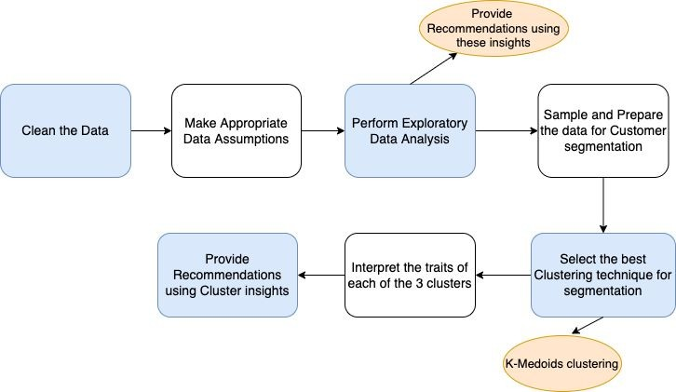
Solution Map

Slide 6
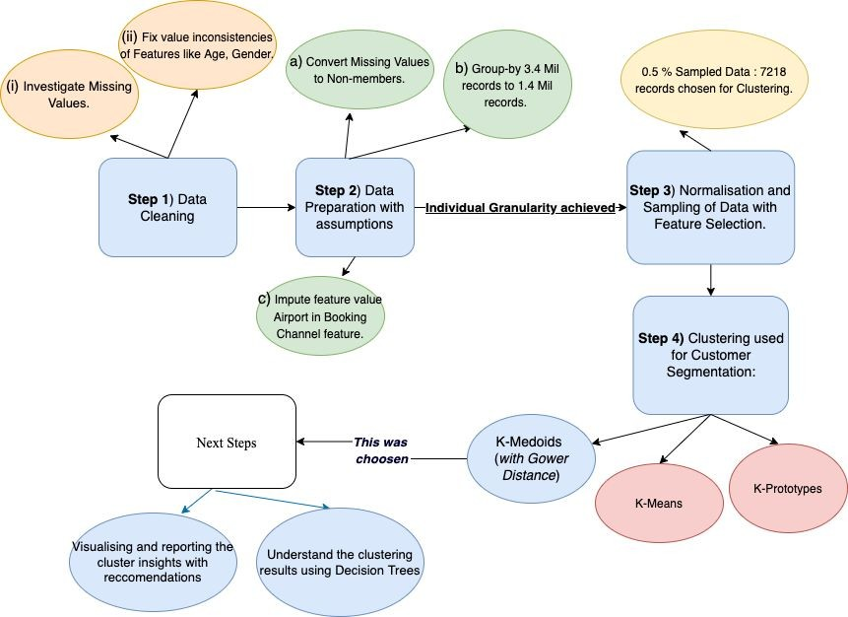
Analysis Plan

Slide 7
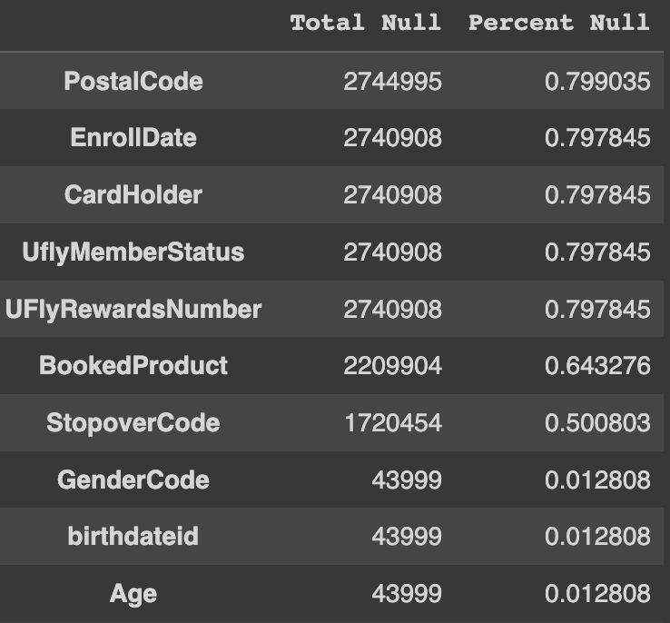
Data Assumptions
Before clustering, some columns are deleted if they do not fit individual granularity, we finally keep the data columns of Age, TicketNum,BaseFareAmt, GenderCode, BkdClassOfService, BookingChannel and UflyMemberStatus
Customers with missing age are assigned mean age of total customers.
Customers with missing GenderCode are assigned to ‘female’ (most common gender).
People with missing UflyMemberStatus are not member.

Slide 8
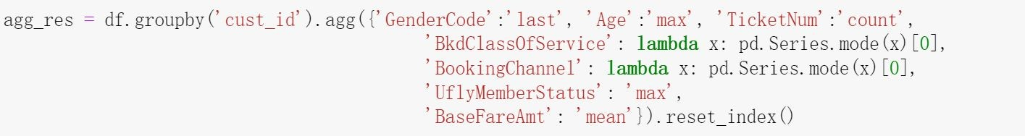
Data Cleaning
People with age over 100 or below 0 are deleted.
We are only interested in Sun Country flights, so we remove any Marketing Airline Codes that are not ‘SY’. This is more than 99% of all flights in the data.
Replace different airport booking channel codes with 'airport' value
Create unique customer identifier by combining EncryptedName and birthdateid columns
Transform dataset into individual granularity

Slide 9
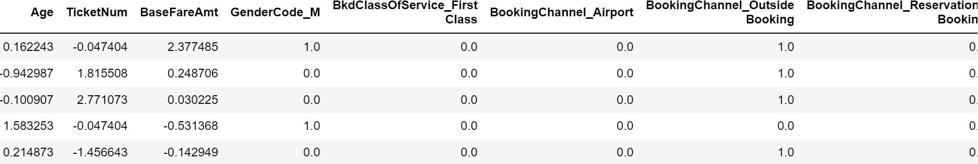
Data Cleaning
Normalized Age, TicketNum and BaseFareAmt by combining log transform method and normalization method
Got Dummy variables from categorical columns: GenderCode, BkdClassOfService, BookingChannel and UflyMemberStatus
Did random sampling to get 0.5% of data to do analysis (~7200 records)

Slide 10
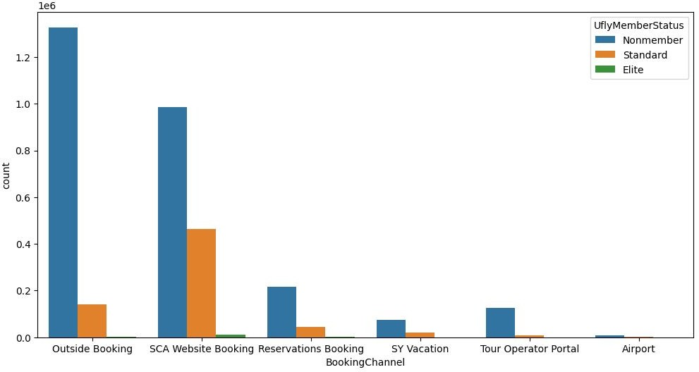
Do Booking channels meet our expectations?
67 percent customers, booking via the SCA website are actually non-members. So although these customers are visiting the SCA website, they choose to remain as non-members.
Let’s understand who these customers are, to give appropriate recommendations.

Slide 11

Target Non-members booking via the website
35 % (or) 988449 of the total non-members are making their bookings via the website.
Possible Recommendation:
Sun Country airlines could oﬀer lucrative one - oﬀ deals to this group of High Value Non Members
when they visit the SCA website next time.
These members have an average age of 41 and frequently ﬂy between MSP, CUN and SFO airports during the months of March, July and December, with 14%(25,174) of them ﬂying in First Class.
Assumption of the Recommendation:
They will either convert into members, therefore driving enrollment or they will bring more revenue to the airlines.

Slide 12
Comparison of High Value Non Members vs Elite Members:
S.No | Trait | High Value Non Members(Potential targets) | Elite Members(Actual Members, highest status)
1) | Number of Tickets | 181105 | 14361
2) | Average Base Fare | 563 | 409
3) | Average Age | 41 | 49
4) | Frequently Flown Airports | MSP(47%) , CUN, SFO | MSP(47%), JFK, SFO
5) | Frequently Booking Months (Descending order) | May, June, July | Oct, Sep, August
6) | Frequent Travelling Months (Descending order) | March(18%) , July(13%), December | Oct, Nov, December
7) | How many fly First Class? | 14% or 25,174 | 26 % or 3742

Slide 13
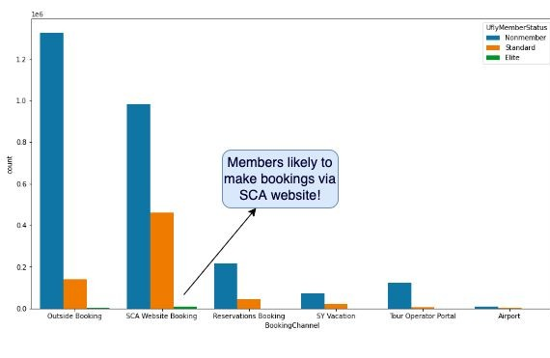
Intuitive Customer Insight Based Questions:
Q1 ) Is it actually viable to remove the observations having ages greater than 100 or 120?
Ans 1) We found that there were 1604 flight records corresponding to ages between (100,120). However, the number of unique customers aged between 100 and 120 was only 841.
Were they actual passengers? Interestingly there were 80,000 centenarians(100+ people) living in 2013 in the USA so it is plausible that 841 of them traveled using SCA. Removing these customers does not seem like the best step to take!
Q2) Are members most likely to make bookings from the website itself?
Ans2) Yes, thankfully the members are most likely to make bookings from the SCA website rather than the outside booking!

Slide 14
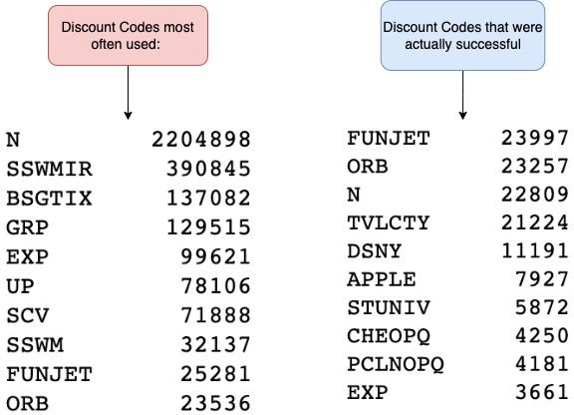
Intuitive Customer Insight Based Questions:
Q3) Which of the Booked Products(Discount code feature) are associated with more discounts?
Ans3) The most successful discount codes were FUNJET, ORB, TVLCTY, DSNY. The N code is just a placeholder for null values.
Q4) Any discount codes for Veterans or any intuitive information for this category of fliers?
Ans4) NAVY Booked products code was the only interesting veteran discount code found. 182 records were found with this coupon code. Interesting fact: These codes symmetrically belongs to only two flights: [MSP => PNS] and [PNS=>MSP]. The next interesting fact is that PNS is the gulf coast Pensacola airport and there is a Naval Base in Pensacola!
Probable recommendation:
Can give NAVY Code to that particular journey Itinerary, as promoting this to such a location like PNS() which has a coast can help drive the sales for this particular flight / or these kinds of flights in the future and also provide discounts to the much deserved veterans of the country!

Slide 15
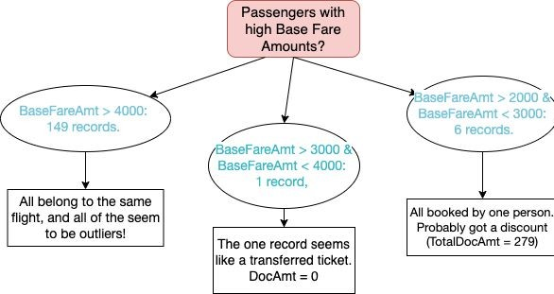
Intuitive Customer Insight Based Questions:
Q5) Any passengers having unusually high base fare amount?
The flow chart succinctly summarizes the information. The intuitive fact is there is only one unique value of Base fare above 4000, i.e. 4342$. But the total amount they paid was only 440$.
However, there are 149 such records with the same fare. This could only mean that the flight no. 530 was an alternative flight that these 149 passengers were provided as they used some prior account credit to reduce the fare. The passengers from flight, paying this fare, could be considered as outliers, skewing the data!
Are there any other passengers on the flight paying lesser? Yes, there are 15 people having a lesser base fare amount than 4342. These are normal records, not outliers.
Q6) Any trends in flight booking patterns of different customer age groups?
Ans 6) Yes, when we dug through the senior citizens age group, we found that there were 19231 unique travelers above the Age 80. There were more even valued bookings than odd, and after analysis, we concluded that older travelers (above the age 80) prefer booking round trips more often than not.
This information can be used to understand that segment of the customers, when adding additional Sun Country hospitality services across locations.

Slide 16
Exploratory Data Analysis
EDA Recommendations
Provide Recommendations w.r.t. the entire data based on EDA
/01
/02
Derive peculiar insights from data
Clustering Recommendations
Provide Recommendations based on Clusters
Clustering Results
Observe Results from Clustering on Individual Granularity data
/03
/04

Slide 17
Data Preparation for Clustering
Aggregate
Individual Granularity
Clustering Feature Selection
Filtering
Age
Ticket Number
Base Fare
Age : 0 – 100
Airline : Sun Country
Replace Data Value
Gender
Class of Booking
Channel of Booking
Various airports -> ‘Airport’
Impute
Missing Values
Age : Mean
Gender: Female
Membership : Non-member
Membership Status

Slide 18





Clustering Results
Cluster 1: Retention Customers
Ufly Rewards Members (Standard, Elite)
Book on SCA website
Cluster 2: Prospective Members
Non-members
Book on SCA website
Cluster 3: “Tough Nut” Customers
Non-members
Booking on outside channels
Converting these users maybe a more difficult task

Slide 19
Clustering Results cont.
★ | Retention Customer Cluster | ★ Prospective Members Cluster | ★ | “Tough Nut” Cluster
 | Important Features: SCA booking, uﬂy rewards members Group of customers who are members (both standard and elite) and book on SCA. Our favorite customers! | Important Features: SCA booking, non-members Group of customers booking on SCA who are not yet members. Can we convert these customers to the rewards program while they are booking on the website? |  | Important Features: outside booking, non-members Group of customers who utilize outside booking and are not members. We have little opportunity to convert these customers.
 | ~18% of our sample | ~40% of our sample |  | ~42% of our sample

Slide 20
Clustering Report: Results of K-medoids with 3 clusters & 7218 records
 | Prospective members Cluster | Retention Members Cluster | Tough Nut customer Cluster
Who are they? | Non members, booking tickets via SCA website. | Higher spending(mean fare of 290), older customers with SCA membership. | Younger(mean age 36), harder to convert Non Members, booking tickets via outside bookings.
Booking Channel trends | Primarily book through SCA website, tour operator portal | Mixed booking channels, no real trends | Everyone(3195) used outside booking as the chanel
Age trends | Avg age = 39; Median age = 39 | Avg age = 45; Median age = 48 | Avg age = 38; Median age = 36
Booked Class trends | First class: 59 | First class: 74 | First class: 17
Ufly Member status trends | Median fare: 240, but 17 yr old F outlier is present. | Median Fare: 265(highest) | Median Fare: 258
No. of Tickets trends | Similar No. of Tickets distribution as the last cluster. (Mostly 1-5 ticket numbers) | Mostly 1-5 but although, few instances of 10-30, 40-50. (other clusters do not have this) | Similar No. of Tickets distribution as the first cluster. (Mostly 1-5 Ticket Numbers)

Slide 21
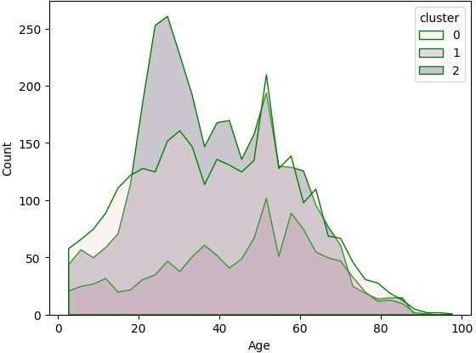
Comparing cluster wise Age distribution :
This plot confirms that the Cluster(0), i.e. the Tough Nut Cluster consists of younger(mean age 36) customers than their older counterparts.
The mean age also looks higher for Cluster(1), i.e. Retention Members cluster(with an average age 45) , confirming our previous detailed report on cluster characteristics.

Slide 22
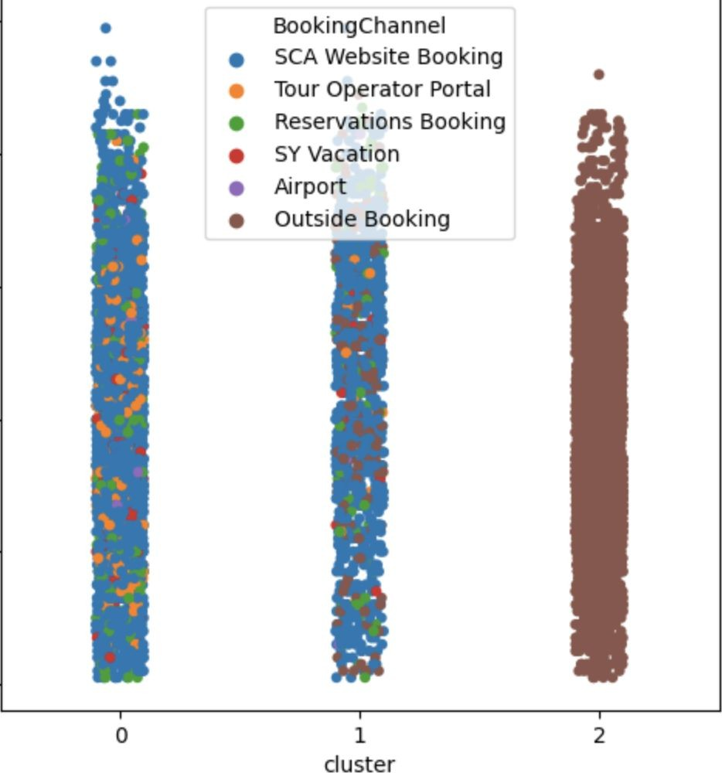
Comparing cluster wise booking channel distribution
This strip plot confirms that the tough nut cluster(2) contains all the bookings as outside bookings
Also, the prospective cluster(0) primarily has bookings from SCA website.
Possible Recommendation:
If SCA plans to offer lucrative deals to convert
non-members to members, SCA possibly should not prioritize customers belonging to the tough nut cluster,
i.e. customers having a mean age of 36, mostly flying coach, buying between 1-5 tickets.
This is because everyone in that cluster, 3195 of them have booked via outside bookings, and it will be harder to convince these customers to not only visit the website but also become members.

Slide 23
Business Steps/Actions
Based on our clustering results, ~40% of customers are booking on SCA website but are not ufly rewards members.
How can we drive enrollment of ufly rewards while users are on the site?
Increasing visibility of Ufly rewards on the website.
Redesign the website to feature the program, ensuring users on the site are cognizant of its existence.
Offering discounts during checkout.
Before users finish their purchase and leave the website, incentivize signing up for ufly rewards by offering a % discount on tickets if users sign up for a membership.
Both these steps could be launched as an experiment using A/B tests to monitor the efficacy of the recommendation.

Slide 24
Further Steps
Utilize Entire Data
Machine Learning Algorithm
Use heavy computational resources to extrapolate result to full data set.
Develop an algorithm to predict which customers are most similar to our “prospective members” cluster and target those customers using target marketing.

Slide 25
Conclusion
EDA ANALYSIS
SCA Website is the favorite booking channel for members
Target Non-members booking via SCA website
Clustering
Clustering result
Prospective members Cluster
Retention Members Cluster
Tough Nut customer Cluster
Clustering recommendation
Drive enrollment of Ufly rewards while users are on the site

