Slide 1

SAMSUNG PRISM
Generative AI
Hackathon
3rd Edition 2026 – 27
Theme ID - 2
Team Name Peers of Posts
College Name – SRM Institute of Science & Technology
Member Name & Email 1- Shashank Prasad ; sp2127@srmist.edu.in
Member Name & Email 2- Suriyaa S ; ss0938@srmist.edu.in
Member Name & Email 3- Vedika Choudhary ; vc8583@srmist.edu.in
Member Name & Email 4- Prachetas Shukla ; ps7746@srmist.edu.in
Submission Github link - https://github.com/Shashank-Prasad7/SmartFix
Notes:
Opening slide for the 3rd edition of the PRISM Generative AI Hackathon. Replace the SAMSUNG PRISM pill with the official PRISM logo image if you have the asset. Confirm the academic year label (2026-27) before circulating.

Slide 2
Theme 2 : Smart Guided Troubleshooting Engine
Source-grounded troubleshooting with structured guidance and Galaxy Settings deeplinks
1
2
3
Understand
Guide
Resolve
Parses the user's issue in natural language and matches it to the right Galaxy Settings context and support content.
Delivers clear, source-grounded, step-by-step guidance — nothing beyond what the article actually supports.
A one-tap Galaxy Settings deeplink takes the user straight to the fix, closing the loop.

Slide 3
Existing Solutions & Gaps
Today's tools help people find information — they don't close the loop between advice and action.
TODAY
THE GAP
Support pages and search tools provide useful information on most issues.
Generic chatbots can answer questions, but not always to a specific article.
Users still have to self-navigate Settings menus to apply any fix.
Users must sift through long articles themselves to find the relevant steps.
Chatbot answers can lose source conditions or suggest actions the article doesn't support.
No direct bridge from advice to the actual Settings screen that fixes it.

Slide 4
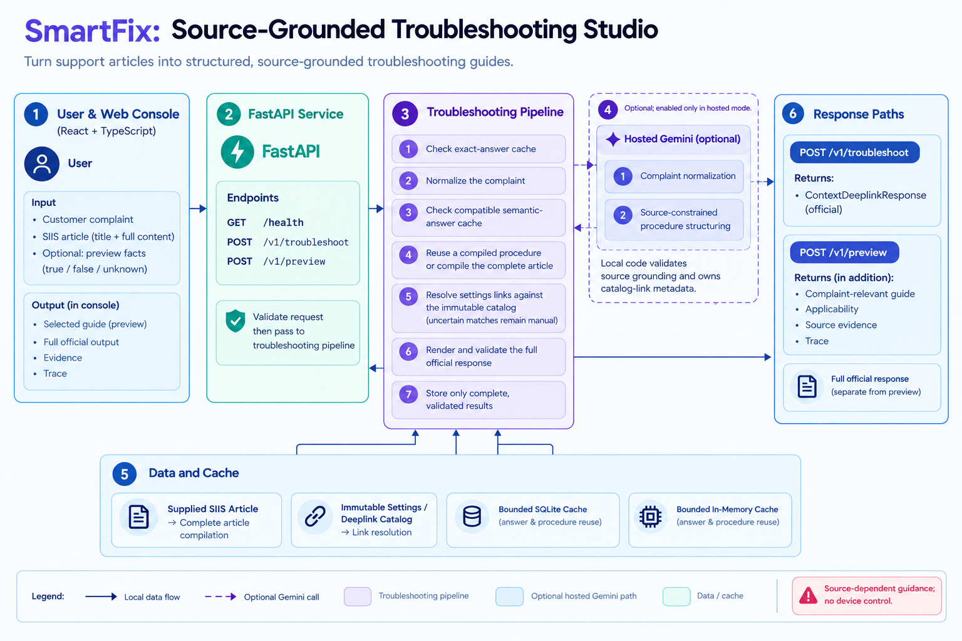
Our Solutions & Architecture Diagram

Slide 5
Demo & Product Walkthrough
1
2
3
4
Describe the Issue
Grounded Retrieval
Guided Walkthrough
Deeplink Resolution
User explains the Galaxy problem in natural language inside the chat.
Engine pulls the matching support article and current Settings state.
Step-by-step fix is shown, one clear action at a time.
Tapping “Fix it” jumps straight to the right Settings screen.

Slide 6
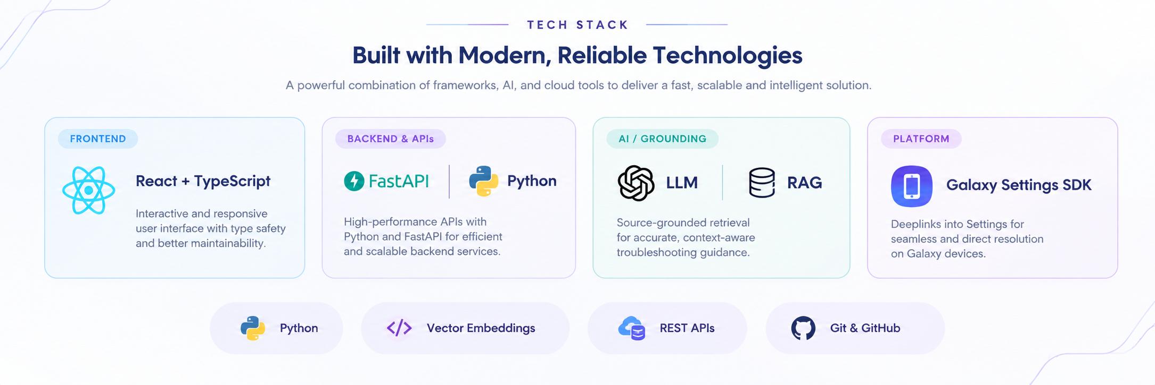
Tools and tech stack used

Slide 7
Impact & Use case
Faster Resolution
Cuts fix time from long searches to a guided walkthrough in minutes.
Reduced Support Load
Fewer repetitive tickets reach human support agents.
✓
✓
Trustworthy Answers
Every step traces back to verified source content — no guesswork.
Seamless Fixes
Deeplinks remove the friction between getting advice and taking action.
✓
✓

Slide 8
Innovation highlights, results and limitations
INNOVATION
RESULTS
LIMITATIONS
Pairs source-grounded troubleshooting with direct Galaxy Settings deeplinks — guidance that acts, not just answers.
Working prototype generates grounded, step-by-step fixes and resolves them via live deeplinks on sample issues.
Deeplink coverage is limited to mapped Settings screens, and the knowledge base needs ongoing curation.

Slide 9
What’s next
1
2
3
4
Expand Knowledge Base
Cover more devices, OS versions and support articles.
Broaden Deeplink Coverage
Map more Galaxy Settings screens for direct fixes.
Add a Feedback Loop
Learn from resolved and unresolved sessions to improve grounding.
Pilot with Real Users
Test on a live support channel and measure deflection.

Slide 10
Brownie points slide( differentiation)
1
2
Fully Source-Grounded
No hallucinated steps — every action traces back to a real support article.
Action, Not Just Advice
Galaxy Settings deeplinks close the loop instantly, in one tap.
3
4
Built to Scale
Modular RAG pipeline extends easily to new devices and OS versions.
Hackathon-Ready Prototype
A working end-to-end demo, built and deployed within the hackathon timeframe.

Slide 11
Checklist- Updated on Public GitHub
Working prototype code — public or shared GitHub repo (Y/N): Y
README with reproducible setup instructions (Y/N): Y
Demo video, max 5 minutes (YouTube or Drive link): https://youtu.be/dOxAHL3kfXk
Presentation file (PPT or PDF) (Y/N): Y

Slide 12
Thank you
Organised by the Language AI Team and the PRISM Team, Samsung R&D Institute India
Notes:
Closing slide. Add the Google Form URL and a contact email before sharing. Edition 2 organising team for reference: Language AI - Sourabh Tiwari, Gaurav, Sanjeeth Pothireddy, Gorang Maniar; PRISM - Binny Lakra, Prakhar Chandrakar, Vishu Kumar; Kick-off and mentors - Giridhar Jakki, Deepraj Prabhakar Patkar (Language AI), Srimanu Prasad Nagaraju, Ashish Kumar (Tech Strategy).

