Slide 1
US Rental Market Analysis
DATS 6401
Shashank Shivakumar (G30631923)

Slide 2
Introduction
Data: Apartment rental pricing dataset (Source: UCI)
Background of the data:
This dataset contains around 100,000 observations with comprehensive details about US apartment rentals. It includes attributes like amenities, bedrooms, pricing, location, and more. Partially cleaned, it's a valuable resource for real estate research, enabling various data analysis tasks and insights into US apartment rental dynamics. Ideal for further analysis.

Slide 3
Overview of the Dataset
Dataset Size:
Total Records: 99190
Columns:
Total: 24 features
Includes detailed information on pricing, amenities, location, number of bedrooms and bathrooms, square footage, pet policies, and more..
Data Diversity:
The dataset features a broad spectrum of apartment rentals across various regions in the US. It reflects diverse aspects such as rental prices, apartment features, and geographical locations, providing a holistic view of the apartment rental market.
Relevance:
This dataset's extensive coverage and depth provide essential insights into market dynamics, pricing strategies, and consumer preferences, enabling a detailed analysis of real estate rental trends and strategic decision-making.

Slide 4
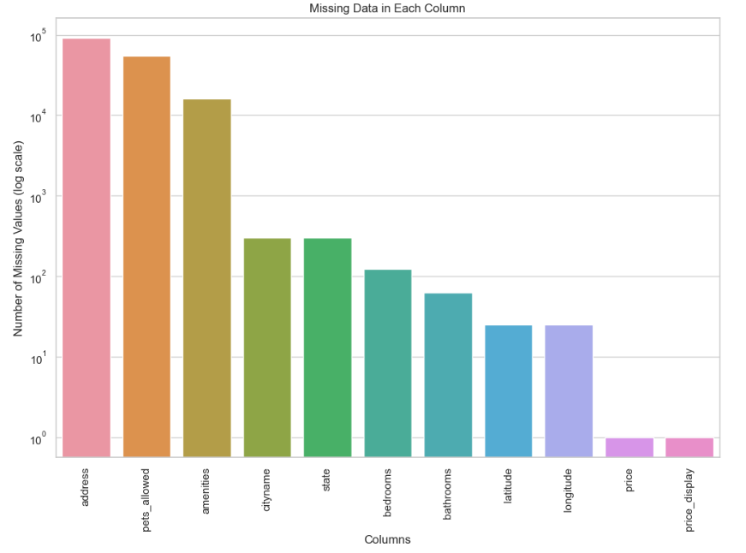
Observing the dataset
Column | Missing_Values
address | 91549
pets_allowed | 55354
amenities | 16044
cityname | 302
state | 302
bedrooms | 124
bathrooms | 63
latitude | 25
longitude | 25
price | 1
price_display | 1

Slide 5
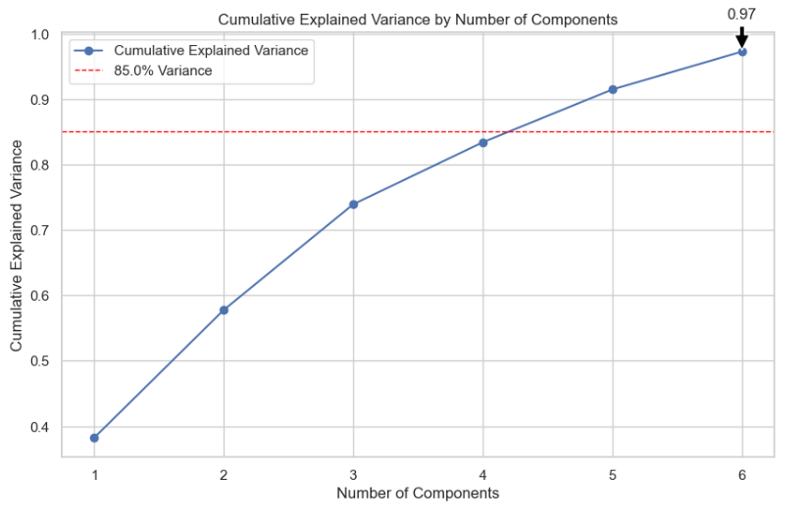
Principal Component Analysis Overview

Slide 6
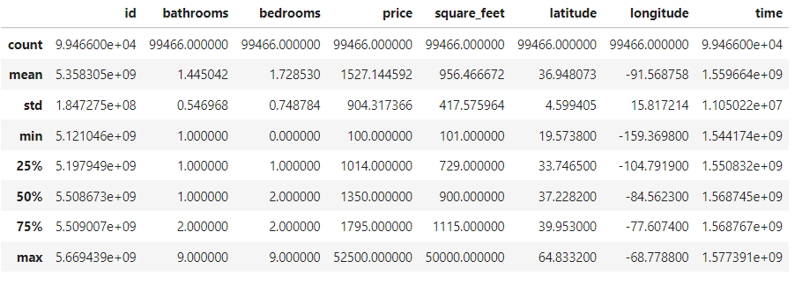
Identifying Outliers in the Data
Statistical Summary

Slide 7
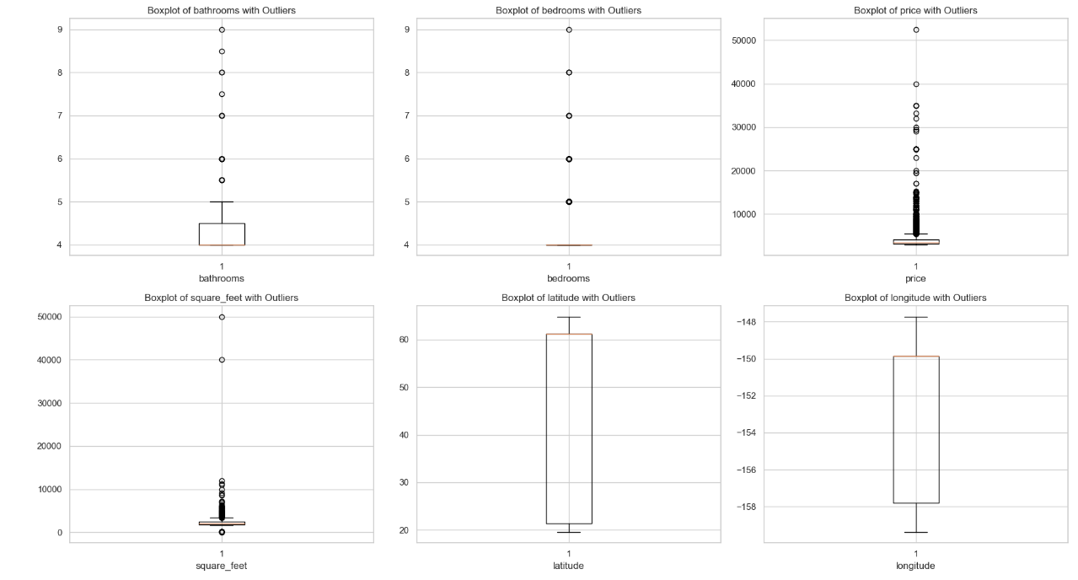
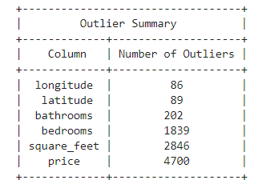
Outlier Detection: IQR Methodology & Results

Slide 8
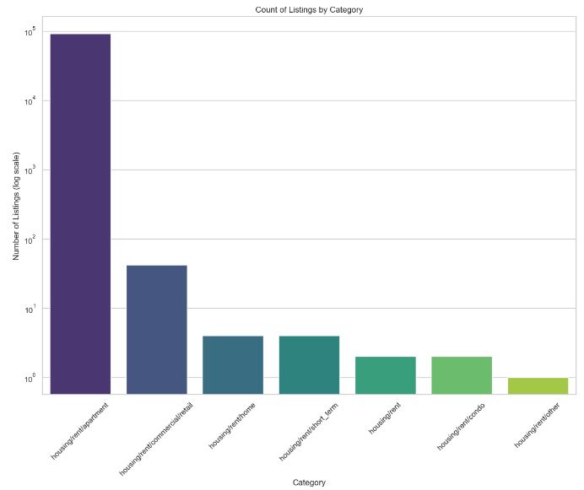
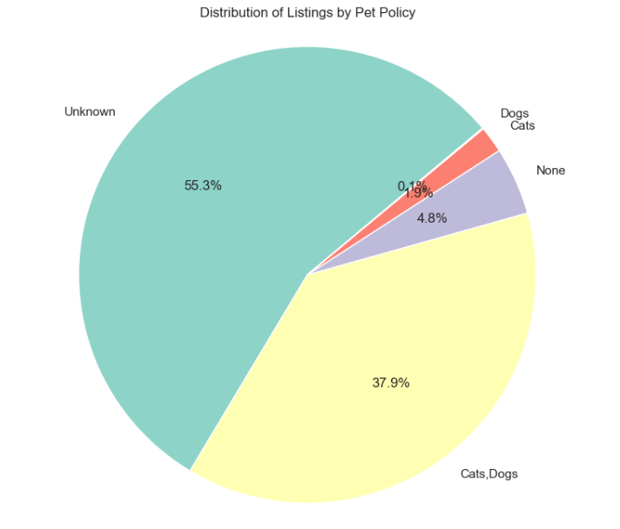
Distribution of different features

Slide 9
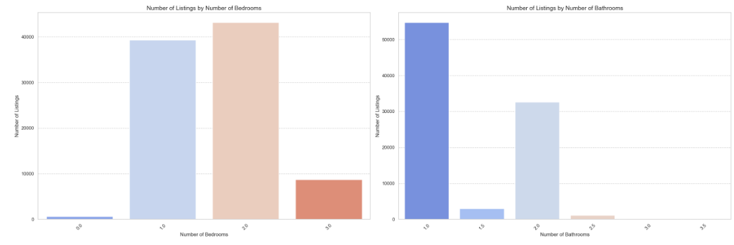
Distribution of different features(cont..)

Slide 10
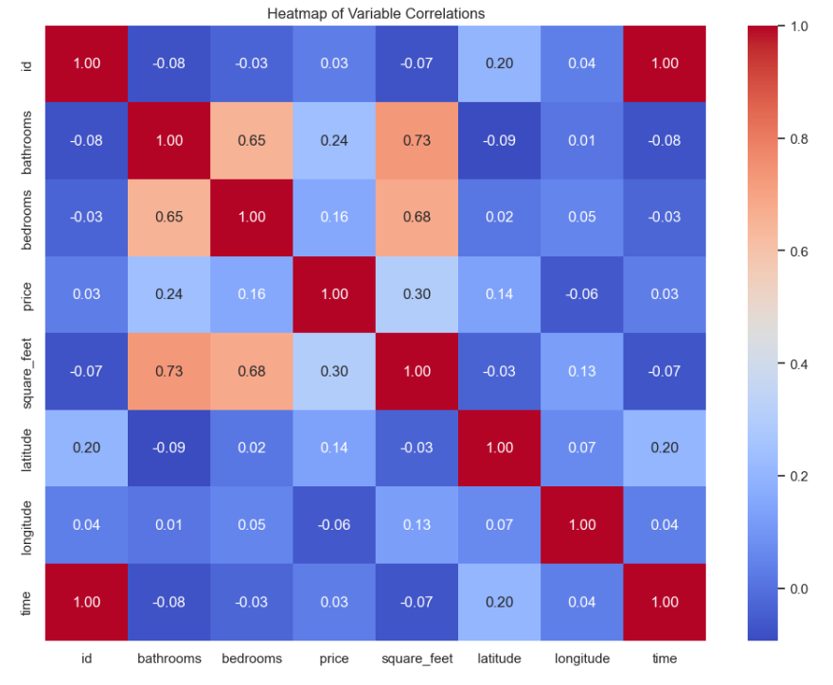
Understanding Relationships

Slide 11
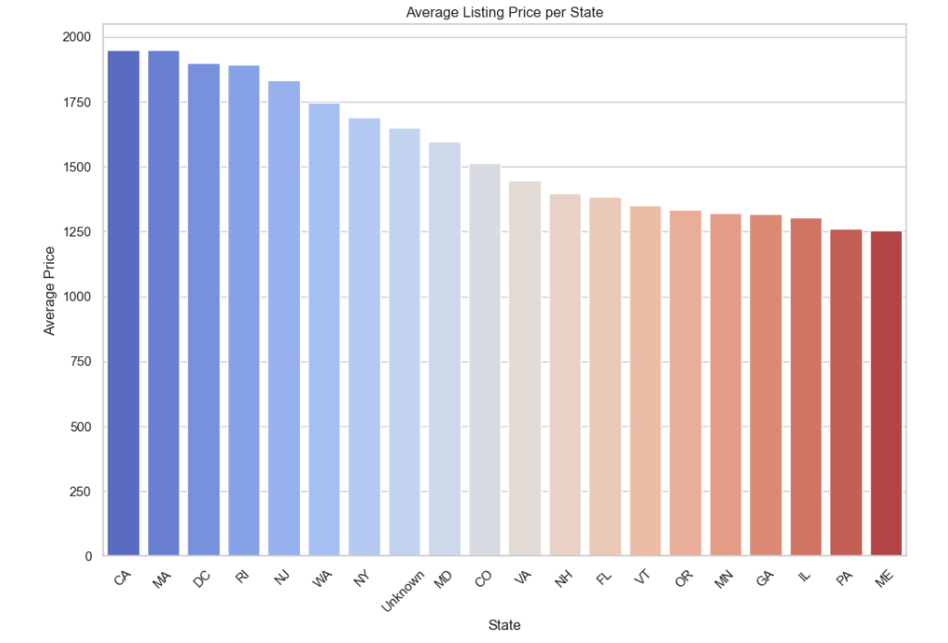
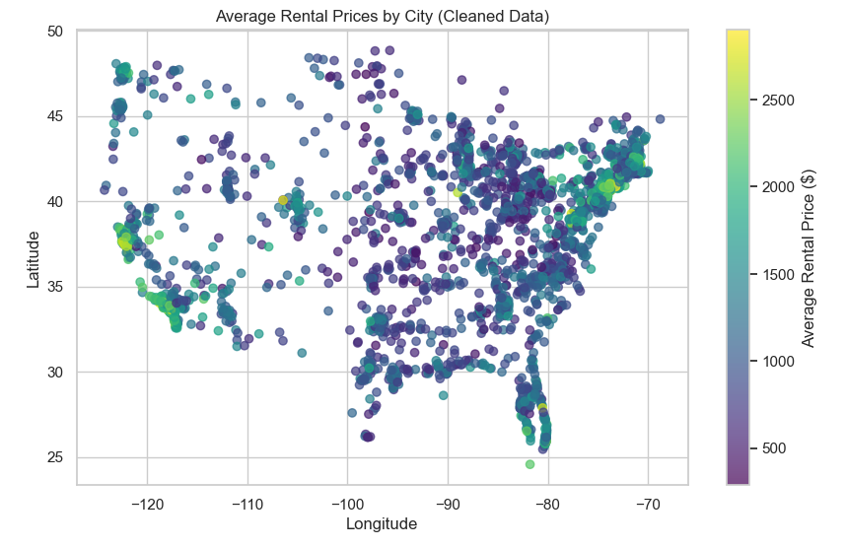
Location-Based Analysis of Rental Prices

Slide 12
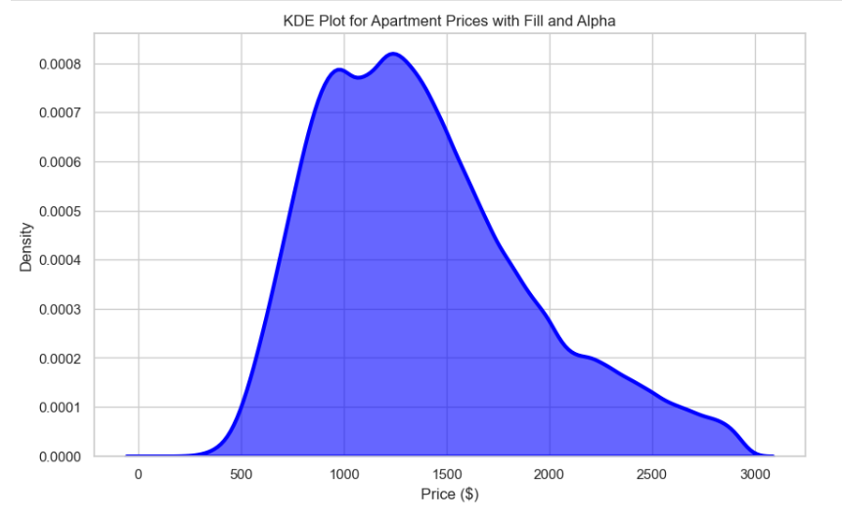
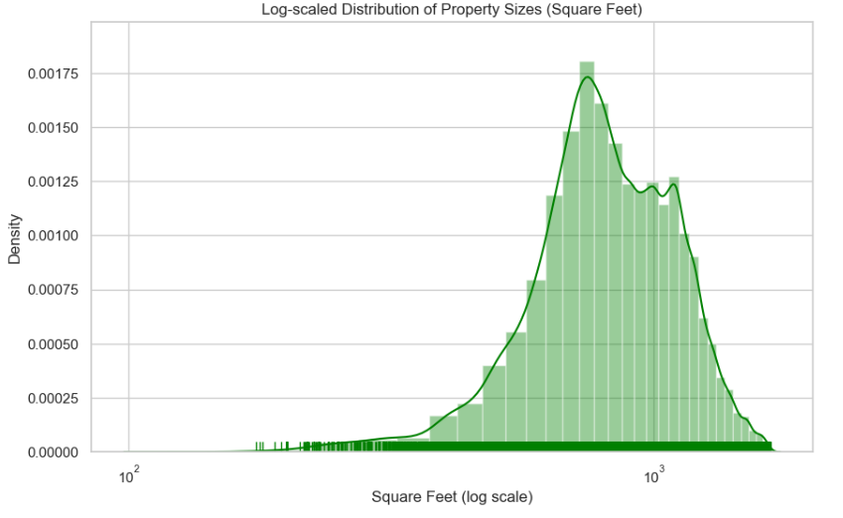
Comparative Analysis of Rental Prices & Property Sizes

Slide 13
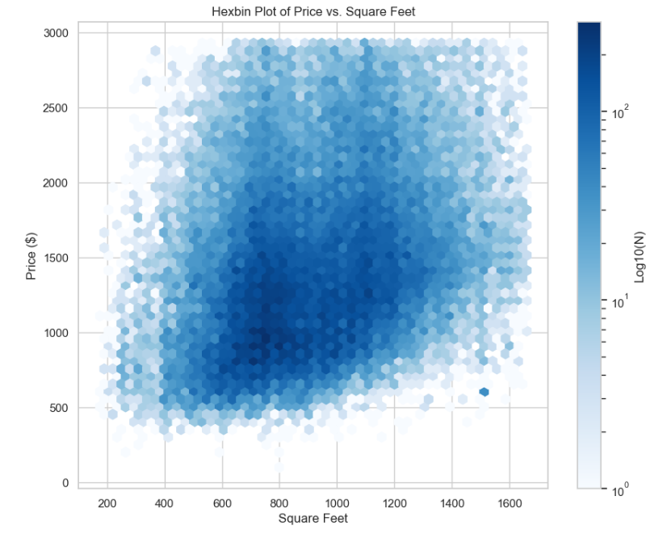
Relationship Between Property Size and Rental Price

Slide 14
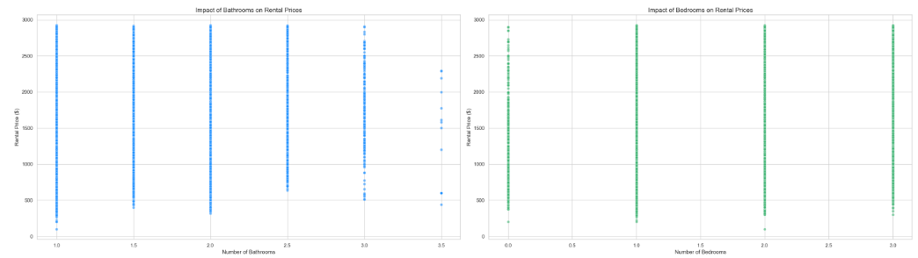
Impact of Bedrooms & Bathrooms on Rental Price

Slide 15
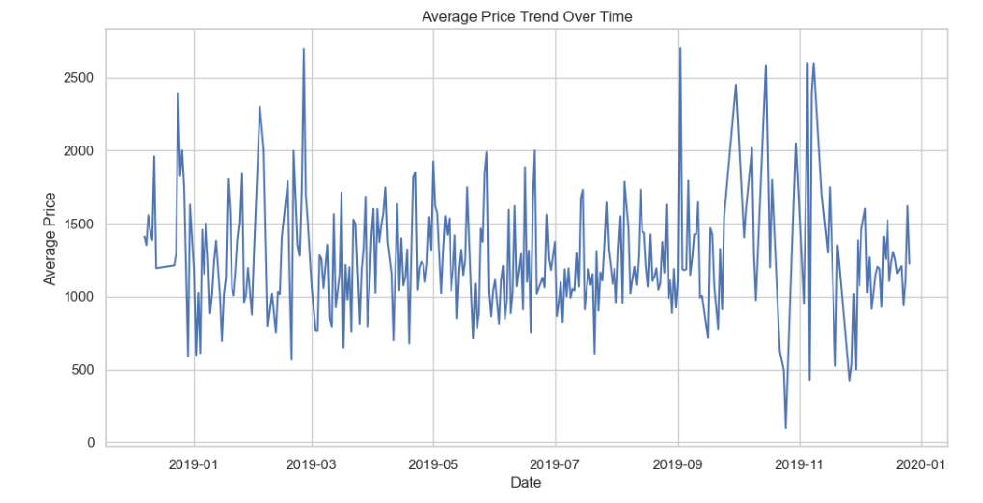
Temporal Dynamics of Rental Prices

Slide 16
Conclusion
Market Profiles: Most apartments fall in the modest size and price range, with fewer luxury options.
Location Costs: Coastal and metropolitan areas typically command higher rental prices.
Timing Matters: Rental prices fluctuate seasonally, absent a consistent long-term trend.
Feature Premiums: Additional bathrooms slightly elevate rental prices, amidst other influencing factors.
Size Matters: There’s a general, though variable, trend of larger apartments attracting higher prices.
Market Dynamics: Visual data analysis reveals intricate patterns of how features and geography drive rental pricing.
Notes:
To conclude, MySQL is preferred for structured data and complex queries, offering robust transactional support.
MongoDB excels in handling unstructured data, characterized by its flexibility and scalability, making it ideal for dynamic, large-scale applications.
While MySQL demonstrates efficiency in complex data retrievals, MongoDB is faster in data modification operations.
The choice between MySQL and MongoDB should be driven by the project's specific needs.

Slide 17
THANK YOU
Dashboard Demo
https://dashapp-5jocwpusma-ue.a.run.app/

