Slide 1
CHEMICAL BONDING
LIMITATIONS OF VBT
CRYSTAL FIELD THEORY (CFT)
OCTAHEDRAL SPLITTING

Slide 2
LIMITATIONS OF VBT
It gives only the qualitative explanation for complexes
It does not explain the magnetic properties of complexes.
It does not make exact predictions regarding the tetrahedral or square planar structures.
It is not able to distinguish between strong and weak field ligand.
It does not explain the kinetic and thermodynamics stabilities of different coordination compounds.

Slide 3
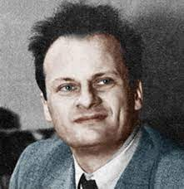
CRYSTAL FIELD THEORY (CFT)
The crystal field theory (CFT) was developed by the physicist Hans Bethe in 1929.
CFT assumed that metal ion and the ligands act as point charges and the interaction between them is purely electrostatic or ionic i.e. metal ligand bonds are 100% ionic.
This theory takes into account the effect of different electrostatic fields :
(a) The different geometries of complexes.
(b) Different basic strengths of the ligand.

Slide 4
Features of CFT
The transition metal forms the central cation and is surrounded by ligands with lone pairs of electrons.
All types of ligands are treated as point charges whether they are ionic (F-, Cl-, etc) or molecular (H2O, NH3, etc).
If ligand is neutral molecule than negative end of the dipole is oriented towards the metal.
(3) The attraction between the metal and ligands is considered to be purely electrostatic.
(4) The valence electrons of the metal will be repelled by the negative field of ligands. These electrons occupies those d orbitals which have their lobes away from the direction of the ligand.
(5) The number of ligands and their arrangement around the atom will be determined by the crystal field.
(6) Different crystal fields will have different effect on the relative energies of the 5 d orbitals.

Slide 5
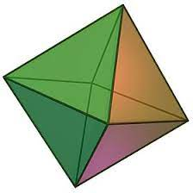
What are octahedral complexes ?
In a octahedral complex, there are 6 ligands attached to the central atom.
Octahedral complexes have either sp3d2 or d2sp3 hybridization.
The d orbitals also split in two different energy levels. The top two consist of dx2-y2 and dz2
and the bottom three consists of dxy , dyz , and dxz orbitals.

Slide 6
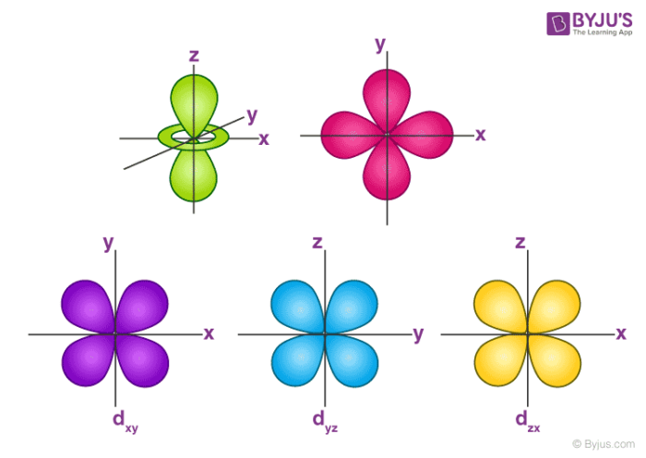
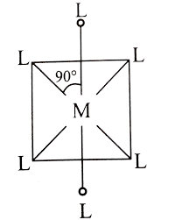
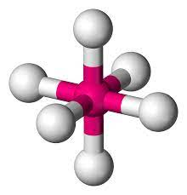
OCTAHEDRAL SPLITTING
Z
Y
X

Slide 7
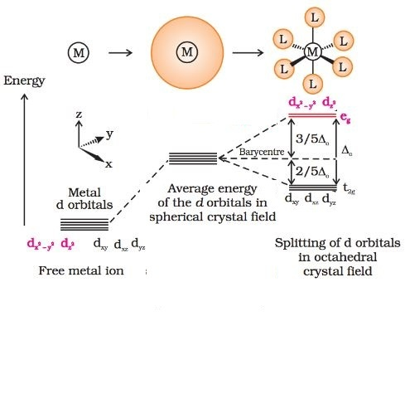
the dx2-y2 and dz2 orbitals which point towards the axes along the direction of the ligand will experience more repulsion and will be raised in energy; and the dxy, dyz and dxz orbitals which are directed between the axes will be lowered in energy relative to the average energy in the spherical crystal field. Thus, the degeneracy of the d orbitals has been removed due to ligand electron-metal electron repulsions in the octahedral complex to yield three orbitals of lower energy, t2g set and two orbitals of higher energy, eg set.

Slide 8
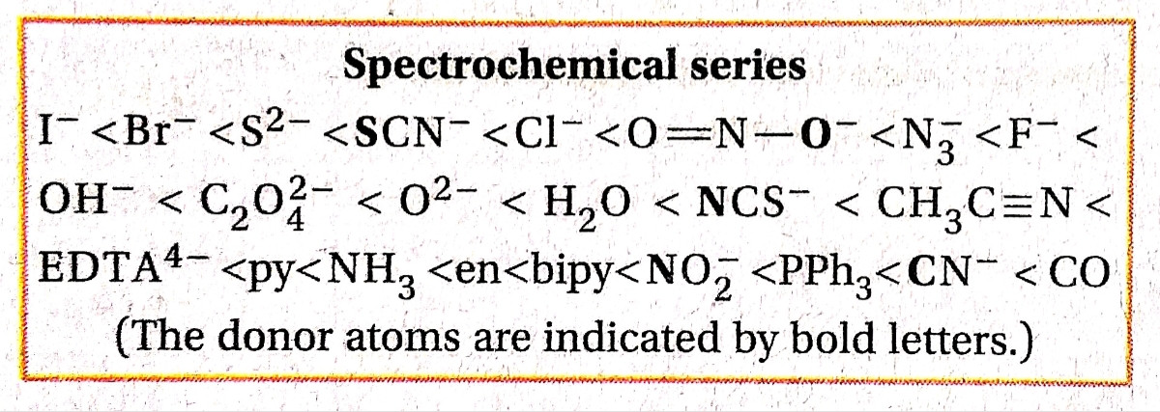
The spectrochemical series arranges the ligands in order of their ability to split d-orbitals in the complex.

Slide 9
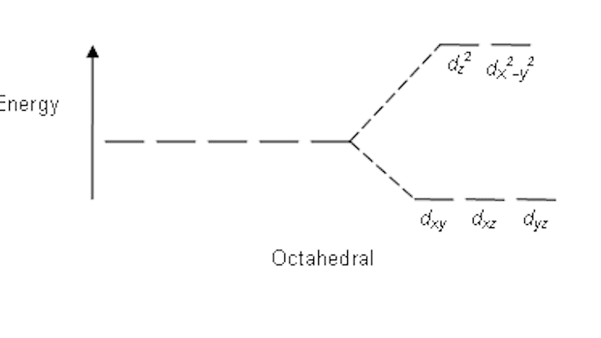
FILLING OF ELECTRONS
If ∆o < P, the fourth electron enters one of the eg orbitals giving the configuration t2g3 eg1 . Ligands for which ∆o < P are known as weak field ligands and form high spin complexes.
(ii) If ∆o > P, it becomes more energetically favourable for the fourth electron to occupy a t2g orbital with configuration t2g 4 eg 0 . Ligands which produce this effect are known as strong field ligands and form low spin complexes.

Slide 10
What is Crystal Field Stabilization Energy (CFSE) ?
The distribution of the electron in the t2g and eg set will take place in such a way that it will gain increased stability with respect to barry centre.
This increase in stability or overall decrease in energy is known as Crystal Field Splitting Energy (CFSE).

Slide 11
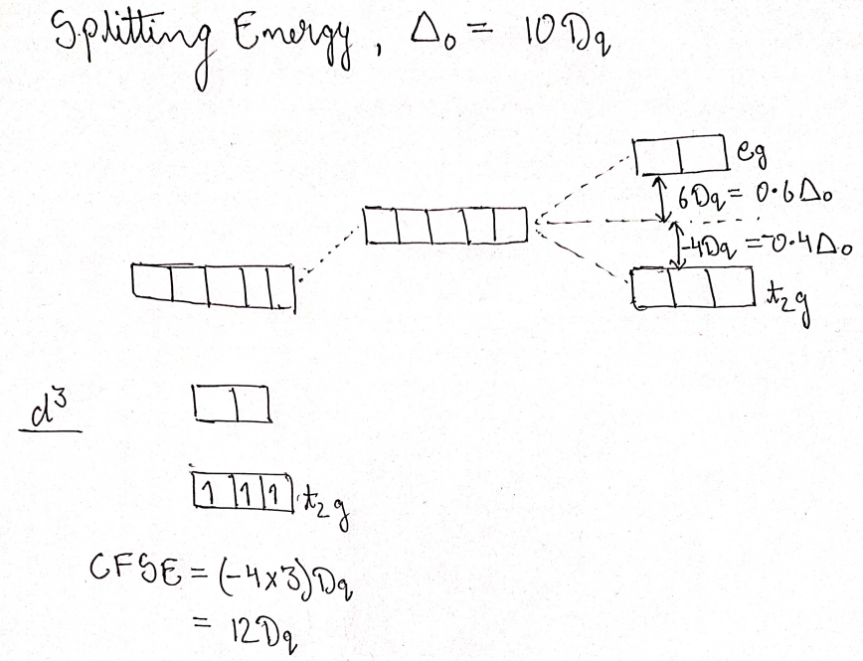
Calculation of CFSE in octahedral complex ?

Slide 12
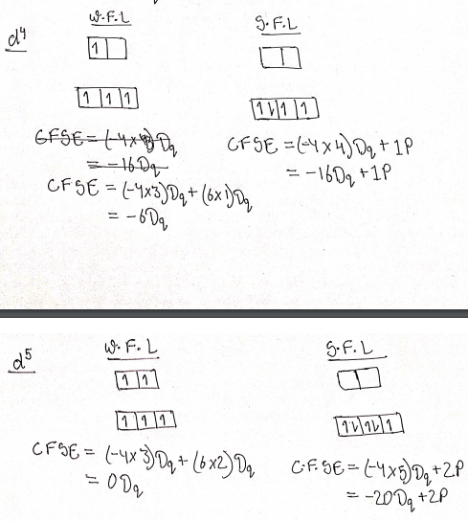

Slide 13
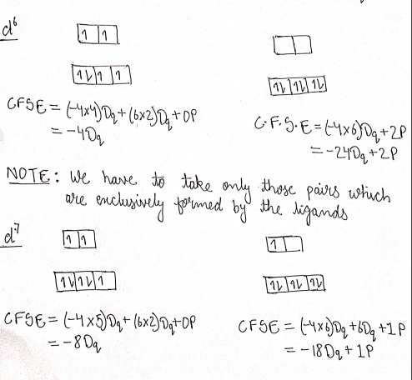

Slide 14


