Slide 1
REST Web Services
What are Web Services?
SOAP vs REST
REST Introduction
Q&A

Slide 2
What are Web Services?
Way of exposing APIs/Resources to World.
When providing jars no more a solution!
Web Service characteristics:
1. HTTP exchange : The data exchange generally should be over HTTP protocol.
SOAP WS uses HTTP with POST method. It can also use protocols as SMTP.
REST WS uses HTTP but there is no such restriction over HTTP methods.
2. Protocol : both server and client adheres to some protocols (Message format) to transfer messages among them.
SOAP WS uses SOAP(Simple Object Access Protocol) protocol. The messages must be using XML with strict rules how it should be.
REST WS uses NO protocol. The messages can be transferred as XML/Json/Text etc
as long as both client and server understand them.
3. Service definition : Client should know about services and how to invoke them.
SOAP WS has WSDL (document contains all info of APIs can be invoked).
REST WS has little to NO documentation.

Slide 3
SOAP vs REST
Verb terminology vs Noun terminology.
SOAP is xml based message protocol and guidelines maintained by community.
While REST is resource based architecture similar to www. There is no such guidelines.
SOAP invokes services via RPC methods while REST calls services via URL path.
SOAP uses wsdl for communication where as REST uses json or xml.
SOAP is not just over HTTP, it also uses protocols such as FTP,SMTP etc.
SOAP doesn’t return human readable responses while REST returns simplified json or xml

Slide 4
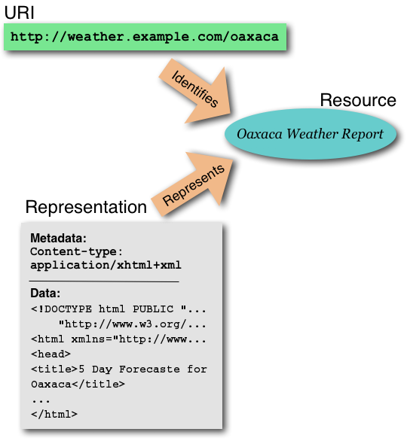
REST Introduction
Why is it called Representational State Transfer ?
Client
http://weather.example.com/oaxaca
Resource
Json/xml data

Slide 5
… Continued
HTTP and REST : REST name was given by Roy Fielding (one of the author of HTTP Specification).
Some of the concepts inspired by HTTP:
Resource Location: Practice in REST is to have resource based addresses similar to hyperlinks in html.
Every Resource must be identified by a unique URI
eg.
Action based: weatherapp.com/weatherLookUp.do?zipcode=12345
REST based : weatherapp.com/zipcode/12345
HTTP Methods: A good RESTful API makes good uses of these HTTP methods.
Metadata in header: We get some extra information for REST calls along with response like status codes, content type content length etc.

Slide 6
… Continued
CRUD operation using standard HTTP methods
POST : Creates a Resource. It is not idempotent.
GET : Reads a Resource.
PUT : Updates a Resource.
DELETE : Deletes a Resource.

Slide 7
… Continued
HTTP status codes
200 : OK, Resources was read, updated or deleted successfully.
201 : Created, Resource was created.
400 : Bad Request.
403 : Not Authorized, Request was not authorized to do the action.
404 : Not Found, Resource not found.
500 : Internal server error.

Slide 8
… Continued
HATEOAS
Hypermedia As The Engine Of Application State
We know, best REST APIs don’t need Service definition or documentation. We want to best make them self documented very similar to hypertexts.
Example with a Rest Response:
{
“Id” : 20“,
“message” : “Hello World!”,
“links” : [
{
“href” : “messages/20”,
“rel” : “self”
},
{
“comments-href” : “messages/20/comments”,
“rel” : “comments”
}
]
}
Now this Hypermedia acts as engine to drive application state.

Slide 9
… Continued
The Richardson maturity model : How much RESTful your API is ?
LEVEL 0: NOT A REST API
example : A SOAP URI, where action is defined in message request body and there is single URI for all operations.
URI: /messanger
CREATE Request Body:
<create-message>
<message> “Hello World!”</message>
<author>”John Doe”</author>
</create-message>
DELETE Request Body:
<delete-comment>
<message-id>20</message-id>
<comment-id>30</comment-id>
</delete-comment>

Slide 10
…Continued
LEVEL 1 : Only Resource URI are implemented but operations still defined in Request body.
Level 2 : You use standard HTTP methods and status codes on Resource URIs, which takes care of operation to be performed.
LEVEL 3 : You implement HATEOAS with links

Slide 11
… Continued
Demonstration and guidelines for creating Resource based URIs
Sample can be cloned from github URL
https://github.com/Shashank085236/RestApiMessangerDemo
Examples:
To access all messages
http://localhost:8080/rest/messages
2. To access single message by Id
http://localhost:8080/rest/messages/{message_id}
To access comments on a message
http://localhost:8080/rest/messages/{message_id}/comments
To access a particular comment on a message
http://localhost:8080/rest/messages/{message_id}/comments/{comment_id}

Slide 12
Questions and Answers

