Slide 1
Akka and Actor System
Shashank Dwivedi
Developer @ Micro Focus

Slide 2
Akka
Akka is a toolkit and runtime for building applications which are highly concurrent, distributed, fault tolerant and event-driven applications on the JVM.

Slide 3
Motivation for new model
"Don't communicate by sharing memory rather share memory by communicating"
Program at higher level
No shared state
No Threads and locks
Paradigm shift from think about concurrency to how message flows in system
Low latency
High throughput
Scalability
Distributable in nature

Slide 4
Actor
Carl Hewitt’s definition –
Actors are fundamental unit that embodies
Processing (Behavior)
Storage (State)
Communication

Slide 5
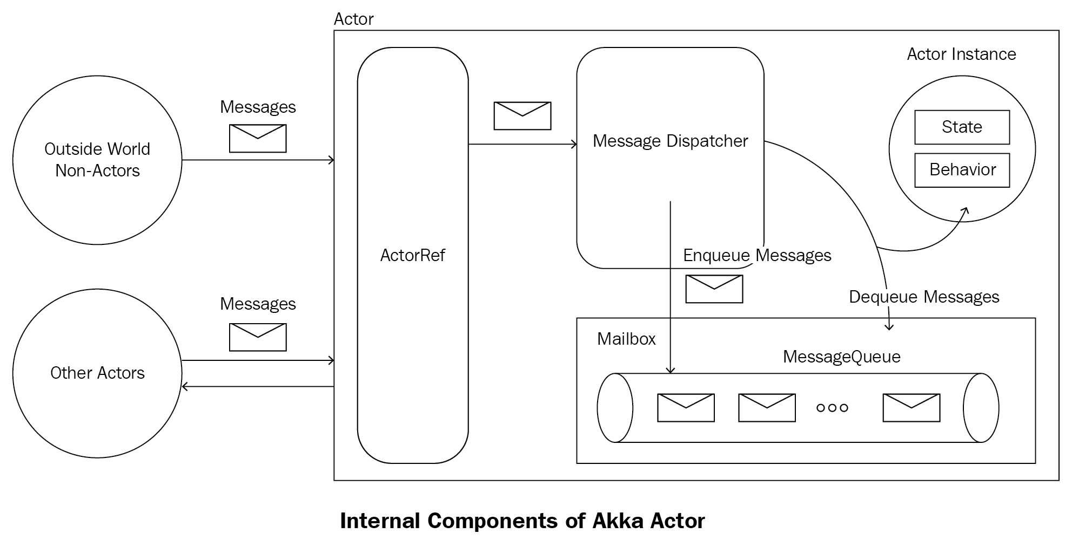
Actor Component

Slide 6
Characteristics of Actor
1
Extremely Light weight(< 1kb)
2
Reactive
3
Messages based communication
4
Asynchronous

Slide 7
5
Encapsulated & decoupled black boxes
Manages their own memory & behaviour
6
7
Elastic- can grow & shrink on-demand
8
4
Persistent

Slide 8
Actor operations
1
Create a new Actor
2
Change it’s state and behaviour
3
Send message to another actors
4
Supervise another actors

Slide 9
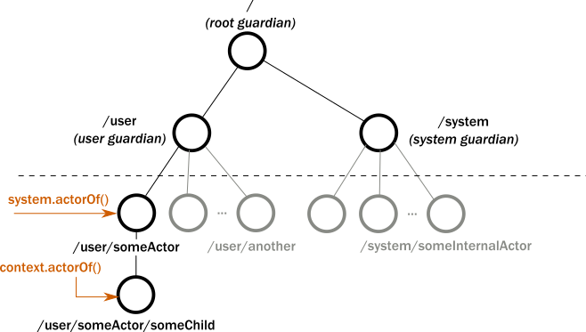
Actor Hierarchy
Notes:
Why such Actor hierarchy?
Life cycle
Supervision

Slide 10
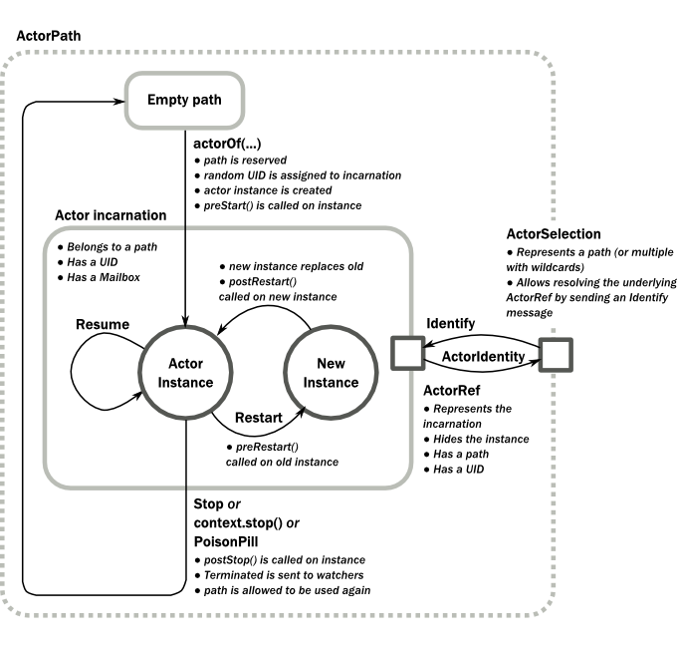
Actor Lifecycle

Slide 11
Actor Supervision
In act of failure of an actor, the parent (supervisor) can choose to
Restart the actor – restarts thus previous state is cleared
Resume the actor – ignores message caused failure and resumes
Stop the actor – further messages goes to dead letters mailbox
Escalate to it’s parent (supervisor) – parent supervision strategy

Slide 12
Actor default supervision strategy
Every Actor has a default supervisor strategy
ActorInitializationException → Stop
ActorKilledException → Stop
Exception → Restart
Throwable → Escalate
Otherwise → Escalate

Slide 13
Message delivery semantics
At-most-once
Each message is delivered zero or one time
Messages can be lost, but are never duplicated.
Cheapest and result in highest performance because of fire and forget approach.
At-least-once delivery
Potentially multiple attempts are made to deliver each message, until at least one succeeds
Messages can be duplicated but are never lost.
Exactly-once
Each message is delivered exactly once to the recipient
The message can neither be lost nor be duplicated.
Note:
Message ordering is maintained per sender-receiver pair.
It is left up to application to build a ack based system if required.

Slide 14
An Example (at-most-once)
Actor A1 sends messages M1, M2, M3 to A2
Actor A3 sends messages M4, M5, M6 to A2
This means that:
If M1 is delivered it must be delivered before M2 and M3
If M2 is delivered it must be delivered before M3
If M4 is delivered it must be delivered before M5 and M6
If M5 is delivered it must be delivered before M6
A2 can see messages from A1 interleaved with messages from A3
Since there is no guaranteed delivery, any of the messages may be dropped, i.e. not arrive at A2

Slide 15
Special messages
PoisonPill – instructs message to stop without supervision interference.
Example: victim.tell(akka.actor.PoisonPill.getInstance(), ActorRef.noSender());
Kill – causes actor to throw ActorKilledException which can be handled by supervision strategy
Example: victim.tell(akka.actor.Kill.getInstance(), ActorRef.noSender());
Terminated – After an actor is stopped, it sends Terminated message to all it’s watchers.

Slide 16
Death watch
Allows an actor to watch another actor and be notified(not limited to parent-child relationship)
The watcher receives a Terminated message containing reference to the watched actor.
The watcher can either handle this message explicitly or will fail with a DeathPactException.
Latter is useful if the actor can no longer perform its own duties after the watched actor stopped.

Slide 17
Best practices
Prefer depth than breadth in Actor tree while designing
Isolate blocking logics in separate thread based dispatcher
All messages must be immutable
Put asynchronous boundaries where required. Actor in all 3 tier doesn’t make sense

Slide 18
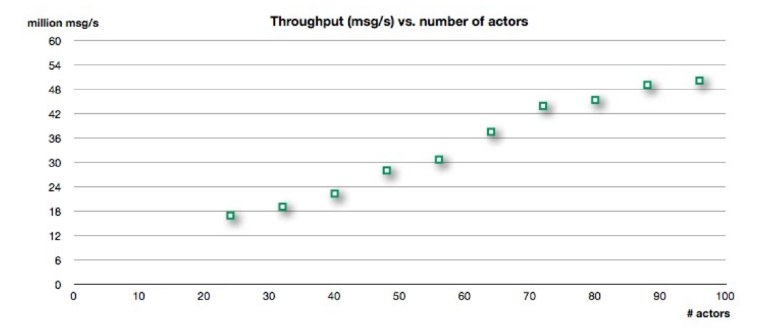
Performance
https://letitcrash.com/post/20397701710/50-million-messages-per-second-on-a-single

Slide 19
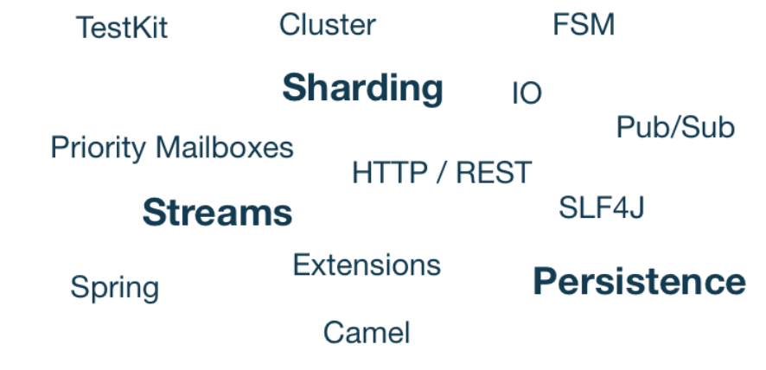
Akka modules (beyond scope)

Slide 20
References
https://akka.io/docs/
https://letitcrash.com/post/20397701710/50-million-messages-per-second-on-a-single
https://www.youtube.com/watch?v=lPTqcecwkJg&t=1721s&ab_channel=AppNexus
https://www.youtube.com/watch?v=7erJ1DV_Tlo&ab_channel=jasonofthel33t

Slide 21


