Slide 1
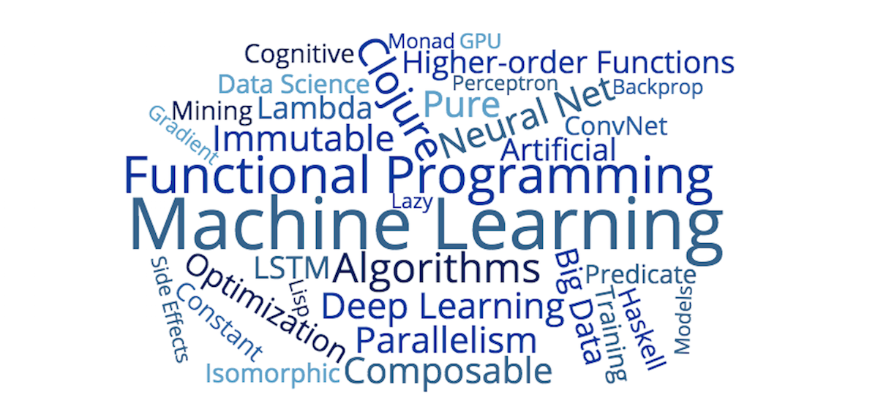
Functional Programming
Shashank Dwivedi
Sr. Software Designer
Micro Focus

Slide 2
7 characteristics of Functional Programming
1
First-class functions
2
Higher-order functions
3
Immutable data
Pure functions
4
Notes:
First class functions and Higer-Order function
Power to compose by not only allowing assigning reference to states but to process itself

Slide 3
5
Recursion
Lazy Evaluation
6
7
Declarative
4
Notes:
Functional programming is declarative and thus more abstract.
5+5+5+5+5+5+5+5+5+5 = 5*10
Declarative vs Imperative
What to do vs How to do

Slide 4

Immutability
Shield against
Multithreading.
Hidden side-effects.
Caching issues.
Notes:
- Fundamentally broken in multithreaded environment.
- Equality in presence of mutability becomes meaningless.
- Misuse of mutability is root cause of all the evil.
- There should be proper justification to mutation in code.
-methods taking final paramete

Slide 5
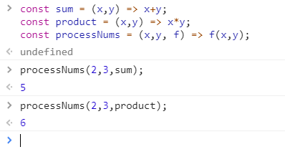
Higher Order function
Notes:
- Always favor first class functions.
Higher order functions – Takes at least one parameter as function!

Slide 6
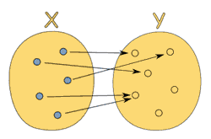
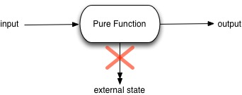

Pure Functions
Notes:
- Functions are relationships between sets which we strive to achieve.
- For same input always gives same output without involving any external dependency and having no side effects.
Note: Only exception can be if external state is immutable.
Problem and solution
minimum can be defined const
can be defined in checkAge locally
can be passed as argument

Slide 7
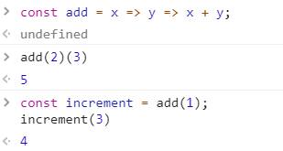
Currying
Notes:
- A step towards single input single output which we strive.
A way of calling a function with lesser arguments than it expects! Closure helps remembering first argument.
Java 8 tried achieving this with functional interfaces which expects single argument.
What if I tell you to define increment (++) operator? ☺-- Partial Functions

Slide 8
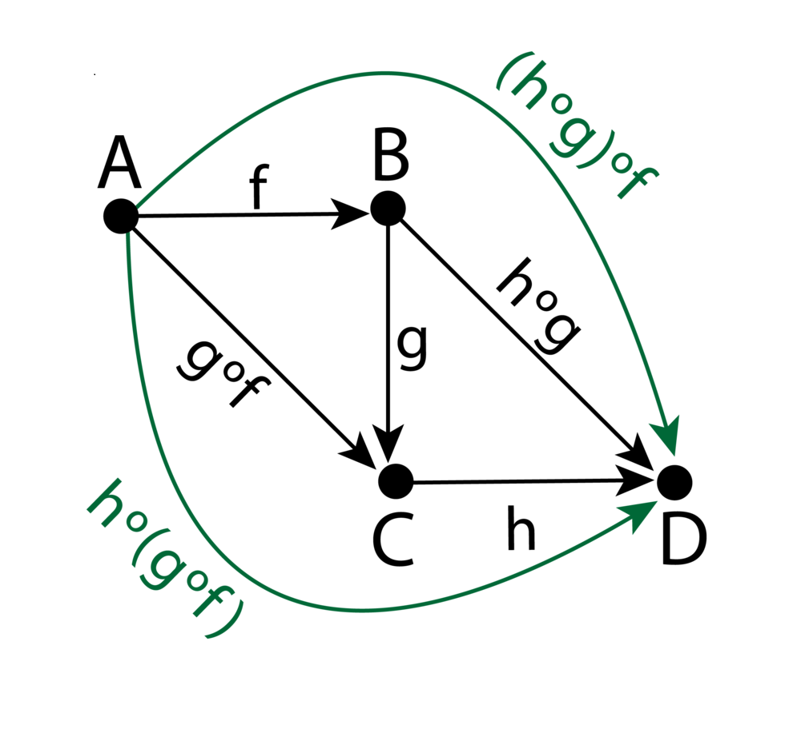
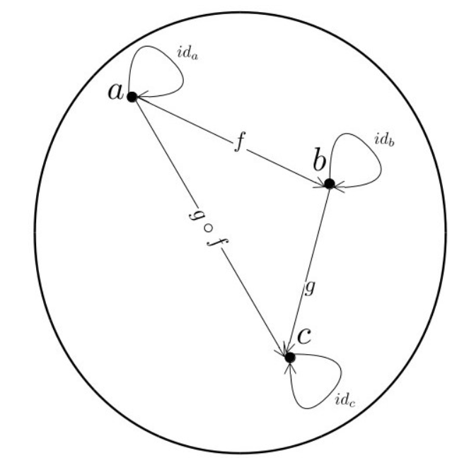
A glimpse of Category Theory
Notes:
Category theory: A mathematical study of a group of objects and their behavior.
A Category consists of
Objects or points
Morphisms or arrows
Laws of category theory:
Composition – It is associative in nature (hog)of = ho(gof)
Identity (Used to define isomorphism eg : initial and terminal objects, product and co product etc.. ) Also it enables us to define a category with 2 objects

Slide 9

Composition
Consider car object below and re write function using composition.

Slide 10
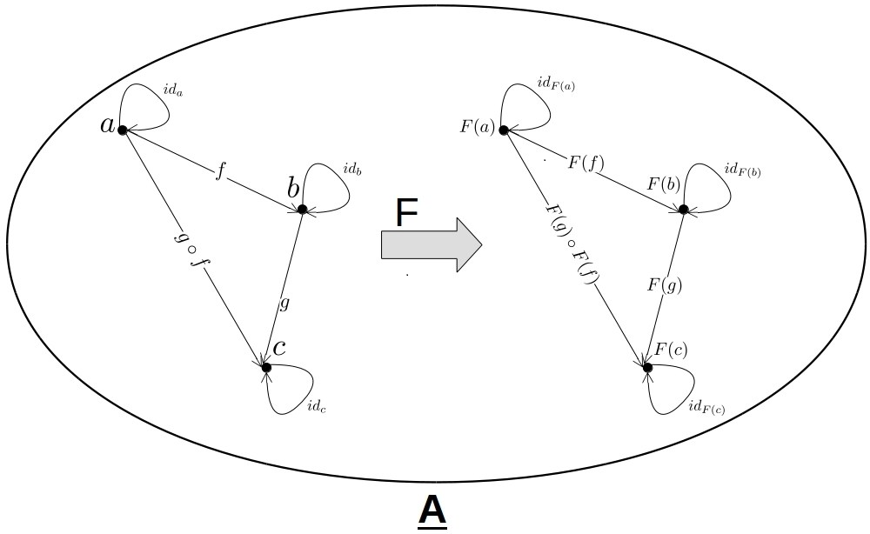
Functor
map :: Functor F => (a -> b) -> F a -> F b
# identity law map(idx) = idF(x) for all objects.
# composition law map(compose(f, g)) = compose(map(f), map(g));
Notes:
Functor : mapping among categories maintaining structure.
It forms category of categories where objects are category and morphisms are Functor.
Functor Laws:
Identity law : F(idx) = idF(x) for all objects.
Composition law: F(gof) = F(g)oF(f) for all morphisms.

Slide 11
Functor
Maybe – some|none / just|nothing
1 2 3 4 5 6 7 8 9 10 11 12 13 14 15 16 17 18 19 20 21 | class Maybe { static of(x) { return new Maybe(x); } get isNothing() { return this.$value === null || this.$value === undefined; } constructor(x) { this.$value = x; } map(fn) { return this.isNothing ? this : Maybe.of(fn(this.$value)); } inspect() { return this.isNothing ? 'Nothing' : `Just(${inspect(this.$value)})`; } }
Notes:
providing fn = a way to go from a -> b, when applied to value present i.e a will return fn(a) or Maybe(b)

Slide 12
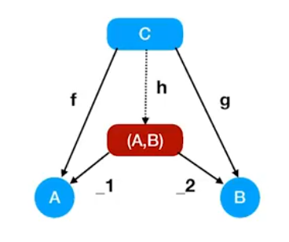
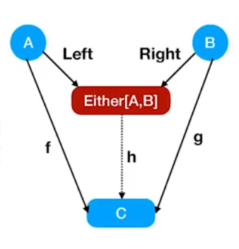
Product and Sum
Notes:
Sum and Product are dual in opposite categories.
Sum and Product are isomorphic

Slide 13
Either
1 2 3 4 5 6 7 8 9 10 11 12 13 14 15 16 17 18 19 20 21 22 23 24 25 | # Either a b :: Left a | Right b class Either { static of(x) { return new Right(x); } constructor(x) { this.$value = x; } } class Left extends Either { //ignores request to map. map(f) { return this; } inspect() { return `Left(${inspect(this.$value)})`; } } class Right extends Either { map(f) { return Either.of(f(this.$value)); } inspect() { return `Right(${inspect(this.$value)})`; } }
Notes:
Either : by convention Right is right(success) and Left is (failure)

Slide 14
Pointfree
1 2 | // map :: Functor f => (a -> b) -> f a -> f b const map = curry((f, anyFunctor) => anyFunctor.map(f));
Notes:
A paradigm in which a function definition doesn’t identify arguments on which they operate.
Achieved via currying and composition

Slide 15

Exercise
Write a function that uses `checkActive` and `showWelcome` to grant access or return the error.
1 2 3 4 5 6 7 8 9 | // showWelcome :: User -> String const showWelcome = compose(append('Welcome '), prop('name')); // checkActive :: User -> Either String User const checkActive = function checkActive(user) { return user.active ? Either.of(user) : left('Your account is not active'); };
Notes:
Why map there in solution?
- checkActive returns Either, then we call Either.map(showWelcome)
- note map here is point free

Slide 16
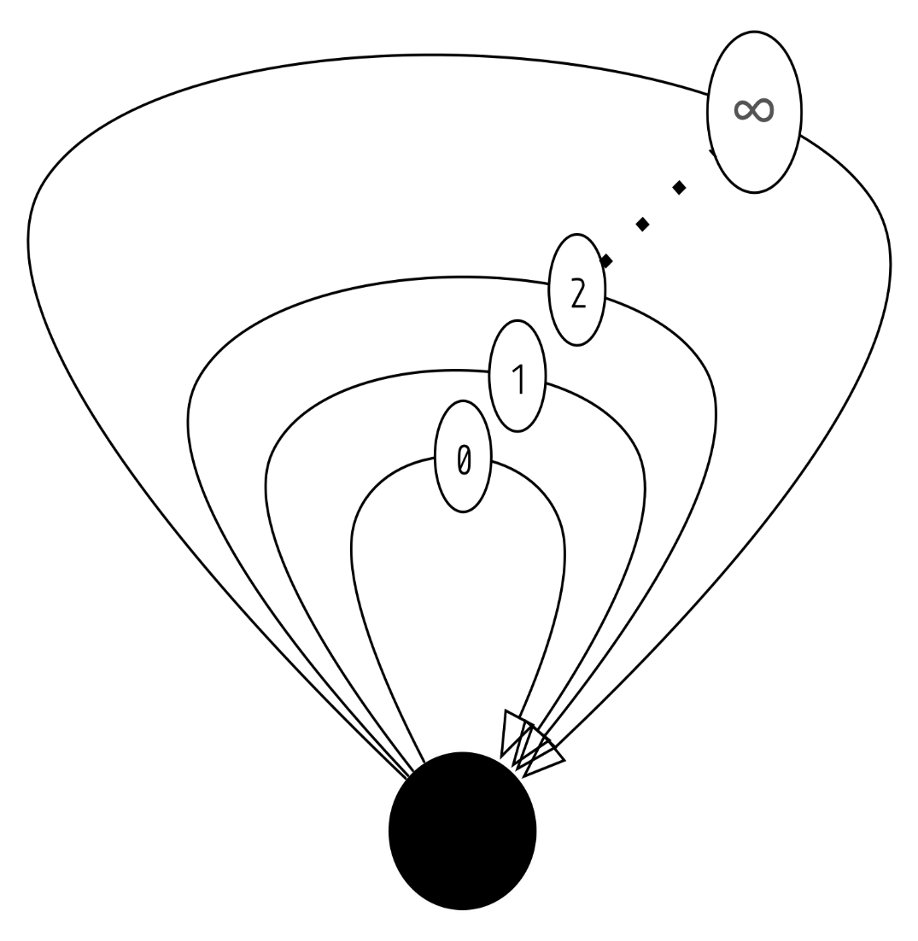
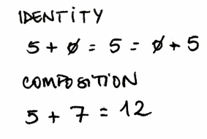
Monoid
Example Moniods –
M: Int / 0 / +
0 is Identity, + is composition and Int as object.
M: Int / 1 / *
1 is Identity, * is composition and Int as object.
M: String / “” / +
Notes:
EndoFunctor: Objects and morphisms are within same Category.
Monoid is a some set M treated as single Object in category!
It therefore follows category laws: 1. composition with associativity 2. Identity
Monoid law
o : (M,M) => M, Id : M

Slide 17
Exercise
Is a chair monoid?
Is a Chair stack monoid?
Notes:
1. NO – Composition fails. We can’t combine two chairs into one.
2. YES – composition of more stacks still gives a stack with Identity with no chairs.

Slide 18
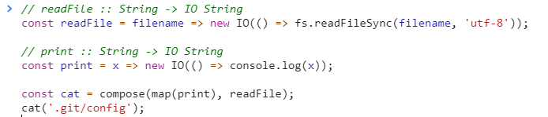
Monods
const map = curry((f, anyFunctor) => anyFunctor.map(f));
Notes:
"monads are pointed functor which can be flatten.”
Consists of,
Unit : of or type constructor
map: applies function to value and returns container
flatten or join: flattens the result to container
Yikes IO(IO(***)), we have to invoke $value().$value() twice.

Slide 19

Monods
Notes:
chain is also referred as >>= or flatMap or bind or liftM. flatMap being most accurate as it really flattens map function..

Slide 20


