Slide 1
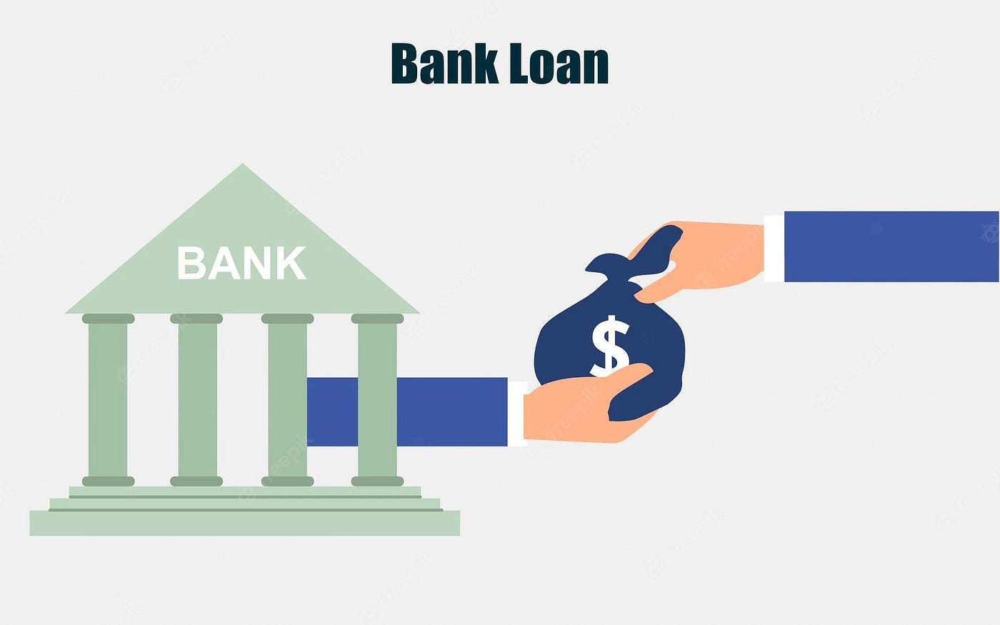
Analytics
Group 3

Slide 2

INTRODUCTION
This project aims to analyze bank loan data to understand customer behavior, loan approval patterns, and default risks. Using Excel for cleaning, SQL for data merging and KPI calculation, and Power BI and Tableau for dashboard creation, the project transforms raw financial data into meaningful insights. The analysis helps identify key factors that influence loan approval, highlights risk segments, and provides visual dashboards that support faster and more accurate decision-making for banks.

Slide 3
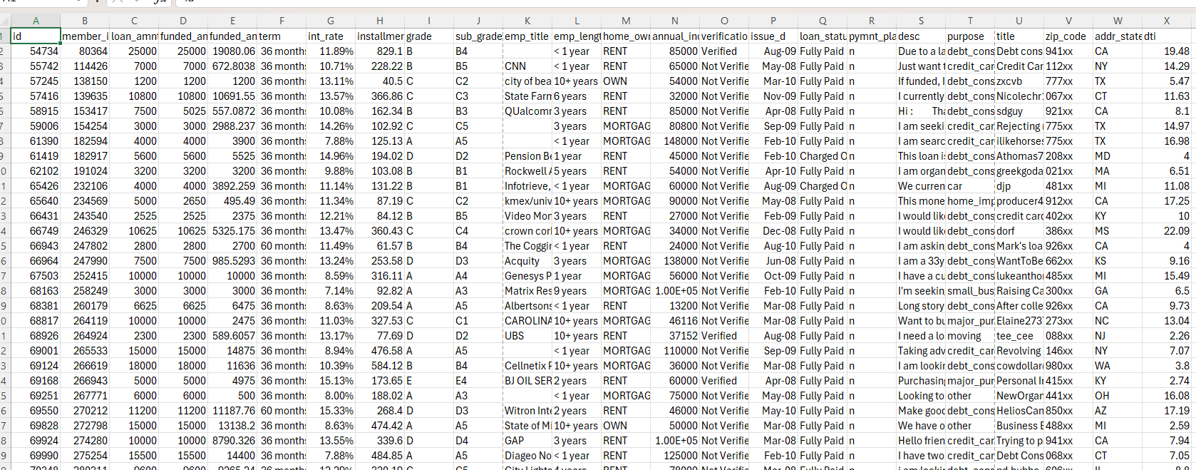
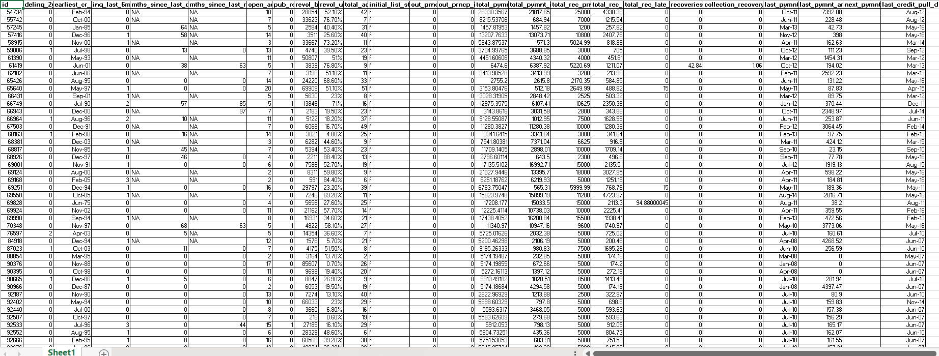
FINANCE_1
Datasets
FINANCE_1 AND FINANCE_2 ARE THE TWO DATASETS USED FOR ANALYSIS
FINANCE_2

Slide 4





KPI 1: Year Wise Loan Status
KPI 2: Grade & Sub-Grade Wise Revolving Balance
KPI’S ADDRESSED
KPI 3: Total Payment for Verified Status Vs Total Payment for Non-Verified Status
KPI 4: State Wise & Month Wise Loan Status
KPI 5: Home Ownership by Last Payment Date Stats

Slide 5
PROBLEM STATEMENT
The objective of this project is to analyze a bank loan dataset to understand lending patterns, repayment behavior, credit risk, customer distribution, and financial performance.
By using Excel, SQL, Power BI, and Tableau, we aim to clean the raw data, transform it into meaningful insights, and visualize key trends that can support effective decision-making.

Slide 6
PROJECT METHODOLOGY
STEPS TAKEN TO SOLVE THE PROBLEM
1️⃣ Data Understanding
Studied Finance_1 and Finance_2 datasets
Understood column definitions and missing values
Identified data quality issues
2️⃣ Data Cleaning (Excel + SQL)
Removed duplicates
Standardized numeric formats (int_rate, revol_util, emp_length, term)
Corrected inconsistent text categories
Fixed date formats
Converted percentage/text fields into numeric form

Slide 7
3️⃣ Data Transformation
Merged Finance_1 and Finance_2
Extracted year, month from issue date
Calculated new fields
Prepared clean dataset for dashboarding
4️⃣ SQL Query Development
Year-wise loan amount
Verification status vs total payment
Grade & sub-grade revolving balance
State-wise loan status
Homeownership vs last payment date
Backend KPIs validated using SQL
5️⃣ Dashboard Creation
Excel: KPI cards, slicers, pivot charts
Power BI: Modern visuals, drill-down charts
Tableau: Interactive filters, advanced analytics
SQL: Analytical script support and KPI extraction
6️⃣ Insights Generation
Identified patterns, customer behavior, and risk indicators
Compared repayment performance across different groups

Slide 8




TOOLS
Microsoft Excel
Microsoft Power-BI
Tableau
My SQL

Slide 9
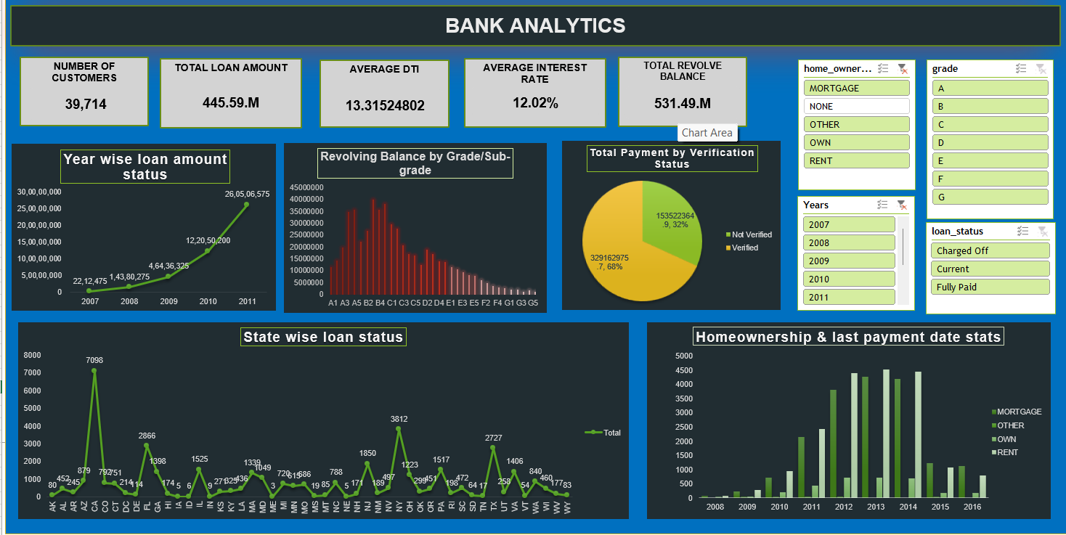
Excel Dashboard
KPI’S ADDRESSED

Slide 10
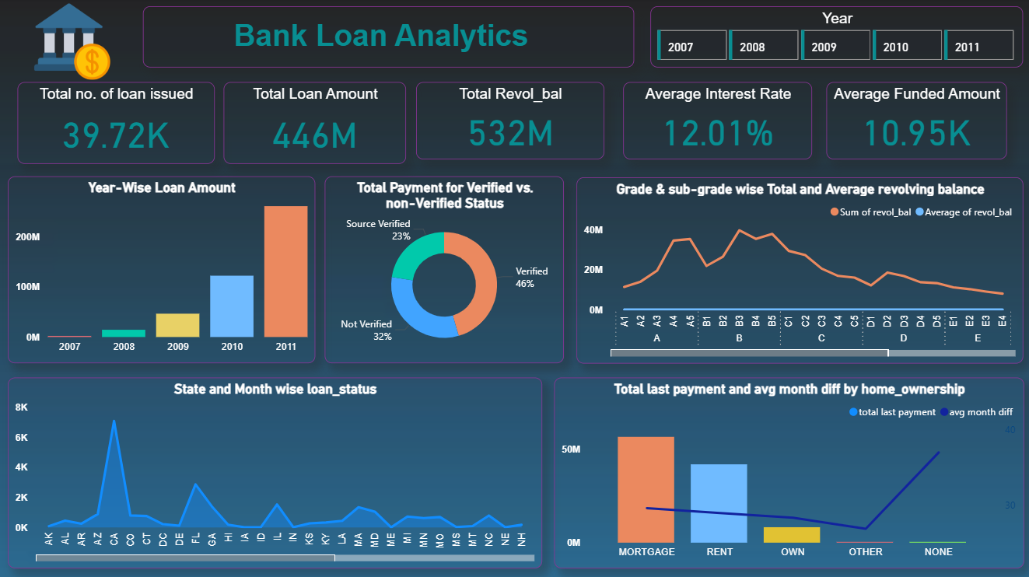
Power BI Dashboard
KPI’S ADDRESSED

Slide 11
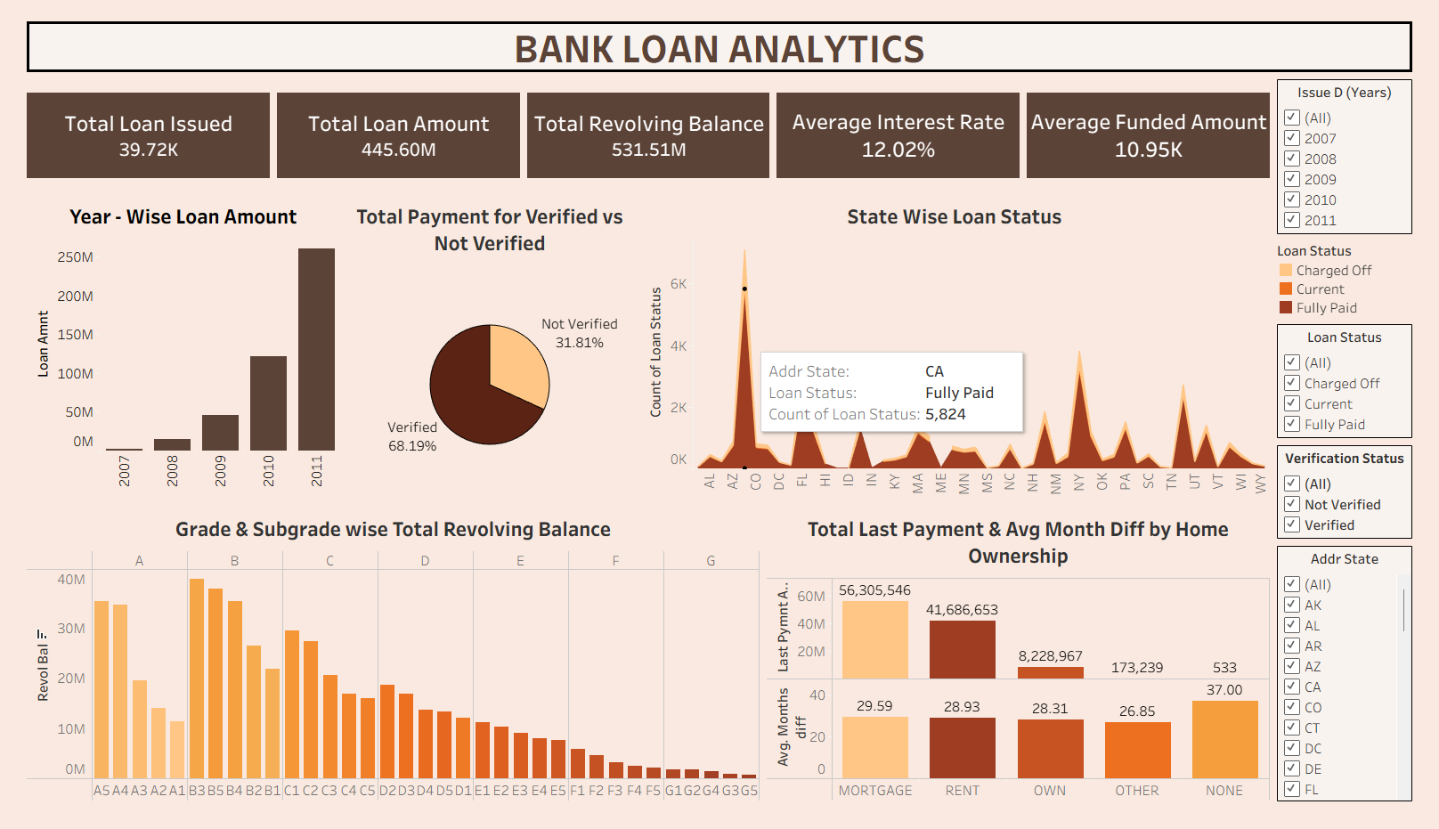
Tableau Dashboard
KPI’S ADDRESSED

Slide 12
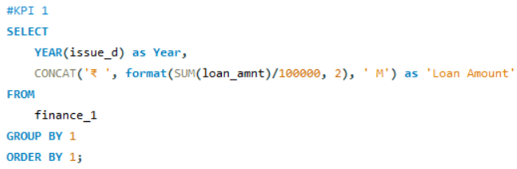
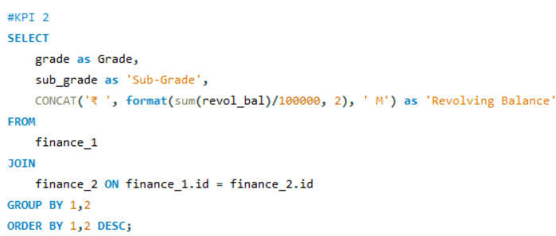
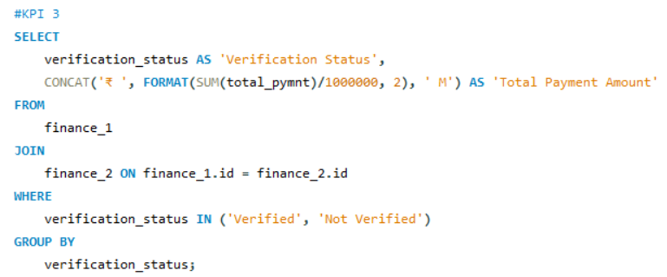
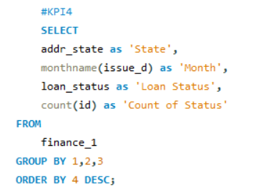
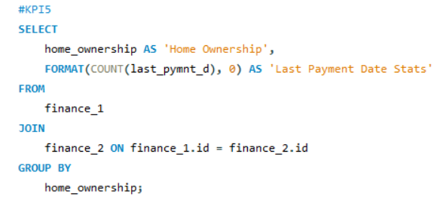
SQL
KPI’S ADDRESSED

Slide 13
KEY INSIGHTS
Loan disbursement increased steadily and peaked around 2011.
Verified customers are more reliable in repayments.
California and Florida are the biggest lending regions.
Grades B & C hold the highest revolving balances → higher active debt.
Mortgage owners repay more consistently than renters or others.
Average interest rate is around 12%, indicating moderate-risk lending.
Total revolving balance is higher than total loan amount due to ongoing reuse + interest addition.

Slide 14
RECOMMENDATIONS
Increase focus on verified customers and strengthen verification process.
Expand marketing efforts in high-performing states like CA, FL.
Monitor middle-grade (B, C) borrowers for repayment risk.
Encourage mortgage-backed loans for better repayment stability.
Provide financial counseling for high revolving balance customers.
Use dashboards regularly for monthly decision-making reviews.

Slide 15
CONCLUSION
This project demonstrates how raw financial data can be converted into powerful insights using Excel, SQL, Power BI, and Tableau.
Through ata cleaning, transformation, KPI extraction, and interactive dashboarding, we gained a clear understanding of loan behavior, customer trends, and risk patterns.
These insights can help banking teams make data-driven decisions and improve their lending strategies.

Slide 16
KPI’S ADDRESSED
Thank
you

