Slide 1
SECURE DATA HIDING IN IMAGES USING STEGANOGRAPHY
SECURE THE DATA TO PREVENT HACKERS
Presented By:
Student Name : Shashank Chaudhary
College Name & Department : Graphic Era University (BTECH CSE)

Slide 2
OUTLINE
Problem Statement
Technology used
Wow factor
End users
Result
Conclusion
Git-hub Link
Future scope

Slide 3
Problem Statement
In today's digital world, protecting sensitive information is crucial. Traditional communication methods are vulnerable to interception. This project addresses the need for secure communication by hiding secret messages inside image files. Using image steganography, the project allows users to embed hidden messages in images and retrieve them with password protection. This ensures that only authorized users can access the confidential information.

Slide 4
Technology used
cv2 (OpenCV): Used for image processing and manipulation.
os: Helps with file handling and system operations.
string: Provides string manipulation utilities.
tkinter: Enables GUI-based user interaction.
filedialog, simpledialog: Allow file selection and user input via dialogs.
PIL (Image, ImageTk): Used for handling and displaying images in Tkinter.
messagebox: Displays alert and confirmation messages to the user.

Slide 5
Wow factors
This project stands out with its user-friendly GUI, making it accessible even to users without prior technical knowledge. A passcode feature adds an extra layer of security, ensuring only authorized access to hidden data. Each component, including image insertion and message entry, is uniquely identified for seamless interaction. Implemented in Jupyter Notebook, the project provides an interactive and intuitive experience. The combination of steganography, security, and accessibility makes it a unique and practical solution.

Slide 6
End users
Cybersecurity Professionals – Use it to securely share confidential information without being detected.
Journalists & Whistleblowers – Protect sensitive information when communicating in restrictive environments.
Privacy-Conscious Users – Ensure private communication by embedding hidden messages in ordinary image files.
Educational Institutions – Use it to teach concepts of data hiding and steganography techniques.

Slide 7
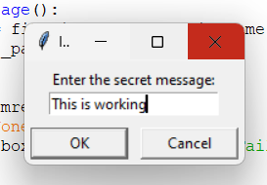
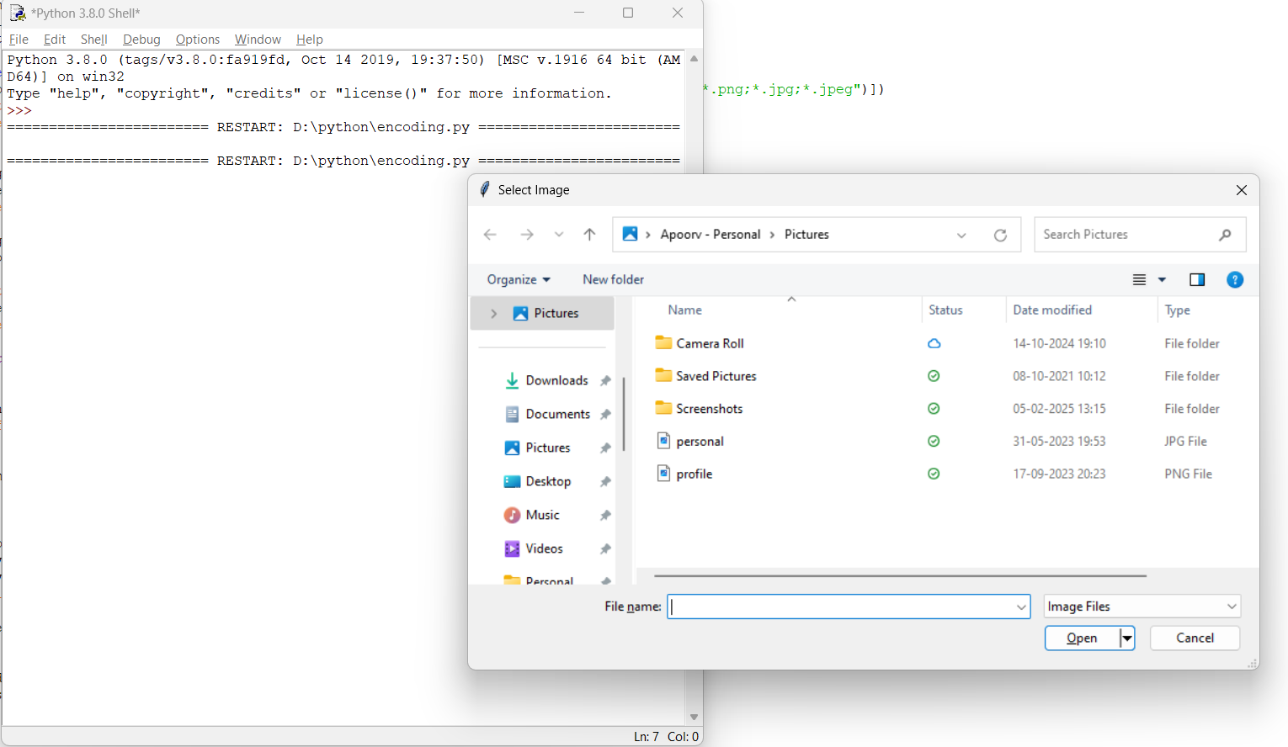
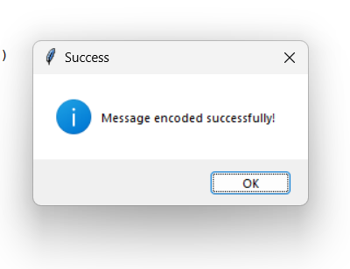
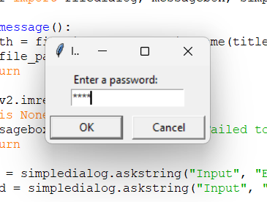
Results
Encoding

Slide 8
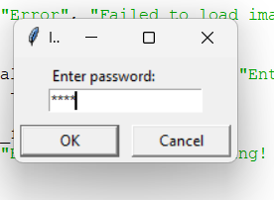
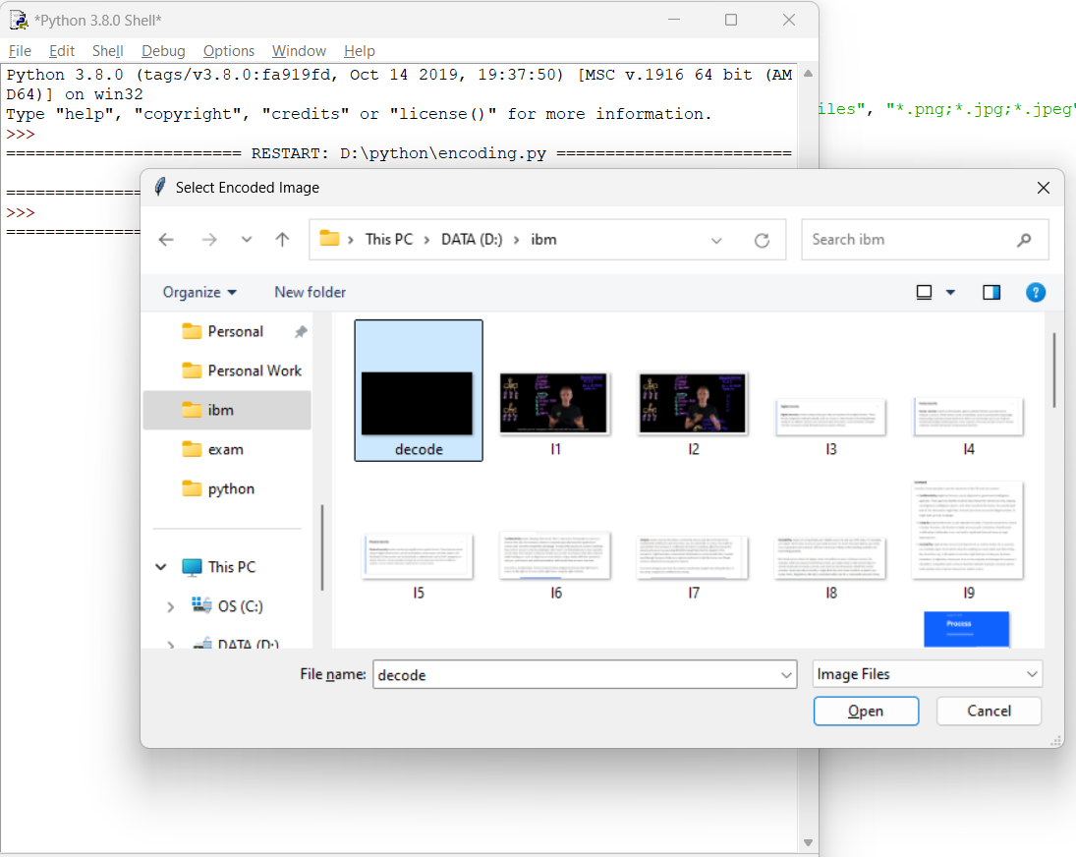
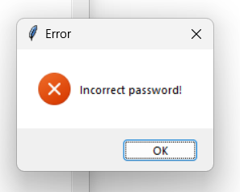
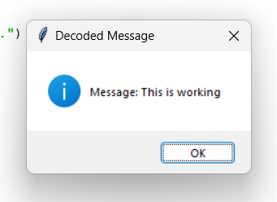
Decoding

Slide 9
Conclusion
The Image Steganography Using Python project provides a secure, reliable, and user-friendly way to hide sensitive messages within image files. By combining steganography techniques with password protection, the system enhances the confidentiality of digital communication. This project successfully addresses the need for secure, hidden communication in environments where privacy is essential.

Slide 10
GitHub Link
https://github.com/Shashank2619/AICTE_Internship.git

Slide 11
THANK YOU

