Slide 1

Gen-AI Led Transformation in Real Estate : AUGMENTING Innovative Value Chains
BY : Shashank Sahoo
(SENIOR DATA SCIENTIST)

Slide 2
Topics to cover
Real Estate : Market Insights
Real Estate : Identifying Business Value Chains
Rise of Gen-AI : A Real Estate Perspective
Gen-AI in Real Estate : Use Case in CRM & Marketing
Gen-AI in Real Estate : Use Case in HR
Gen-AI in Real Estate : Use Case in Finance
Gen-AI in Real Estate : Chatbot Solution Design Architecture
Gen-AI in Real Estate : Azure Deployment Architecture

Slide 3
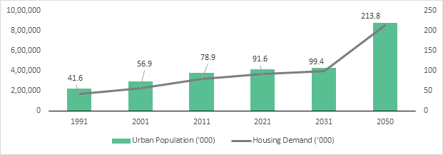
real estate : market insights
Steady Appreciation
Real estate Assets have historically demonstrated steady value appreciation over time, making it ideal for long-term investments
Passive Income Channel
Commercial and residential properties generate consistent rental income, offering a reliable revenue stream for owners and investors
Sustainable Practices
The rise of sustainability and smart city initiatives is driving the growth with prominence of energy-efficient buildings, green construction practices and efficient resource management techniques
Robust Demand
The real estate market is experiencing robust growth with increased demand for properties, driven by low interest rates and a desire for more space due to remote work and flexible office trends post COVID-19 pandemic.
Source : https://bwsmartcities.businessworld.in/
Smart Technology Integration
AI, IoT, and blockchain backed key technologies is witnessing an increased adoption and creating multifarious opportunities to improve property management, streamline processes, enhance customer experiences, and provide valuable-data for decision making
Demographics Shift & Government Subsidies
Participation from governing bodies is complimenting the demographics shift to create new growth avenues. Strategies like tax-credits, subsidies and incentives helps create new real-estate consumer base willing to get benefitted by these policies

Slide 4
Real estate : identifying business value chains
Land Acquisition & Expansion
Market Research & Inspections
Legal assessment
Project Development
Design & Planning
Construction
Marketing
Custom Ad Program
Listing creation
Sales
Price estimation
HR
Finance
Job Analysis
CRM
Securing Funds through credits
Risk assessment
Permits & Approvals
Quality Control
Smart marketing via social, digital and print media
Lead Generation
Physical and Virtual property tours
Demand capitalization
Price negotiation
Rental or Lease Agreement
Lead Conversion
Customized discounts for premium and luxury units
Market Research
Securing investor
Diversification across residential, commercial and industrial domains
Portfolio management
Exit Strategy
Feasibility studies and analysis
Resume screening
Orientation programs
Career development
Reskill and Upskill programs
Talent acquisition & retention
Training & Development
Mentorship
Client data collection and integration
Client segmentation and suggest property recommendations
Operations
Customer service and support
Feedback analysis and reporting
Client profiling and managing across communication channels
Interior designing experience with AR and VR
Land sourcing & acquisition
Expansion across cities, regions or countries
Capital Expenditure & Budgeting Strategy
Mortgage underwriting
Performance management
Property inspection
Property appraisal
Lease management
Maintenance & repairs
Accounting
Project progress tracking with milestones and KPIs
Property handover

Slide 5
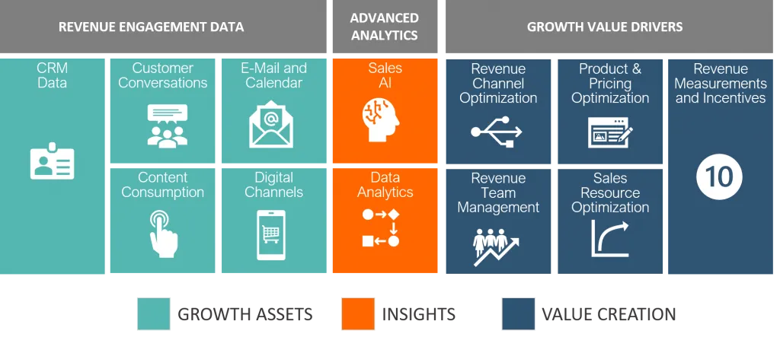
Rise of Generative AI : A Real estate perspective
The GenAI Revolution
Generative AI is revolutionizing the real estate landscape by transforming traditional practices and enhancing value creation throughout the industry. Embracing this technological wave and fostering collaboration between industry experts and AI specialists will be the key to unlocking its full potential and shaping the future of real estate. It essentially has three major components to realise impact and execute AI transformation
Data Acquisition
AI Model
Business Impact
Source : https://www.revenueenablement.com/

Slide 6
Gen-AI in real estate : use case in crm & Marketing
Areas | Challenges | Gen AI Solution
Data Management | Managing, organizing, and updating client information, property details, transaction history, customer inquiries etc., can be time-consuming and error-prone | Generative AI can automate data entry and cleansing tasks by extracting and structuring data from various sources, reducing manual efforts and ensuring data accuracy.
Personalized Communication | Tailoring communication and property recommendations to individual client preferences and needs can be labour-intensive. | Generative AI can generate personalized emails, messages, and property recommendations for each client by analysing their historical interactions and preferences. This improves engagement and conversion rates.
Customer Support and Chatbots | Providing timely customer support and handling routine inquiries can be resource-intensive. | AI-powered chatbots equipped with Generative AI can handle customer inquiries 24/7, answer frequently asked questions, and provide information about available properties. They can improve response times and free up human agents for more complex tasks.
Fraud Prevention | The real estate industry is susceptible to fraudulent activities, such as identity theft or fraudulent property listings. | AI can analyse data patterns and detect anomalies, helping to identify potentially fraudulent activities. Natural language processing (NLP) models can analyse property descriptions for inconsistencies and flag suspicious listings.
Marketing Content Generation | Creating engaging marketing content, property descriptions, and listings for a large portfolio of properties can be time-consuming. | Generative AI can assist in generating property descriptions, blog posts, and social media content. It can also create virtual property tours and videos, making content creation more efficient.

Slide 7
Gen-AI in real estate : use case in hr
Areas | Challenges | Gen AI Solution
Talent Acquisition | Identifying and attracting top real estate talent can be competitive and time-consuming. | Generative AI can streamline the recruitment process by analysing resumes, assessing candidates' qualifications, and matching them to job requirements. AI-powered chatbots can also engage with potential candidates 24/7, providing information and collecting initial data.
High Turnover Rates | The real estate industry often experiences high turnover rates, especially among sales agents and property managers, leading to increased recruitment efforts and costs. | Generative AI can analyse historical turnover data and employee profiles to identify common characteristics or patterns leading to attrition. This information can help HR departments develop targeted retention strategies, such as improved training or incentive programs, to reduce turnover.
Candidate Screening and Matching | Sorting through a large pool of applicants to identify the most suitable candidates for real estate roles can be time-consuming and challenging. | Generative AI can automate the initial screening process by analysing resumes, cover letters, and application forms. It can rank candidates based on qualifications, experience, and cultural fit, making it easier for HR professionals to identify top candidates quickly.
Performance Evaluation and Skill Assessment | Real estate professionals often work independently, making performance evaluation challenging. | Generative AI can establish performance benchmarks and track individual and team performance against these benchmarks. It can also provide data-driven insights to help managers identify areas for improvement and provide targeted feedback.
Diversity and Inclusion | Promoting diversity and inclusion in a traditionally homogenous industry. | AI can help identify unconscious biases in recruitment and performance evaluations, ensuring fairer treatment and opportunities for all employees.

Slide 8
Gen-AI in real estate : use case in FINANCE
Areas | Challenges | Gen AI Solution
Risk Assessment and Management | Assessing and managing various risks associated with real estate investments, such as market fluctuations, economic downturns, and environmental factors. | AI can analyse historical data, market trends, and external factors to create predictive models that assess and mitigate risks. It can also simulate different scenarios to help investors make informed decisions.
Property Valuation | Determining accurate property values, which can be influenced by multiple factors and market conditions. | AI can analyse large datasets, including property attributes, location, and historical sales data, to provide more accurate property valuations. It can also adjust valuations in real-time based on changing market conditions.
Mortgage Underwriting | Evaluating the creditworthiness of borrowers and managing the mortgage underwriting process efficiently. | AI can automate the underwriting process by analysing applicant data and credit histories, streamlining loan approval. It can also identify potential red flags or fraud indicators.
Fraud Detection | Detecting and preventing fraud in real estate transactions, such as mortgage fraud or property title fraud. | AI can analyse transactional data and patterns to identify anomalies and potential fraudulent activities. It can also improve identity verification processes.
Transaction Efficiency | Streamlining the transaction process, which often involves complex documentation and multiple parties. | AI can automate document processing, reduce paperwork, and improve transaction efficiency. Smart contracts powered by AI can automate contract execution and payment processes.

Slide 9
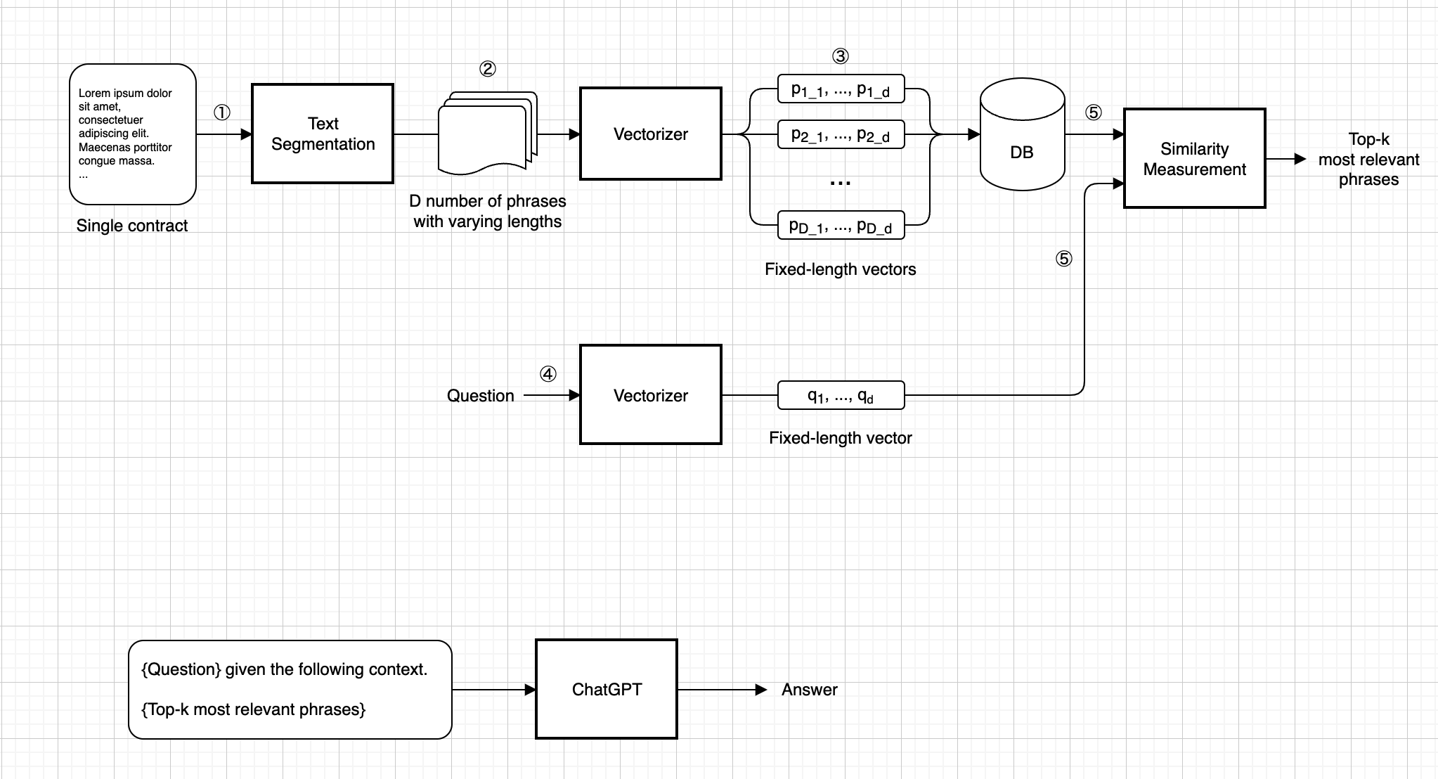
Gen-AI in real estate : CHATBOT SOLUTION design ARCHITECTURE

Slide 10
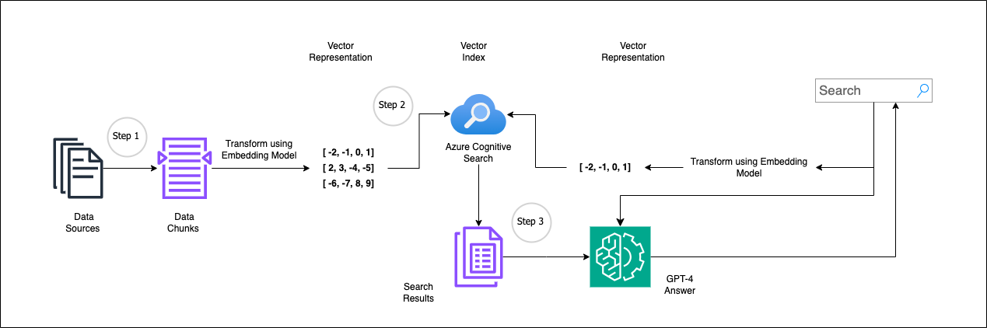
Gen-AI in real estate : azure deployment ARCHITECTURE

