Slide 1

UNIFIED MENTOR INTERNSHIP
Project 1 – Financial Dashboard Analysis
Name - SHASHANK BAJPAI
Email – Shashankax0@gmail.com
Designation – Business Analyst Intern

Slide 2
Overview
This dashboard provides a comprehensive financial overview of Western countries using key performance indicators such as sales, profit, discount, and units sold. Built using Power Bi and Excell, it visualizes patterns across years, products, segments, and countries, enabling strategic business decisions.

Slide 3
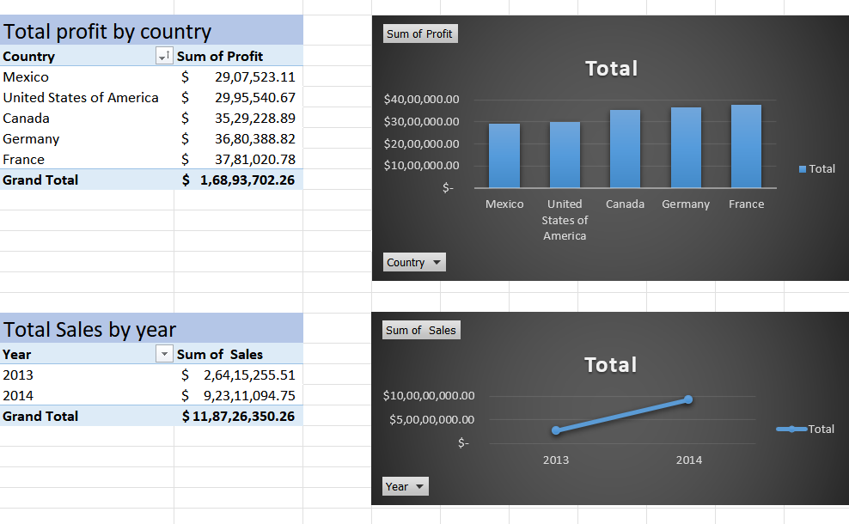
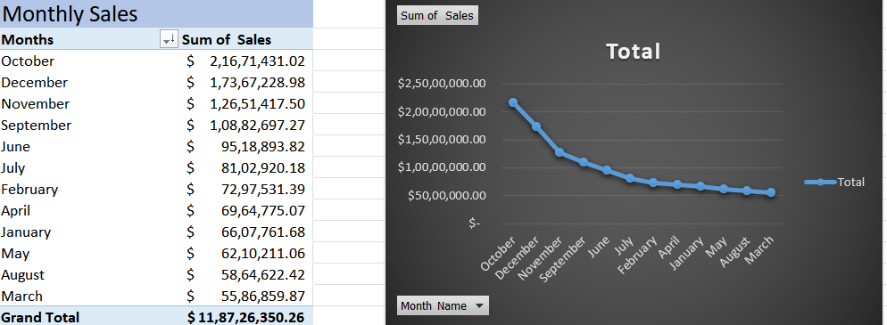
Excell Pivot tables and Charts

Slide 4
Year-wise Analysis
• Sales increased from $26M (2013) to $92M (2014)
• Profit dropped from $4M (2013) to -$13M (2014)
• Units Sold: 0.26M (2013) to 0.86M (2014)
Action: Identify what drove this growth (product launches, region focus, discounts) and double down on those successful tactics.

Slide 5
Country-wise Sales
• Germany: $3.78M (22.38%)
• United States: $3.53M (20.89%)
• France: $2.91M (17.21%)
Top 3 countries account for over 60% of total sales
Action: Prioritize marketing and product expansion strategies in these countries to boost profits further.

Slide 6
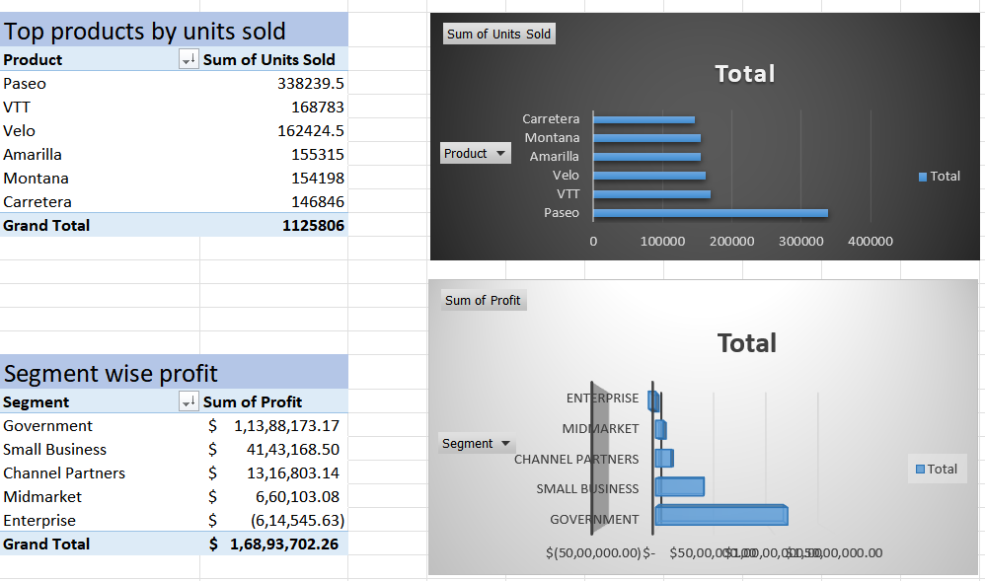

Slide 7
Product Insights
• Highest Selling Product: Paseo – $33M
• Bottom Products: Amarilla ($18M), Montana ($15M), Carretera ($14M)
• Highest Discount: Paseo ($2.6M)
Action: Evaluate if high discounts are necessary. Could profits be improved by reducing discount slightly without hurting sales volume?

Slide 8
Segment-wise Performance
• Top Segment: Government – $15M sales, $53M profit
• Small Business: $11M sales, $42M profit
• Midmarket and Enterprise have lower or negative profit

Slide 9
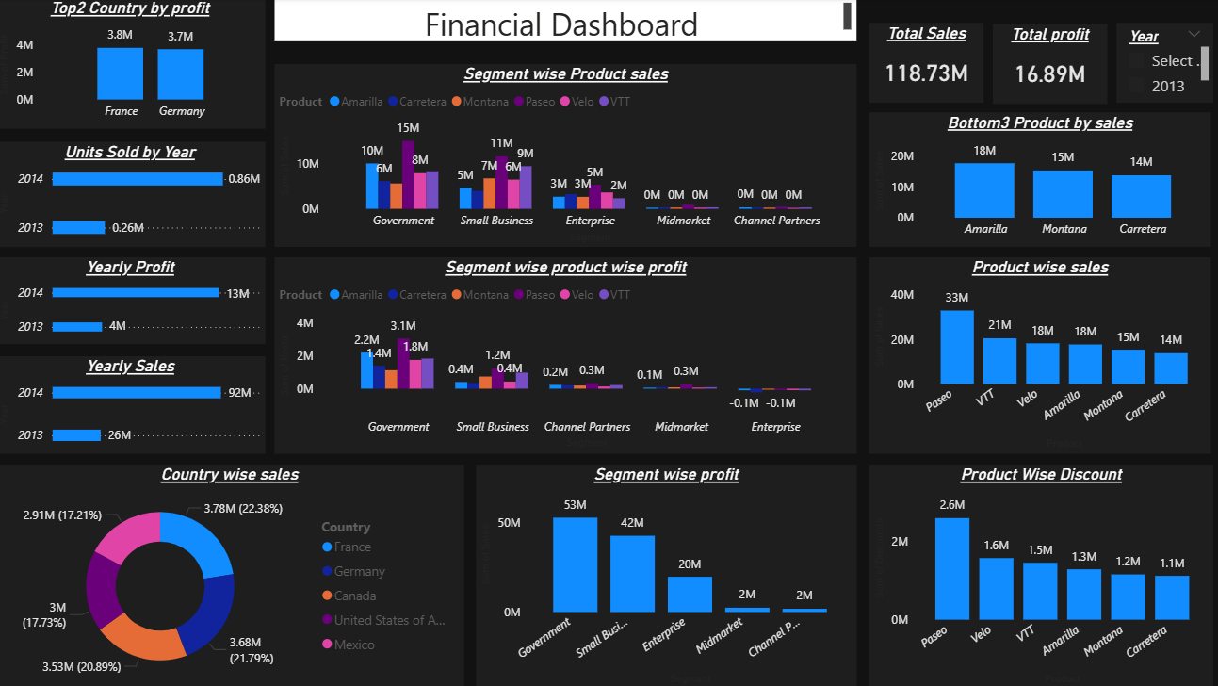

Slide 10
Improve Midmarket & Channel Partner Performance
Sales and profits from these segments are near zero.
❗️ Action: Investigate causes — is it lack of focus, wrong product mix, or market mismatch? Potential for strategic overhaul or exit.

Slide 11
Low Sales Products: Carretera, Montana, Amarilla
These products are in the bottom 3 by sales and offer low or negative profits in some segments.
Action: Audit these products for profitability. Consider bundling, repositioning, or phasing out underperforming SKUs.

Slide 12
Segment-Product Insights
• Best Pair: Carretera in Government segment (15M sales)
• VTT and Velo perform consistently across segments
Amarilla, Montana, and Carretera are among the lowest in sales and profit — their positioning should be reevaluated.

Slide 13
Conclusion
The financial dashboard reflects strong year-over-year business growth, with substantial increases in sales, profit, and units sold from 2013 to 2014. The Government and Small Business segments emerge as the primary revenue and profit drivers, while specific products and countries show clear patterns of performance. However, certain segments and products are underperforming and may require strategic revision.

Slide 14

THANK YOU

