Slide 1

UNIFIED MENTOR INTERNSHIP
Project -4 : Stock Market Dashboard Analysis
Name - SHASHANK BAJPAI
Email – Shashankax0@gmail.com
Designation – Business Analyst Intern

Slide 2
📘 Project Summary – Stock Market Analysis
This project analyzes the stock performance of Apple (AAPL), Google (GOOG), Microsoft (MSFT), and Netflix (NFLX) from February to May 2023 using Excel and Tableau.
Key metrics include closing price trends, moving averages (7-day & 14-day), volatility, daily returns, and trading volume. Advanced visuals such as return-to-volatility ratios, moving average crossovers, and risk-return scatter plots were created to extract deeper insights.
🔍 Key Findings:
MSFT showed the best risk-adjusted return and consistent growth.
AAPL and GOOG remained stable with low volatility.
NFLX was the most volatile but recovered strongly in May.
March saw peak trading activity across all stocks.
GOOG underperformed in return despite high stability.
This dashboard offers a clear view of risk-return tradeoffs and helps assess each company's market behavior over the short term.

Slide 3
📂 Dataset Description
The dataset contains historical daily stock data for four major companies: Apple (AAPL), Google (GOOG), Microsoft (MSFT), and Netflix (NFLX) over a 4-month period (February–May 2023). It was used to analyze market trends, volatility, and performance comparisons.
📄 Key Fields in the Dataset:
Field Name | Description
Date | Trading date (daily frequency)
Ticker | Company stock symbol (AAPL, GOOG, MSFT, NFLX)
Open | Stock price at market open
High, Low | Daily highest and lowest stock prices
Close | Price at market close
Volume | Number of shares traded on that date
Daily Return% | Day-over-day return percentage
7Day Volatility% | Price volatility over the previous 7 trading days
14Day Volatility% | Price volatility over the previous 14 trading days
Moving Average 7days | 7-day rolling average of the closing price
Moving Average 14days | 14-day rolling average of the closing price

Slide 4
📊 KPI Matrix – Stock Market Analysis (Feb–May 2023)
KPI | AAPL | GOOG | MSFT | NFLX
📈 Avg Monthly Close (₹) | 160.01 | 106.04 | 298.90 | 346.38
📊 Avg Daily Return (%) | 0.48% | 0.32% | 0.52% | 0.57%
⚠️ 7-Day Volatility (%) | 2.12% | 1.88% | 4.83% | 6.89%
⚠️ 14-Day Volatility (%) | 2.83% | 2.68% | 6.91% | 10.76%
🧠 Return-to-Volatility Ratio | 0.23 | 0.12 | 0.38 | 0.08
📉 Max Drawdown Period | Apr–May | Mar | – | Mar–Apr
📊 Peak Trading Volume (Month) | March | March | March | April
✅ Key Takeaways:
MSFT leads in risk-adjusted performance.
NFLX is high return, but also highest risk.
GOOG is stable, but low return efficiency.
AAPL is a balanced performer with low volatility.

Slide 5
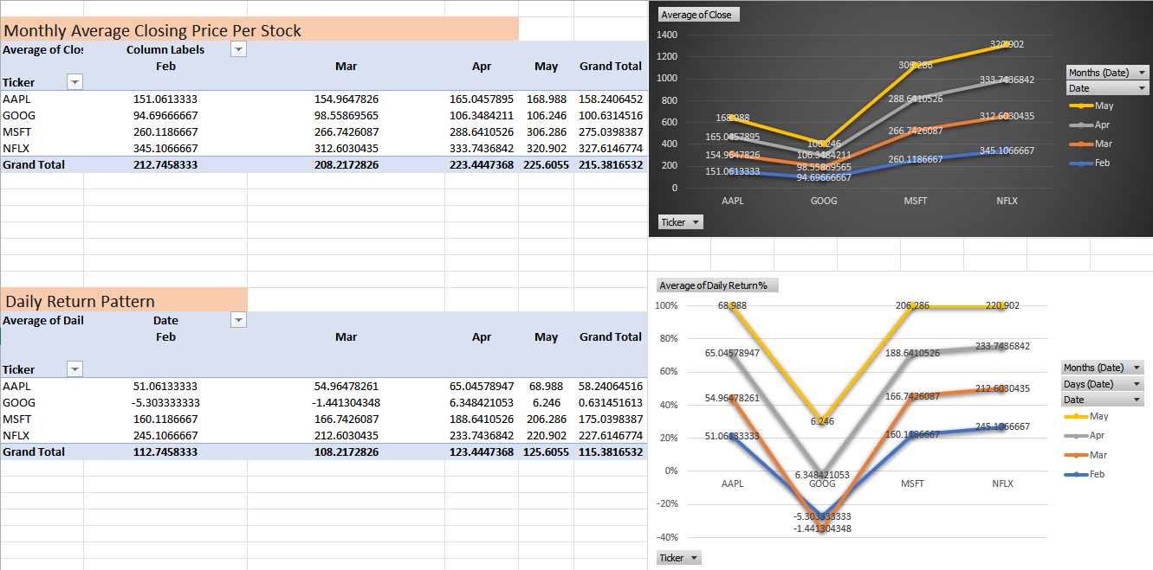

Slide 6
📊 Key Insights & Suggestions
NFLX shows the highest returns across months but remains volatile.
MSFT delivers consistent growth and strong return performance — a balanced performer.
AAPL maintains steady, low-risk growth, appealing to conservative investors.
GOOG underperforms in both return and price growth, signaling weak momentum.
📉 GOOG’s dip in March pulled down its average return despite price stability — points to weak investor confidence.
🔼 MSFT’s daily return peaks in May (₹206), aligned with its highest monthly close — indicating strong upward momentum.
📊 Volume-adjusted gains (from other views) also favor MSFT and NFLX as high-interest stocks.
📈 Suggestions:
✅ NFLX: Focus on volatility control to sustain high returns.
✅ MSFT: Leverage as a stable, growth-driven investment.
✅ AAPL: Promote as a reliable long-term option.
⚠️ GOOG: Needs strategic push to regain investor interest.

Slide 7
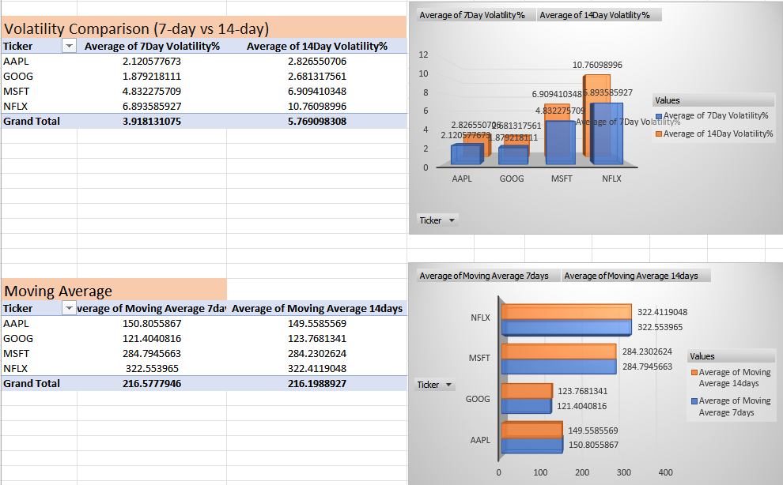

Slide 8
Stock Stability & Momentum Analysis – Volatility vs Moving Averages
NFLX shows the highest volatility (10.76%) but also leads in price momentum (Avg MA ~₹322), signaling high-risk, high-reward behavior.
MSFT maintains moderate volatility with strong average prices (~₹284) — a balanced performer.
AAPL and GOOG have lowest volatility (~2%), ideal for low-risk investors; however, GOOG lags in price movement.
Bullish crossover seen in AAPL and NFLX (7-day MA > 14-day MA), indicating short-term upward momentum.
Volatility gap between 7-day and 14-day is largest for NFLX, highlighting unstable trends.
📈 Suggestions for Growth:
✅ NFLX: Reduce short-term volatility with clearer guidance or market sentiment strategies.
✅ MSFT: Position as a reliable long-term growth stock in balanced or retirement-focused portfolios.
✅ AAPL: Leverage its low volatility and bullish signal to attract conservative investors.
⚠️ GOOG: Reignite investor interest through innovation or strategic moves to overcome price stagnancy.

Slide 9
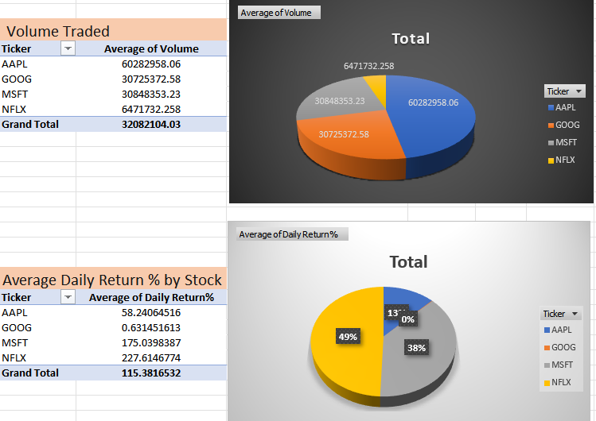

Slide 10
Stock Performance & Market Activity – Volume vs Return Analysis
📊 Key Insights :
NFLX leads in both trading volume (~64.7M) and average daily return (~227.6%), indicating high investor interest and strong return potential.
AAPL also shows very high volume (~60.2M), but with moderate return (~58.2%), positioning it as a stable and liquid investment.
MSFT offers a strong daily return (~175%) with moderate trading volume (~30.8M) — a solid growth option with balanced activity.
GOOG has the lowest daily return (~0.63%) and lowest trading volume (~30.7M), signaling low investor engagement and weak short-term performance.
📈 Suggestions for Growth:
✅ NFLX: Continue capitalizing on investor interest; consider managing volatility to maintain returns.
✅ MSFT: Promote as a high-return, balanced option for growth investors.
✅ AAPL: Leverage its liquidity and consistency to attract large, risk-averse investors.
⚠️ GOOG: Needs revitalization — consider strategic announcements, buybacks, or innovation push to drive investor interest and returns.

Slide 11
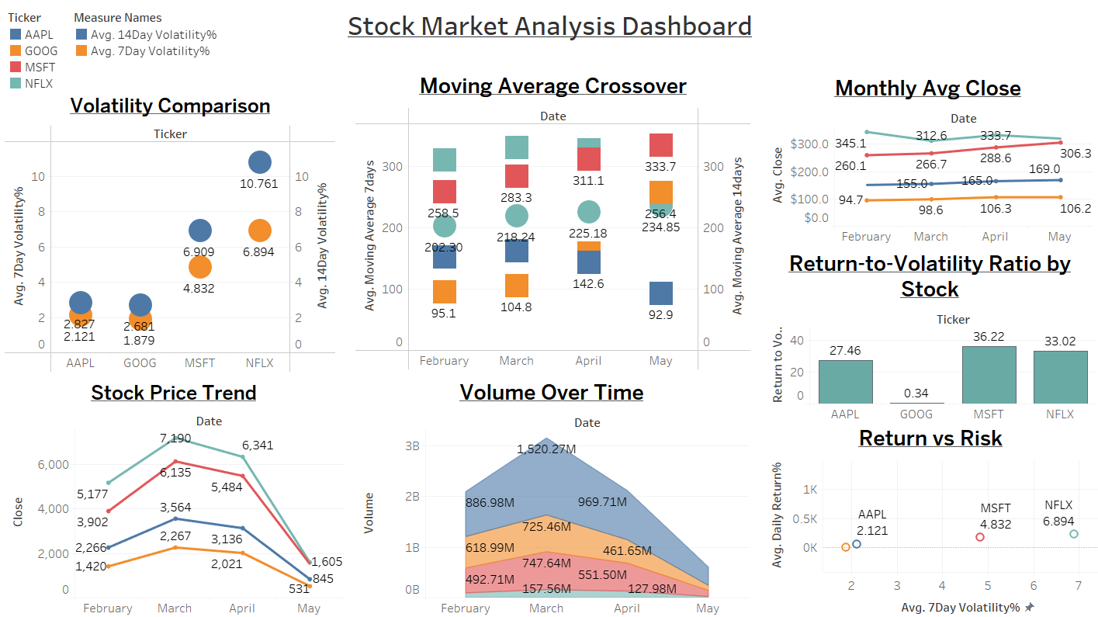

Slide 12
Stock Market Performance Overview
🔹 Volatility:
NFLX has the highest volatility (14-day: 10.76%), indicating frequent price swings.
AAPL and GOOG are the most stable (volatility < 3%), ideal for low-risk profiles.
🔹 Moving Average Crossover:
AAPL and NFLX show 7-day MA crossing above 14-day MA — a bullish signal.
MSFT maintains consistently high MA values, confirming sustained momentum.
🔹 Monthly Avg Close:
MSFT and NFLX show strong upward trends.
GOOG remains flat, indicating stagnation in performance.
🔹 Return-to-Volatility Ratio:
MSFT (36.22) and NFLX (33.02) offer the best risk-adjusted returns.
GOOG (0.34) significantly underperforms, despite low volatility.
🔹 Stock Price Trend:
Peak price levels seen in March–April; dip in May across all stocks suggests correction or seasonal trend.
🔹 Volume Over Time:
March had the highest trading volume, especially for AAPL and NFLX — likely due to earnings or key events.
🔹 Return vs Risk:
MSFT and NFLX balance good return with higher but manageable risk.
AAPL gives stable returns with minimal risk — perfect for conservative investors.

Slide 13
📈 Additional Suggestions for Growth:
🔸 1. Diversify Investor Messaging
* NFLX and MSFT should tailor investor communications:
Highlight growth potential and strategic initiatives
Acknowledge volatility (NFLX) while presenting risk management plans
🔸 2. Capitalize on Strong Trading Periods
* Since March had the highest volume, companies should align:
Product launches, earnings announcements, or strategic updates
With these high-engagement windows to maximize market impact.
🔸 3. Reinforce Confidence in Stable Performers
* AAPL and GOOG can:
Promote their low-risk, long-term investment appeal to attract institutional and conservative investors
Share consistent dividend strategies or capital efficiency moves
🔸 4. Leverage Bullish Indicators
* Stocks like AAPL and NFLX, showing 7-day > 14-day MA crossover, can:
Be promoted in short-term trading forums and growth-centric portfolios
Attract momentum traders or options investors
🔸 5. Optimize Risk-Return Balance
* MSFT can:
Target both risk-averse and aggressive investors by promoting its strong return-to-volatility ratio
Use this to position itself as a flagship portfolio anchor

Slide 14
✅ Conclusion
This stock market analysis of Apple (AAPL), Google (GOOG), Microsoft (MSFT), and Netflix (NFLX) reveals key differences in performance, volatility, and investor interest from February to May 2023.
Microsoft (MSFT) emerged as the strongest overall performer, offering high returns with balanced volatility and consistent upward trends — ideal for both growth and stability-focused investors.
Netflix (NFLX) showed the highest returns and trading activity but also carried the highest volatility, making it a high-risk, high-reward option.
Apple (AAPL) remained stable and consistent, with steady price movement, low volatility, and a bullish moving average crossover — a safe haven for long-term investors.
Google (GOOG) showed low volatility but weak returns, underperforming in risk-adjusted metrics and signaling the need for stronger strategic or market moves.
Overall, the analysis highlights how different stocks cater to different investor profiles, and how combining return, risk, volume, and trend indicators can support better investment decisions.

Slide 15
Thank You for the Opportunity.
Open to questions or further analysis.

