Slide 1

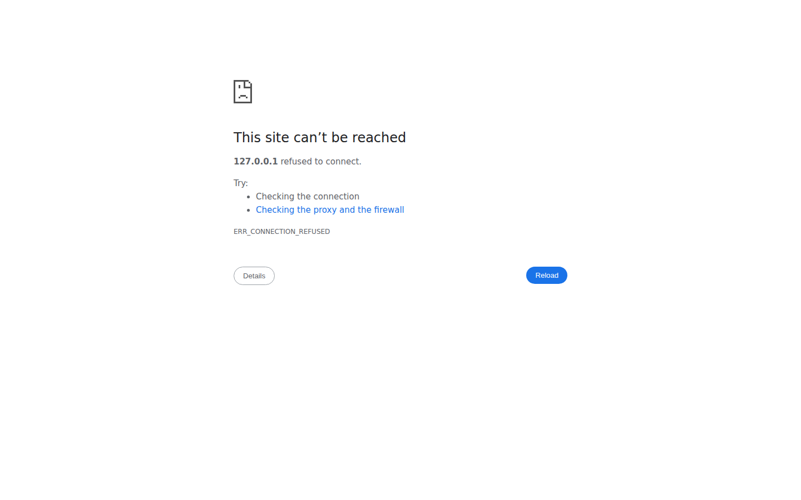
Validator Demo
Turn payment-file validation into a fast, confident, business-ready workflow

Slide 2
Why customers care
• Manual file checks are slow and error-prone
• Late validation creates payment delays and rework
• Compliance misses can become expensive and risky
• Teams need clear errors, not technical noise

Slide 3
What Validator does in seconds
1
1. Upload or paste
Bring in XML/CSV instantly
2
2. Validate
Run structural + rule checks automatically
3
3. Fix fast
Jump to exact error lines and re-validate
4
4. Share evidence
Export HTML/CSV reports for audit and stakeholders

Slide 4
Live demo walkthrough (non-technical)
✓ Show how quickly a file is loaded
✓ Click Validate and point to instant results
✓ Highlight clear line-by-line error guidance
✓ Show downloadable reports for sharing

Slide 5
Business outcomes your customer buys
Faster operations
Cut validation time from minutes to seconds
Lower risk
Catch schema/rule errors before submission
Higher confidence
Use reports as proof for audits & teams
Easier onboarding
Simple UI for non-technical users

Slide 6
How to pitch this in 30 seconds
“Validator helps your team submit cleaner payment files, faster. It highlights issues in plain language, pinpoints exact lines to fix, and gives shareable reports—so you reduce delays, avoid costly mistakes, and move with confidence.”
Next Step: Run a live file from your workflow and measure time-to-validate improvement in the first week.

Slide 7
Thank you
Ready for
a live pilot?
Validator by LVT LABS

