Slide 1



Groundwater Nitrate Contamination Mapping Using Machine Learning

Slide 2

Learning Objectives
Understand spatial modeling of groundwater nitrate contamination using synthetic well data.
Learn to apply Random Forest regression for predicting nitrate concentrations.
Explore the integration of GIS data and machine learning for environmental risk assessment.
Visualize contamination probability maps for decision support.
GOAL
Source :
www.freepik.com/

Slide 3
Tools and Technology used
Python ecosystem: Pandas, Numpy, Matplotlib, GeoPandas, Shapely
Scikit-learn: Random Forest regression, model evaluation
GIS spatial data handling with GeoPandas
Optional raster export with Rasterio (conditional)
Synthetic data generation simulating real-world well and contaminant distributions

Slide 4
Methodology
Study Area Definition: Bounded spatial box with coordinates defining the groundwater basin and critical contamination sources (point pollution sources and a river).
Synthetic Data Generation:
450 synthetic wells randomly distributed within the study area.
Simulated environmental features per well: land use category, soil permeability, rainfall, depth to water, well depth, distance to sources and river.
Nitrate concentration synthesized based on exponential decay with distance to sources and other factors including land use influence plus stochastic noise.
Feature Engineering:
One-hot encoding of categorical land use.
Computation of distances from wells to pollution sources and river line segments.
Model Training:
Regression using Random Forest with 300 trees to predict nitrate concentrations from environmental and spatial features.
Training on 75% of wells; testing on 25%.
Prediction & Mapping:
Model applied on a fine grid spanning the study area.
Probability of nitrate exceeding a threshold (50 mg/L) calculated via logistic transformation of predictions.

Slide 5
Problem Statement:
Groundwater nitrate contamination poses a serious risk to water quality and public health.
Field data is costly and sparse, limiting traditional monitoring.
This project uses machine learning with synthetic spatial data to predict nitrate levels and contamination risk across a study area by leveraging relationships with hydrological, geological, and land use factors.
The goal is to produce reliable nitrate contamination maps for unmonitored locations to assist resource management and public safety.

Slide 6
Solution:
Developed a Random Forest regression model trained on synthetic groundwater well data incorporating spatial, hydrological, and land use variables.
Model captures complex, nonlinear relationships governing nitrate contamination influenced by distance to pollution sources and river, soil permeability, rainfall, and well characteristics.
Prediction grid created over the entire study area providing spatially continuous nitrate concentration estimates where measurements are unavailable.
Translated predicted nitrate values into contamination risk probabilities using logistic transformation, highlighting zones exceeding critical nitrate levels (>50 mg/L) for targeted action.
Visualizations integrate well data, pollution sources, and river networks with modeled risk maps to offer an intuitive understanding of contamination distribution.
This solution supports proactive groundwater quality monitoring and management in data-limited environments by leveraging synthetic data and machine learning.
GitHub: ShashankAtmakur/Groundwater-Nitrate-Contamination-Mapping-Using-Machine-Learning

Slide 7
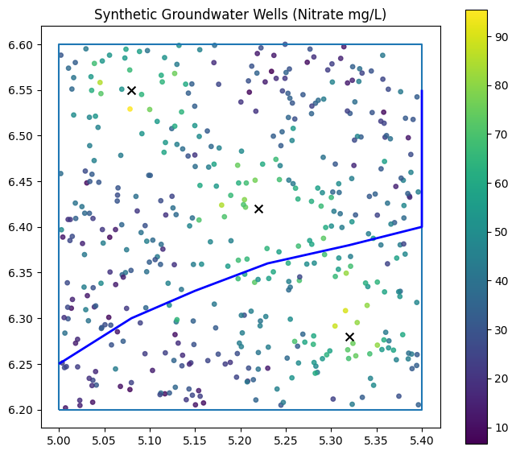
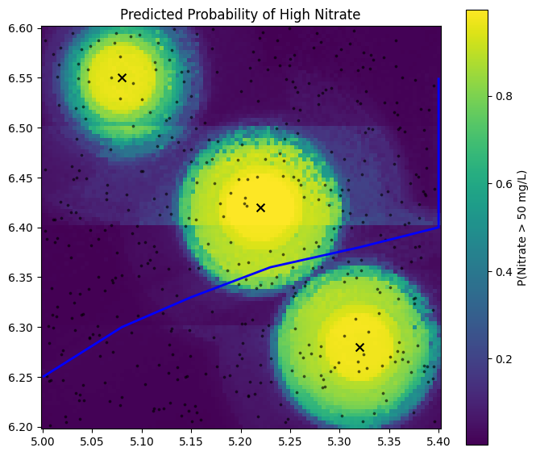
Screenshot of Output:

Slide 8
Conclusion:
Machine learning with synthetic well and environmental data can effectively model and map groundwater nitrate contamination risk.
Spatial features and land use significantly influence nitrate distribution, as incorporated by the model.
Probability maps provide actionable insights to prioritize monitoring and remediation efforts.
This approach is valuable in data-scarce regions, enabling preemptive contamination assessment.

