Slide 1
Weather Detection app using cloud Techniques
By –
Ayush Agarwal
Kishor Kumar Nanda
Shashank Awasthi
Sonu Kumar Tiwari
Suraj Verma

Slide 2
Cloud Computing
Cloud computing is the on-demand delivery of compute power, database storage, applications, and other IT resources through a cloud services platform via the internet with pay-as-you-go pricing.
Cloud computing provides a simple way to access servers, storage, databases and a broad set of application services over the Internet.
A Cloud services platform such as Amazon Web Services owns and maintains the network-connected hardware required for these application services.
With cloud computing, instead of making large upfront investments in hardware and spending a lot of time on the management of that hardware, you can provision exactly the right type and size of computing resources you need to power your ideas.

Slide 3
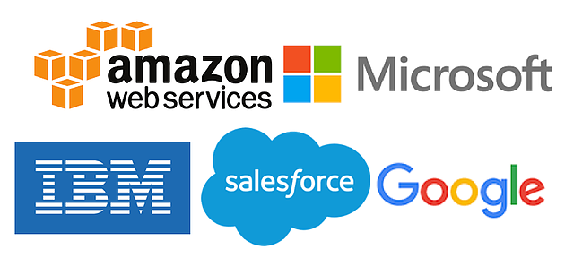
Some of the top cloud computing service providers

Slide 4
AMAZON WEB SERVICES (AWS)
Amazon Web Services provides a highly reliable, scalable, low-cost infrastructure platform in the cloud.
AWS offers low, pay-as-you-go pricing with no up-front expenses or long-term commitments with a broad set of products and services you can use as building blocks to run sophisticated and scalable applications.
The AWS Cloud provides a broad set of infrastructure services, such as computing power, storage options, networking and databases, delivered as a utility.

Slide 5
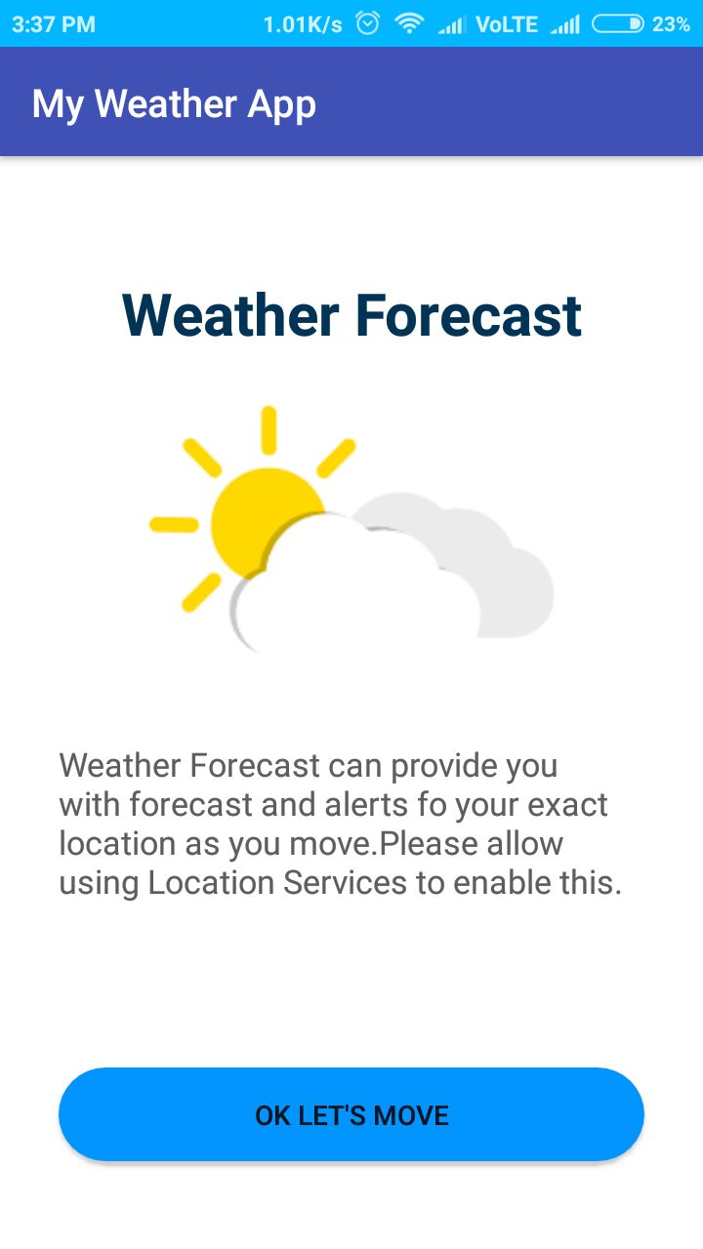
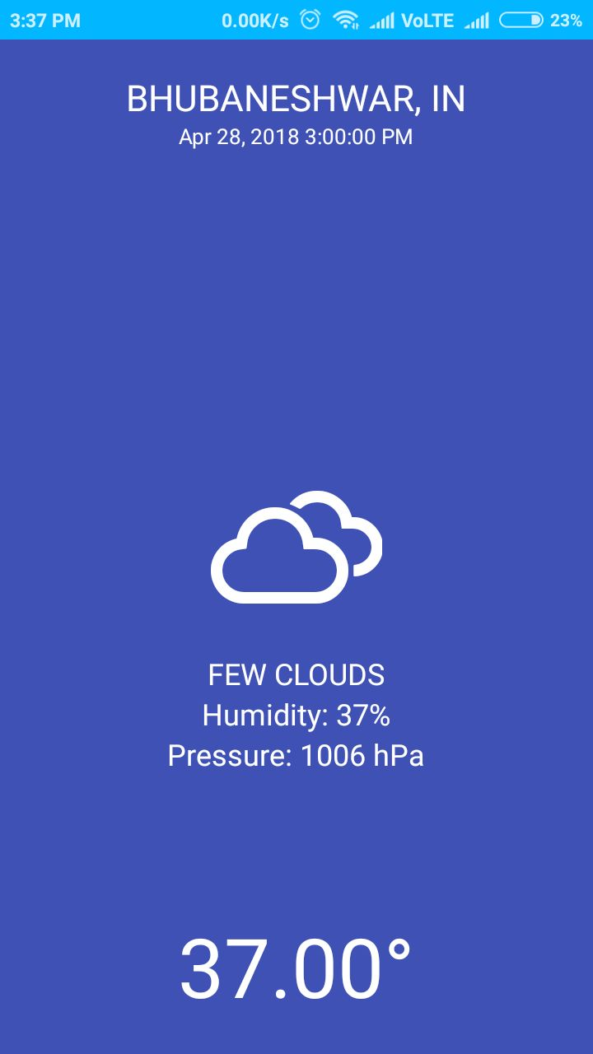
Activity 1
Activity 2

Slide 6
AWS MOBILE HUB and PINPOINT
The AWS platform handles demanding requirements for virtually any application, and for our project we used variety of services provided by the AWS such as the mobile services of AWS known as AWS Mobile Hub for the deployment of our Android application on the AWS cloud.
AWS Mobile Hub gives you a single place to easily configure AWS services. It generates a cloud configuration file, which stores information about configured services.
Amazon Pinpoint helps to engaging by sending email, SMS, and mobile push messages.
Amazon Pinpoint can be integrated into apps to check usage and track the ways that customers respond to the messages sent, which helps you better understand how customers interact with your apps.
You can send direct messages such as order confirmations, welcome messages, and one-time passwords using the console or the Pinpoint REST API

Slide 7
CONNECTING TO AWS BACKEND
After downloading and adding the cloud configuration file in the 'raw' directory of 'res' of our android project for backend, we connect to the backend services to utilize the benefits of the cloud.
The AWS SDK provided code has to be added to the application source code to connect.
User permission had to be added to the AndroidManifest.xml file to allow Internet and Network State Access.
Dependencies were added to our app/build.gradle. These dependency libraries enable basic AWS functions, like credentials, and analytics.
AWS provided code had to be added to the onCreate function of our MainActivity and AWSMobileClient class had to be imported.
And the app is set up to interact with the AWS services configured in our Mobile Hub project.
To check the connectivity to the AWS cloud, we run the application and in our logcat, we search for 'Welcome to AWS!' which ensures our app is successfully able to connect to cloud and can utilize its benefits.

Slide 8
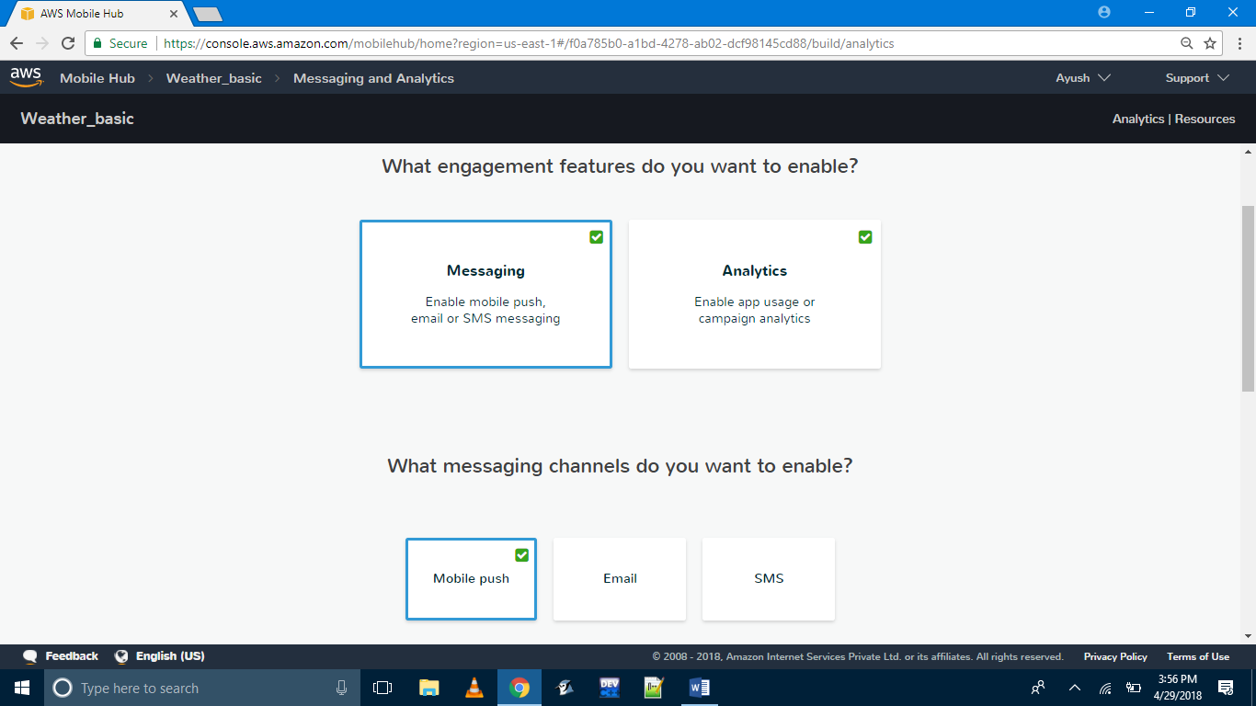
AWS Mobile Hub- Backend and Analytics enabled

Slide 9
CAPTURING ANALYTICS AND MONITORING THROUGH PINPOINT ANALYTICS
To gather the data that helps improve our app's usability, sessions, and engagement with our users, Mobile Hub deploys our analytics backend when enabling the Messaging and Analytics feature, which uses the Amazon Pinpoint service.
To ensure that the analytics are enabled or not we check out Mobile Hub console of our application, and a green tick present there ensures it.
Analytics session is started at the beginning of the onCreate() method of our MainActivity.
To stop the session, we use stopSession() and submitEvents() at the last point in the session we wanted to capture. PinpointMangager and PinpointConfiguration classes were imported for the analytics session capture and sending reports to the console.
Metrics for the application usage can be checked on the console.The metrics that were monitored were 'Daily Active endpoints', 'New Endpoints', 'Monthly Active endpoints', 'Sessions', '7-day retention period' and 'Revenue'.

Slide 10
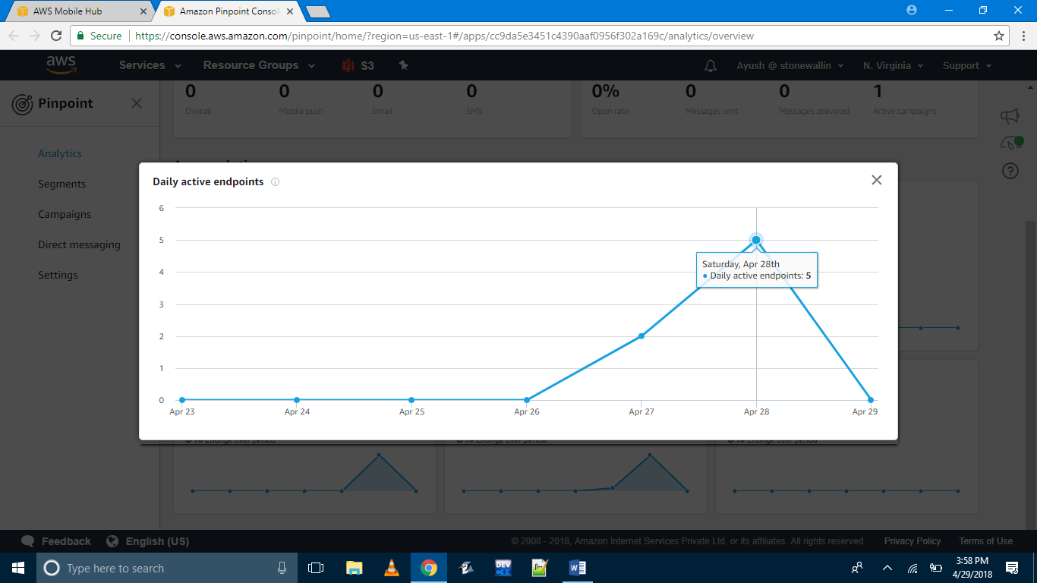
AWS Pinpoint Analytics- Daily Active Endpoint

Slide 11
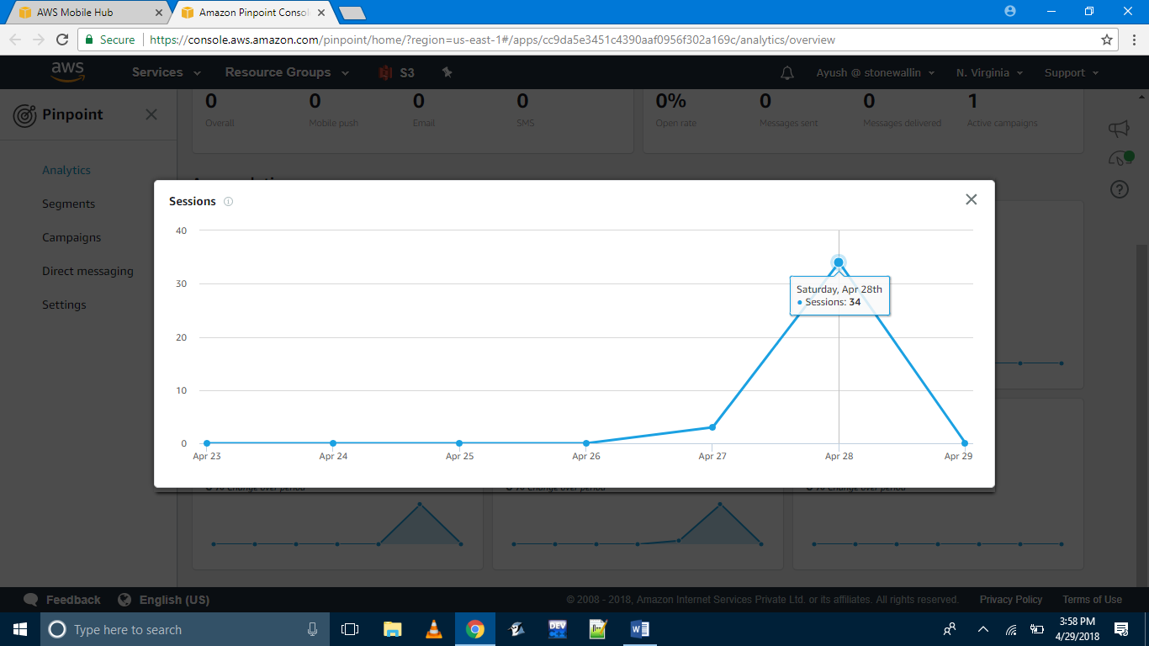
AWS Pinpoint Analytics- User Sessions

Slide 12
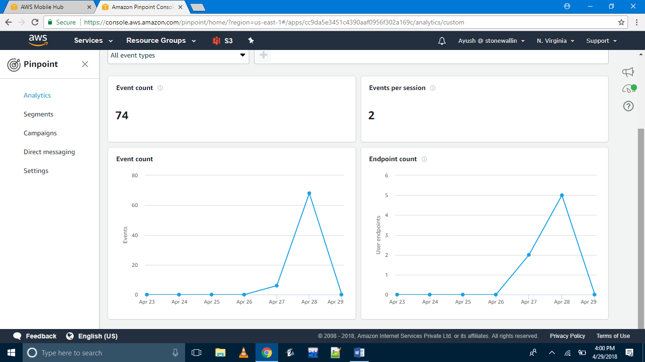
AWS Pinpoint Analytics- Events

Slide 13
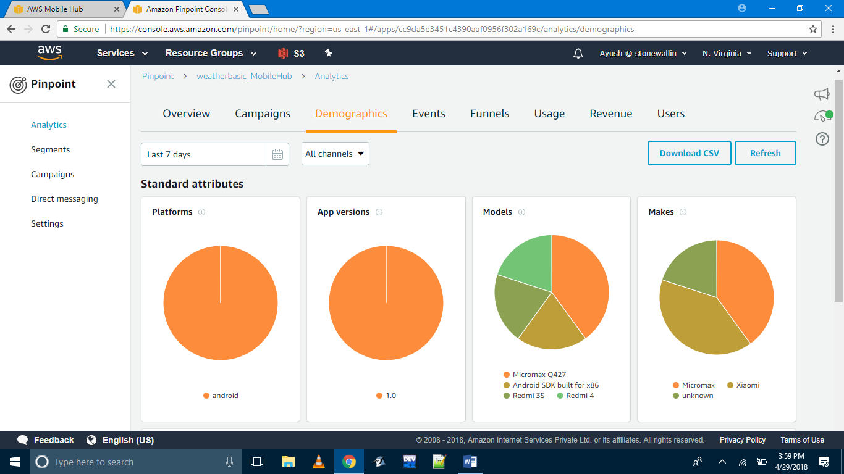
AWS Pinpoint Analytics-Demographics

Slide 14
ADDING PUSH NOTIFICATIONS THROUGH PINPOINT CAMPAIGN AND DIRECT MESSAGING
To add push notification to our application we use the 'Messaging and Analytics' feature of Amazon Pinpoint Service.
Amazon Pinpoint enables apps to receive mobile push messages sent from the Apple (APNs) and Google (FCM/GCM) platforms.
For android we have the option of using either the Google Cloud Messaging(GCM) or the Firebase Cloud Messaging(FCM).
We require that in order to obtain the application API key and Sender ID as it is required to send notification to the devices where our application is installed.
We create a new Firebase project for our application that provide us with required application key and Sender ID.

Slide 15
Then we add the application API key and Sender ID under the 'Android' section which is in 'Push notification' option in Messaging.
When the operation is complete, we download the latest copy of the cloud configuration file choosing the pop-up banner to return to the project details page and click on the 'Integrate' button.
The application is updated with the latest configuration file and then connected to the backend service using the AWS Mobile SDKs.
User-permission are added to AndroidManifest.xml file to be able to receive notification.
Dependencies are added in app/build.gradle and also project level build.gradle.
An Amazon Pinpoint client is created in the location of your push notification code and by adding the SDK code into our onCreate() function and importing the GoogleCloudMessaging class and the InstanceID class.
A new PushListener class is created and making required updates on AndroidManifest file.

Slide 16
Amazon Pinpoint console enables you to target your app users with push messaging.
We can send individual messages or configure campaigns that target a group of users that match a defined profile.
The updates of features can be managed easily through the Pinpoint Console.
Through the console we can add title and body of our notification, add endpoints and the function that it notification will perform when user interacts with it.
The 'Direct Message' can be used to send a direct message. A direct message is a one-time message that can be send to a limited audience without creating a campaign.
We configure a campaign based on certain criteria based on which our users will receive notifications and interact with the app. These campaign can be edited easily through the console.

Slide 17
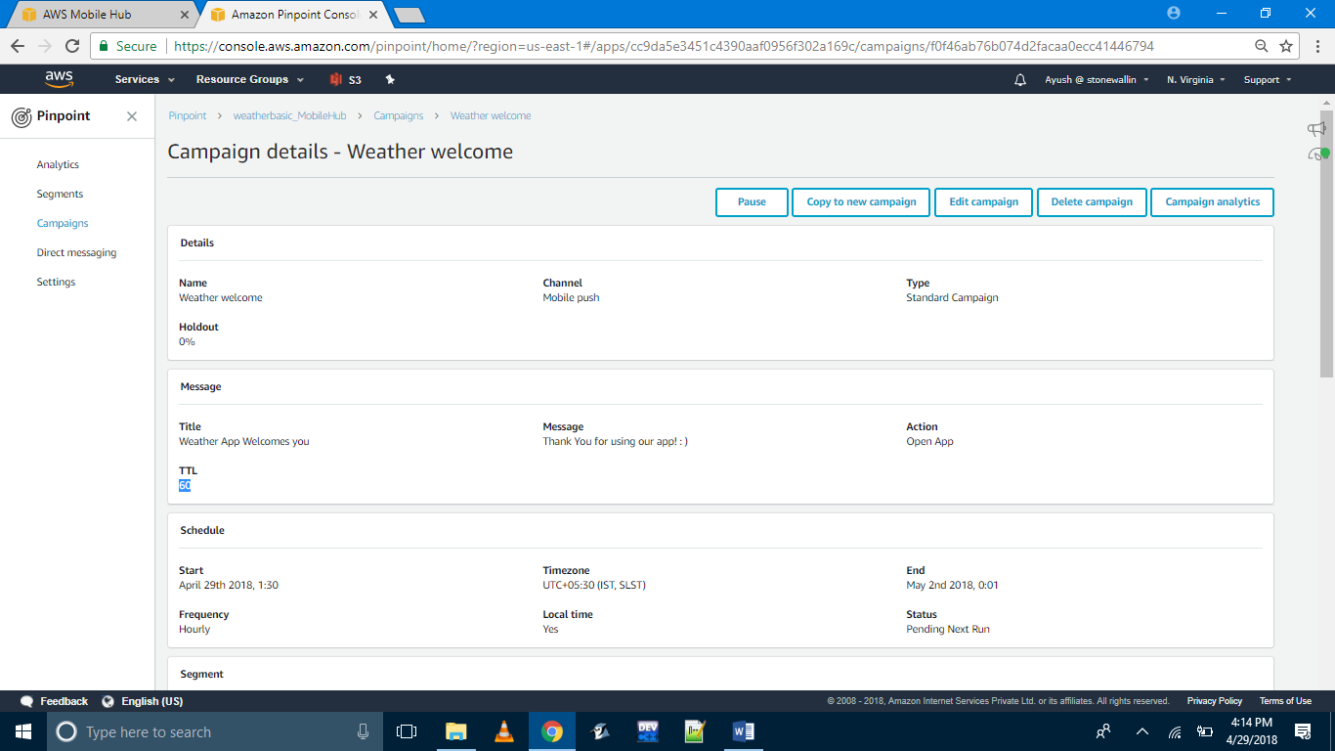
AWS Pinpoint – Campaign

Slide 18
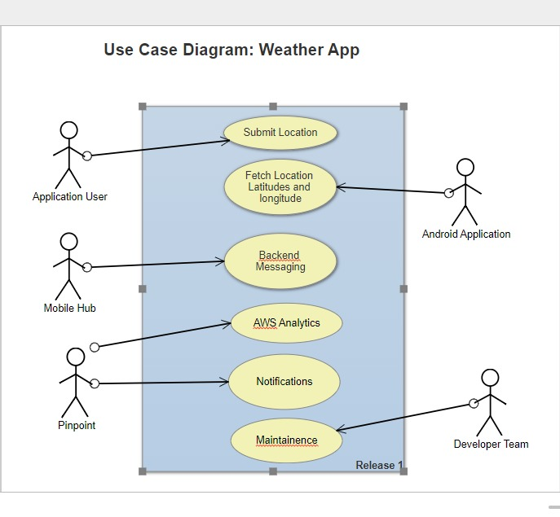

Slide 19
Conclusion
In this developing world, where cloud deployment of applications made the scalability, reliability, availability and integrating additional features very easy.
Using AWS Mobile Hub and Pinpoint for android application deployment has made adding features and their management very easy to implement.
The android application provides information about weather conditions and can send notifications to the user to help in any possible way.

