Slide 1



Gen-a-thon Tantrafiesta 2K23
Problem Statement – 1
Educational Chatbot for Juniors
Team Name
Zero One
Atharva Shetty(Leader)
Shashank Tripathi
Pranjal Bhagat
College Name: Indian Institute of Information Technology, Nagpur

Slide 2
Problem Statement – 1
"Creating an Educational Chatbot for Juniors: Empowering Students to Navigate Academic and Non-Academic Challenges"
The chatbot should be capable of providing answers and guidance on a variety of topics, offering practical examples and solutions. For instance, it should be able to explain mathematical concepts, suggest effective study techniques, recommend suitable extracurricular activities, and provide motivational advice.

Slide 3






Solution
AI Chabot in the form of a user-friendly platform for helping students to navigate academic challenges using RASA framework.
Implemented cloud pretrained nlm on top of RASA Framework to enhance the credibility of the chatbot to answer the queries more efficiently and quickly
Model is trained on the domain generic data for the conversational AI chatbot.
On the user end, the trained model would make use of BERT or similar transformer architecture to understand the query and respond to it accordingly,

Slide 4
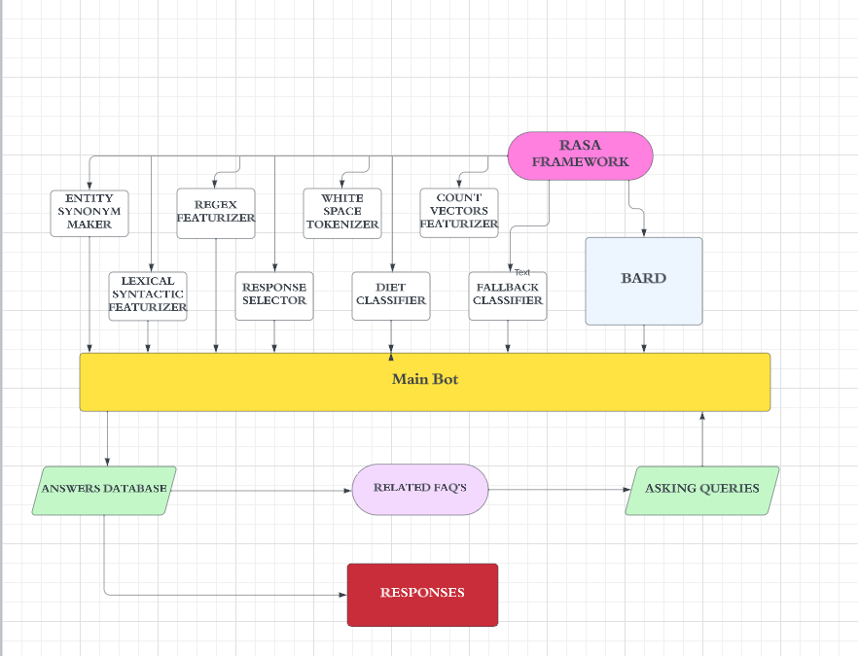
Working Model
PRE TRAINEED
NLU

Slide 5













Tech Stack
Front End
Back End
FrameWorks

Slide 6




Use Case 1
Institutes will no longer be solely dependent on manual administrative processes. Instead, they can use the chatbot to streamline various aspects of their administration, enhance communication, and provide better services to students.
Use Case 2
Domain specification questions and answers. It will also help students to gain deep knowledge of the topics and courses they recently learned.
Use Case 3
This model can be viewed as a profitable opportunity for institutes. As the institute now need to appoint less employees and man-work is also less.

Slide 7


