Slide 1
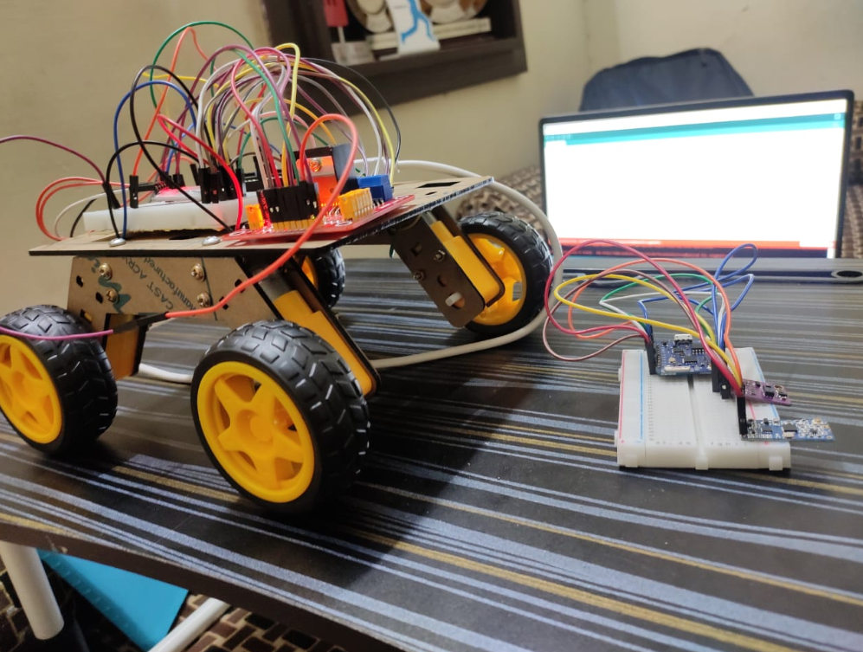
Gesture Control Robocar Ayush Sharma(1910992009) Shashank Jain(1910992001)
Contents:
Introduction
About the project
Description
Major components of project
Working of the project
Results and conclusion

Slide 2
Introduction:
Humans in the physical world interact by the means of the five senses. Gestures play important role in the field of communication from ancient time, even before the invention of any language. These days machines are taking control over every complex work, interactions with machines have become really important.

Slide 3
Typical modalities used to remotely control robots, such as keyboard, mouse, joystick or teach pendant, are generally considered unnatural methods of communication and require prior training, which can be unpleasant and time consuming. There are many ways of controlling a robocar, such as keyboards, mouse, joysticks or teach pendant but these methods are unnatural ways of communication which requires a prior training, which can be unpleasant and time consuming. Here we will be going to use gesture control sensor to control our robocar.

Slide 4
Gesture Control robocar is a kind of robot which can be controlled by our hand gestures not by old buttons. This gesture control robocar can be used in many ways and we believe that its applications will only going to increase with time. As it is not something which have predefined finite number of applications. It depends on user who can think of more creative ways to use it.

Slide 5
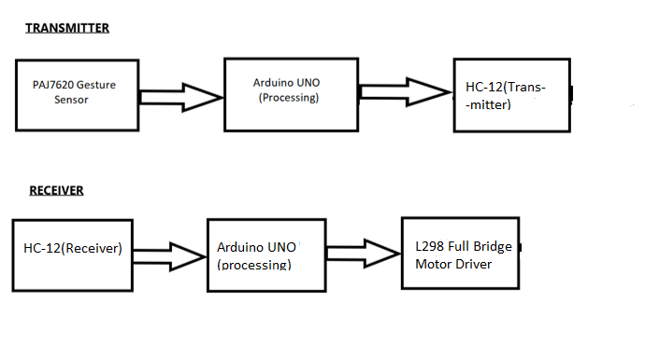
Block Diagram:

Slide 6
Description of flow chart: - We make use of PAJ7620 for gesture control. - For processing of data we used Arduino UNO on transmitting side. - Now, for transmitting this data to receiving side we used HC-12 Wireless module. - In receiving side to receive data from transmitting side we again used HC-12 Wireless module. - For processing of data at receiving side we used Arduino UNO. - For working of motor we used L298 Bridge motor driver.

Slide 7
Major Components of the Project: S.No. Name of the component Quantity 1. PAJ7620 1 2. Arduino UNO 2 3. HC-12 Bluetooth module 2 4. L298 Bridge motor driver 1 5. Battery 1

Slide 8
Specification of major components used: Arduino UNO: The Arduino Uno is an open-source microcontroller board based on the Microchip ATmega328P microcontroller and developed by Arduino.cc. The board is equipped with sets of digital and analog input/output (I/O) pins that may be interfaced to various expansion boards (shields) and other circuits. Full Bridge motor driver: This L298N Motor Driver Module is a high power motor driver module for driving DC and Stepper Motors. This module consists of an L298 motor driver IC and a 78M05 5V regulator. L298N Module can control up to 4 DC motors, or 2 DC motors with directional and speed control.

Slide 9
HC-12 Bluetooth Module: The HC-12 is a half-duplex wireless serial communication module with 100 channels in the 433.4-473.0 MHz range that is capable of transmitting up to 1 km. PAJ7620: PAJ7620U2 is an integrated gesture recognition sensor. It can recognize 9 human hand gestures such as moving up, down, left, right, forward, backward, clockwise, counter-clockwise and waving

Slide 10
Working: We will give hand gestures and our robocar will be going to move according to it. We will use a tiny little sensor that can recognize various hand gestures such as moving your hands up, down, left, right, forward, backward, clockwise, anti-clockwise, and waving. Here we will be using the HC12 wireless module for sending data from the Sensor to the robocar. It is one of the most commonly used wireless modules in the field of robotics and other remote-control applications. Then we have the transmitter of the Gesture Controlled Robocar consist of a Gesture sensor that senses the gesture, an Arduino that processes the signal, and an HC12 Wireless module that will transmit the signal to the Receiver. .

Slide 11
Working(cont..): The Receiver part consists of an HC12 wireless module that receives the signal from the Transmitter module, an Arduino which will process the signal and drive our Gesture Controlled Robocar. We will do coding on Arduino IDE in the C language. We will also attach some different color lights to the robocar car to give it a cool look

Slide 12
Result: The robocar is moving according to the gestures we are giving to the sensor. Our gesture sensor can recognize 9 different gestures and we can move our robocar according to it. The processing of the data on transmitting side is done by Arduino UNO and on receiving side also is done by Arduino Uno.

Slide 13
Conclusion: First, we had given the gesture to the gesture sensor. The gesture sensor then transferred the data to the Arduino UNO for the processing. With the help of HC-12 Wireless module we transferred this data to the HC-12 Wireless module on receiving side to receive the data and give this data to Arduino UNO for processing. Then Arduino uno will give signal to L298 bridge motor driver and it will move the motor according to it.

