Slide 1

Swiggy Bangalore Outlet Data Analysis
Faculty mentor name - Prof Amit Saraswat
Industry mentor name - Mr Krish Naik & Dibyanshu
iNeuron Intelligence Private Limited
By – Shashank Shekhar Nishad

Slide 2
About iNeuron
iNeuron started as a product development company, then launched its ed-tech division. We provide 360 degree solutions from learning to internship to finding a job, and the first ever educational OTT platform to upgrade your skill set. job, and the first ever educational OTT platform to upgrade your skill set.

Slide 3
What Are Business Intelligence Tasks?
Developing procedures for the collection and processing of data
.
Gathering, storing, and analyzing data in the correct manner.
Inform management of the results of the data analysis.
Make sure that data collection is being monitored constantly.
Analyze data more efficiently by developing methodologies

Slide 4
OBJECTIVES
Relevant and accurate reporting: Using different kinds of data sources, employees can customize their reports and monitor KPIs.
Key Insights: BI reporting tools assist in monitoring. To get the complete insight on revenue, losses, gains, the productivity of the employees, performances of the employees.
Stay ahead in the game: Companies of all sizes have vast amounts of data. Moreover, managing and using data for business decisions provides a competitive edge

Slide 5
Strategies
Focus on Long-Term Business Objectives
Get Ready for the Change
Build an Achievable Roadmap
Set Important KPIs
Analyse your current situation

Slide 6
Analysis and Findings

Slide 7
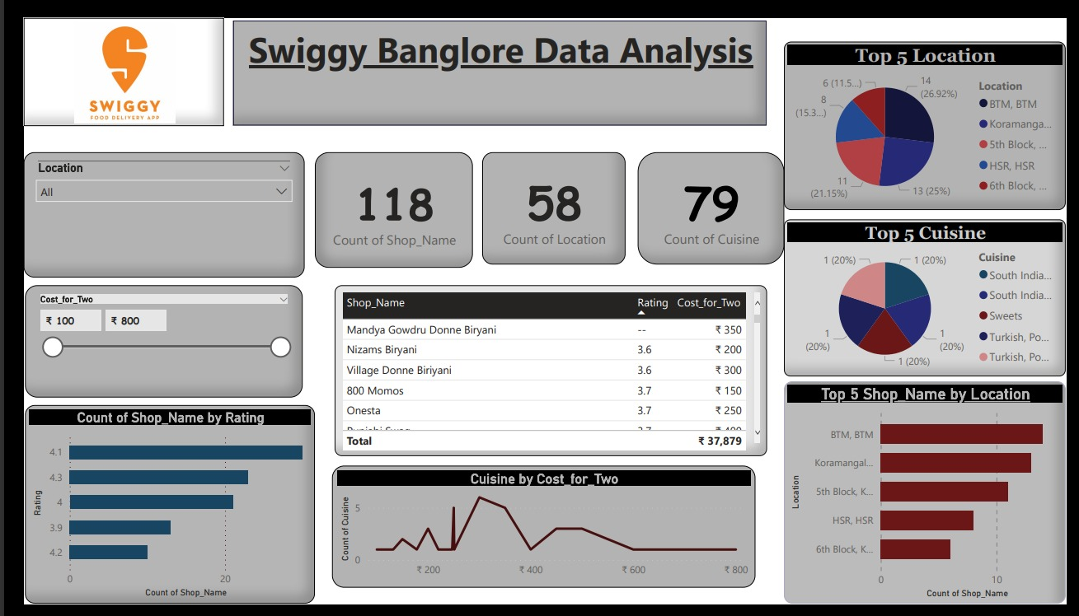
Analysis and Findings

Slide 8
CONCLUSION
Improve sales
Accurate reporting
Better decision-making
Identify opportunities and trends
Operational efficiency
Reduce waste
Better inventory
Customer satisfaction
Increased revenue

Slide 9
Thankyou

