Slide 1

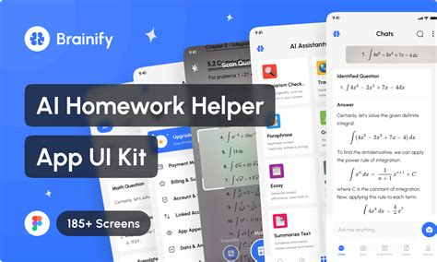

Introduction to Homework Helper
Homework Helper is an innovative AI-powered platform that leverages the power of Natural Language Processing (NLP) to revolutionize the way students approach their homework and academic tasks. This introduction will provide an overview of the key features and benefits of this transformative tool.

Slide 2

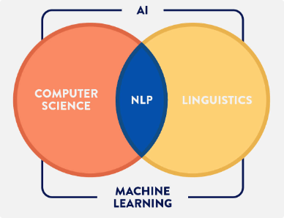
What is NLP?
1
Understanding Language
2
Analyzing Text
3
Driving Automation
NLP is the branch of artificial intelligence that enables computers to comprehend, interpret, and generate human language.
NLP algorithms can analyze textual data, identify key concepts, and understand the underlying meaning and context.
By applying NLP, Homework Helper can automate many tedious tasks, freeing up students to focus on the core learning process.

Slide 3
How NLP can assist with homework
Intelligent Tutoring
Automated Grading
Content Summarization
Homework Helper uses NLP to provide personalized guidance, answer questions, and offer step-by-step explanations tailored to each student's needs.
The platform can analyze student responses and provide immediate feedback, allowing for faster grading and identification of areas for improvement.
Homework Helper can distill

Slide 4


Personalized learning experience
Adaptive Algorithms
Dynamic Assessments
Homework Helper's algorithms analyze each student's strengths, weaknesses, and learning style to provide a tailored approach to their academic needs.
The platform regularly assesses student progress and adjusts the content and difficulty level to ensure optimal learning outcomes.
Targeted Feedback
Motivation and Engagement
Homework Helper offers detailed feedback and guidance, empowering students to address their specific challenges and areas for improvement.
By providing a personalized and interactive learning experience, Homework Helper helps students stay motivated and engaged throughout the learning process.

Slide 5


Improved comprehension and retention
1
Conceptual Understanding
Homework Helper's explanations and visualizations help students develop a deeper understanding of the material, going beyond simple memorization.
2
Cognitive Reinforcement
The platform's interactive features and targeted practice exercises solidify the concepts in students' minds, enhancing long-term retention.
3
Efficient Learning
By streamlining the learning process and addressing individual needs, Homework Helper enables students to learn more effectively and efficiently.

Slide 6






Seamless integration with existing workflows
Scheduling
Content Integration
Homework Helper seamlessly integrates with students' calendars, helping them plan and manage their study time effectively.
The platform can be easily integrated with existing learning management systems and educational resources, ensuring a cohesive learning experience.
Collaboration
Reporting
Homework Helper facilitates seamless collaboration between students, teachers, and parents, fostering a supportive learning environment.
The platform provides comprehensive analytics and progress reports, enabling educators to monitor student performance and make data-driven decisions.

Slide 7





Conclusion and next steps
Explore
Discover how Homework Helper can transform your academic journey and unlock new levels of success.
Experience
Try the platform for yourself and witness the power of NLP-driven learning firsthand.
Elevate
Embrace the future of education and take your academic performance to new heights with Homework Helper.

