Slide 1

Name : Yogesh S
Subject :Principles of programming in C
Topic : Space Exploration Software :Writing software for space missions
Section : EICHER
Lab No : 23IS1999

Slide 2
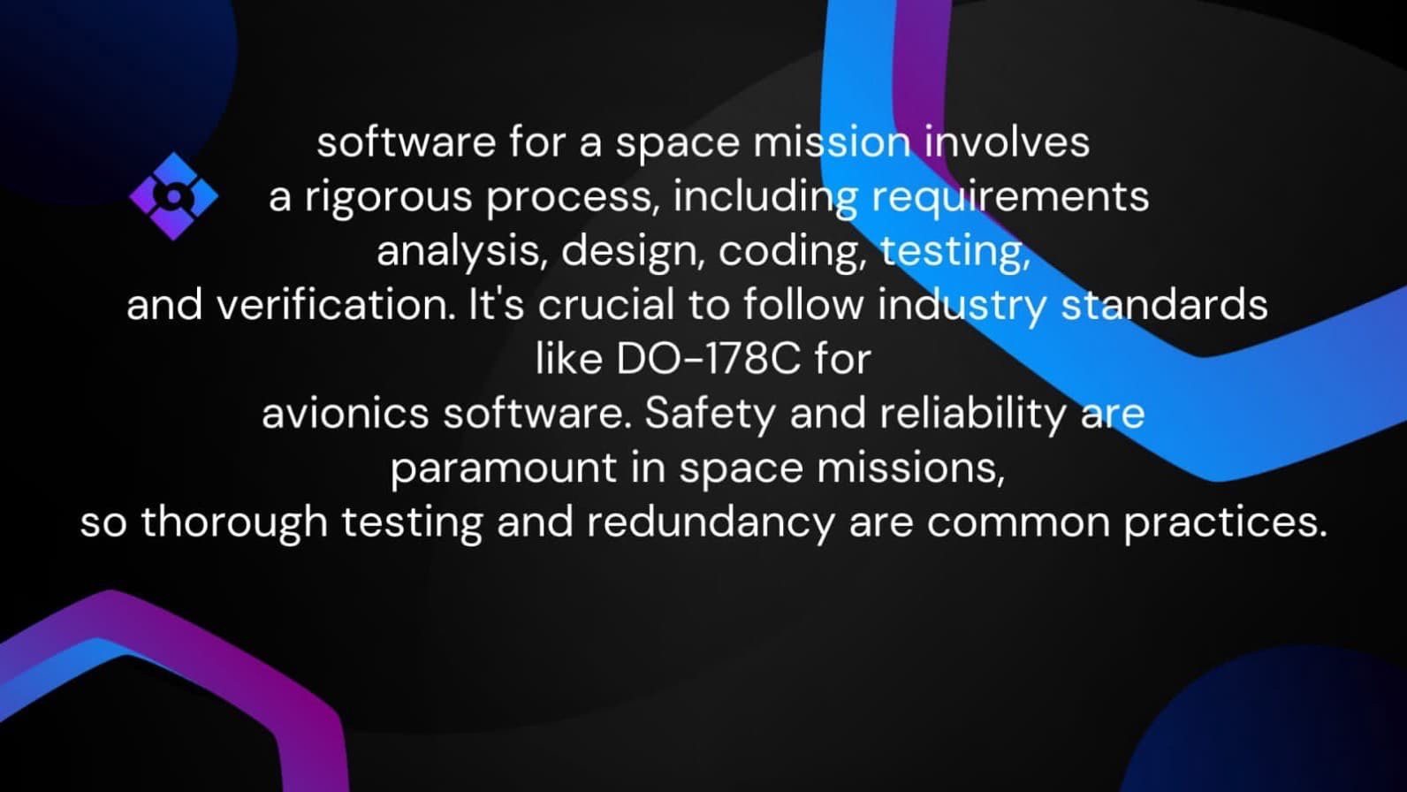

Slide 3
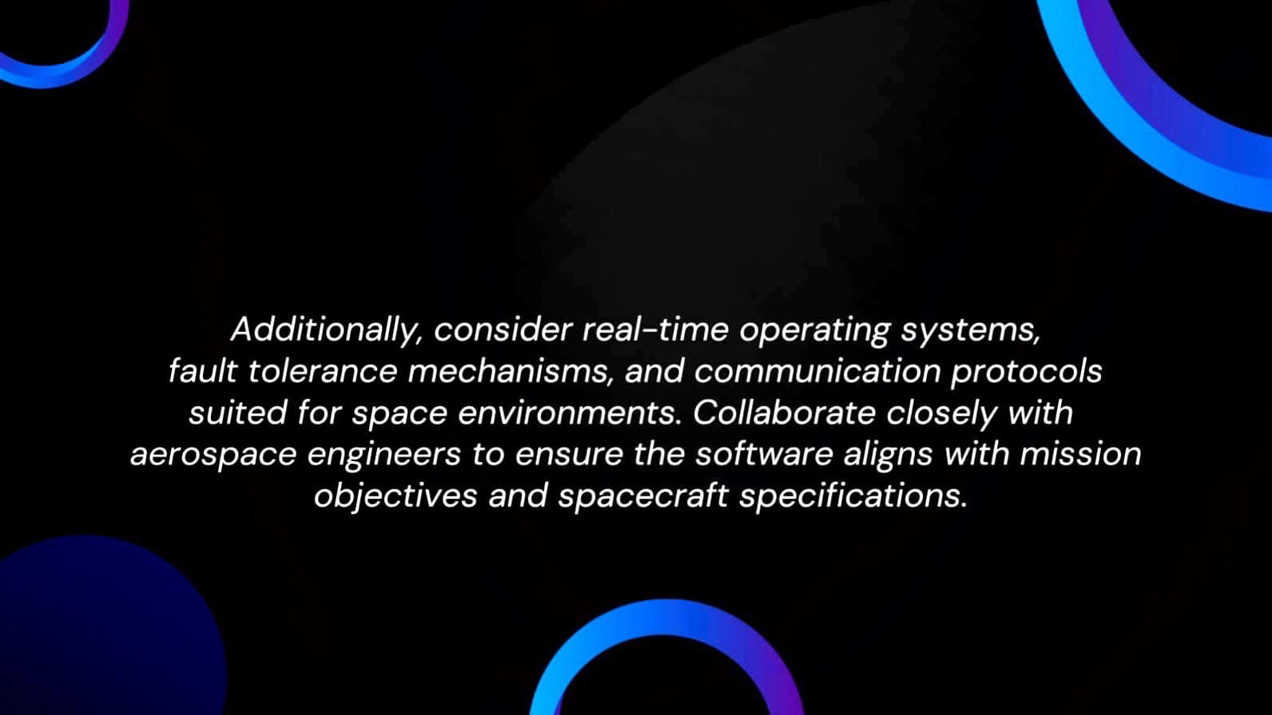

Slide 4
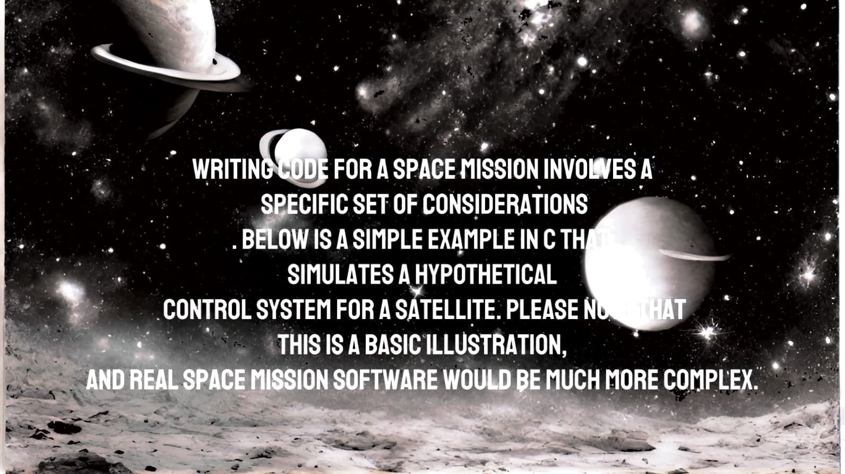

Slide 5
#include
<stdio.h>
#include <stdlib.h>
II
Constants
#define MAX_ THRUST 100
#define MIN_THRUST 0
II
Function to control the satellite's thrusters
void contro/Thrusters(int desiredThrust) {
II
Ensure desired thrust is within valid range
if (desiredThrust < MIN_THRUST) {
desiredThrust = MIN_THRUST;
} else if (desiredThrust > MAX_THRUST) {
desiredThrust = MAX_THRUST;
}
II
Code to adjust satellite's thrusters based on desired thrust
II
(In a real scenario, this would involve interacting with hardware)
printf("Adjusting thrusters to %din: desiredThrust);
II
Additional code for interacting with hardware goes here
}
int main() {
II
Example: Control the thrusters based on a desired thrust value
int desiredThrust;
printf("Enter desired thrust (between %d and %d): : MIN_THRUST, MAX_THRUST);
scanf("%d &desiredThrust);
II
Simulate the control process
controlThrusters(desiredThrus t);
return 0;
}

Slide 6
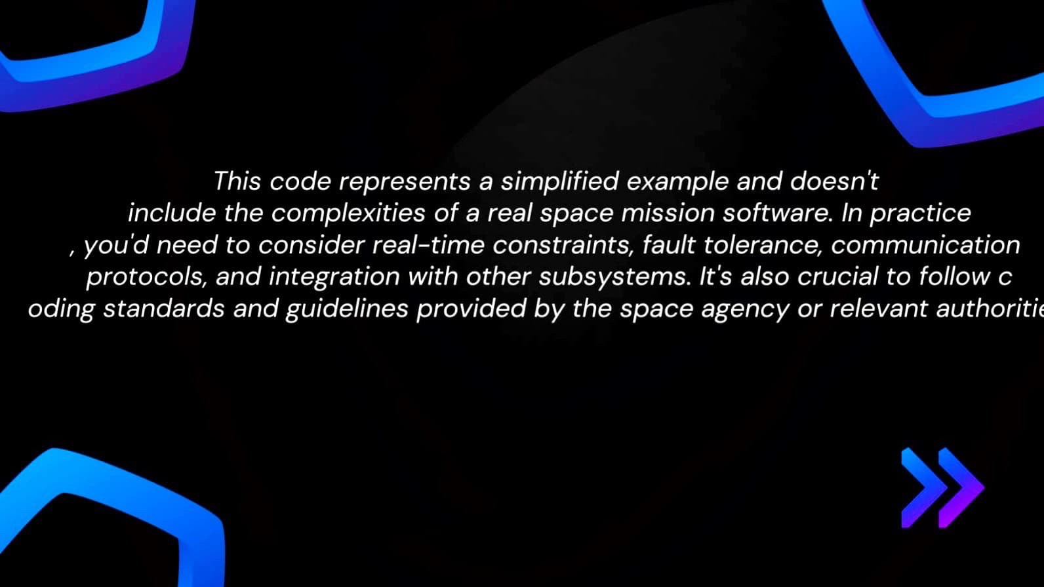

Slide 7
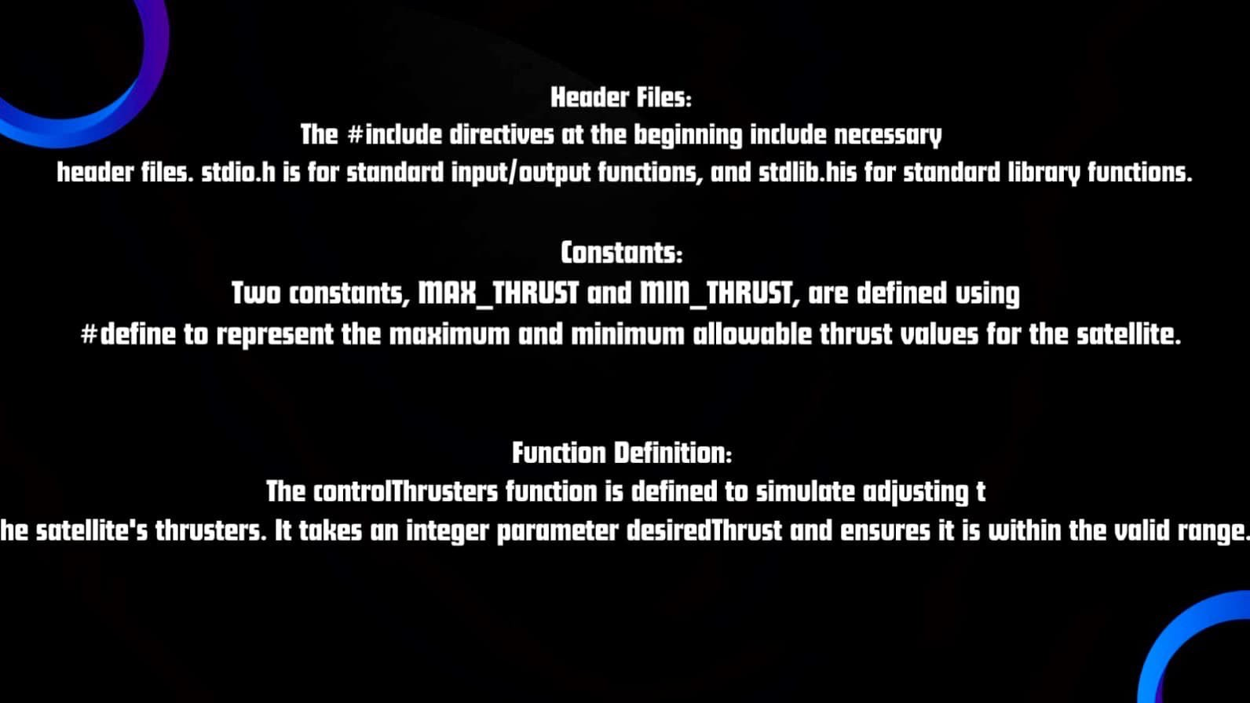

Slide 8
