Slide 1


Mental Health Meme Classification
MT23006 Aaditya
MT23111 Anand
MT23141 Shashank

Slide 2


Motivation
Context: Memes are increasingly being used to express personal struggles, especially mental health concerns like anxiety and depression.
Example: Memes such as "When you’re too anxious to text back" or "
the feeling of impending doom before an exam" reflect anxiety and
other symptoms.
Need: There is a need for a model that can classify such meme
automatically to detect mental health symptoms, which can be valuable
for researchers and mental health practitioners.
Impact: This classification could help in identifying mental health issues early and providing appropriate support.

Slide 3
Related Work
Mental Health Meme Classification: Some recent works have attempted to
classify mental health memes but struggle with complex figurative language
humor, and multimodal understanding.
Challenges: Existing models like BERT and DeBERTa are limited by their ability
to interpret figurative language, sarcasm, and visual-textual interactions.
Gap: While multimodal approaches like LLaVA and GPT-4o show promise, there’s a need for better models that can understand the nuanced expressions of mental health issues in memes.

Slide 4
Methodology
Multimodal Model: Combining text (OCR-extracted text) and images (meme visuals) to classify mental health symptoms.
Figurative Reasoning: Using commonsense reasoning to interpret figurative language language and humor.
Knowledge Fusion: Integrating external knowledge through a Retrieval - Augmented Generation (RAG) method to improve understanding.
Classification: Using transformers like GPT-4o and BART for final symptom classification based on multimodal inputs.

Slide 5
Techniques
OCR Extraction: Extracting text from meme images .
Commonsense Reasoning: Using GPT-4o for generating figurative and . commonsense reasoning about memes .
RAG: Combining relevant meme examples retrieved from a database to .
enhance understanding before classification.

Slide 6
Novelty
Fusion of Visual and Textual Features: Combined CLIP (image features) with different textual models (BERT, Sentence Transformers, and RoBERTa) to classify anxiety-related symptoms from memes.
CLIP + Mental BERT: Combined CLIP's visual features with BERT's text embeddings.
CLIP + Sentence Transformers: Used sentence transformers (paraphrase-MiniLM) to process meme text.
CLIP + RoBERTa: Integrated RoBERTa for better text understanding alongside CLIP for visual cues.

Slide 7
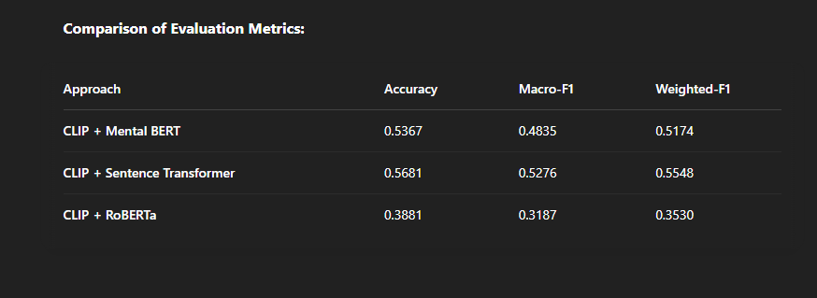
Evaluation Results of Three Approaches

Slide 8
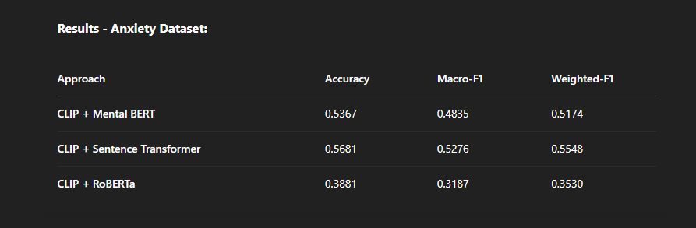

Slide 9
Conclusion
Project Success: Successfully demonstrated that combining CLIP with text-based models (BERT, Sentence Transformers, and RoBERTa) enhances the ability to classify mental health symptoms in memes.
Best Performing Approach: CLIP + Sentence Transformer showed the best results in accuracy and F1 scores, making it the most effective model for the task.

