Slide 1




SMART INDIA HACKATHON 2026
TITLE PAGE
  Problem Statement ID – SIH26087
  Problem Statement Title - AI & LMS - Enabled Cooperative Capacity Building, ERP & Employment Ecosystem
  Theme - Smart Education
  PS Category - Hardware
  Team ID - 130412
  Team Name - Untitled
Notes:
SCENE 1 - OPENING (0:00-0:15)
[0:00-0:08] SHOW THIS SLIDE.
SAY: "Hi, we're Team Untitled, and this is EduDisha, our solution to problem statement SIH26087."
[0:08-0:15] CUT TO: live site home page (ncct-platform-1.onrender.com).
SAY: "One platform that takes a cooperative trainee from enrolment to a verified certificate to a job."

Slide 2




















AI & LMS - ENABLED COOPERATIVE CAPACITY BUILDING, ERP & EMPLOYMENT ECOSYSTEM
Proposed Solution
1. REGISTRATION & PROFILE
“An integrated platform to train, certify, and connect rural talent with opportunities — powered by AI, LMS, and verified hardware attendance”
Trainee / Institution / Employer
2. PROGRAMME & BATCH MANAGEMENT
01
UNIFIED DATA & ERP FOUNDATION
02
HARDWARE-VERIFIED ATTENDANCE
Courses, batches, content
Unify trainees, institutions, programmes, assessments, certifications, employers, and hardware in one ecosystem.
Low-cost, tamper-resistant Wi-Fi kiosk verifies attendance in real time using an NFC card tap + face verification.
3A. SMART ATTENDANCE
3B. LEARNING (LMS)
Multilingual content, offline learning (cache) & progress tracking
  Data integration (ERP, LMS, IoT hardware)
  Standardized model for skills, certificates & attendance
  Secure and scalable platform
  RFID tap-in + ESP32-CAM face verification
  OLED display + buzzer for instant feedback
  Wireless & battery-powered, no USB cable
  Controller designed as one custom PCB
NFC
Trainee Card
ESP32 +
RC522
Wi-Fi
ERP
4. ASSESSMENT
Conduct assessments, evaluate and track learning outcomes
03
LEARNING, ASSESSMENT & SKILL DEVELOPMENT
04
AI-POWERED OPPORTUNITIES
5. CERTIFICATION & SKILL PASSPORT
Delivers multilingual content, tracks progress, runs assessments, and issues digital certificates with verified skill records.
AI-matched skills connect trainees to jobs and employer opportunities — with skill-gap analysis and built-in career guidance.
Digital certificates & verified skill passport
6. EMPLOYMENT & OPPORTUNITIES
  Multilingual LMS (online/offline)
  Training-to-skill mapping (NCCT framework)
  Assessments and certification
  Verified skill passport
  Skill & competency matching
  AI career counsellor
  AI job matching & skill-gap analysis
  Analytics for employability and impact
Skill-based job matching
7. ANALYTICS & MONITORING
Dashboards for institutions & NCCT to track KPIs, outcomes & impact
2
2
Team Untitled
@SIH Idea Submission • EduDisha
3
Notes:
SCENE 2 - PROBLEM (0:15-0:42)
[0:15-0:27] SHOW THIS SLIDE. Point to the left-hand flow (steps 1-7).
SAY: "NCCT institutes like VAMNICOM, the RICMs and ICMs train cooperative staff using separate, paper-heavy systems. Attendance is on registers, so proxies are easy."
[0:27-0:37] Point to pillar 02 (Hardware-verified attendance), then 03 (certificates), then 04 (AI opportunities).
SAY: "Paper certificates are easy to forge, and trained rural youth have no link to employers."
[0:37-0:42] Zoom in on the quote at the top.
SAY: "EduDisha fixes all three, in one system."
THIS SLIDE IS ALSO THE MAP FOR THE LIVE DEMO:
- Scene 4 (1:00-1:20) = flow steps 1-2: registration, programme and batch management
- Scene 5 (1:20-1:50) = step 3B: Learning (LMS)
- Scene 6 (1:50-2:23) = step 3A: Smart attendance + pillar 02
- Scene 7 (2:23-2:47) = steps 4-5: assessment, certification and skill passport
- Scene 8 (2:47-3:17) = pillar 04 + step 6
- Scene 10 (3:37-3:51) = step 7: analytics and monitoring

Slide 3


















TECHNICAL APPROACH
TECH STACK
FRONTEND
KIOSK HARDWARE >
ON SITE
CLIENTS
  Web App: React 19 + Vite + TypeScript (all 4 role views)
  Mobile App: Capacitor build of the same web app (Android + iOS)
  Kiosk Terminal: Chrome/Edge page on the kiosk Wi-Fi, driven by the ESP32
ESP32 DevKit
ESP32 - CAM
Web App
Mobile App
RC522 reader . OLED . buzzer . button
serves JPEG over LAN WiFi
React 19 + Vite + TypeScript . all 4 roles
Capacitor → Android + iOS . wraps the same web build
BACKEND
  Express API: one backend serving every client
  Auth middleware: verifies Supabase JWT + role-based access (requireRole)
  34 route modules: programmes, lessons, attendance, jobs, kiosk
  Core services: certificate PDF + QR generation, RAG chatbot, face verification, analytics, skill-gap & job matching
Wi-Fi . HTTP /events
HTTP get / capture
HTTPS . JWT
HTTPS JSON
Bearer JWT
KIOSK TERMINAL
Chrome/Edge · same Wi-Fi
HARDWARE(KIOSK DEVICES)
no client reaches the database directly
  ESP32 DevKit: RC522 RFID reader, OLED display, buzzer, push button
  ESP32-CAM — captures & serves JPEG frames over LAN WiFi for face verification
  Connects to the Kiosk Terminal over Wi-Fi (local HTTP), no USB
EXPRESS API . ONE BACKEND FOR EVERY CLIENT
Auth middleware
34 route modules
Services
verify Supabase JWT + requireRole (...)
programmes . lessons . attendance . jobs . kiosk
certificate PDF + QR . chatbot RAG . face verify . analytics . skill-gap . job matching
DATA & INTEGRATIONS
  Supabase Postgres + pgvector: 29 tables with row-level security (RLS)
  Supabase Auth (JWT issuer) + Supabase Storage (PDFs, images)
  Groq: RAG chatbot, AI career counsellor & skill-gap
  Backblaze B2: stores lesson video content, served via presigned URLs
SQL + pgvector
verify token
signed URL
context + query
presigned URL
SUPABASE
EXTERNAL
Postgres + pgvector
Auth
Storage
Groq API
Backblaze B2
29 tables , RLS policies
JWT issuer
(PDFs , images)
gpt-oss-120b
(lesson video)
3
Team Untitled
@SIH Idea Submission • EduDisha
3
Notes:
SCENE 3 - HOW IT'S BUILT (0:42-1:00)
[0:42-0:55] SHOW THIS SLIDE. Trace the diagram top to bottom: CLIENTS (Web + Mobile) and KIOSK -> EXPRESS API -> SUPABASE + EXTERNAL. Point to the red cross line at the end.
SAY: "Four roles (admin, trainer, trainee and employer) on web, Android and iOS, plus a Wi-Fi attendance kiosk. Everything goes through one secure API and one database. No client touches the database directly."
[0:55-1:00] CUT TO: Asha Patil's profile card.
SAY: "Let's follow one trainee, Asha Patil, from a village PACS in Baramati."
REUSE IN SCENE 6 (1:50-1:58): flash the KIOSK HARDWARE box (ESP32 DevKit + ESP32-CAM) for 2 seconds before the real hardware shot.
--- SCENES 4-5 ARE LIVE APP (no slide) ---
SCENE 4 (1:00-1:20) Admin window: Programmes -> create -> Hybrid. Trainee phone: Learn -> Nominate / Enroll -> Nominate me. Admin: Approve + hostel room. Admin -> Users: CSV import.
SAY: "The admin creates a programme (online, offline or hybrid) and opens nominations." / "Asha nominates herself from her phone. The admin approves her and assigns her a hostel room." / "Whole batches can also be imported from CSV."
SCENE 5 (1:20-1:50) Phone: tap Hindi, open a video lesson, complete a matching exercise, tap Download, airplane mode ON, lesson still opens, airplane mode OFF.
SAY: "Asha learns on her phone in English or Hindi." / "Lessons include videos, PDFs and interactive exercises." / "Connectivity in villages is weak, so she downloads lessons, learns offline, and her progress syncs when she's back online."

Slide 4






FEASIBILITY AND VIABILITY
Feasibility
Challenges
Solution
  Browser-based middleware & offline-first LMS built (software)
  Rural connectivity gaps
  Offline-first sync architecture (software)
  RFID + OLED + button working (hardware)
  Legacy system integration across institutions (software)
  Consented face embeddings, no photos (software)
  Battery-powered kiosk, no USB
dependency (hardware)
  Biometric data privacy (software/data)
  Battery + boost converter for stable power (hardware)
COMPETITIVE EDGE
Comparison
COST & SCALABILITY
  ~₹2,000 ESTIMATED HARDWARE COST PER KIOSK (HARDWARE)
Capability | Our Solution | Manual Attendance | Standard Biometric
Prevents proxy attendance
Real-time digital records
Works Offline
Verified Skill Passport
Low Infrastructure Cost
  CUSTOM-PCB DESIGN CUTS COST FURTHER AT SCALE (HARDWARE)
  UNIFIED ERP/LMS PLATFORM SCALES ACROSS EVERY NCCT INSTITUTION (SOFTWARE)
TECHNICAL FEASIBILITY
USER EXPERIENCE
  RC522 RFID: 13.56 MHZ, 0-60MM READ RANGE — CONFIRMED WORKING (HARDWARE)
  ON-DEVICE FEEDBACK: ENGLISH-ONLY OLED + BUZZER, ICON-BASED (HARDWARE)
  STANDARD WEB STACK FOR ERP/LMS (SOFTWARE)
  MULTILINGUAL SUPPORT HANDLED AT THE LMS/WEB LAYER (SOFTWARE)
  ONE PCB CARRIES READER, OLED, BUZZER & BUTTON (HARDWARE)
  SIMPLE TAP-AND-SCAN FLOW, MINIMAL TRAINING NEEDED
4
4
3
Team Untitled
@SIH Idea Submission • EduDisha
Notes:
SCENE 6 - ATTENDANCE KIOSK (1:50-2:23) [hero scene]
[1:50-1:58] SHOW THIS SLIDE for 2-3 seconds and point to "~Rs 2,000 estimated hardware cost per kiosk". Then CUT TO a wide shot of the real kiosk (OLED shows TAP CARD).
SAY: "For attendance, we built a Rs 2,000 battery-powered kiosk: an ESP32 with an NFC reader, an OLED screen, a buzzer, and an ESP32-CAM."
[1:58-2:10] LIVE HARDWARE: tap card -> OLED "Hi, Asha" / LOOK AT CAMERA / PRESS BUTTON -> scan -> buzzer -> success.
SAY: "Asha taps her card. The kiosk greets her by name, she looks at the camera and presses the button, and her face is verified in seconds."
[2:10-2:18] LIVE: trainer's session attendance list with Asha Present. Optionally flash this slide's Solution box ("Consented face embeddings, no photos").
SAY: "It shows up instantly on the trainer's attendance list. Her face was stored only as numbers, never a photo, and only after she gave consent, as the DPDP Act requires."
[2:18-2:23] LIVE: 6-digit session code / QR screen.
SAY: "A trainee who isn't enrolled in the programme can't check in. A QR code or session code is available as a fallback."
--- SCENES 7-8 ARE LIVE APP (no slide) ---
SCENE 7 (2:23-2:47) Test -> Passed with marks -> Learn -> My Certificates -> PDF zoom on QR -> scan with a second phone -> Valid.
SAY: "She takes the module test. It's graded on the server, so no score can be faked." / "When she passes, a certificate with a unique QR code is issued automatically." / "Anyone can scan it and confirm it's genuine, with no login needed."
SCENE 8 (2:47-3:17) Career -> Jobs "Best Matches for You" -> Skill-Gap Check -> Ask a Counsellor: "Which job suits me best?" -> point to the data tags under the answer.
SAY: "Now the AI. Asha sees jobs ranked for her using her skills and certificates." / "Skill-gap analysis shows which skills she has, which she's missing, and what to learn first." / "The AI career counsellor answers from her own records and shows which data it used, so it doesn't make up answers."

Slide 5






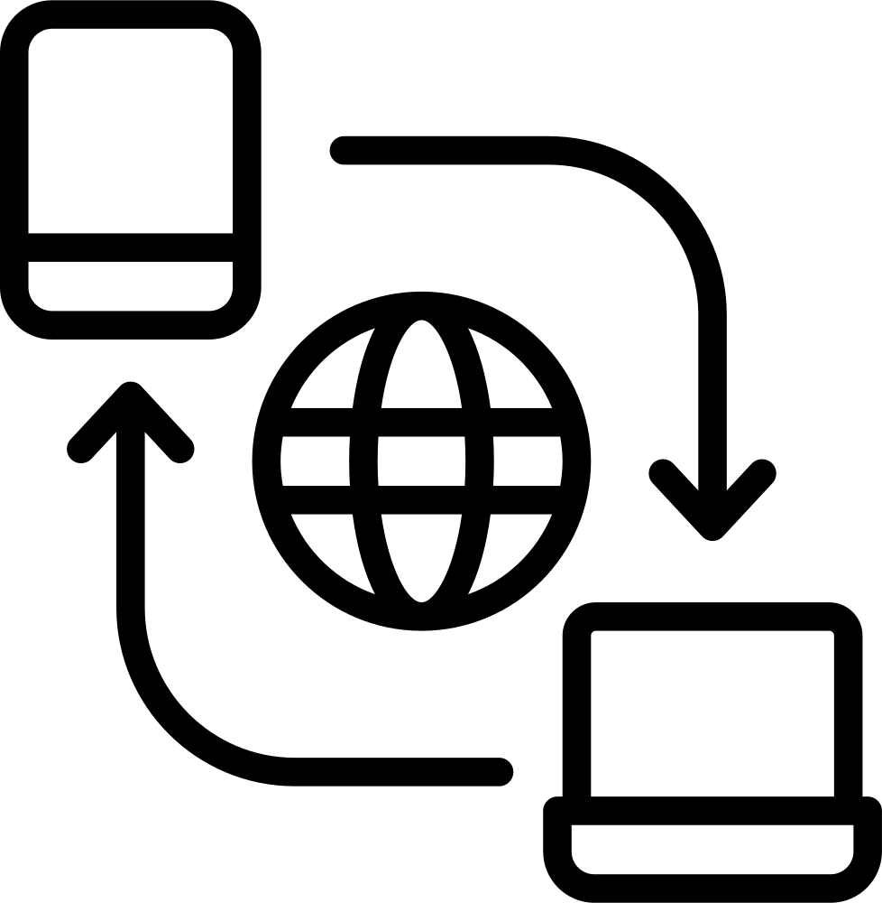

IMPACT AND BENEFITS
CREDENTIAL TRUST
POLICY-LEVEL VISIBILITY
A VERIFIED, TAMPER-RESISTANT SKILL PASSPORT GIVES EMPLOYERS A CREDENTIAL THEY CAN ACTUALLY TRUST — UNLIKE EASILY-FORGED PAPER CERTIFICATES.
INSTITUTIONAL EFFICIENCY
EMPLOYABILITY & LIVELIHOOD
INCLUSIVE LEARNING ACCESS
NCCT AND INSTITUTIONS GET LIVE, GRANULAR OUTCOME DATA INSTEAD OF PERIODIC MANUAL REPORTING.
  Unifies registration, batch management, attendance & certification - no more cross checking across separate systems
  Real time institutional dashboards replace manual compilation for tracking KPIs & batch progress
  AI career counsellor gives personalized guidance - most rural trainees have never had access to.
  Skill-matched job recommendations & skill-gap insights connect training directly to outcomes
  Multilingual LMS removes the language barrier to quality training content
  Offline first design reaches trainees in areas where standard e-learning platforms can’t serve
  Accessible interface widens participation beyond who current systems reach
ONE ECOSYSTEM
TRAINING TO EMPLOYMENT
Inclusive Participation
LOCAL EMPLOYMENT RETENTION
LESS PAPERWORK
BETTER SKILL MATCH
WIDER ACCESS
KEY OUTCOMES
Multilingual, offline, accessible design brings training within reach of trainees current digital systems exclude.
SKILL-MATCHED LOCAL JOB MATCHING REDUCES TRAINEES' NEED TO MIGRATE ELSEWHERE FOR OPPORTUNITIES.
Faster, seamless processes
Right opportunities for the right people
More inclusive equitable growth
5
Team Untitled
@SIH Idea Submission • EduDisha
3
Notes:
SCENES 9-11 - EMPLOYER, ANALYTICS, CLOSING (3:17-4:05)
SCENE 9 (3:17-3:37) LIVE: employer posts a job, searches, opens Asha's summary, clicks Shortlist. Then a hands-on shot: NFC card on a phone -> public profile opens.
Optionally flash this slide's CREDENTIAL TRUST box first.
SAY: "An employer posts a job, searches verified trainees, and shortlists Asha." / "At a job fair, she taps her NFC card on a recruiter's phone, and her verified profile opens. No app needed."
SCENE 10 (3:37-3:51) Flash this slide's POLICY-LEVEL VISIBILITY box for 2 seconds, then LIVE: Admin -> Analytics -> Trainees by Region, Completion Rate by Programme, zoom on Dropout Risk.
SAY: "NCCT gets a live dashboard showing trainees by region, completion rates and certificates issued." / "It also flags trainees at dropout risk, so staff can step in early."
SCENE 11 (3:51-3:59) SHOW THIS SLIDE (KEY OUTCOMES strip: less paperwork, better skill match, wider access), then the closing card.
SAY: "Built with React, Node, Supabase and Groq, backed by over 650 automated tests, EduDisha is live today on web and Android, with iOS ready."

Slide 6
RESEARCH AND REFERENCES
Prototype :-
RESEARCH PAPER :-
1)
NFC Smart Classroom — Shen et al., 2014
Explores the use of NFC technology for classroom management and student attendance systems.
NFC Smart Classroom
Prototype link :-
https://ncct-platform-1.onrender.com
2)
AI Skill-to-Job Recommendation — Giabelli et al., 2021
AI Skill-to-Job
Recommendation
Investigates AI-driven models that recommend jobs based on
individual skills and competencies.
Demo Video link :-
3)
AI Job Matching Review — Spoladore et al., 2026
A comprehensive review of AI techniques for job matching
and employment services.
AI Job Matching
4)
Vocational Training + Job Information in India —
Chakravorty et al., 2024
Documentation link :-
https://github.com/ShashankPonna/NCCT-platform
Vocational Training
Analyzes the landscape of vocational training and job information
systems in India.
6
Team Untitled
@SIH Idea Submission • EduDisha
3
Notes:
SCENE 11 - CLOSING (3:59-4:05)
SHOW THIS SLIDE (prototype + documentation links) as the final frame, or end on a team-name card.
SAY: "Ready to scale across every NCCT institute, turning training into real jobs. Thank you."
Fill in the Demo Video link before submitting.

Slide 7




IMPACT AND BENEFITS
POLICY-LEVEL VISIBILITY
01
INSTITUTIONAL EFFICIENCY
NCCT AND INSTITUTIONS GET LIVE, GRANULAR OUTCOME DATA INSTEAD OF PERIODIC MANUAL REPORTING.
  Unifies registration, batch management, attendance & certification — no more cross-checking across separate legacy systems
  Real-time institutional dashboards replace manual compilation for tracking KPIs & batch progress
  Digital certificate issuance cuts turnaround from weeks of paperwork to instant
CREDENTIAL TRUST
LOCAL EMPLOYMENT RETENTION
SKILL-MATCHED LOCAL JOB MATCHING REDUCES TRAINEES' NEED TO MIGRATE ELSEWHERE FOR OPPORTUNITIES.
A VERIFIED, TAMPER-RESISTANT SKILL PASSPORT GIVES EMPLOYERS A CREDENTIAL THEY CAN ACTUALLY TRUST — UNLIKE EASILY-FORGED PAPER CERTIFICATES.
02
EMPLOYABILITY & LIVELIHOOD
  AI career counsellor gives personalized guidance most rural trainees have never had access to
ONE ECOSYSTEM
TRAINING TO EMPLOYMENT
  Verified skill passport builds employer trust — reducing hiring mismatch from unverifiable paper credentials
  Skill-matched job recommendations & skill-gap insights connect training directly to outcomes
Inclusive Participation
03
INCLUSIVE LEARNING ACCESS
Multilingual, offline, accessible design brings training within reach of trainees current digital systems exclude.
  Multilingual LMS removes the language barrier to quality training content
  Offline-first design reaches trainees in areas standard e-learning platforms can't serve
Business Canvas
  Accessible interface widens participation beyond who current systems reach
5
Team Untitled
@SIH Idea Submission • EduDisha
3
Notes:
NOT USED IN THE VIDEO. Duplicate of slide 5 (Impact and Benefits), with an empty Business Canvas box. Delete it or finish it before submitting.

