Slide 1



Database Application Development

Slide 2

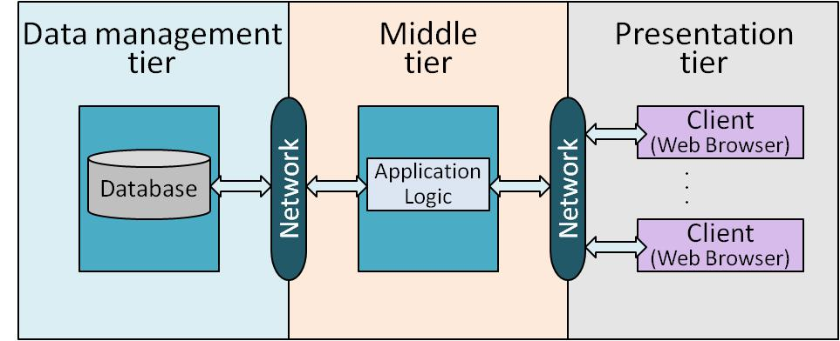
Outline
This chapter – How to use DBMS from applications
SQL in application code
Embedded SQL
Cursors
Dynamic SQL
JDBC
SQLJ
Stored procedures
Done!

Slide 3
Ad Hoc Query
SELECT S.sname, S.age
FROM Sailors S
WHERE S.rating > 6
sid | sname | rating | age
12 | dustin | 9 | 19
24 | brandon | 6 | 27
36 | emily | 7 | 32
45 | trevor | 6 | 21
Sailors

Slide 4
SQL in Application Code
Program
SQL commands can be called from within a host language (e.g., C++ or Java) program.
SQL statements can refer to host variables (including special variables used to return status).
:c_minrating = 6
SELECT S.sname, S.age
FROM Sailors S
WHERE S.rating > :c_minrating
sid | sname | rating | age
12 | dustin | 9 | 19
24 | brandon | 6 | 27
36 | emily | 7 | 32
45 | trevor | 6 | 21
Sailors

Slide 5
SQL Integration Approaches
Two main integration approaches:
Embed SQL in the host language (Embedded SQL, SQLJ)
Create special API to call SQL commands (JDBC)

Slide 6
Embedded SQL – Language Constructs
Connecting to a database:
EXEC SQL CONNECT TO mydb
Declaring host variables:
EXEC SQL BEGIN DECLARE SECTION
EXEC SQL END DECLARE SECTION
Statements:
EXEC SQL Statement;
Must include a statement to connect to the right database.
See user manual
Notes:
16

Slide 7


Embedded SQL
Embed SQL in the host language.
A preprocessor converts the SQL statements into special API calls.
Then a regular compiler is used to compile the code.
I know the native API
Without SQL
Computer program
EXEC SQL …
SELECT …
FROM …
WHERE …
Computer program
API CALL …
Native API
Preprocessor 1
DBMS
Notes:
16

Slide 8
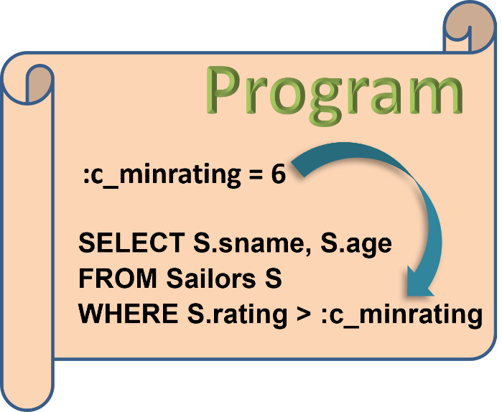
Using Host Variables in SQL
We assume C in our discussion. Minor differences in different host languages
SQL statements can refer to variables in host program
Such host variables must be declared in the DECLARE SECTION of SQL, and
they are prefixed by a colon (:) in SQL statements

Slide 9
Embedded SQL: VARIABLES
EXEC SQL BEGIN DECLARE SECTION
char c_sname[20]; /* CHARACTER(20)
long c_sid; /* INTEGER
short c_rating; /* SMALLINT
float c_age; /* REAL
EXEC SQL END DECLARE SECTION
EXEC SQL
INSERT INTO Sailors
VALUES (:c_sname, :c_sid, :c_rating, :c_age);
Host variables declared in host program
SQL embedded in the program
Host variable prefixed by “:”

Slide 10
Embedded SQL: “Error” Variables
Two special variables for reporting errors:
SQLCODE (older)
A negative value to indicate a particular error condition
The appropriate C type is long
SQLSTATE
Predefined codes for success, warning, and error conditions
Appropriate C type is char[6]
One of these two variables must be declared. We assume SQLSTATE
Notes:
char[6]: A character string of five letters long with a null character at the end to terminate the string

Slide 11
Impedance Mismatch
Database
SQL relations are sets of records, with no a priori bound on the number of records.
No such data structure exist traditionally in procedural programming languages such as C++. (Though now: STL*)
SQL supports a mechanism called a cursor to handle this.
Query result
Query
How big ?
Data structure
Computation
Computer program
*STL (Standard Template Library) is a generic C++ library that provides many basic algorithms and data structures of computer science

Slide 12

Cursors
Can declare a cursor on a relation or query statement (which generates a relation).
Can open a cursor, and repeatedly fetch a tuple then move the cursor, until all tuples have been retrieved.
Can use an ORDER BY clause in the query to control the order in which tuples are returned.
Can also modify/delete tuple pointed to by a cursor.
Notes:
16

Slide 13
Cursor that gets names of sailors who’ve reserved a red boat, in alphabetical order
Cursor name
EXEC SQL DECLARE sinfo CURSOR FOR
SELECT S.sname
FROM Sailors S, Boats B, Reserves R
WHERE S.sid=R.sid AND R.bid=B.bid AND B.color=‘red’
ORDER BY S.sname
A cursor
SQL Result
Jessica
Ashley
Michael
Matthew

Slide 14
Cursor that gets names of sailors who’ve reserved a red boat, in alphabetical order
EXEC SQL DECLARE sinfo CURSOR FOR
SELECT S.sname
FROM Sailors S, Boats B, Reserves R
WHERE S.sid=R.sid AND R.bid=B.bid AND B.color=‘red’
ORDER BY S.sname
Sorted by name
SQL Result
Fields in ORDER BY clause must also appear in SELECT clause
Ashley
Jessica
Matthew
Michael
Jessica
Ashley
Michael
Matthew
ORDER BY
sname

Slide 15



Relations
We will use these table definitions in this module
Sailors(sid: integer, sname: string, rating: integer, age: real)
Boats(bid: integer, bname: string, color: string)
Reserves(sid: integer, bid: integer, day: date)
Make reservations

Slide 16
Embedding SQL in C
Print names and ages of sailors of a certain rating level, sorted by names.

Slide 17
Embedding SQL in C
Print names and ages of sailors of a certain rating level, sorted by names.
char SQLSTATE[6]; /* “error” variable
EXEC SQL BEGIN DECLARE SECTION
char c_sname[20]; short c_minrating; float c_age;
EXEC SQL END DECLARE SECTION
c_minrating = random(); /* initialize c_minrating
EXEC SQL DECLARE sinfo CURSOR FOR /* declare cursor
SELECT S.sname, S.age FROM Sailors S
WHERE S.rating > :c_minrating /* retrieve good sailors
ORDER BY S.sname;
EXEC SQL OPEN sinfo; /* open cursor
do {
EXEC SQL FETCH sinfo INTO :c_sname, :c_age; /*fetch cursor
printf(“%s is %d years old\n”, c_sname, c_age);
} while (SQLSTATE != ‘02000’); /* no data - no more rows
EXEC SQL CLOSE sinfo; /* close cursor
Notes:
%s: print the next argument as string. %d: Print the next argument as integer. \n refers to “new line”.
“SQLSTATE = 02000”: No row was found.

Slide 18

Update/Delete Commands
Modify the rating value of the row currently pointed to by cursor sinfo
UPDATE Sailors S
SET S.rating = S.rating + 1
WHERE CURRENT of sinfo;
Delete the row currently pointed to by cursor sinfo
DELETE Sailors S
FROM CURRENT of sinfo;
+1
`
After delete, the cursor is positioned before the next row of its result table.
Notes:
After the row is deleted, the cursor is positioned before the next row of its result table. If there is no next row, the cursor positioned after the last row.

Slide 19
Protecting Against Concurrent Updates
EXEC SQL DECLARE sinfo INSENSITIVE CURSOR FOR
SELECT S.sname /* Retrieve sailor who reserves red boats
FROM Sailors S, Boats B, Reserves R
WHERE S.sid=R.sid AND R.bid=B.bid AND B.color=‘red’
ORDER BY S.sname
INSENSITIVE
This application
The cursor operates over a private copy of the answer rows, i.e., insensitive to concurrent updates
Read only, can’t make changes to the underlying tables
Using Cursor
Copy
Other applications
Private copy

Slide 20
Scrolling Cursors
EXEC SQL DECLARE sinfo SCROLL CURSOR FOR
SELECT S.sname
FROM Sailors S, Boats B, Reserves R
WHERE S.sid=R.sid AND R.bid=B.bid AND B.color=‘red’
ORDER BY S.sname
SCROLL – The result tuples can be fetch in flexible orders
FETCH NEXT/PRIOR: gets the next or previous tuple
FETCH FIRST/LAST: gets the first or last tuple
FETCH RELATIVE 3 (-3): gets the row 3 rows beyond (prior to) cursor
FETCH ABSOLUTE 3 (-3): gets the row 3 rows from the beginning (end) of the result table
ABSOLUTE 1 is synonym for FIRST
ABSOLUTE -1 is synonym for LAST

Slide 21

Read-Only Cursor
EXEC SQL DECLARE sinfo CURSOR FOR
SELECT S.sname
FROM Sailors S, Boats B, Reserves R
WHERE S.sid=R.sid AND R.bid=B.bid AND
B.color=‘red’
ORDER BY S.sname
FOR READ ONLY
FOR READ ONLY – Any attempt to update or delete through the cursor will cause an error

Slide 22
Dynamic SQL
SQL query strings are not always known at compile time (e.g., spreadsheet, graphical DBMS frontend).
Such application must accept commands from the user; and based on what the user needs, generate appropriate SQL statements.
The SQL statements are constructed on-the-fly
Example:
char c_sqlstring[ ]= {“DELETE FROM Sailors WHERE raiting>5”};
EXEC SQL PREPARE readytogo FROM :c_sqlstring;
EXEC SQL EXECUTE readytogo;
Can be a variable
Inform SQL system to take the string as query
Instruct SQL system to execute the query

Slide 23
Limitation of Embedded SQL
DBMS-specific preprocessor transform the Embedded SQL statements into function calls in the host language
This translation varies across DBMS’s (API calls vary among different DBMS’s)
Database specific
Database specific
1
Preprocessor 1
2
EXEC SQL …
SELECT …
FROM …
WHERE …
API CALL …
Native API
Database specific
DBMS

Slide 24
Limitation of Embedded SQL
Even the source code can be compiled to work with different DBMS’s, the final executable works only with one specific DBMS.
→ DBMS-independent only at the source code level
Database specific
Database specific
1
Preprocessor 1
2
EXEC SQL …
SELECT …
FROM …
WHERE …
API CALL …
Native API
Preprocessor 2
Database specific
DBMS

Slide 25
Another Approach: Database API
Embedded SQL
Database specific
Preprocessor
Native API
EXEC SQL …
SELECT …
FROM …
WHERE …
API CALL …
Database specific
Database specific
DBMS
Database API
Database specific
Preprocessor
Preprocessor not needed
Database API
EXEC SQL …
SELECT …
FROM …
WHERE …
API CALL …
API CALL …
Database specific
Database specific
DBMS

Slide 26

A Potential Issue
Database specific
Need to learn the different DBMS-specific APIs
Need to revise the application
Database API
CALL another API
…
AnotherDBMS
Database API
Database specific
Preprocessor not needed
Database API
API CALL …
DBMS

Slide 27


Using Standard API
Database API
Translate
Database specific
Standard API
JDBC
Database API
CALL Standard API
…
DBMS
Database specific
Translate for another DBMS-specific API
Database API
AnotherDBMS
JDBC = Java DataBase Connectivity

Slide 28
Using Standard API
Database API
Translate
Database specific
Standard API
JDBC
Database API
CALL Standard API
…
DBMS
Database specific
Translate for another DBMS-specific API
Database API
AnotherDBMS

Slide 29
Using Standard API
JDBC is a collection of Java classes and interface that enables database access
The classes and interfaces are part of the java.sql package
JDBC
JDBC contains methods for
connecting to a remote data source,
executing SQL statements,
receiving SQL results
transaction management, and
exception handling

Slide 30
Using Standard API
JDBC is a collection of Java classes and interface that enables database access
JDBC
Java Application
java.sql
This executable works with any DBMS
JDBC API
DBMS specific
JDBC Driver
DBMS

Slide 31

Advantage of API Approach
Applications using ODBC or JDBC are DBMS-independent at the source code level and at the level of the executable
API Approach
Embedded SQL
Java.sql provides a standard call-level API for database access
Computer program
EXEC SQL …
SELECT …
FROM …
WHERE …
Java Application
Preprocessor
JDBC API
JDBC call
Computer program
API CALL …
Industry Standard
Introducing an extra level of indirection (i.e., JDBC Driver):
A DBMS-specific “driver” traps the calls and translates them into DBMS-specific code
No preprocessor. Same executable works on different DBMSs without recompiling (need proper drivers)
All in Java
Database specific
Database specific hidden in lower level
JDBC Driver
Native API
Database specific
DBMS
Oracle
Native API
Database specific call

Slide 32
Driver Manager
Java Application
Drivers are registered with a driver manager
Drivers are loaded dynamically on demand
The application can access several different DBMS’s simultaneously
JDBC API
JDBC Driver Manager
JDBC Driver 1
JDBC Driver 2
SQL Server
Oracle

Slide 33
JDBC: Architecture
Four architectural components:
Application (initiates and terminates connections, submits SQL statements)
Driver manager (loads JDBC driver and passes function calls)
Driver (connects to data source, transmits requests and returns/translates results and error codes)
Data source (processes SQL statements)
Java Application
JDBC API
JDBC Driver Manager
JDBC Driver 1
JDBC Driver 2
SQL Server
Oracle

Slide 34
JDBC: Type 1 Driver
Client
Java Application
Bridge:
Translates JDBC function calls into function calls of another non-native API such as ODBC.
The application can use JDBC calls to access an ODBC compliant data source.
Advantage: no new drivers needed
Disadvantage:
The additional layer affects performance
Client requires the ODBC installation
Not good for Web applications
JDBC API
JDBC call
Type 1 Driver
Extra Layer
ODBC call
ODBC Driver
Native API
DBMS

Slide 35
JDBC: Type 2 Driver
Client
Java Application
Direct translation to native API via non-Java driver:
Convert JDBC calls into database-specific C/C++ API calls
Drivers typically provided by the database vendor
JDBC API
JDBC call
Type 1 Driver
Extra Layer
ODBC call
ODBC Driver
Native API
DBMS

Slide 36
JDBC: Type 2 Driver
Client
Java Application
Direct translation to native API via non-Java driver:
Convert JDBC calls into database-specific C/C++ API calls
Drivers typically provided by the database vendor
JDBC API
JDBC call
Type 2 Driver
Call native API directly instead of going through ODBC
Native API
DBMS

Slide 37
JDBC: Type 2 Driver
Direct translation to native API via non-Java driver:
Convert JDBC calls into database-specific C/C++ API calls
Drivers typically provided by the database vendor
Advantage: Better performance than Type 1
Disadvantage:
Native API must be installed in client
Not good for Web applications
Client
Java Application
JDBC API
Call native API directly instead of going through ODBC
Non-Java
Type 2 Driver
Native API
DBMS
Better performance

Slide 38
JDBC: Type 3 Driver
Client
Java Application
Move this to another server
JDBC API
Type 2 Driver
Native API
DBMS

Slide 39
JDBC: Type 3 Driver
Client
3-Tier Approach:
The driver uses standard network sockets to send commands over the network to a middleware application server
The middleware server translates the JDBC requests into database-specific calls
Advantage: Needs only small JDBC driver at each client
Disadvantage: Need to maintain another server
Java Application
JDBC API
Small JDBC driver
Type 3 Driver
JDBC request
Middleware Application Server
Type 1 Driver
Type 2 Driver
Type 4 Driver
DBMS
Database-specific call

Slide 40
JDBC: Type 4 Driver
Direct translation to the Native API via Java Driver:
The Java-based driver uses java networking libraries to communicate directly with the database server (i.e., java sockets)
The driver translates JDBC calls into native API of the database system
Advantage:
Implementation is all Java
Performance is good
Disadvantage: Need a different driver for each database (compared to Type 3 Driver)
Client
Java Application
JDBC API
JDBC call
Type 4 Driver
Pure Java
Native API call via socket connec-tion
DBMS

Slide 41
JDBC Classes and Interfaces
Steps to submit a database query:
Load the JDBC driver
Connect to the data source
Execute SQL statements
Java Application
3
JDBC API
JDBC Driver Manager
1
JDBC Driver 1
JDBC Driver 2
SQL Server
2
Oracle

Slide 42
JDBC Driver Management
DriverManager class:
Maintains a list of currently loaded drivers
Has methods to enable dynamic addition and deletion of drivers
Java Application
JDBC API
JDBC Driver Manager
JDBC Driver 1
JDBC Driver 2
DBMS1
DBMS2
Two ways of loading a JDBC driver:
In the Java code: Class.forName(“oracle/jdbc.driver.Oracledriver”);
/* This method loads an instance of the driver class
Enter at command line when starting the Java application: -Djdbc.drivers=oracle/jdbc.driver

Slide 43
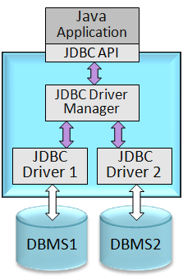
Connections in JDBC
We interact with a data source through sessions.
A session is started through creation of a Connection object
Connections are specified through a URL that uses the jdbc protocol - jdbc:<subprotocol>:<otherParameters>
Each connection identifies a logical session with a data source
Example:
String url=“jdbc:oracle:www.bookstore.com:3083”;
Connection con;
try{
con = DriverManager.getConnection(url,userId,password);
} catch(SQLException excpt) { …}
Host
Port
Different drivers have slightly different URL format - check the documentation
Con is a logical session with the Oracle database
Notes:
“Try …” discussed later

Slide 44
ACID Properties
A transaction is a collection of actions with the following ACID properties:
Atomicity: A transaction’s changes to the state are atomic – either all happen or non happen.
Consistency: A transaction is a correct transformation of the state.
Isolation: Even though transaction execute concurrently, it appears to each transaction, T, that other executed either before or after T, but not both.
Durability: Once a transaction completes successfully, its changes to the state survive failures (transaction’s effects are durable).

Slide 45
Higher-Level Protected Actions (Transactions)
Transaction (protected)
Since unprotected actions can be undone, they can be included in a higher-level operation (i.e., transaction), which as a whole has the ACID properties.
Begin Work
unproted action
unproted action
unproted action
unproted action
Commit Work

Slide 46
Connection Class Interface (1)
void setTransactionIsolation(int level) Sets isolation level for the current connection
public int getTransactionIsolation()
Get isolation level of the current connection
Multiple transactions update the same data item
More concurrency
Four isolation levels
Degree 0 - unrepeatable reads, dirty reads, lost updates
Degree 1 - unrepeatable reads, dirty reads
Degree 2 - unrepeatable reads
Degree 3 - true isolation
Reading updates made by transaction that has not finished
Computing aggregate function while other applications update the data
As long as applications know what they are doing, better performance can be achieved without causing anomalies
Example: “Cursor stability” applications do not repeat read operations anyway !

Slide 47
Connection Class Interface (1)
void setTransactionIsolation(int level) Sets isolation level for the current connection
public int getTransactionIsolation()
Get isolation level of the current connection
void setReadOnly(boolean b) Specifies whether transactions are read-only
public boolean getReadOnly()
Tests if transaction mode is read-only
void setAutoCommit(boolean b)
If autocommit is set, then each SQL statement is considered its own transaction.
Otherwise, a transaction is committed using commit(), or aborted using rollback().
public boolean getAutoCommit()
Test if autocommit is set

Slide 48
Connection Class Interface (2)
public boolean isClosed() Checks whether connection is still open.
connectionname.close() Close the connection connectionname

Slide 49
Executing SQL Statements
Three different ways of executing SQL statements:
Statement (both static and dynamic SQL statements)
PreparedStatement (semi-static SQL statements)
CallableStatment (stored procedures)
PreparedStatement class:
Used to create precompiled, parameterized SQL statements
SQL structure is fixed
Values of parameters are determined at run-time

Slide 50
PreparedStatement Object
Parameterized SQL
String sql=“INSERT INTO Sailors VALUES(?,?,?,?)”;
PreparedStatment pstmt=con.prepareStatement(sql);
“con” is a database object
Use the prepareStatement method to create an “SQL” object for con
SQL statements are submitted to DBMS as a parameter in an API call

Slide 51
PreparedStatement Object
Four parameters
Place holders
String sql=“INSERT INTO Sailors VALUES(?,?,?,?)”;
PreparedStatment pstmt=con.prepareStatement(sql);
pstmt.clearParameters();
pstmt.setInt(1,sid);
pstmt.setString(2,sname);
pstmt.setInt(3, rating);
pstmt.setFloat(4,age);
int numRows = pstmt.executeUpdate();
Good style to always clear
Setting parameter values.
sid, sname, rating, age are java variables
Number of rows modified
Use executeUpdate() when no rows are returned

Slide 52
PreparedStatement Object
String sql=“INSERT INTO Sailors VALUES(?,?,?,?)”;
PreparedStatment pstmt=con.prepareStatement(sql);
pstmt.clearParameters();
pstmt.setInt(1,sid);
pstmt.setString(2,sname);
pstmt.setInt(3, rating);
pstmt.setFloat(4,age);
int numRows = pstmt.executeUpdate();
Step 1: Write SQL
Step 2: Create SQL object
Step 3: Set the parameter values
Step 4: Submit the SQL

Slide 53



PreparedStatement Object
String sql=“INSERT INTO Sailors VALUES(?,?,?,?)”;
PreparedStatment pstmt=con.prepareStatement(sql);
pstmt.clearParameters();
pstmt.setInt(1,sid);
pstmt.setString(2,sname);
pstmt.setInt(3, rating);
pstmt.setFloat(4,age);
int numRows = pstmt.executeUpdate();
Submit
SQL
con
DBMS

Slide 54
ResultSet
PreparedStatement.executeUpdate only returns the number of affected records
int numRows = pstmt.executeUpdate();
PreparedStatement.executeQuery returns data, encapsulated in a ResultSet object
ResultSet rs=pstmt.executeQuery();
ResultSet is similar to a cursor
Allows us to read one row at a time
Initially, the ResultSet is positioned before the first row
Use next() to read the next row
next() returns false if there are no more rows

Slide 55
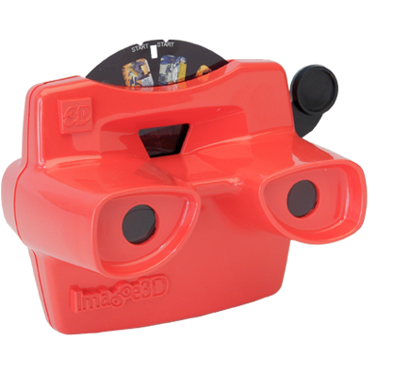
ResultSet Example
PreparedStatement
object
ResultSet rs=pstmt.executeQuery();
// rs is now a cursor
While (rs.next()) {
// process the data
}
Use while loop to process one tuple each iteration until end of result set

Slide 56
Common ResultSet Methods (1)
POSITIONING THE CURSOR
next() | Move to next row
previous() | Moves back one row
absolute(int num) | Moves to the row with the specified number
relative(int num) | Moves forward or backward (if negative)
first() | Moves to the first row
Last() | Moves to the last row

Slide 57
Common ResultSet Methods (2)
RETRIEVE VALUES FROM COLUMNS by NAME or INDEX
getString(string columnName): | Retrieves the value of designated column in current row
getInt(int columnIndex) | Retrieves the value of designated column in current row
Example: String schoolname = rs.getString(“name”)
Notes:
getFloat(string columnName): Retrieves the value of the designated column in the current row of this ResultSet object as a float in the Java programming language.

Slide 58
Matching Java and SQL Data Types
SQL Type | Java class | ResultSet get method
BIT | Boolean | getBoolean()
CHAR | String | getString()
VARCHAR | String | getString()
DOUBLE | Double | getDouble()
FLOAT | Double | getDouble()
INTEGER | Integer | getInt()
REAL | Double | getFloat()
DATE | java.sql.Date | getDate()
TIME | java.sql.Time | getTime()
TIMESTAMP | java.sql.TimeStamp | getTimestamp()

Slide 59
Matching Java and SQL Data Types
SQL Type | Java class | ResultSet get method
BIT | Boolean | getBoolean()
CHAR | String | getString()
VARCHAR | String | getString()
DOUBLE | Double | getDouble()
FLOAT | Double | getDouble()
INTEGER | Integer | getInt()
REAL | Double | getFloat()
DATE | java.sql.Date | getDate()
TIME | java.sql.Time | getTime()
TIMESTAMP | java.sql.TimeStamp | getTimestamp()
Example: String schoolname = rs.getString(“name”)

Slide 60
SQL Data Types
BIT | A boolean value
CHAR(n) | A character string of fixed length n
VARCHAR(n) | A variable-length character string with a maximum length n
DOUBLE | A double-precision floating point value
FLOAT(p) | A floating point value with a precision value p
INTEGER | A 32-bit signed integer value
REAL | A high precision numeric value
DATE | A day/month/year value
TIME | A time of day (hour, minutes, second) value
TIMESTAMP | A day/month/year/hour/minute/second value

Slide 61
Statement Object – Another Way to Execute an SQL Statement
Three different ways of executing SQL statements:
Statement (both static and dynamic SQL statements)
PreparedStatement (semi-static SQL statements)
CallableStatment (stored procedures)
Statement stmt = con.createStatement();
// create an empty statement object
String query = "SELECT name, rating
FROM Sailors";
ResultSet rs = stmt.executeQuery(query);
Execute the Statement object stmt with the query inside

Slide 62
Statement Object – Another Way to Execute an SQL Statement
Three different ways of executing SQL statements:
Statement (both static and dynamic SQL statements)
PreparedStatement (semi-static SQL statements)
CallableStatment (stored procedures)
Statement stmt = con.createStatement();
// create an empty statement object
String query = "SELECT name, rating
FROM Sailors";
ResultSet rs = stmt.executeQuery(query);
Note: The query can be dynamically created

Slide 63
Review: Throwable Class
Throwable object: can have an associated message that provides more detail about the particular error or exception that is being thrown
getMessage(): returns the error message string of the throwable object
Throwable class: is the superclass of all errors and exceptions in the Java language
Java
Object
GetMessage()
Throwable
Exception
Error

Slide 64
Exception/Warning Class Hierarchy
GetMessage() returns the error message string of the throwable object
Java
Object
Throwable
GetSQLState() returns an SQLState identifier according to SQL 99
Exception
Java.SQL
SQLException
GetWarning() retrieves SQL warning if they exist
SQLWarning

Slide 65
SQLException
Object
Java
Throwable
Most of the methods in java.sql can throw an exception of type SQLException if an error occurs
Exception
Java.SQL
SQLException
SQLWarning

Slide 66
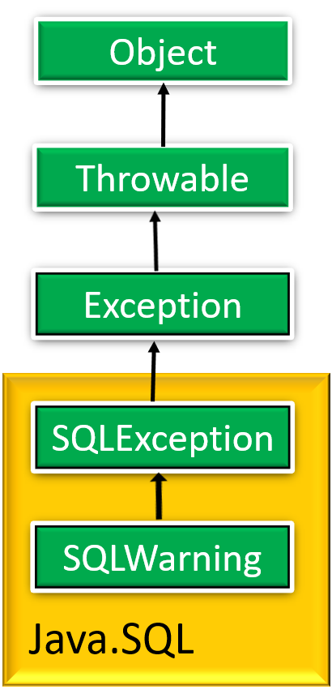
JDBC: Exceptions
SQLException has the following methods:
public String getMessage()
is inherited from the Throwable class
public String getSQLState()
returns an SQLState identifier according to SQL 99
public int getErrorCode()
retrieves a vendor-specific error code
public SQLException getNextException()
gets the next exception chained to this SQLException object

Slide 67
Catch the Exception
The class name of the exception we want to handle, e.g., SQLException
Contains code that might throw the exception
try {
body-code
} catch ( exception-classname variable-name) {
handler-code
}
The variable that will hold the exception object
Contains the code to execute if the exception occurs

Slide 68
JDBC: Warnings
SQLWarning is a subclass of SQLException.
Warnings are not as severe. They are not thrown and their existence has to be explicitly tested.
getWarnings()
retrieves SQL warning if they exist
getNextWarning()
retrieves the next warning chained to
this SQLwarning object
Notes:
Warnings do not stop the execution of an application, as exceptions do; they simply alert the user that something did not happen as planned. For example, a warning might let you know that a privilege you attempted to revoke was not revoked. Or a warning might tell you that an error occurred during a requested disconnection.

Slide 69
Warning & Eception Example
try {
stmt=con.createStatement(); // create an empty statement object
warning=con.getWarnings(); // retrieve warning if it exists
while(warning != null) {
// handle SQLWarnings
warning = warning.getNextWarning();
// get next warning chained to the warning object
}
con.clearWarnings();
stmt.executeUpdate(queryString);
warning = con.getWarnings();
…
} //end try
catch( SQLException SQLe) { // catch the SQLException object
// handle the exception
}

Slide 70

Another Example
Sailors(sid: integer, sname: string, rating: integer, age: real)
Print names and their rating

Slide 71
Another Example
Sailors(sid: integer, sname: string, rating: integer, age: real)
Connection con = // connect
DriverManager.getConnection(url, ”login", ”pass");
Statement stmt = con.createStatement(); // create and execute a query
String query = "SELECT name, rating FROM Sailors";
ResultSet rs = stmt.executeQuery(query);
try {
while (rs.next()){ // loop through result tuples
String s = rs.getString(“name"); // get the attribute values by name
Int n = rs.getInt(“rating");
System.out.println(s + " " + n); // print name and rating
}
} catch(SQLException ex) { // handle exceptions
System.out.println(ex.getMessage ()
+ ex.getSQLState () + ex.getErrorCode ());
}
rs works like a cursor

Slide 72
Executing SQL Statements
Three different ways of executing SQL statements:
Statement (both static and dynamic SQL statements)
PreparedStatement (semi-static SQL statements)
CallableStatment (stored procedures)

Slide 73
Stored Procedures
What is a stored procedure ?
Program executed through a single SQL statement
Executed in the process space of the server
Client/Server
Embedded SQL
Stored Procedure
Computer 1
Client
Computer 1
Application
Computer 1
Application
part 1
Remote
procedure
call
Queries
& cursors
Remote
procedure
call
Stored procedure
Computer 2
Server
Computer 2
DB Server
Computer 2
Application
part 2
Queries
& cursors
DBMS
DB Server

Slide 74
Stored Procedures: Advantages
Can encapsulate application logic while staying “close” to the data
Less inter-process communication
Avoid tuple-at-a-time return of records through cursors
Less network communication
Reuse of application logic by different users
Computer 1
Application
part 1
2
Remote
procedure
Call (RPC)
Stored procedure
Computer 3
Another application
RPC
Application
part 2
3
1
Queries
& cursors
Stored procedures can be called from JDBC using CallableStatement object
DB Server
Computer 2

Slide 75
SQL/PSM: Persistent Stored Modules
A standard for coding stored procedures, and storing them in the database itself
A mixture of conventional statement (if, while, etc.) and SQL
Declare a stored procedure:
CREATE PROCEDURE <name>(<parameter list>)
<local variable declarations>
procedure code;
Declare a stored function:
CREATE FUNCTION <name>(<parameter list>)
RETURNS sqlDataType
<local variable declarations>
function code;

Slide 76
Parameters in SQL/PSM
The parameters must be valid SQL types
Unlike the usual name-type pairs in conventional languages, e.g.,
Name String
Rating Integer
PSM uses mode-name-type triples, e.g.,
IN StudentID Integer
Three different modes in PSM:
IN parameters are arguments to the stored procedure
OUT parameters are returned from the stored procedure
INOUT parameters combine the properties of IN and OUT parameters

Slide 77
Main SQL/PSM Constructs
Local variables (DECLARE <name> <type>)
RETURN values for FUNCTION (Unlike C, etc., it does not terminate function execution)
Assign variables with SET <variable> = <expression>
Branches and loops:
IF (condition) THEN statements; ELSEIF (condition) statements; … ELSE statements; END IF;
LOOP statements; END LOOP
Queries can be parts of expressions
Can use cursors naturally without “EXEC SQL”

Slide 78

SQL/PSM – Function Example
CREATE FUNCTION rateSailor (IN sailorId INTEGER) RETURNS INTEGER
DECLARE rating INTEGER // two local variables
DECLARE numRes INTEGER
BEGIN
SET numRes = (SELECT COUNT(*)
FROM Reserves R WHERE R.sid = sailorId);
IF (numRes > 10) THEN rating =1;
ELSE rating = 0;
END IF;
RETURN rating;
END;
NO “EXEC” anywhere
BEGIN … END for groups of statements
SQL can be part of an expression

Slide 79
SQL/PSM: Procedure Examples
CREATE PROCEDURE ShowNumReservations (
IN sailorid INTEGER, OUT numres INTEGER )
SET numres = (SELECT COUNT(*) FROM Reserves R WHERE R.sid = sailorid)
CREATE PROCEDURE IncreaseRating( IN sailor_sid INTEGER, IN increase INTEGER )
UPDATE Sailors
SET rating = rating + increase WHERE sid = sailor_sid

Slide 80
SQL/PSM: Returning Result Set
<declare cursor> statement is used to return a result set
The result set is returned to JDBC CallableStatement object that calls the procedure
CREATE PROCEDURE Goodsailors(
IN goodrating INTEGER)
DYNAMIC RESULT SETS 1
BEGIN
DECLARE Cur1 CURSOR WITH RETURN FOR
SELECT sid, sname, rating
FROM Sailors S
WHERE S.rating > goodrating;
OPEN Cur1
END
Maximum number of result sets is 1
Make sure to open cursor in order to return the result set
Result set will be returned

Slide 81
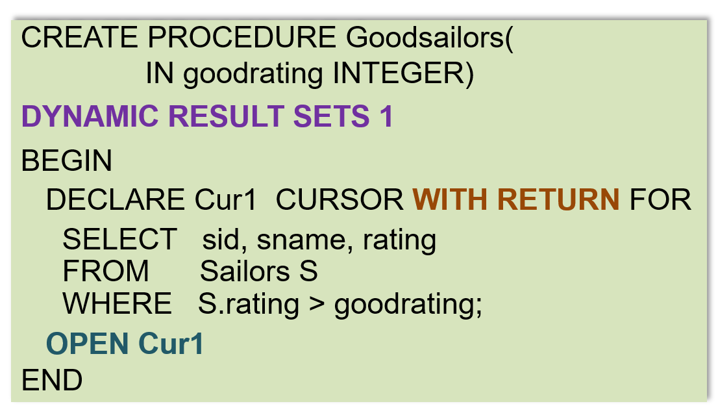
Preparation for Calling Stored Procedure
The stored procedure is executed with a JDBC CallableStatement execute() method
(next slide)
Stored procedure
1
Preperation for calling the stored procedure Goodsailors
Import java.sql.CallableStatement;
…
CallableStatement CStmt = con.prepareCall(“{Call Goodsailors(?)”);
CStmt.setInt(“goodrating”, 8); // Set parameter using its name
2

Slide 82
Processing Multiple Result Sets
A stored procedure may return multiple result sets
All the result sets that were opened are returned to the CallableStatement object CStmt
Calling getResultSet() returns the current result set
Boolean hadResults = CStmt.execute();
while (hadResults) {
ResultSet rs = CStmt.getResultSet();
// process result set
hadResults = CStmt.getmoreResults();
}
Calling getMoreResultsets() to move to the next result set
Notes:
A stored procedure may return more than one result set

Slide 83
Execute() vs. executeQuery()
Boolean execute()
Executes the SQL statement which may be any kind of SQL statement
(e.g., can be an update)
ResultSet executeQuery()
Executes the SQL statement and returns the ResultSet object generated by the query
A query object
JDBC:
CallableStatement cstmt= con.prepareCall(“{call ShowSailors}”);
ResultSet rs = cstmt.executeQuery();
while (rs.next()) {
… // process result set
}

Slide 84
Stored Procedures in Java
Stored procedure do not have to be written in SQL
The following stored procedure in Java is dynamically executed by the database server whenever it is called by the client
CREATE PROCEDURE TopSailors( IN num INTEGER)
LANGUAGE Java
EXTERNAL NAME “file:///c:/storedProcs/rank.jar”
The language in which the routine is written
Specifies the program that runs when this procedure is called

Slide 85
Calling Stored Procedures from embedded SQL
1
EXEC SQL BEGIN DECLARE SECTION
Int sid;
Int rating;
EXEC SQL END DECLARE SECTION
// set sid and rating to some values
// now increase the rating of this sailor
EXEC CALL IncreaseRating(:sid, :rating);
2
3
Variables in host language

Slide 86
JDBC Summary: 5 Steps
Load the JDBC driver
Create a database Connection object (your database) using the DriverManager
Create a Statement, PreparedStatement, or CallableStatement object that contains the SQL statement (your query object)
Execute the SQL Statement object, and receive the result in a ResultSet object
Step through the rows in ResultSet object and process the data in the host language

Slide 87

Another Option ?
Embedded SQL:
Pro: Do not need to learn the different “envelops”
Con: Not compatible at the level of the executable
API Approach:
Pro: Compatible at the level of the executable
Con: Need to learn and prepare the “envelops”
Can’t we have the best of both world?

Slide 88

SQLJ: Java with Embedded SQL
Java program
#SQL …
#SQL …
Computer program
EXEC SQL …
SELECT …
FROM …
WHERE …
SQLJ Preprocessor
Preprocessor
Computer program
API CALL …
Function call in the host language
Computer program
API CALL …
Function call in Java
Industry standard
Database specific
JDBC Driver
Not compatible at the level of the executable
Native API
DBMS
DBMS
SQLJ (part of the SQL standard) versus embedded SQL (vendor-specific) → SQLJ is more portable.

Slide 89
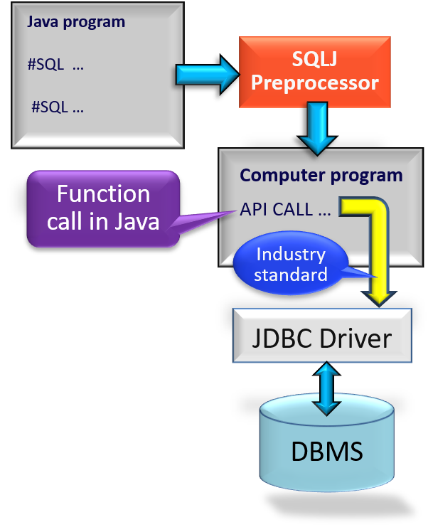
SQLJ Precompiler
SQLJ applications are pre-processed through an SQLJ translation program
Replaces embedded SQLJ code with calls to an SQLJ Java library
Usually, the SQLJ Java library makes calls to a JDBC driver (standard interface)
The modified program code can then be compiled by any Java compiler
Applications using SQLJ are DBMS-independent at the source code level and at the level of the executable

Slide 90
Using SQLJ
Every SQLJ statement has the special prefix #sql
We submit a query and retrieve the results through an iterator objects (basically a cursor)
Usage of an iterator goes through five steps:
Declare the Iterator Class
Example: #sql iterator Sailors (Int sid, String name, Int rating);
Instantiate an iterator object from the new iterator class
Example: Sailors sailors;
Initialize the iterator using an SQL statement (i.e., submit the query)
Example: #sql sailors = {SELECT sid, sname, rating FROM … WHERE …}
Iteratively, read the rows from the iterator object (i.e., receive results)
Example: while (sailors.next()) { // process row }
Close the iterator object
Example: sailors.close();

Slide 91
SQLJ Variables
Complements JDBC with a (semi-)static query model
SQLJ - All arguments always bound to the same variable:
#sql sailors = { SELECT name, rating INTO :name, :rating // name is bound FROM Sailors WHERE sid = :sid; } // to variable :name
Compare to JDBC: sid=rs.getInt(1); // get value of first attribute, i.e., sid if (sid==1) { sname1=rs.getString(2); } // name can be assigned to else { sname2=rs.getString(2); } // different variable
Compiler can perform syntax checks, strong type checks, consistency of the query with the schema
Sailors(sid: integer, sname: string, rating: integer, age: real)

Slide 92
SQLJ Example
Named iterator allows retrieval of columns by name
Int sid; String name; Int rating;
// (1) declare the iterator class
#sql iterator Sailors(Int sid, String name, Int rating);
Sailors sailors; // (2) intantiate an iterator object
rating = 7
#sql sailors = {
SELECT sid, sname INTO :sid, :name FROM Sailors WHERE rating = :rating }; // (3) initialize iterator
while (sailors.next()) { // (4) retrieve rows from iterator object
System.out.println(sailors.sid + “ “ + sailors.name));
}
sailors.close(); // (5) close the iterator object

Slide 93

Two Types of SQLJ Iterators
Named iterator
Example in last slide
Need to specify both the variable type and the name of each column of the iterator
This allows retrieval of columns by name.
Positional iterator
Need to specify only the variable type of the iterator, and then FETCH .. INTO construct:
#sql iterator Sailors(Int, String, Int); Sailors sailors; #sql sailors = { SELECT … FROM … WHERE … }; while (true) { #sql {FETCH :sailors INTO :sid, :name} ; // fetch next sailor if (sailors.endFetch()) { break; } // exit loop if end of iterator // process the sailor }
#sql iterator Sailors(Int sid, String name, Int rating);
1
2
1
2

Slide 94
Calling Stored Procedure from JDBC & SQLJ
A query object
A query class
JDBC:
CallableStatement cstmt= con.prepareCall(“{call ShowSailors}”);
ResultSet rs = cstmt.executeQuery();
while (rs.next()) {
… // process result set
}
SQLJ:
#sql iterator SailorInfo(…);
SailorInfo sailorinfo;
#sql sailorinfo={CALL ShowSailors};
while (sailorinfo.next()) {
…
}
Call stored procedure
A query object
Call stored procedure
Note: con is the database
Call procedure instead of writing SQL
Notes:
SQLJ Preprocessor generates the JDBC code from the SQLI code in the right

Slide 95
MySQL System Catalog
System catalog is a system schema called INFORMATION_SCHEMA
It contains tables that can be queried for metadata about the tables and other things in any schema (e.g., MyDatabase) in MySQL
SELECT TABLE_NAME, TABLE_ROWS
FROM INFORMATION_SCHEMA.TABLES
WHERE TABLE_SCHEMA = ‘MyDatabase’;
Retrieve name and size of the tables in the MyDatabase database
Information about tables

Slide 96
JDBC Metadata
DatabaseMetaData object gives information about the database system such as table names and table’s columns.
DatabaseMetaData md = con.getMetaData();
// print information about the driver:
System.out.println( “Name:” + md.getDriverName() + “version: ” + md.getDriverVersion());
Your database

Slide 97
JDBC Catalog and Schema
According to JDBC, a database may have a set of catalog and each catalog may have a set of schemas (i.e., concepts for grouping tables).
Schema
Table
Catalog
Schema
Table
A Database
Table
Schema
Catalog

Slide 98
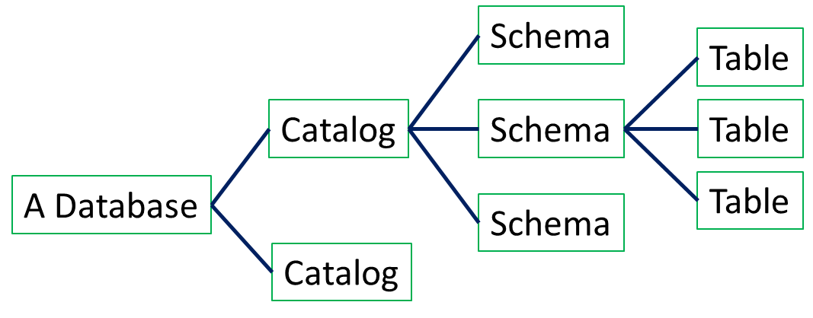
JDBC Catalog and Schema
getTables(catalog, schema, tableNames, columnNames) | Returns table names for all tables matching tableNames and all columns matching columnNames
getColumns(catalog, schema, tableNames, columnNames) | Returns table column names for all tables matching tableNames and all columns matching columnNames
Ex: “getTables(null,null,null,null)” gets information for all tables
Ex: “getColumns(null,null,tableName,null)” gets all attributes of tableName

Slide 99
JDBC Catalog and Schema
Different DBMS’s may have different semantics by using the same JDBC API
You have to test your code against different DBMS’s.
According to JDBC, a database may have a set of catalog and each catalog may have a set of schemas (i.e., concepts for grouping tables).
getTables(catalog, schema, tableNames, columnNames) | Returns table names for all tables matching tableNames and all columns matching columnNames
getColumns(catalog, schema, tableNames, columnNames) | Returns table column names for all tables matching tableNames and all columns matching columnNames
Ex: “getTables(null,null,null,null)” gets information for all tables
Ex: “getColumns(null,null,tableName,null)” gets all attributes of tableName

Slide 100
Catalog and Schema
In MySQL, DATABASE and SCHEMA are synonyms. It is a “folder” for tables, views, constraints, triggers, and stored procedures)
CREAT SCHEMA TheDatabase;
USE TheDatabase
CREAT TABLE FirstTable (…); …
Some other vendors treat the terms DATABASE and SCHEMA differently
Some vendors also have a term “CATALOG” (used to group schemas). MySQL does not support this concept
Notes:
CREAT SCHEMA is synonym for CREAT DATABASE in MySQL

Slide 101
Some DatabaseMetaData Methods
134 methods in JDBC 2.0
getCatalogs(): retrieves catalog names available in this database
getIndexInfo(): retrieves a description of the indexes and statistics for the given table
getTables(): retrieves a description of the tables available in the given catalog
GetColumns(): retrieves a description of table columns available in the specified catalog
getPrimaryKeys(): retrieves a description of the given table’s primary key columns.

Slide 102
Print names of tables and their columns
(Using MySQL)
DatabaseMetaData md=con.getMetaData();
ResultSet trs=md.getTables(null,null,null,null); // get all tables
String tableName;
While(trs.next()) { // for each table, do …
tableName = trs.getString(“TABLE_NAME”); // get TABLE_NAME field
System.out.println(“Table: “ + tableName);
ResultSet crs = md.getColumns(null,null,tableName,null);
// get all attributes of tableName
while (crs.next()) {
System.out.println(crs.getString(“COLUMN_NAME”) + “, “);
}
}
trs
TABLE_NAME
…
crs
Table1
…
COLUMN_NAME
…
Table2
…
sid
…
Print the columns of each table
Sailors
…
sname
…
Table3
…
rating
…
Table4
…
age
…
Table5
…
Notes:
trs stands for “table returned string” crs stands for “column returned string”

Slide 103
SUMARY - SQL in Application Code
Pure JAVA
Need preprocessor
Need preprocessor
Java program
with JDBC
Java program
C program
PreparedStatement
SQLJ
Embedded SQL
SQL
Statement
Iterator
Cursor
CallableStatement
#SQL
executeQuery
Call
EXEC SQL
executeQuery
#SQL
Call
EXEC Call
JDBC
SQL/PSM
Vendor specific
ResultSet
ResultSet
DBMS

Slide 104
Summary
Embedded SQL allows execution of parametrized static queries within a host language
Dynamic SQL allows execution of completely ad-hoc queries within a host language
Cursor mechanism allows retrieval of one record at a time and bridges impedance mismatch between host language and SQL
APIs such as JDBC introduce a layer of abstraction between application and DBMS

Slide 105
Summary (Contd.)
SQLJ: Static model, queries checked at compile-time.
Stored procedures execute application logic directly at the server
SQL/PSM standard for writing stored procedures

