Slide 1
EXPORT/IMPORT
EXPORTING DATABASE
Database name
C:\Program Files\MySQL\MySQL Server 8.0\bin>mysqldump -u root -p hr > exphr.sql
Enter password: ********
mysql> create database ramu;
Query OK, 1 row affected (0.01 sec)
C:\Program Files\MySQL\MySQL Server 8.0\bin>mysql -u root -p ramu < exphr.sql
Enter password: ********
mysql> use ramu;
Database changed
mysql> show tables;
+------------------+
| Tables_in_ramu |
+------------------+
| countries |

Slide 2
COMMON TABLE EXPRESSIONS
SYNTAX
with CTE (column1,column2 ..)
as (cte query)
SQL statement

Slide 3
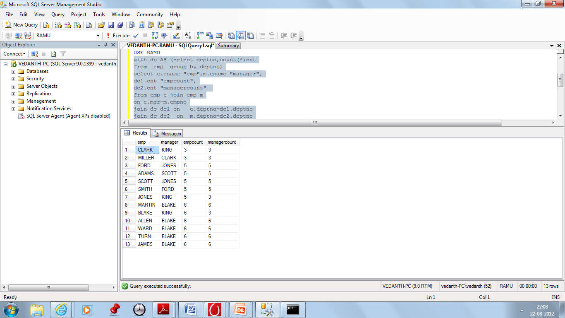
COMMON TABLE EXPRESSIONS
with dc AS (select deptno,count(*)cnt
from emp group by deptno)
select e.ename "emp",e.deptno “edep”,
m.ename "manager",m.deptno
“mdep”,
dc1.cnt "empcount",
dc2.cnt "managercount"
from emp e join emp m
on e.mgr=m.empno
join dc dc1 on e.deptno=dc1.deptno
join dc dc2 on m.deptno=dc2.deptno

Slide 4

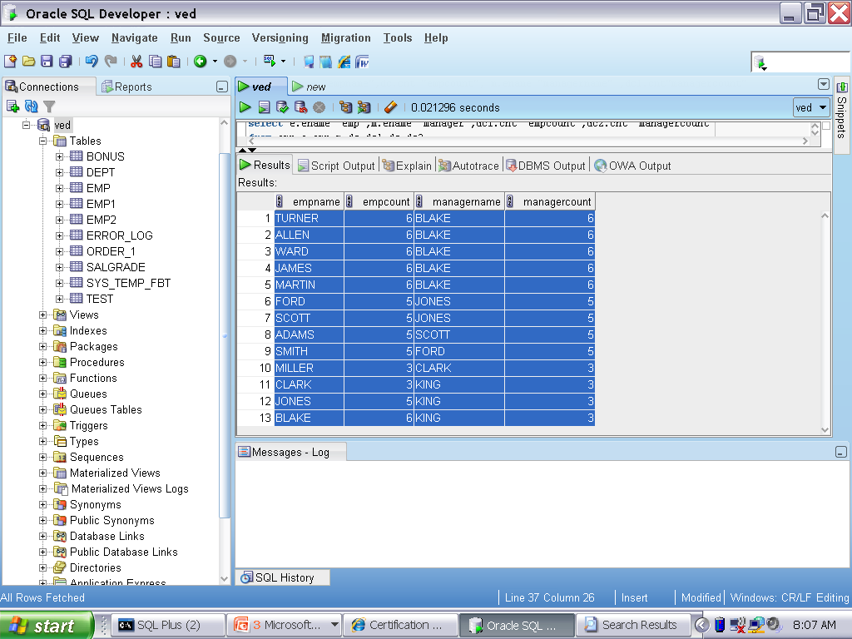
CTE(COMMON TABLE EXPRESSIONS)
USING DERIVED TABLE
USING WITH
select e.ename "empname",dc.cnt "empcount",m.ename"managername", dc1.cnt"managercount" from emp e join emp m on e.mgr=m.empno join (select deptno,count(*) cnt from emp group by deptno)dc on e.deptno=dc.deptno join (select deptno,count(*) cnt from emp group by deptno) dc1 on m.deptno=dc1.deptno
with dc as (select deptno,count(*)cnt from emp group by deptno) select e.ename "emp", m.ename "manager", dc1.cnt "empcount", dc2.cnt "managercount" from emp e JOIN emp m ON e.mgr=m.empno JOIN DC DC1 ON e.deptno=dc1.deptno JOIN DC DC2 ON m.deptno=dc2.deptno
Notes:
4

Slide 5
RECURSIVE CTE
SYNTAX
WITH expression_name (column_list)
AS ( -- Anchor member initial_query
UNION ALL -- Recursive member that references expression_name.
recursive_query ) -- references expression name
SELECT * FROM expression_name

Slide 6
WINDOW FUNCTIONS
ANALYSIS OF DATA REQUIRED FOR DECISION MAKING
ENHANCES THE RESULT SET OF QUERIES

Slide 7

WINDOW FUNCTIONS
AGGREGATE | WINDOW
Grouping of the result set | No grouping of the result set
No | They return the group value multiple times with each record.
No dependency on order | Dependency order

Slide 8

WINDOW FUNCTIONS
AGGREGATE | WINDOW
Select count(*) From emp | Select ename,sal, count(*) Over() “cnt” From emp
COUNT(*)
-------------------
14
ENAME SAL CNT
---------- --------------- --------
SMITH 800 14
ALLEN 1600 14
WARD 1250 14
JONES 2975 14
MARTIN 1250 14
BLAKE 2850 14
CLARK 2450 14
SCOTT 3000 14
KING 5000 14
TURNER 1500 14
ADAMS 1100 14
JAMES 950 14
FORD 3000 14
MILLER 1300 14

Slide 9
WINDOW FUNCTIONS
RANKING
LAG/LEAD
FIRST_VALUE/LAST_VALUE/NTH_VALUE

Slide 10
WINDOW FUNCTIONS
RANK
DENSE_RANK
ROW_NUMBER

Slide 11
RANK FUNCTIONS
* Find rank of an Item

Slide 12
RANK FUNCTIONS
RANK() and DENSE_RANK() to rank items in a group
RANK | DENSE_RANK
leaves a gap in the sequence when there is a tie | leaves no gaps

Slide 13
RANK FUNCTIONS
Function | Description
RANK() | Returns the rank of items in a group. RANK() leaves a gap in the sequence of rankings in the event of a tie.
DENSE_RANK() | Returns the rank of items in a group. DENSE_RANK() doesn't leave a gap in the sequence of rankings in the event of a tie.
NTILE() | Returns n-tiles: tertiles, quartiles, and so on.
ROW_NUMBER() | Returns a number with each row in a group.

Slide 14
RANK FUNCTIONS
You use the PARTITION BY clause with the analytic functions when you need to divide the groups into subgroups.

Slide 15
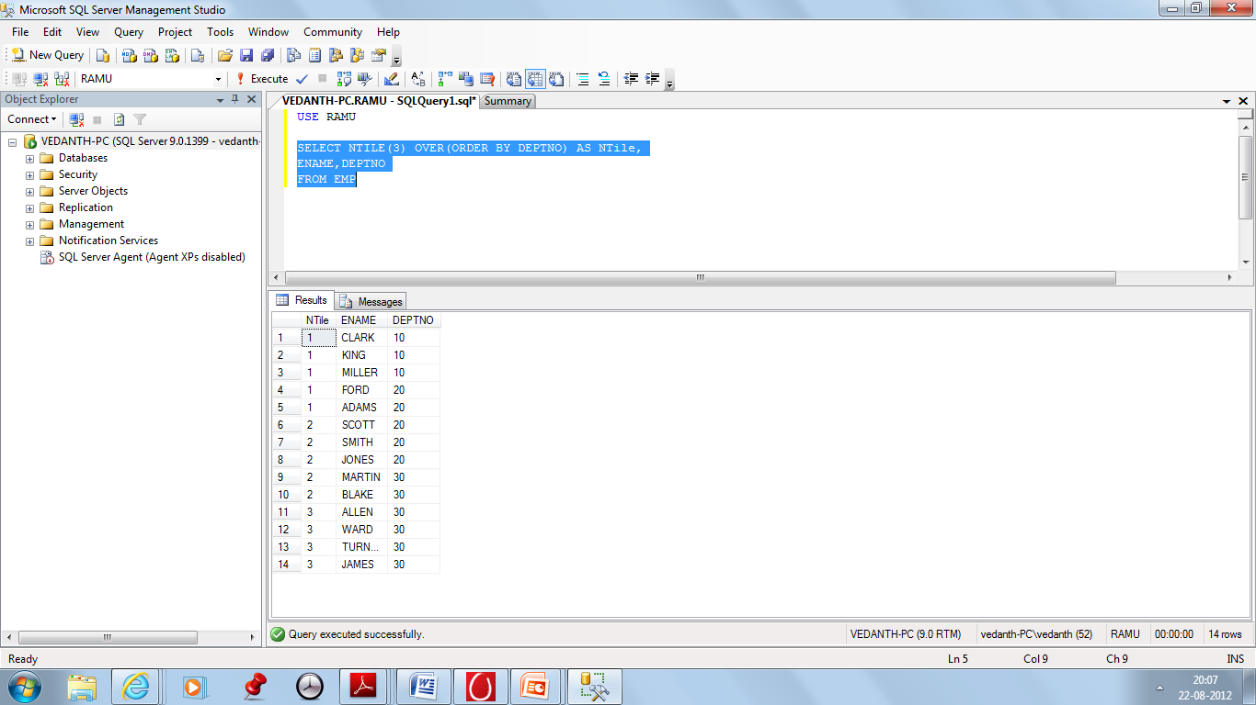
WINDOWING FUNCTIONS
NTILE
SELECT NTILE(5) OVER(Order by deptno) AS NTILE, Ename,deptno FROM emp

Slide 16
LAG/LEAD FUNCTIONS
LEAD
LAG
return data from the next row
access data from a previous row
To compare value of the current row wrt previous/next row.

Slide 17
LAG/LEAD
SELECT ENAME,SAL,LAG(SAL) OVER(ORDER BY SAL) "PRIOR” FROM EMP;
ENAME SAL PRIOR
---------- ---------------- ----------
SMITH 800
JAMES 950 800
ADAMS 1100 950
WARD 1250 1100
MARTIN 1250 1250
MILLER 1300 1250
TURNER 1500 1300
ALLEN 1600 1500
CLARK 2450 1600
BLAKE 2850 2450
JONES 2975 2850
SCOTT 3000 2975
FORD 3000 3000
KING 5000 3000
SAL OF SMITH

Slide 18
LAG/LEAD
SELECT ENAME,SAL,LEAD(SAL) OVER(ORDER BY SAL) “NEXT” FROM EMP;
ENAME SAL PRIOR
---------- ---------------- ----------
SMITH 800 950
JAMES 950 1100
ADAMS 1100 1250
WARD 1250 1250
MARTIN 1250 1300
MILLER 1300 1500
TURNER 1500 1600
ALLEN 1600 2450
CLARK 2450 2850
BLAKE 2850 2975
JONES 2975 3000
SCOTT 3000 3000
FORD 3000 5000
KING 5000
SAL OF JAMES

Slide 19
LAG/LEAD
SELECT ENAME,SAL,LEAD(SAL) OVER(ORDER BY SAL) “NEXT” FROM EMP;
ENAME SAL PRIOR
---------- ---------------- ----------
SMITH 800 950
JAMES 950 1100
ADAMS 1100 1250
WARD 1250 1250
MARTIN 1250 1300
MILLER 1300 1500
TURNER 1500 1600
ALLEN 1600 2450
CLARK 2450 2850
BLAKE 2850 2975
JONES 2975 3000
SCOTT 3000 3000
FORD 3000 5000
KING 5000
SAL OF JAMES

Slide 20
Nth_value()
select ename,sal,nth_value(sal,2) over(order by sal desc) "2nd highsal“ from emp;
+--------+------+-------------+
| ename | sal | 2nd highsal |
+--------+------+-------------+
| KING | 5000 | NULL |
| x | 3000 | 3000 |
| SCOTT | 3000 | 3000 |
| FORD | 3000 | 3000 |
| JONES | 2975 | 3000 |
| BLAKE | 2850 | 3000 |
| CLARK | 2450 | 3000 |
| ALLEN | 1600 | 3000 |
| TURNER | 1500 | 3000 |
| MILLER | 1300 | 3000 |
| WARD | 1250 | 3000 |
| MARTIN | 1250 | 3000 |
| ADAMS | 1100 | 3000 |
| JAMES | 950 | 3000 |
| SMITH | 800 | 3000 |
+--------+------+-------------+
SAL OF X
The NTH_VALUE() is a window that allows you
to get a value from the Nth row in an ordered set of
rows.

Slide 21
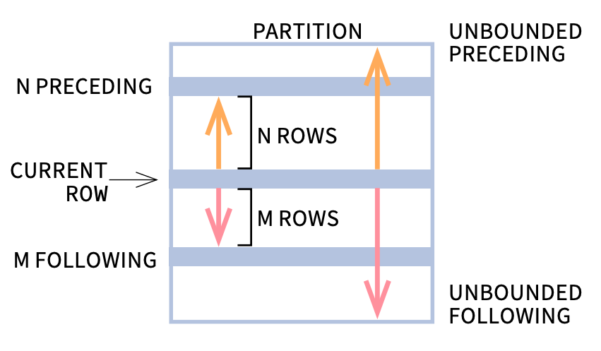
FRAME
RANGE BETWEEN start_point AND end_point
ROWS BETWEEN start_point AND end_point

Slide 22
FRAME
select ename,sal,last_value(sal) over(order by sal range between unbounded preceding and unbounded following) "las“ from emp;
+--------+------+------+
| ename | sal | las |
+--------+------+------+
| SMITH | 800 | 5000 |
| JAMES | 950 | 5000 |
| ADAMS | 1100 | 5000 |
| WARD | 1250 | 5000 |
| MARTIN | 1250 | 5000 |
| MILLER | 1300 | 5000 |
| TURNER | 1500 | 5000 |
| ALLEN | 1600 | 5000 |
| CLARK | 2450 | 5000 |
| BLAKE | 2850 | 5000 |
| JONES | 2975 | 5000 |
| SCOTT | 3000 | 5000 |
| FORD | 3000 | 5000 |
| KING | 5000 | 5000 |
+--------+------+------+

Slide 23
PRACTICE SESSIONS-1
List highest paid employees in each department.Display ename,deptno,sal
List highest paid employees in each job.Display ename,job ,sal
Find the Seniormost Manager
Find Highest paid Salesman
Find Lowest paid CLERK
Find Juniormost CLERK
Display employees who is taking more salary than average salary in their respective jobs
Display employees who is taking more salary than average
salary in their respective departments
9. Display employee name,sal,sal difference for every employee
And successive employee

Slide 24
PRACTICE SESSIONS-2
Find the number of days difference between 1st analyst and 2nd analyst
Find the number of days difference between 1st Manager
And 2nd Manager
3. Find the number of days difference between 1st CLERK and 2nd CLERK
4. Find the salary difference between 1st SALESMAN and 2nd SALESMAN
5. Find the salary difference between 1st MANAGER and 2nd MANAGER
6. Find the number of days difference between 1st CLERK and 2nd CLERK

