Slide 1
Data Analysis

Slide 2
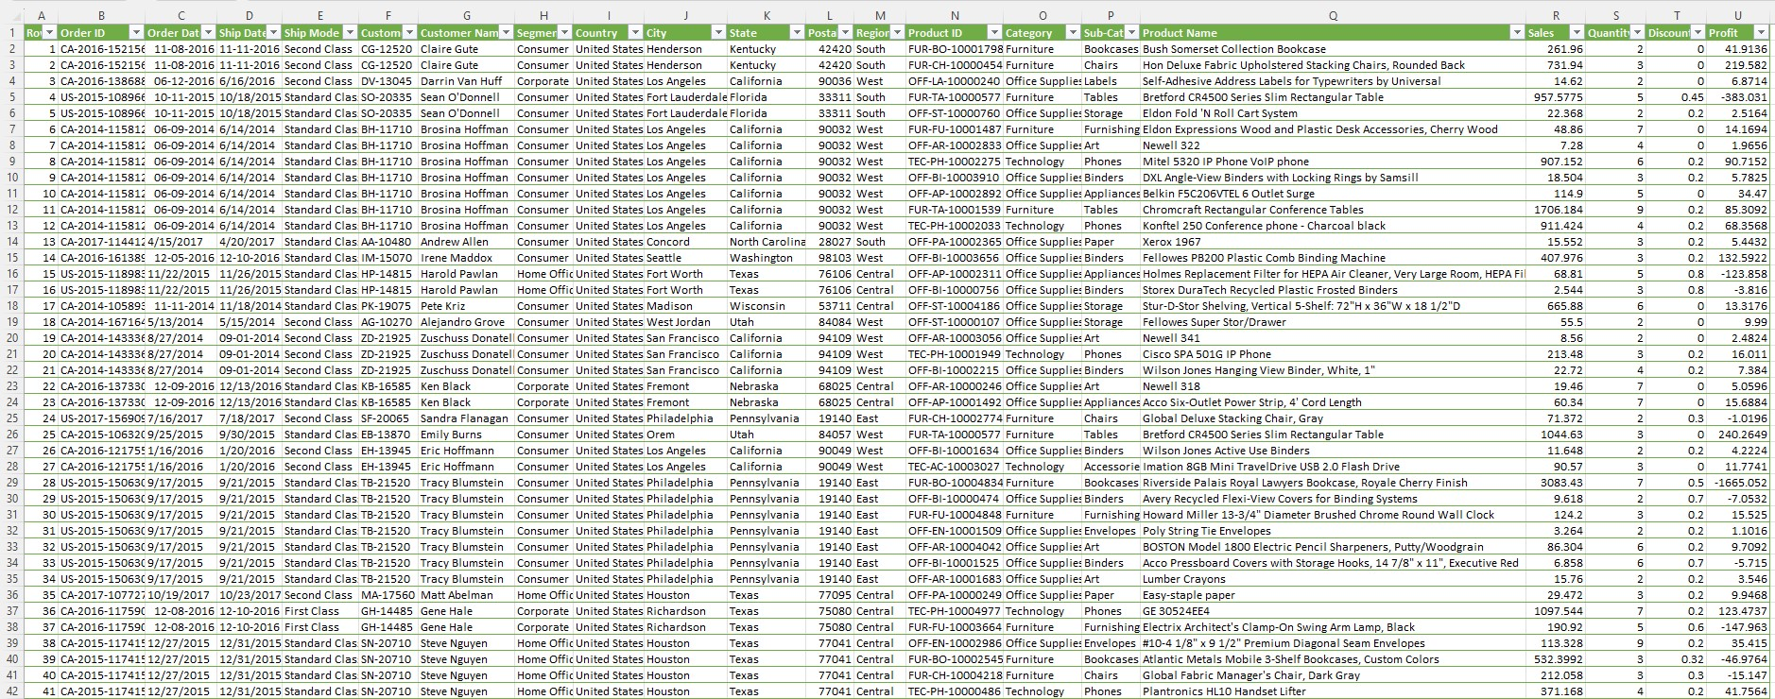
Superstore Dataset

Slide 3
Dataset
21 Columns
9994 records
Store data of Customers
Sale, Quantity, Discount, Profits
Region, State, City wise data

Slide 4
Questions
State-wise total Sales & Profits
Most profits out of all cities
Highest profitable category of products
Product wise discounts
Region-wise profits

Slide 5
SQL Server
Queries

Slide 6
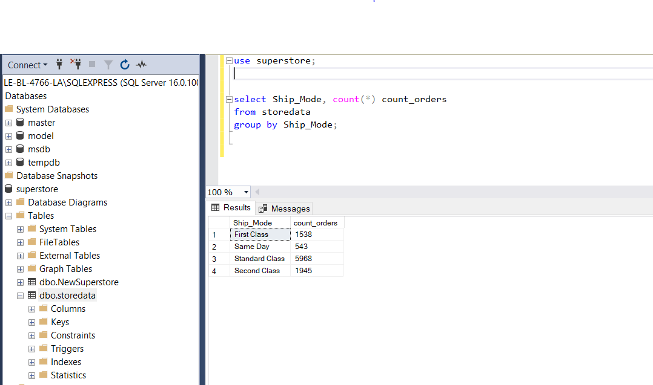
Part I: SSMS Query-1

Slide 7
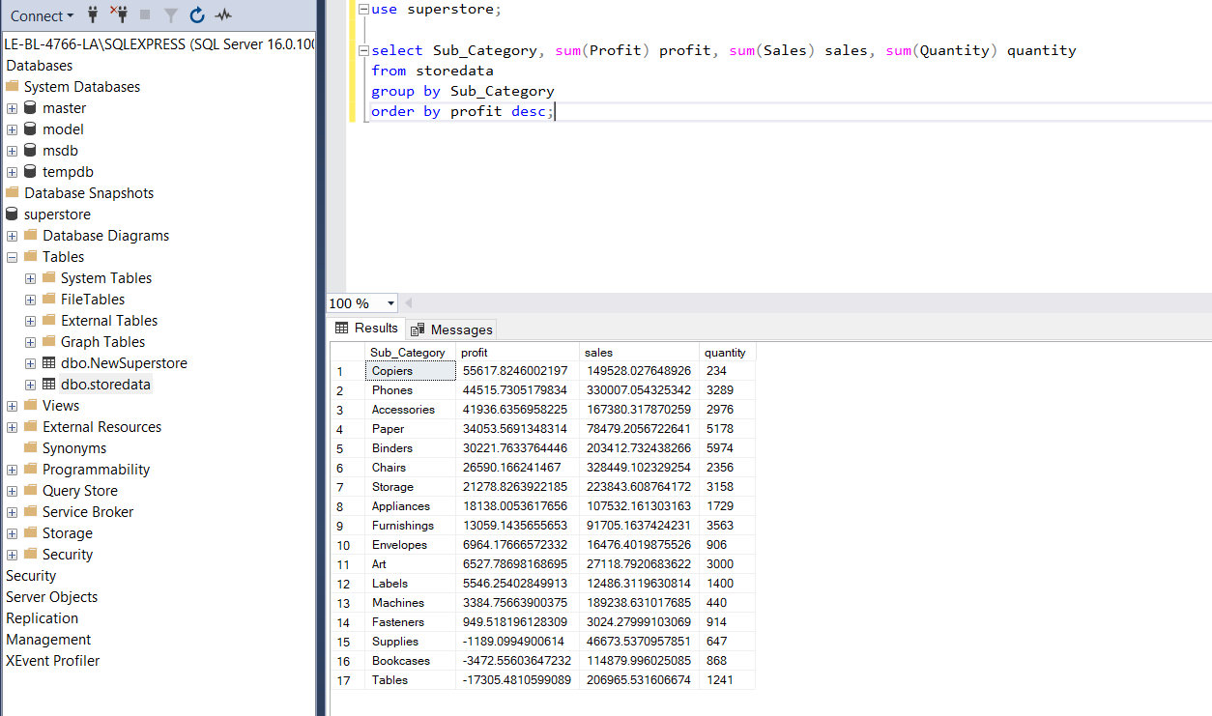
Part I: SSMS Query-2

Slide 8
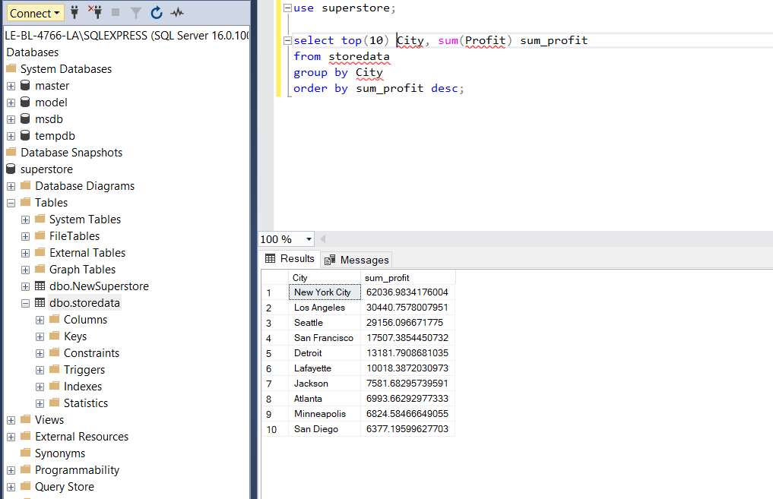
Part I: SSMS Query-3

Slide 9
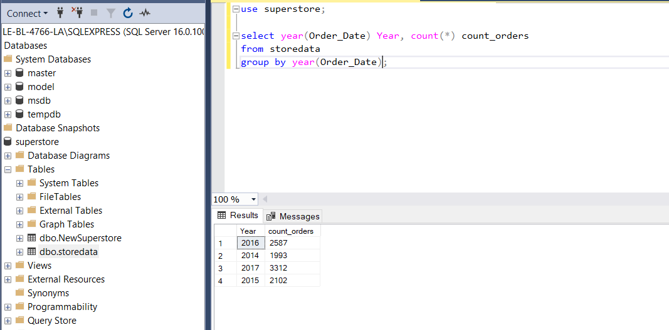
Part I: SSMS Query-4

Slide 10
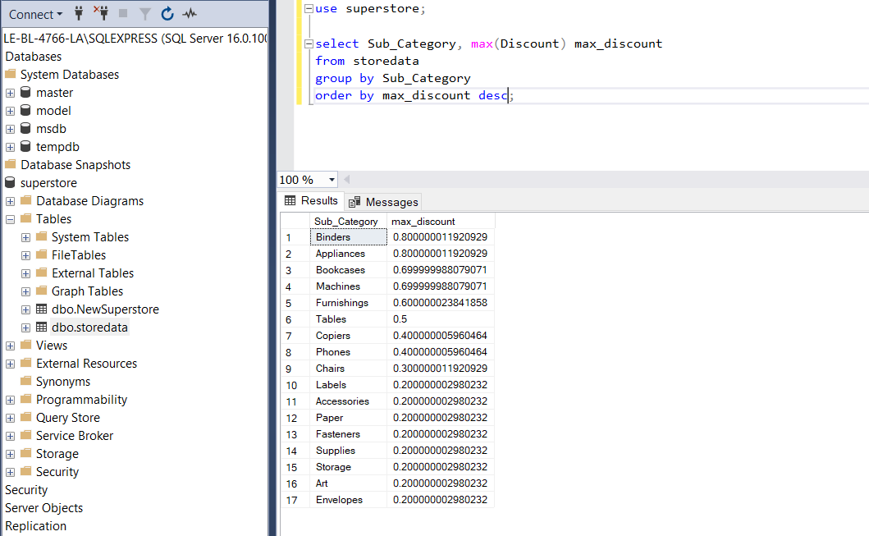
Part I: SSMS Query-5

Slide 11
Excel Functions
Slope, Intercept

Slide 12
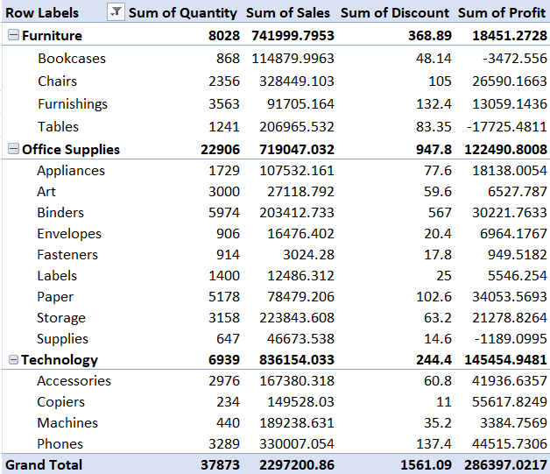
Excel Pivot Table

Slide 13
Excel functions
Functions | Output
Slope(Sales vs Profit) | 1.274542694
Intercept | 193.333563
Slope(Sales vs Discount) | -85.10142552
SUM(Sales) | 2297200.86
SUM(Profits) | 286397.02
AVG(Sales) | 28.65689631

Slide 14
Part ll : Visualization
Report Builder, Power BI

Slide 15
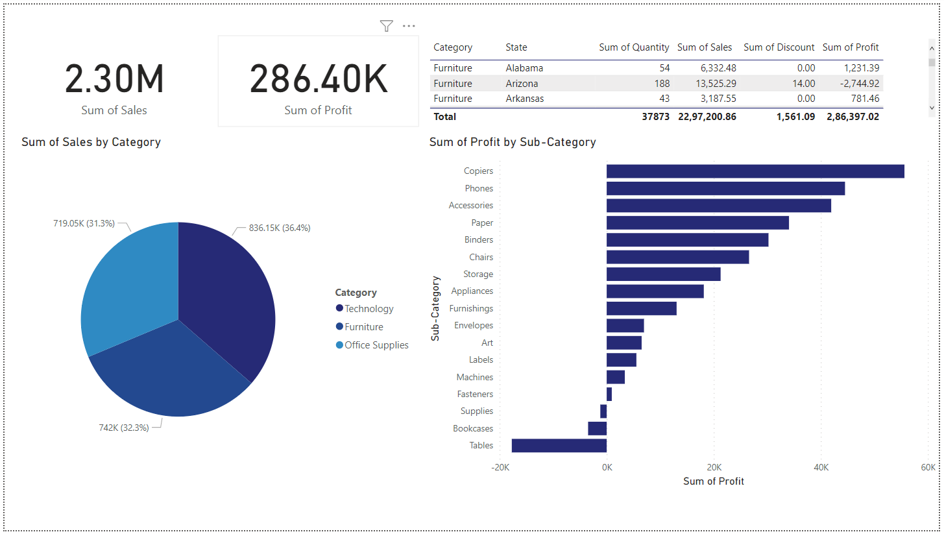
Power BI Dashboard -1

Slide 16
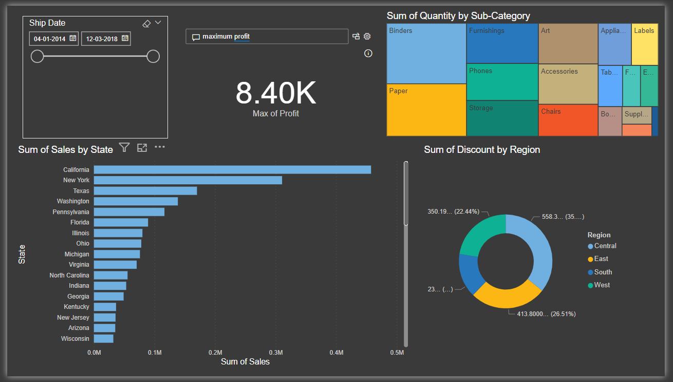
Power BI Dashboard -2

