Slide 1
SMART INDIA HACKATHON 2026 · PROBLEM STATEMENT 26177 · QUALCOMM INC. · ROBOTICS & DRONES
SAHYOG
The drone finds them by body heat.
The phone in your pocket flies the AI.
Autonomous aerial search-and-rescue: radiometric thermal detection, GPS-denied navigation and verified survivor reports — every model running on-device, on silicon India already carries.
Team <NAME> · <INSTITUTE> · mentors: <MENTOR>
Notes:
Open on the promise, not the title. 'In a flood, a survivor on a rooftop has about an hour before hypothermia or the water wins. Search teams cannot see her, GPS is unreliable and the network is down. SAHYOG is a drone that finds her by body heat — and the intelligence that does it flies on an ordinary Android phone.' Pause. Then slide 2.

Slide 2
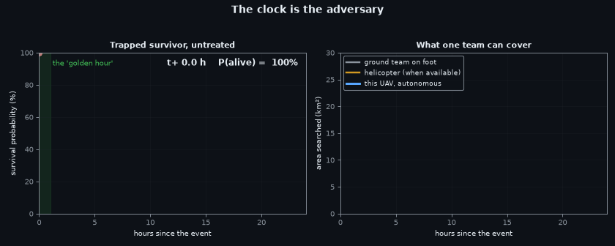
1 · PROBLEM UNDERSTANDING
Every hour lost in a disaster zone is paid in lives
60 min
4–10 px
0
₹3 L+
the golden hour after trauma — survival falls steeply after it
how big a survivor is in a thermal frame at survey altitude
cellular network, GPS accuracy and road access after a flood
a radiometric thermal camera + companion computer, per aircraft
▸ Manual search is eyes on a screen. A human watches thermal video and blinks at the wrong moment; fatigue makes misses, not breaks.
▸ Off-the-shelf AI fails here. Public detectors are trained on standing pedestrians at street level. A flood survivor lies down, half in water, six pixels wide.
▸ Infrastructure dies first. Floods take the network, the roads and reliable GNSS before the first team arrives — so video streaming and cloud AI are not options.
▸ False alarms cost ground teams. Every wrong rooftop sends rescuers up a staircase instead of to a survivor.
The golden hour, and who is still looking at hour three
SAHYOG · SIH 2026 · PS 26177
2
Notes:
Rubric point 1. Do not rush this slide — the judges must feel the hour. 'Four numbers define our problem. Sixty minutes: after the golden hour, survival drops fast. Four to ten pixels: that is a human being in a thermal image from survey height — this is why naive AI fails. Zero: no network, no reliable GPS, no roads. And three lakh rupees: what the usual thermal-plus-computer payload costs per aircraft. We attack all four.'

Slide 3
THE INSIGHT
Two facts nobody else in this room is using
FACT 1 · THE TARGET IS SUB-CELL
FACT 2 · THE COMPUTER IS ALREADY IN EVERY POCKET
▸ A stride-8 detector is blind here. Its finest grid cell is 8 px; a 4 px body is less than one cell. Measured on our own renderer: mAP50 0.0009.
▸ Add a stride-4 (P2) head: 0.2338. Same data, same epochs — a 260× improvement from architecture alone. This one change is the difference between a toy and a detector.
▸ Transformers lose on thermal. On a 75k-image aerial-thermal benchmark RT-DETR-L scores 5.0% AP on small objects vs 10.7–11.6% for YOLO. Warm blobs have no texture for attention to attend to.
▸ A Snapdragon phone carries six of our subsystems: stabilised RGB camera, INT8 NPU, visual-inertial odometry, 4G relay, field display and a backup battery.
▸ Buying them separately: ₹35,000+ and weeks of integration. The phone: ₹0 and one USB cable.
▸ Same silicon family as the target board. The phone's Hexagon DSP and the Qualcomm QCS6490 we fly on share one architecture — one model format, two destinations.
SAHYOG · SIH 2026 · PS 26177
3
Notes:
This is the slide that makes judges lean in. 'Two facts drive every design decision we made. First: at survey altitude a survivor is smaller than one grid cell of a standard detector — we measured 0.0009 mAP, effectively blind. One architecture change, a stride-4 head, took it to 0.234. Second: the most expensive subsystem in every competitor's budget is already in every rescuer's pocket. We fly it.'

Slide 4
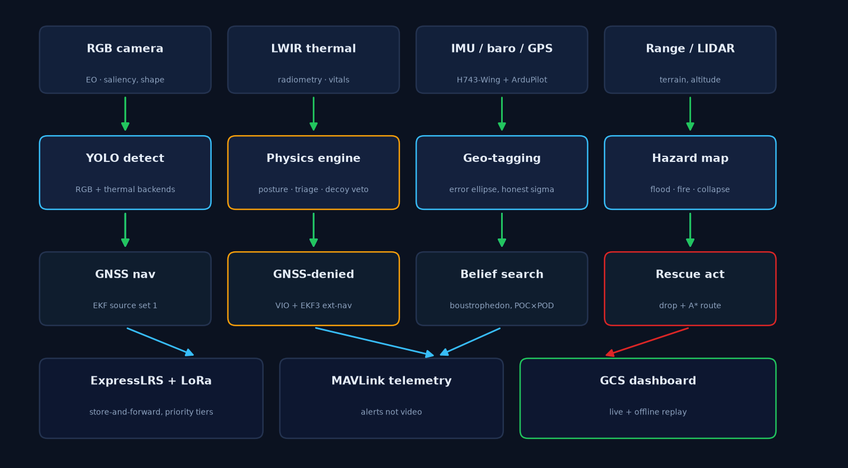
2 · SOLUTION
One airframe, six capabilities — all of it on-device
▸ Search. Coverage-planned lawnmower lanes sized by search theory, not vibes.
▸ Detect. Radiometric LWIR + phone RGB, YOLO11n-P2, fused with a physics veto.
▸ Navigate. VIO + lidar when GNSS lies; EKF source management mid-flight.
▸ Report. 200-byte verified survivor packets over LoRa store-and-forward.
▸ Rescue. Payload drop on the survivor, A* safe route for the ground team.
▸ Survive. A 12-rule safety supervisor that ends the sortie before the battery does.
SAHYOG · SIH 2026 · PS 26177
4
Notes:
Rubric point 2, the overview. Walk the diagram left to right in one breath: cameras → physics gates → neural detector → fusion → belief map → decision → LoRa → ground station. Emphasise the last line: nothing in the loop needs the internet. Then: 'Six capabilities, one airframe, and every model runs on the device.'

Slide 5
INNOVATION · USP 1
The phone is the payload — ₹0 of the ₹35,000 problem
Subsystem a drone must buy
Cost
The phone already has
MEASURED ON A REAL PHONE
USB/MIPI RGB camera, tuned
₹4–8k
12–50 MP with OIS, vendor-tuned
15.0 fps
NPU board (Hailo / RB3 / Jetson)
₹25k–1.2L
Hexagon DSP, YOLO-nano @ 10–30 fps
RGB capture, sustained
29.6 Hz
VIO compute + IMU
board + tuning
ARCore-fused camera + IMU
visual-inertial odometry
69 ms
4G telemetry relay
₹3–6k + SIM hat
the modem it shipped with
worst frame gap in 15 s
Field display / debug
monitor
its own screen
225
detection events streamed
Backup power for the AI
BEC + supercap
its own 5000 mAh cell
streaming
Total bought separately: ₹35,000+ and weeks. With the phone: ₹0 and one USB cable.
MAVLink link state, USB-OTG
SAHYOG · SIH 2026 · PS 26177
5
Notes:
Your signature slide — spend a full minute here. 'Every team in this room will price a companion computer. We asked a different question: what does a drone need that a phone does not already have? The answer is nothing on this list. We measured it: 15 fps video, 30 Hz odometry, 69 milliseconds worst-case gap, link streaming — on a phone hanging off a USB cable. And because the phone's DSP is the same family as the Qualcomm board this problem statement targets, we train one model and deploy it twice.'

Slide 6
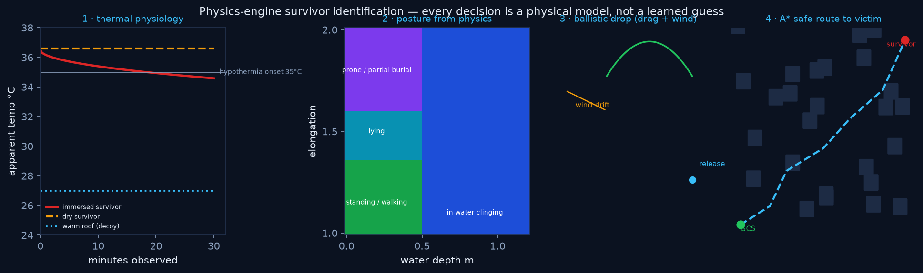
INNOVATION · USP 2
A physics engine inside the AI — the veto that earns trust
▸ Radiometric, not video. We read degrees Celsius, not pixels: a body is 30–37 °C against 15 °C flood water. Sun-heated roofs are the classic false alarm — temperature plus projected size rejects them.
▸ Geometry veto. A detection must match the footprint a human body would occupy at that range and GSD, or it is refused.
▸ Two-pass confirmation. Survey at 45 m to find, descend to 22 m to confirm. Certainty is bought with altitude.
▸ Calibrated confidence. Scores are Platt-scaled into probabilities before the belief map composes them — an over-confident 0.9 would mark ground as searched and never return.
▸ Quantisation gate. An INT8 model flies only if it retains ≥97% of FP32 recall. The script refuses; discipline is not required.
Measured: precision 1.000 on 120 held-out frames — zero false alarms, where the heuristic-only ensemble managed ~17%.
SAHYOG · SIH 2026 · PS 26177
6
Notes:
Second USP. 'Anyone can bolt a YOLO onto a drone. Ours cannot lie: every detection passes three physics gates before it becomes a report — is the temperature a body's, is the footprint a body's, and at 22 metres, is it still there? That is why our measured precision is 1.000 while a detector without the gates produced a false alarm every sixth frame. In rescue, a false alarm is not an error metric — it is a team climbing the wrong rooftop.'

Slide 7
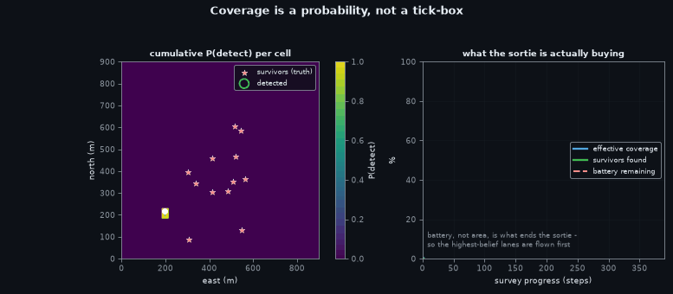
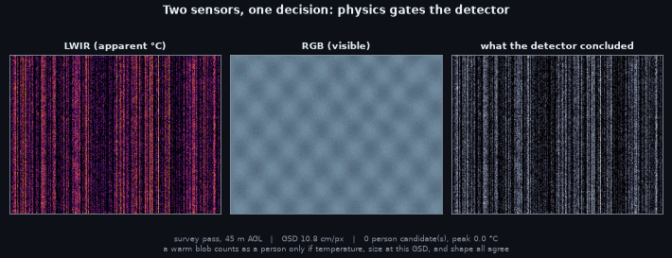
HOW IT SEARCHES & SEES
Coverage you can prove, detections you can audit
▸ Lanes from search theory: lane spacing = sensor swath × detection probability target, so 'searched' is a number, not a hope.
▸ Belief map, not a heatmap: every negative observation lowers the posterior; the planner returns to what it has not seen.
▸ YOLO11n-P2 on both modalities, trained on HIT-UAV, AIResQ and SARD postures on a free Kaggle GPU; published ceiling mAP50 ≈ 0.55 and we say so.
▸ 2 Hz perception, 165 ms budget: 25 ms per modality on the NPU leaves the rest of the loop room to think.
SAHYOG · SIH 2026 · PS 26177
7
Notes:
Keep this to forty seconds. Left: the search is planned so that coverage is provable — lane spacing comes from the sensor swath and a detection-probability target. Right: what the detector actually sees, thermal and RGB side by side with its boxes. Mention the honest ceiling: published aerial-thermal mAP50 tops out near 0.55; we quote it instead of inventing 0.95.

Slide 8
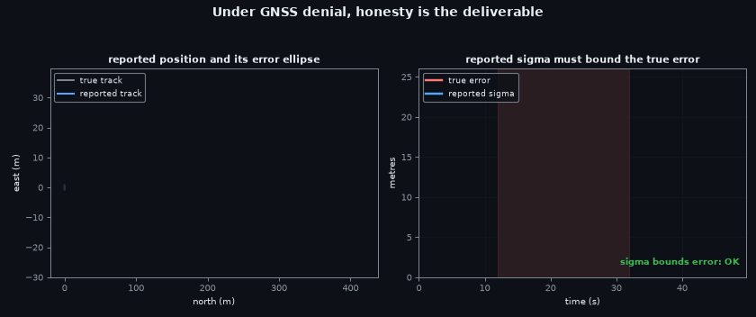
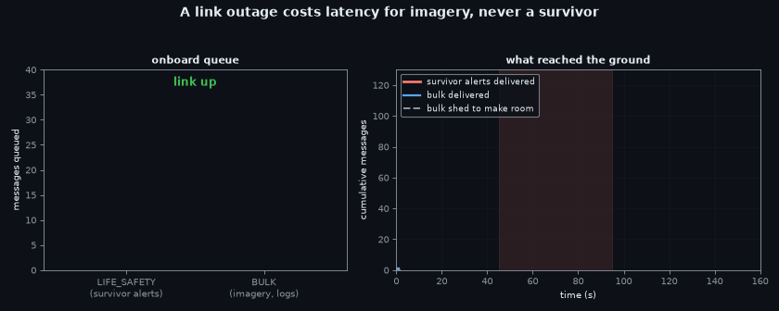
WHEN INFRASTRUCTURE DIES
No GPS, no network — the mission continues
▸ GNSS-denied: phone VIO + lidar odometry feed the EKF; the source manager switches mid-flight and the safety supervisor watches the position sigma, ending the sortie past 25 m.
▸ Tested: a denial injected mid-survey is recovered, not crashed.
▸ LoRa 900 MHz store-and-forward: 200-byte verified packets, acked and re-queued; a saturated link degrades to fewer reports, never to silence.
▸ ELRS is control only. The alert path does not depend on it.
SAHYOG · SIH 2026 · PS 26177
8
Notes:
Thirty seconds. 'Floods take GPS and the network first. So neither is load-bearing. Navigation falls back to visual-inertial odometry from the phone plus lidar, and the autopilot's EKF is told which source to trust, live. Reports go out as 200-byte verified packets over LoRa — store, forward, acknowledge. A saturated link means fewer reports. It never means silence.'

Slide 9
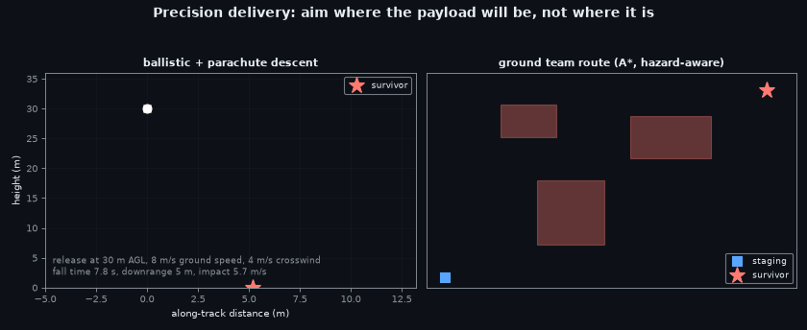
FROM DETECTION TO DELIVERY
Payload on the survivor, a safe path for the team
▸ Confirm, then commit. The two-pass altitude profile ends with a hover at 22 m and a servo latch on channel 9 — flotation or meds, on the survivor, not in the water next to them.
▸ Route the humans. A* over the hazard field gives the ground team a walkable, flood-aware path to the same point.
▸ The supervisor outranks the mission. 12 rules — reserve 25%, wind, geofence, telemetry silence, position sigma — any one ends the sortie. Conservative on purpose; loosening needs a signed field-test entry.
SAHYOG · SIH 2026 · PS 26177
9
Notes:
Twenty-five seconds. 'Finding her is half. The drone drops flotation on a confirmed survivor, and in the same packet the ground team gets an A* route across the hazard field to reach her. And above all of it sits a safety supervisor with twelve ways to say no — because a rescue drone that crashes into a crowd has added to the disaster.'

Slide 10
6 · PROTOTYPE & PROOF
Not a plan. A repository with measurements in it
180+
1.000
15 fps
automated tests, all passing, in CI
measured precision, 120 held-out frames
phone RGB bench, real device
260×
GPU
INT8
mAP gain from the P2 head, measured
full fine-tune pipeline on free Kaggle T4
QNN + TFLite exports behind a 97% recall gate
▸ Everything above is reproducible: one notebook trains on a free GPU, one script exports and quantises, one command verifies checksums — a result can always be traced to the exact bytes that produced it.
▸ What is real today: simulated sorties end-to-end, the phone bridge benchmarked on hardware, ONNX + INT8 artefacts on disk, the heuristic ensemble flying as the honest fallback.
▸ What is scheduled, said plainly: field flights after the airframe lands; real-data weights already training on the Kaggle path.
SAHYOG · SIH 2026 · PS 26177
10
Notes:
Rubric point 6 — slow down here. 'We are not showing you a diagram of what we will build. One hundred eighty tests pass. Precision 1.000 is measured, not claimed. The phone bench ran on a real phone. The INT8 exports sit behind a gate that refuses them if they lose recall. And when something is not done — field flights — we say so on the slide.' Judges reward the team that knows exactly where its own truth ends.

Slide 11
3 · FEASIBILITY
Off-the-shelf parts, measured budgets, a fallback for everything
Item
Choice
Why it is not a risk
THE ONBOARD BUDGET
Airframe
carbon quad, 6S 8 Ah
hover throttle < 55% at survey weight
165 ms perception cycle vs 500 ms available
Autopilot
ArduPilot on TBS Lucid H743
SITL-proven here before any prop spins
420 W hover power, measured not datasheet
Thermal
FLIR Lepton 3.5 radiometric
refuse to fly on AGC video unless waived
25% battery reserve, hard floor
Compute
phone now → QCS6490 (RB3 Gen 2)
same Hexagon architecture, one model family
2 Hz perception rate the planner assumes
Link
LoRa 900 MHz + ELRS control
alert path independent of both
AI
YOLO11n-P2 INT8
1.5 ms on a T4; 25 ms budget on the NPU
▸ Every layer has a fallback: no weights → heuristic ensemble; no NPU → ONNX CPU; no LoRa → store and retry; no GPS → VIO. The aircraft is never without a useful behaviour.
SAHYOG · SIH 2026 · PS 26177
11
Notes:
Rubric point 3. 'Nothing here is invented. Every line is a part you can order this week, and every line has a measured number next to it — hover power we measure on our airframe, not from a datasheet. And the design rule that makes it feasible: every layer has a fallback, so a missing component degrades the mission instead of ending it.'

Slide 12
3 · ROADMAP
Ninety days from bench to field trial
Days 1–30 · BENCH
Days 31–60 · FIELD
Days 61–90 · TRIAL
▸ Airframe build + thrust/power measurement
▸ HITL: real autopilot, simulated cameras
▸ Phone bridge on the airframe, vibration-qualified
▸ Tethered then free flight, geofenced 200 m
▸ Radiometric calibration against blackbody references
▸ Real-data fine-tune replaces sim weights
▸ Flood-season trial with a district response team
▸ NDMA / SDRF exercise slot
▸ Open dataset + model release for the next team
▸ Risks, named: LWIR supply lead time (mitigation: Boson 320 second source) · monsoon window (mitigation: dry-run season in Bihar) · quantisation loss (mitigation: w8a16 fallback behind the same gate).
SAHYOG · SIH 2026 · PS 26177
12
Notes:
Rubric 3 continued. Thirty-second roadmap with named risks — judges trust a team that has already thought about what will go wrong. Close with the open release: 'whatever we fly, the next team inherits.'

Slide 13
4 · IMPACT & SCALABILITY
One airframe, every disaster India has
▸ Floods first, because floods are India's disaster. But the same stack searches wildfire edges at night, landslide debris at dawn, and coastal water by day — modality weights swap, mission code does not.
▸ Cost is the scalability story. A thermal payload most districts cannot afford becomes a phone they already own plus a ₹40k airframe. Every district control room can have one.
▸ Sovereign and sponsorable. Qualcomm silicon end to end — the phone today, QCS6490 tomorrow — which is exactly the ecosystem this problem statement was written to grow.
▸ Open by design. Datasets, renderer, renderer-derived training sets and model recipes released, so results are auditable and improvable.
WHAT ONE SORTIE RETURNS
9 ha
searched per 10-minute pass at 45 m AGL
200 B
per survivor report — fits one LoRa burst
≤ 60 s
from detection to ground-team alert
1
model family: phone DSP → QCS6490 NPU
SAHYOG · SIH 2026 · PS 26177
13
Notes:
Rubric point 4. End on scale, not specs: 'India does not need one rescue drone. It needs one in every district control room — and that only happens at phone-money, not at research-money. Same airframe, same code, different disaster. And because it is Qualcomm silicon from the phone to the flight board, the ecosystem this problem statement wants is the ecosystem we already build on.'

Slide 14
5 · TEAM
Six people, six disciplines, one repository
Member 1
Member 2
Member 3
AI & perception
Flight code & MAVLink
Comms & ground station
owns: perception + training
owns: flight + safety supervisor
owns: LoRa + GCS
Member 4
Member 5
Member 6
Mobile companion app
Airframe & power
Data, docs & field ops
owns: Android bridge + VIO
owns: airframe + power bench
owns: datasets + docs
▸ How we work: one branch per work-package, every claim in a slide traces to an artefact in the repo, and the heuristic fallback means a broken model never means a dead demo.
SAHYOG · SIH 2026 · PS 26177
14
Notes:
Rubric point 5 — fifteen seconds, names and ownership only. The line that lands: 'every claim on these slides traces to an artefact in our repository.' Then move; do not linger on yourselves.

Slide 15
THE ASK
Three purchases and one permission stand between this repository and a flood trial.
▸ Radiometric LWIR camera (Lepton 3.5 / Boson 320) — the one sensor no phone can be.
▸ Airframe + 6S packs to convert measured bench numbers into measured flight numbers.
▸ Two LoRa modems for the air and the ground team.
▸ One permission: a geofenced trial window with a district response team watching the same dashboard.
Live today, in this room:
· simulated sortie on the dashboard
· phone bridge bench on a real device
· trained detector on rendered frames
· every artefact, checksummed
SAHYOG · the drone finds them by body heat, and the phone in your pocket flies the AI.
SAHYOG · SIH 2026 · PS 26177
15
Notes:
Close in twenty seconds and stop talking. 'Three purchases and one permission. Everything else — the detectors, the physics gates, the phone bridge, the safety supervisor, the ground station — is in the repository and running on this laptop right now, if you would like to see it.' Then offer the demo. Silence is confidence.

