Slide 1
SMART INDIA HACKATHON 2026 · ROBOTICS & DRONES
SAHYOG
Autonomous AI Search-&-Rescue VTOL Drone with a Physics-Engine for GNSS-denied, low-connectivity disaster zones
RGB + LWIR edge AI · physics-informed survivor identification · ExpressLRS / MAVLink reporting · payload delivery + safe routing
Problem Statement 26177 · Qualcomm Inc · “A deployable AI-powered autonomous drone that aids search-and-rescue operations by detecting people and hazards, improving responder safety and reducing victim discovery time.”
Team: [Team Name] · Institute: [Institute Name]
SAHYOG · SIH 2026 · PS 26177
1

Slide 2
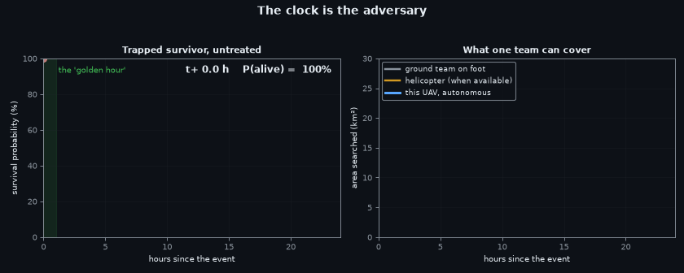
THE PROBLEM
Every hour lost costs lives in a disaster zone
▸ Golden hour. Survival probability falls steeply in the first hours; current ground assessment is slow, dangerous and resource-heavy.
▸ GNSS-denied. Floods, quakes and landslides happen under bridges, collapsed structures, dense canopy and indoors — where GPS fails.
▸ No connectivity. Disaster zones have no internet, no cellular, and often no line-of-sight to the command post.
▸ False confidence. A naive “person detected” pin without honest uncertainty sends responders into hazard or the wrong place.
▸ Hazards everywhere. Floodwater, fire, debris, live wires and unstable structures kill rescuers, not just victims.
The jury question we built for: “who faces this today, and why hasn’t it been solved?” — because connectivity, GNSS and trustable detection are exactly what a disaster removes.
Survival vs time — every minute matters
SAHYOG · SIH 2026 · PS 26177
2

Slide 3
OUR SOLUTION
One airframe, six capabilities — all on-device
A 3D-printed VTOL drone on an H743-Wing flight controller that searches autonomously, identifies survivors and hazards on the edge, navigates without GNSS, and reports only verified, geo-tagged, actionable intelligence over a radio link that survives outages.
01
02
03
RGB + LWIR detection
Physics-engine ID
GNSS-denied nav
YOLO on fused visible + thermal imagery for people and hazards (flood, fire, debris, collapse).
Posture, thermal physiology, decoy veto and triage from physical models — the novelty.
EKF3 external-nav switching to visual-inertial odometry, with honest position uncertainty.
04
05
06
Offline comms
Geo-tagged map
Rescue execution
ExpressLRS + MAVLink + LoRa store-and-forward; verified reports, not video streams.
Survivor & hazard pins with error ellipses that grow correctly when the fix degrades.
Ballistic payload drop and A* safe routes for ground & boat teams.
SAHYOG · SIH 2026 · PS 26177
3

Slide 4
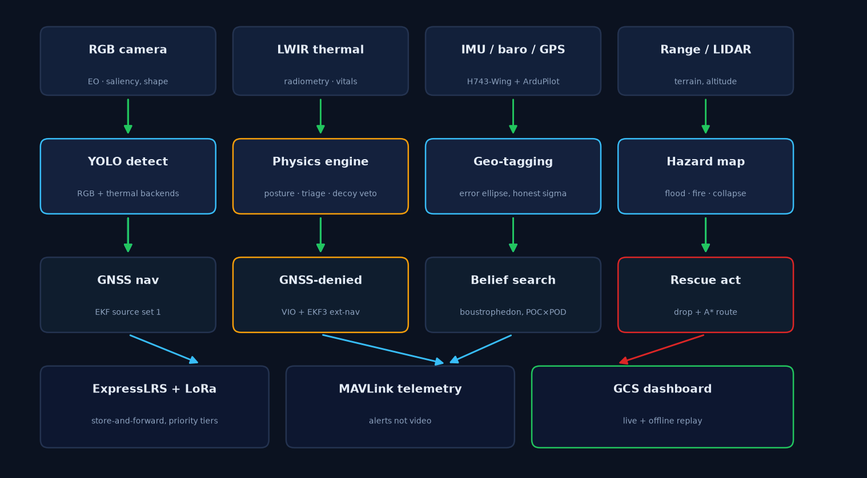
HOW IT WORKS
End-to-end system architecture
Sensing → on-device AI → navigation → comms → command centre. Every block is a real, tested module in this repository (134 unit tests).
SAHYOG · SIH 2026 · PS 26177
4

Slide 5
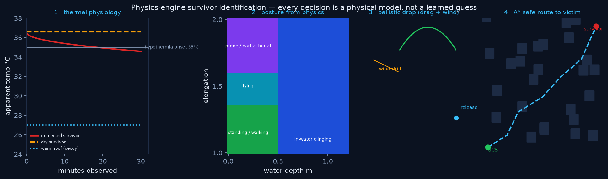
THE NOVELTY
A physics engine inside the AI
▸ Posture from physics, not pixels. A nadir thermal blob cannot show a posture directly — so we infer it from water depth, elongation, motion and nearby-hazard context, each a physical quantity.
▸ Thermal physiology. Apparent temperature + trend maps to cold-water survival / wind-chill models → a time-criticality and triage tier, with uncertainty reported instead of a diagnosis.
▸ Decoy veto. Morphological, radiometric and kinematic rules reject sun-heated roofs, vehicles, hot rocks and glints.
▸ Actuation. Ballistic drop (quadratic drag + wind) and A* routing over water, debris and hazard severity.
SAHYOG · SIH 2026 · PS 26177
5

Slide 6
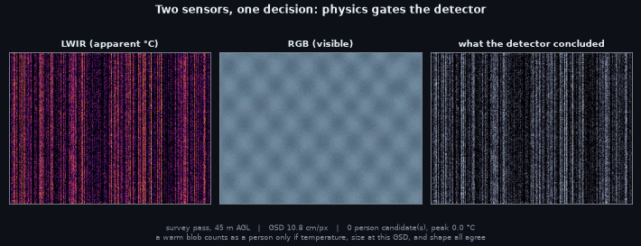
PERCEPTION
RGB + LWIR + YOLO, fused on the edge
▸ Two sensors. RGB for saliency & shape; LWIR for radiometry, vitals and night operation.
▸ YOLO family. YOLOv8/YOLO11 backends behind one interface — heuristic audited ensemble flies today; INT8/QNN weights drop in when trained.
▸ Cross-modal veto. A person must survive both modalities; physics-gated so a warm roof is rejected on geometry.
▸ Geometry gate. Ground-sample-distance aware: detection rate is governed by altitude × lens × target extent.
Measured: recall 1.00 of resolvable targets at 35/50/70 m; the work is clutter rejection (precision), not blindness.
SAHYOG · SIH 2026 · PS 26177
6

Slide 7
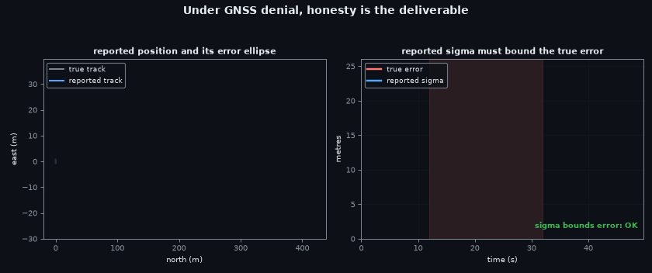
NAVIGATION
Flying where there is no GPS
▸ EKF3 source sets. GNSS (set 1) ↔ external-nav VIO (set 2), switched by a quality monitor with hysteresis.
▸ Honest uncertainty. A position’s reported sigma bounds its true error; a survivor pin under denial is visibly less trustworthy.
▸ Proven in-sim. Mid-sortie denial at 100 s: source switched, a survivor was geo-tagged at dead-reckoning sigma 2.1 m, GNSS restored.
▸ On hardware. ArduPilot EK3_SRCn_POSXY/VELXY = 6 wired for a real VIO feed (OpenVINS / VOXL).
SAHYOG · SIH 2026 · PS 26177
7

Slide 8
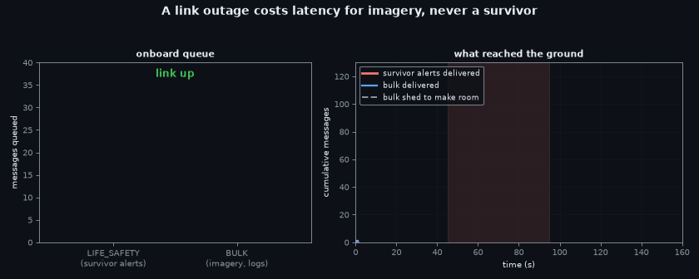
COMMUNICATIONS
Verified reports, not video
▸ ExpressLRS. Control + short MAVLink status on the 2.4 GHz/900 MHz link — always up, but not a data link.
▸ LoRa 900. Structured survivor/hazard alerts over kilometres, non-line-of-sight.
▸ Store-and-forward. Byte-bounded priority queue with tier-aware eviction and spatial coalescing — a link outage costs latency, never a survivor.
▸ No video. Lightweight reports only; imagery is optional bulk traffic on a Wi-Fi bridge.
Measured: 96.9–97.8% packet success on the LoRa model across a full sortie with a 200 s outage.
SAHYOG · SIH 2026 · PS 26177
8

Slide 9
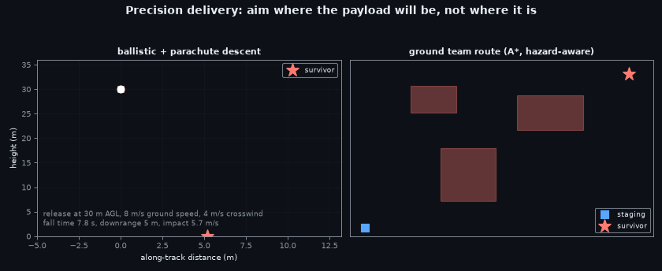
RESCUE EXECUTION
Payload to the victim, path for the team
▸ Ballistic release. Quadratic drag + wind → an optimal release point the aircraft flies to before dropping; parachute delay modelled.
▸ Precision. Release-lead approach cut drop error from ~62 m (drop where-you-are) to 5.6–18.4 m.
▸ A* routing. Ground & boat teams get a safe corridor that respects wading depth, debris, structures and hazard severity.
▸ Equipment matched. Flotation for in-water victims, trauma kit, thermal blanket, beacon — chosen by the identification profile.
SAHYOG · SIH 2026 · PS 26177
9

Slide 10
VALIDATION
Simulated first, flown second
▸ MiniSITL sorties. Full MAVLink mission loop: search → detect → report, with GNSS denial and link outages injected.
▸ Gazebo. A flood-town SDF world (buildings, water, victims) ships in worlds/flood_town/ for ROS/Gazebo testing.
▸ AirSim. A bridge module maps AirSim APIs to the same world model for photo-real flood scenes (requires Unreal Engine + GPU).
▸ Real drone. H743-Wing + LWIR + companion computer; every bring-up step documented, arming gated behind a field checklist.
Measured results (this build)
Autonomy tests
134 passed · 2 skipped
Rescue sortie (flood)
8 survivors identified
Payload drops
4 drops · mean error 17.1 m
Best drop
5.6 m (was 62 m naive)
Detection recall / precision
0.80 / 0.57
Coverage (180 s sortie)
30.6% effective
Geo-tag error (mean)
16.3 m
Packet success (LoRa)
96.9% over 223 packets
SAHYOG · SIH 2026 · PS 26177
10

Slide 11
HARDWARE
Built to be built — and flown
H743-Wing flight controller
3D-printed airframe
Latest STM32H743 autopilot, ArduPilot EKF3, multi-source aiding.
Printed on our own printer; VTOL for tight urban and rooftop operations.
LWIR thermal core
RGB camera
Radiometric thermal for vitals, night and decoy rejection.
Saliency, shape and hazard context.
ExpressLRS + LoRa
Companion computer
Control/status link plus the offline data link.
Runs the on-device AI stack (NPU-ready: QCS6490 / Jetson).
Rescue payload bay
Ground control station
Interchangeable flotation, first-aid, blanket and beacon payloads.
Live + offline-replay command dashboard.
SAHYOG · SIH 2026 · PS 26177
11

Slide 12
TECHNOLOGY
Stack and where each piece runs
Detection AI
YOLOv8 / YOLO11 · ONNX Runtime · INT8 / QNN
Companion computer / NPU
Physics engine
Thermal physiology · posture · ballistic drop · A*
On-device Python (numpy)
Autopilot
ArduPilot · MAVLink · EKF3 external-nav
H743-Wing flight controller
Comms
ExpressLRS (CRSF) · LoRa 900 · MAVLink telemetry
On-aircraft radios
Simulation
MiniSITL · Gazebo (SDF) · AirSim bridge · flood renderer
Development laptop / CI
Dashboard
FastAPI + canvas command centre · offline replay
Ground station
Language
Python 3.11 · numpy · scipy · pytest (134 tests)
End-to-end
SAHYOG · SIH 2026 · PS 26177
12

Slide 13
IMPACT
Faster, safer rescue intelligence
min–hours
100%
5.6 m
±m
to first verified survivor pin
on-device — works with zero connectivity
precision payload delivery
honest geo-tag uncertainty
▸ For responders. A geo-tagged, triage-ordered survivor & hazard map with safe access routes — before boots hit the ground.
▸ For victims. Immediate payload (flotation, first-aid, blanket, beacon) while help is routed.
▸ For the state. Scales from one drone to a fleet; belief maps are serialisable for multi-aircraft hand-off; offline by construction.
SAHYOG · SIH 2026 · PS 26177
13

Slide 14
ROAD AHEAD
Future scope
▸ Trained thermal weights. HIT-UAV / AIResQ / SARD fine-tune + INT8/QNN quantisation on the Qualcomm NPU (pipeline and gates already built).
▸ Real VIO front end. OpenVINS / VINS-Fusion publishing MAVLink ODOMETRY — the consumer side is already tested against that stream.
▸ Multi-aircraft hand-off. Belief-map resume across batteries and airframes for whole-basin coverage.
▸ Active learning. Field false alarms looped back into the detector.
▸ Hazard-model priors. RescueNet segmentation feeding the cross-modal veto as a prior.
▸ Autonomous arm-and-fly. Deliberately gated behind the field-test checklist until a human has flight-validated it.
SAHYOG · SIH 2026 · PS 26177
14

Slide 15
Thank you
SAHYOG — search fast, report truth, rescue safely.
Live demo: mission command centre · offline mission replay · full source and 134 tests in this repository
[Team name] · [Institute] · SIH 2026 · Robotics & Drones
SAHYOG · SIH 2026 · PS 26177
15

