Slide 1
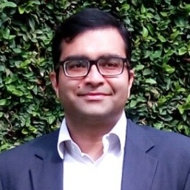

Coach Profile - Shashank Shekhar Singh Senior Manager – Data Science @ Diageo
https://www.linkedin.com/in/shashank-shekhar-singh-693ab615/
Data Scientist with 13+ years of work experience, where he:
Currently leads the Data Science Agenda in the area of Consumer Marketing, Digital marketing & commerce and Finance for Diageo.
In the past he designed end to end in-house AI/ML based Fraud Analytics product for Biometric Identity Fraud Detection and Prevention from scratch for Govt of India for their Aadhaar program
Helped Telcos across EU, & ME and Africa regions to fight Fraud and prevent revenue leakages other wise through improvising Fraud Analytics and Revenue Assurance product while working at Subex Ltd.
Education wise he is :
Certified from Big Data Analytics Program of Indian Institute of Management, Bangalore
Bachelors in Electronics & Communication Engineering from UPTU, Lucknow
Outside of work he loves cooking up lip smacking dishes, is a fitness enthusiast and goes on offbeat treks

