Slide 1


SGC – session 1
Mentor Connect
3rd Jan, 2021

Slide 2
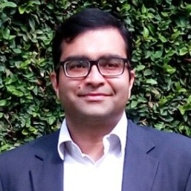

Coach Profile - Shashank Shekhar Singh Senior Manager – Data Science @ Diageo
https://www.linkedin.com/in/shashank-shekhar-singh-693ab615/
Data Science Leader by title and hands on practitioner by passion.
Passionate about transforming data into actionable insights through Data Science, Machine Learning and Artificial Intelligence that drive business decisions and help create shared success
10+ years of work experience spanning across, Marketing Analytics, Digital Analytics, Fraud Analytics, Predictive Modeling, Machine Learning, NLP and forecasting at scale spanning across wide variety of industries (CPG, Telecommunications, Biometric Solutions and E-Governance)
Currently lead the Data Science initiatives in the area of Consumer Marketing, Digital marketing & e-commerce for Diageo.
Designed end to end in-house AI/ML based Fraud Analytics stack for Biometric Identity Fraud Detection and Prevention for Govt of India for their Aadhaar program
Helped Telcos across EU, & ME and Africa regions to fight Fraud and prevent revenue leakages other wise through improvising Fraud Analytics and Revenue Assurance product while working at Subex Ltd.

Slide 3

Let’s break some Ice

Slide 4
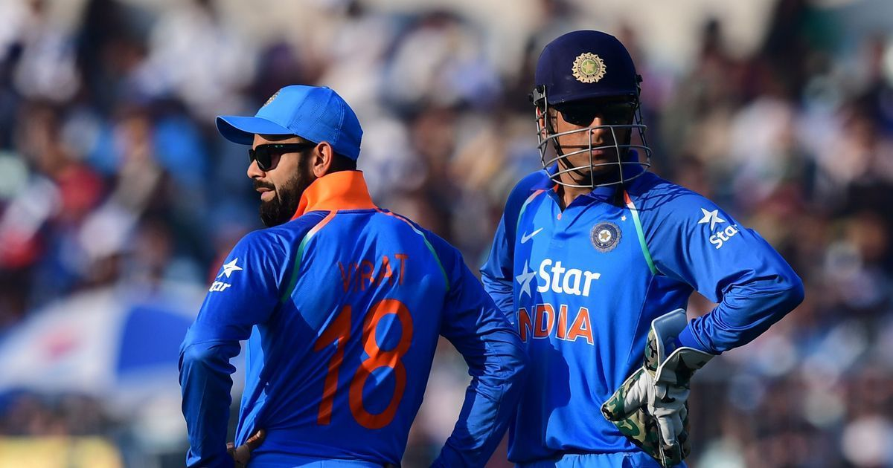
Choose your Captain

Slide 5
Overview of upcoming SGC sessions
Career Guidance
Resume / IDP / Goal sheet prep & feedback
Articulation / Story Telling with Data
Project Portfolio
Soft Skills & Strategies to handle interviews / discussions
1
5
Track specific doubt resolution and topic discussions
Track Selection
Common Curriculum
Python for DS & Visualization
Career Landscape
Inferential Statistics
Exploratory Data Analytics – Flip Classroom
machine learning module – Regression / Classification & Clustering - Flip Classroom

Slide 6


