Slide 1
KISS SkillBridge
CS 31001 SOFTWARE ENGINEERING · GROUP DEMONSTRATION
From a student’s application to a certificate anyone can verify
Shashank Singh · Arnav Ambasta
kiss-vtmp.vercel.app · KIIT, Autumn 2026
Notes:
Shashank opens. We built a web portal that takes every vocational student at KISS from applying to a course to a certificate an employer can check in seconds. We each present our own part: Shashank the original design and build, Arnav the testing, quality and maintenance after release.

Slide 2
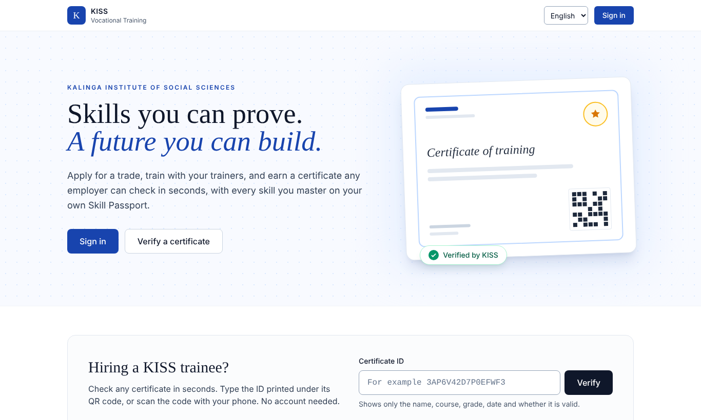
Paper records, certificates nobody could check
UNIT 1 · A SOCIALLY RELEVANT PROBLEM
KISS trains tribal students in vocational trades. Applications, batches, attendance and marks lived on paper and in spreadsheets, and an employer had no way to tell a real certificate from a fake one.
User | Needs
Student | Apply, follow training, get and share a certificate
Trainer | Attendance, marks, who is falling behind
Admin | Courses, approvals, batches, completion, reports
Employer | Check a certificate without an account
Quality attributes first: correct rules, privacy, Odia and Hindi, works on 3G phones, every change audited.
Shashank · BRD §1–§5, NFR-01…NFR-14
Notes:
Who uses it and what matters to them. The quality attributes were decided before any code: correctness of the rules, privacy of student data, local languages, slow phones, auditability.

Slide 3
Iterative and incremental, with a written plan first
UNIT 1 · PROCESS MODEL
1 · PLAN
2 · BUILD
3 · RELEASE
4 · ITERATE
Written spec
14 sprints
3 releases, 2 gates
Feedback rounds
Project documentation, BRD v1.0, TAD v1.0
Each a deployed slice with tests and a sprint-log entry
Acceptance tests on the live site before sign-off
Test run, logic review, security review: 11 pull requests
Why not waterfall: the client’s real needs (programmes, automatic approval) only showed once they used it.
Why not pure agile: rules about certificates carry weight, so they were numbered first and change only by a BRD amendment.
Shashank · Scrum practices: definition of done, small commits, CI on every push, reviewed pull requests · PROGRESS.md
Notes:
Plan-driven start, then sprints. Each sprint had a definition of done: lint, typecheck, tests, the API description, seed data, translated strings, and a progress entry. Gate 1 and Gate 2 were acceptance tests on the live site.

Slide 4
Every rule numbered, every rule tested
UNIT 2 · REQUIREMENTS ENGINEERING
28
Decision table: can a student complete? (BR-09)
Condition | R1 | R2 | R3 | R4 | R5 | R6
Attendance ≥ 75 % | Y | N | – | – | – | –
Every ended session marked | Y | – | N | – | – | –
All mandatory marks in | Y | – | – | N | – | –
Aggregate ≥ 40 % | Y | – | – | – | N | –
Trainer recommends | Y | – | – | – | – | N
Eligible? | Yes | No | No | No | No | No
business rules, BR-01…BR-28
14
quality requirements, NFR-01…NFR-14
120/120
requirements and rules traced to a test; CI fails otherwise
SRS = BRD.md, in IEEE 830 order. Unit-tested at the boundaries: 74.99 vs 75.00 % attendance, 39.99 vs 40.00 % aggregate. Thresholds are settings, not code.
Shashank · BRD.md, TRACEABILITY.md, completion/rules.ts
Notes:
The SRS is the BRD. Each requirement is a BRQ with a priority; each rule a BR. A script checks that every one is cited by a test and fails CI if not. The decision table is the completion rule exactly as the code implements it.

Slide 5
A modular monolith: high cohesion, low coupling
UNIT 2 · DESIGN
Browser
React
Security pipeline
helmet → CORS → limit → auth → role → owner → validate
26 modules
routes → service → rules
PostgreSQL
45 tables
Principle | In the code
Cohesion | One module per business area: enrollments, batches, completion, passport…
Coupling | Modules call only each other’s service functions; core never imports add-ons (a test checks it)
Separation of concerns | Business rules only in services; pure rule functions unit-tested at boundaries
Information hiding | Public pages return name, course, grade, date only (BR-15)
Configuration over code | 50 thresholds and switches in a Settings table, changed by the admin and audited
Shashank · TAD.md, ER.md; UML diagrams: PROJECT_REPORT.md §6
Notes:
Point out the pipeline every request passes through, and that the rules live in one place: services, with pure functions in rules.ts. The UML diagrams are in the project report, section 6, if asked.

Slide 6
Chosen for two people, no budget, slow phones
UNIT 2 · TECHNOLOGY CHOICES
Layer | Technology | Why
Language | TypeScript, shared Zod schemas | One language; browser and server check data the same way
Web app | React, Vite, Tailwind, TanStack Query | Pages load on demand for slow phones; consistent design
Languages | i18next, Noto fonts on demand | Odia and Hindi without code changes; small pages
API | Node 20, Express | Long-term support; runs as a serverless function
Data | PostgreSQL 16, Prisma | Constraints and transactions protect the rules; versioned schema
Security | JWT + httpOnly cookie, bcrypt, helmet | Stateless sign-in; tokens out of reach of page scripts
Certificates | PDFKit, qrcode (server side) | Can’t be altered in the browser
Hosting | Vercel, Neon, Blob, Cron | Free, no server to maintain, deploys every merge
Shashank · decision records ADR-01…ADR-10 in TAD.md; alternatives in the Presenter’s Guide §5
Notes:
Each choice follows from the constraints: two developers, a few weeks, zero budget, cheap phones, rules that must be right. If asked about alternatives: microservices (too much for two people), MongoDB (no relational constraints), server sessions (no shared memory on serverless), Render (needs a card).

Slide 7
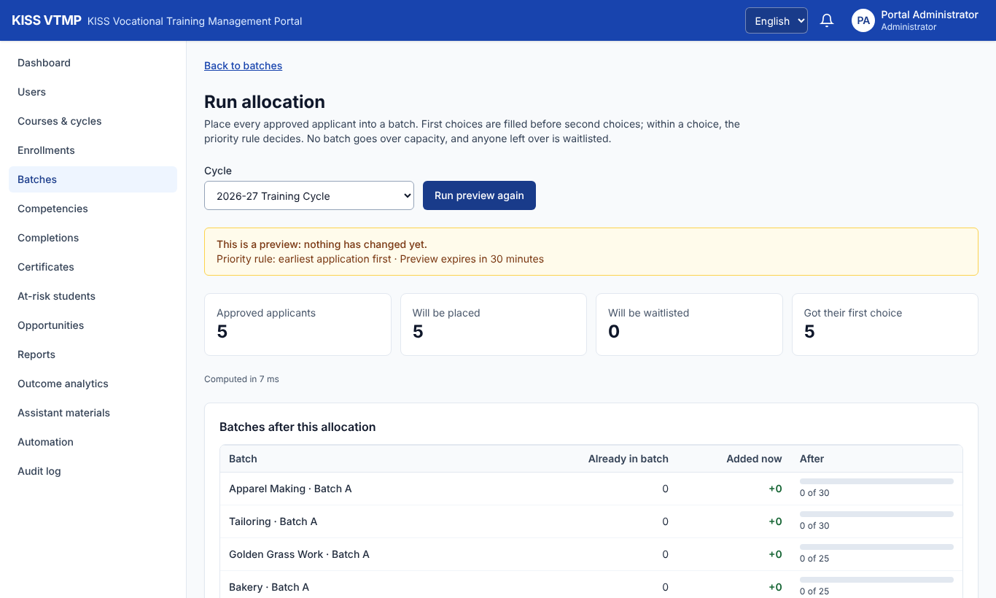
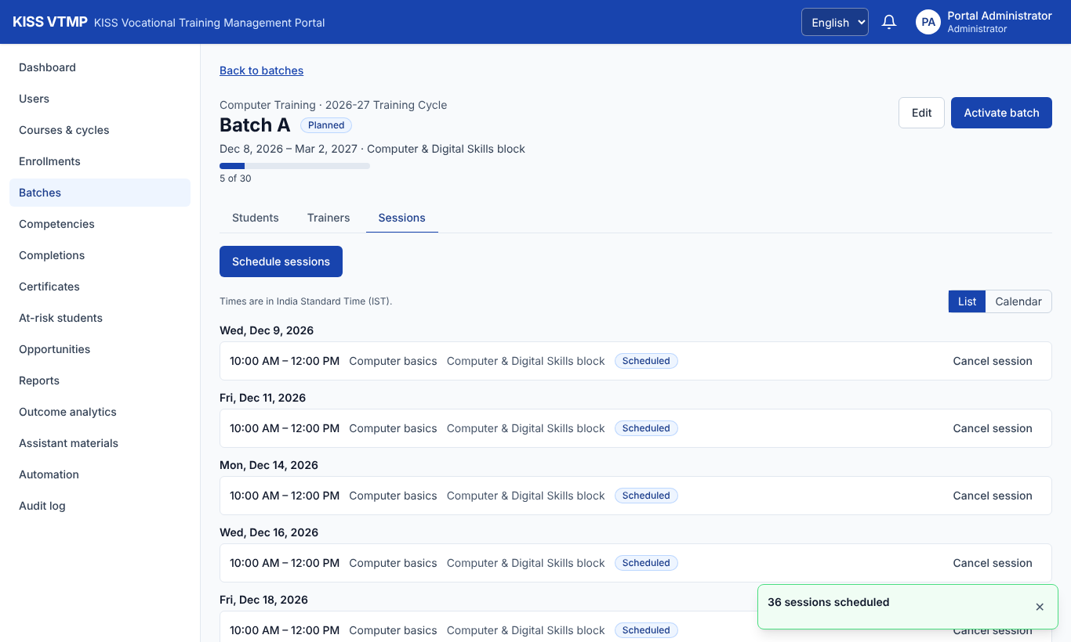
Apply, approve, allocate, schedule
LIVE DEMO · PART 1
Preview first: nothing changes until the admin confirms
A weekly schedule in one step, clashes caught first
One application per cycle while the window is open (BR-01, BR-02) · capacity and preference rank (BR-03, BR-04) · every step audited
Notes:
Switch to the browser. Front page, sign in, switch to Odia and back. Admin: Courses & cycles shows the five programmes. Student window: student006 → Courses → cycle → Computer & Digital Skills → Computer Training → Apply → Submit: approved at once (automatic approval). Admin: Batches → Run allocation → Run preview → Confirm. Open Computer Training · Batch A: the students are there. Sessions → Schedule sessions → weekly Mon/Wed/Fri. If past 7:00, skip scheduling.

Slide 8
Tested at every level, on every push
UNIT 4 · TESTING
Level | Tool | What it proves
Unit (white box) | Jest | Rule functions at their boundaries
Integration | Jest + Supertest | Every endpoint, its checks, transactions, audit
System (black box) | Playwright | Whole journeys, desktop and phone
Acceptance | Gate 1, Gate 2 | Release criteria on the live site
Regression | GitHub Actions | All of it on every push and pull request
Security | Route suite | Who may call each of 177 routes
Accessibility | axe-core | Every page: 0 serious issues
491
API tests, 59 files, all passing
79
browser tests, 16 files
Arnav · drivers: fixtures per test; stubs: mock AI and storage providers, so no test calls a paid service · TEST_PLAN.md
Notes:
Arnav takes over. Name the levels from the course: unit is white box on the rule functions, system tests are black box through the browser, acceptance is the two gates, regression is CI on every push. The security suite pins who may call each route.

Slide 9
Three review rounds after release
UNITS 3–4 · VERIFICATION, VALIDATION AND SQA
ROUND 1 · VALIDATION
ROUND 2 · VERIFICATION
ROUND 3 · SECURITY
22
8 + 9
51
findings from a site test run
logic gaps and manual steps
attacks on the running API
Every role, black box. 20 fixed; 2 shown not to be defects.
Rules checked against real cases: 2 amended, 6 new (BR-23…28); 9 steps automated.
Plus code review and a dependency audit: 3 medium, 4 low, all fixed.
SQA as practised: every change through a reviewed pull request · strict TypeScript and lint with no warnings · each fix ships with a test that fails on the old code · requirements amended in the BRD before the code changes. Closest to CMM level 3, defined.
Arnav · CHANGELOG.md v1.1–v1.2.2, pull requests #1–#11
Notes:
Validation asks: did we build the right thing? Round 1 used the site as each role would. Verification asks: did we build it right? Round 2 checked the rules against real cases, for example unmarked sessions that inflated attendance. Round 3 attacked the running system. Every fix has a test that fails on the old code.

Slide 10
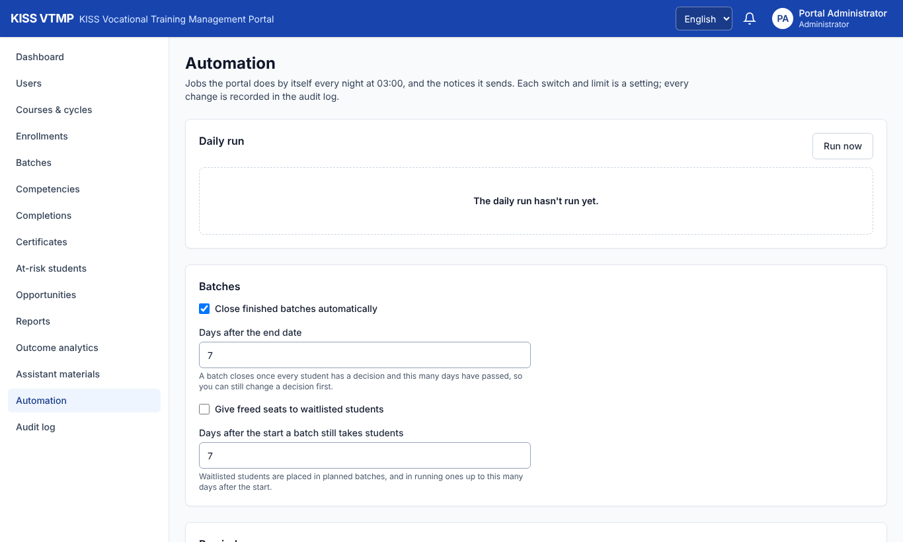
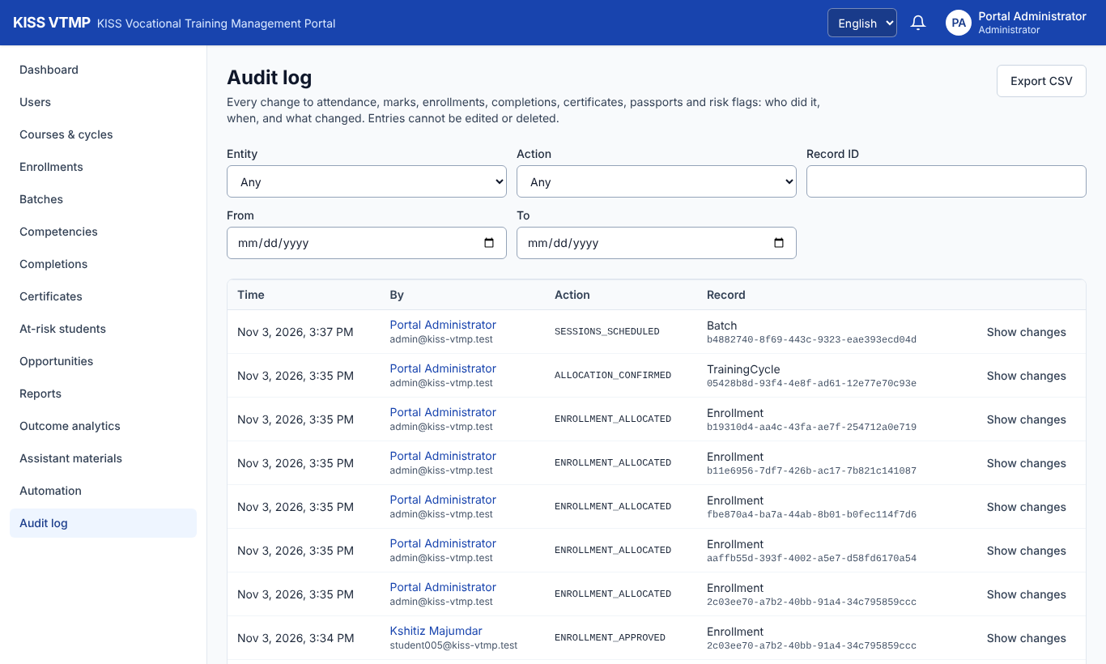
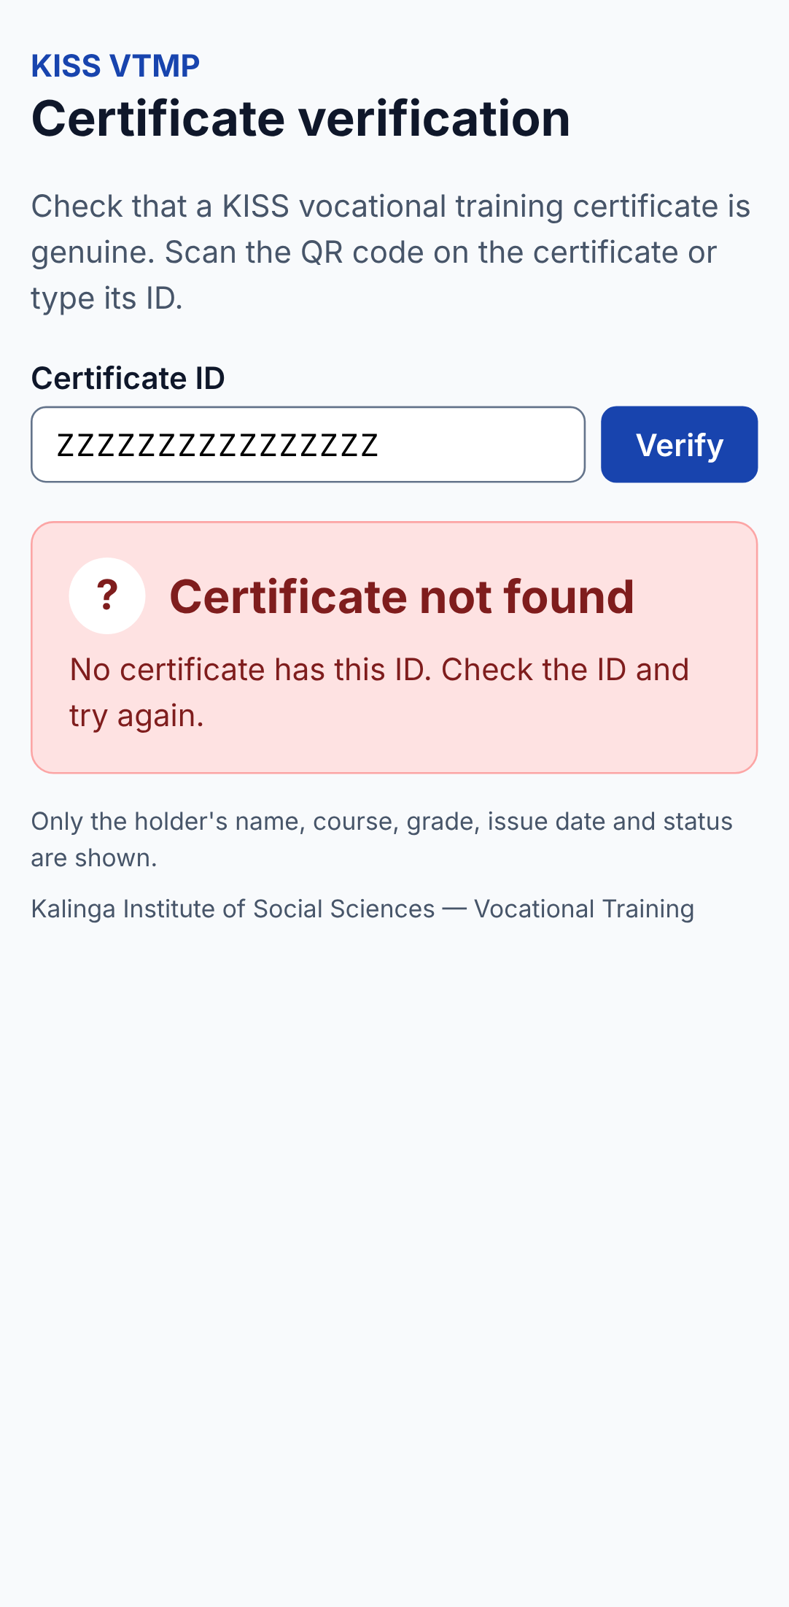
Automation, audit trail, public verification
LIVE DEMO · PART 2
Nine manual steps now run nightly
Who did what, when; the log can’t be edited
Any phone, no account
Perfective maintenance (A1–A9) · insert-only audit log · public fields whitelisted (BR-15)
Notes:
Admin: Automation. Show the switches and limits, the last run, press Run now. Users → Import students: the CSV is checked first, then all or nothing. Audit log → filter entity Enrollment: the submissions, approvals and the allocation from part 1. Phone view: /verify with a wrong ID shows Certificate not found; the page shows name, course, grade and date only. If past 11:00, skip the import.

Slide 11
All four kinds of maintenance, after release
UNIT 5 · MAINTENANCE
Corrective
Adaptive
Unmarked sessions inflated attendance; 20 wrong passwords sent at once never locked the account
API moved to serverless; rate limits kept in the database; jobs on a cloud scheduler
Perfective
Preventive
Automation A1–A9, CSV import, programmes, the public front page
Browser security headers, a dependency update, search escaping, a separate admin password
Arnav · each change: BRD amendment → code → test that fails on the old code → pull request
Notes:
One example of each. The attendance one is the best story: a session nobody marked used to be left out, so a student who missed it kept a higher percentage. Now every ended session must be marked before completion. The lockout race: wrong passwords sent in parallel all read the same counter; now the database adds one atomically.

Slide 12
COCOMO says 15 months; it took three weeks
UNIT 3 · METRICS AND ESTIMATION
38.9
≈ 1,066
1.67
KLOC of product code, plus 11.9 of tests
function points (996 unadjusted)
average cyclomatic complexity, 2,521 functions
Basic COCOMO, organic | Estimate | Actual
Effort 2.4 × 38.9^1.05 | 112 person-months | 2 people
Duration 2.5 × E^0.38 | 15 months | ≈ 3 weeks
Average staff | 7.5 people | 2 + an AI assistant
COCOMO’s 1981 constants assume hand-written code. With frameworks and an AI coding assistant, size measures still describe the product, but effort models need recalibrating.
Arnav · FP: 90 inputs, 10 outputs, 64 inquiries, 45 files, 3 interfaces; VAF 1.07 · PROJECT_REPORT.md §11.5
Notes:
The numbers come from the repository: non-blank lines, ESLint’s complexity rule, and the route list for function points. 22 functions are above 10, the largest being the allocation algorithm and the risk level, which are the most unit-tested. The COCOMO gap is the honest finding of the estimate.

Slide 13
Planned risks, and what really happened
UNIT 3 · PROJECT MANAGEMENT
Risk | What happened | Mitigation that worked
Scope growth | 20 features instead of the MVP’s 9 | MVP frozen and shipped first (Gate 1); the rest in later releases
Security gaps | None in role or ownership checks | A suite over every route; a later attack test found only lockout and header gaps
Testing time | Avoided | Tests written with each feature (definition of done)
Deployment | A host wanted a card | API moved to Vercel in Sprint 2; redeployed on every merge
Zero budget | No paid AI keys | AI assistant built with mock providers, switched off live
New: fork workflow | Merge conflicts, no CI secrets | Merge main before each PR; one repository with write access
Timeline: Sprints 0–5 (19 Oct) · Gate 1 (23 Oct) · Gate 2 and Release 3 (26 Oct) · review rounds and PRs #1–#11 (27 Oct–2 Nov) · programmes and clean start (3 Nov). WBS, Gantt and the full register: Project Documentation v2.1 §20–§22.
Both · demo risk plan: a local copy on a fresh database is ready if the free hosting is slow
Notes:
Both presenters. The planned risk register was written before the project; this table compares it with what happened. The new risk we didn’t plan for was working from a fork.

Slide 14
With an AI writing code, the discipline matters more
UNIT 5 · EMERGING TOPICS
SaaS
AI-based software engineering
Delivered as a service on managed platforms: Vercel for the app and API, Neon for PostgreSQL, Vercel Blob for files. No server to run, zero cost; jobs and rate limits designed for serverless.
Most code and documents were written with Claude Code. We decided what to build, reviewed every change, ran the tests and merged. Numbered rules, tests for every rule and small reviewed changes kept the generated code correct.
Both · the product also has an AI training assistant with cited answers, built and tested with mock providers
Notes:
Be direct about how the work was done: an AI coding assistant wrote most of it, under our direction. The lesson for the course: requirements first, rules in one place, a test for every rule and reviewed small changes are exactly what makes that safe.

Slide 15
What we would add next, and why
FUTURE WORK
NEXT · GO-LIVE
SOON · NEXT TERM
LATER · GROWTH
Load KISS’s real students (CSV import is ready)
Native-speaker Odia and Hindi review
Backups, monitoring, a data protection review
Separate admin password, a second admin
SMS or WhatsApp notices (paid)
Paid hosting: no 2.7 s cold start
Switch on the AI assistant (paid)
Two-factor sign-in for admins; offline attendance
Digitally signed certificates
National-system integration, if KISS wants it
Employer portal; Android app
More campuses on one portal
Both · not planned: microservices; at KISS’s scale a modular monolith is cheaper and simpler
Notes:
Lead with go-live: the system is ready; what it needs is real data, a translation review and operational safety (backups, monitoring, data protection). Paid items are flagged because the project runs at zero cost today.

Slide 16
Who did what
CONTRIBUTIONS
Shashank Singh
Arnav Ambasta
Design and original build · owner
Testing, maintenance, documentation · PRs #1–#11
Project documentation, BRD and TAD v1.0
Sprints 0–13: core workflow to certificates, passport, intervention, scheduling, evidence, matcher, languages, analytics, AI assistant
Security suite, traceability check, Gates 1 and 2, deployment
Programmes, clean seed, front page; merged PRs #1–#11
Site test run, logic review, security assessment; every finding fixed with tests
BRD and TAD v1.1 and v1.2, changelog, test plan
Password recovery, withdrawal, closing batches, automation A1–A9, CSV import
Lockout race, security headers, dependency and search fixes
From the repository history · Arnav’s commits show as “Claude” in git, merged from ArnavAmbasta-05
Notes:
Each presenter confirms their own column in one sentence. If asked about the git author name: Arnav’s work was done in Claude Code sessions, so the commits carry Claude’s identity and came in through his pull requests.

Slide 17
Every requirement traced, every change reviewed
THANK YOU · QUESTIONS
Documents
Try it
PROJECT_REPORT · BRD (SRS) · TAD · ER · TEST_PLAN · TRACEABILITY · USER_GUIDE · Project Documentation v2.1
kiss-vtmp.vercel.app
github.com/ShashankSinghhh/kiss-vocational-training
Notes:
Close together. Point to PROJECT_REPORT.md in the repository for the full report; take questions.

