Slide 1
Digital Books
Presentation by
Shashank Sood

Slide 2
Problem Statement
Build DigitalBooks app which takes traditional books a step further, combining text with visual and audio elements to make authors' publications truly multimodal. Authors can write down their thoughts and assemble a collection of original or curated content ranging from photos, drawings, and images to audio and video clips -- in some cases, even animated text.
Key Features –
Any User can access the website content and search books based on Author name, Price and Category.
A Guest user can search books and provide name and Email Id to purchase any existing book without any login and check buying history.

Slide 3
Business Requirements
Reader
Reader can search for books based on category, author, price
From search results, reader should be able to select a specific book and go ahead to complete purchase by providing Name and Email ID
On successful purchase, unique payment_id need to be generated. Payment should be taken as a guest user only.
Reader can read only purchased books.

Slide 4
Business Requirements(contd.)
Author
Author shall be able to create account.
Author shall be able to login/logout.
Author shall be able to add/edit book.
Author shall be able to block and unblock an book. When book is blocked
  Books will not be shown in Search results.
  Readers (who have purchased book) should get notification about the unavailability of book.

Slide 5
Key Technologies used
In this Project, technologies used are
Sql Server for relational database system.
.Net Web Api Core 5.0 is used to connect to database and work on all the records/tables present in database.
Api Gateway(Ocelot) is used to have a common entry point for the whole application.
Microservices Architecture.
Angular is used for designing the UI of application.
Azure features such as Azure App Service, Azure Web App, Azure SQL Database and Azure API management.

Slide 6
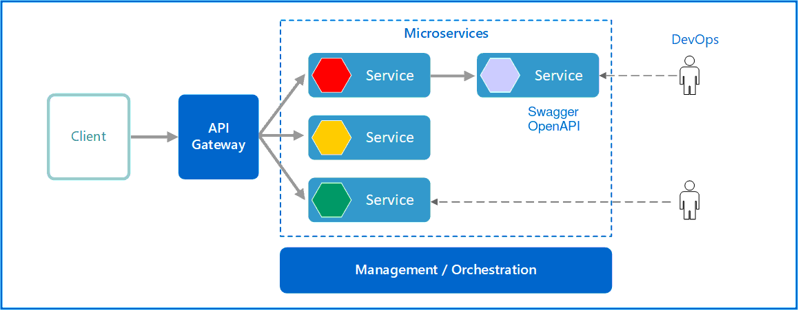
Architecture

Slide 7
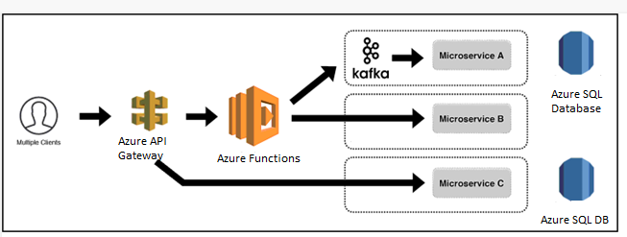
Cloud Architecture

Slide 8
Database Overview
The Digital book database has 3 primary tables
Book Table
DigitalBooksUser Table
Payment Table
Book table is used to store and manipulate data related to books
DigitalBooksUser table is used to store/ manipulate User data based on roles i.e Author/Reader.
Payment Table is used to keep track of all purchase history by a particular user.

