Slide 1
NETWORK ANALYSIS FOR SINGAPORE
MRT NETWORK

Slide 2
PROBLEM STATEMENT
Transportation network supports efficient flow of people between different parts of the city.
We use centrality measures to determine critical nodes in a transportation network, to improve the design of the network and devise plans for coping with the network failures.
Betweenness is more evenly distributed among stations when the metro network is large allowing stations to share commuter load equally.

Slide 3
DATASET
Scraped data from Wikipedia page of Singapore’s stations to create a dataset for list of stations that are planned and currently in operation.
The scraping returned a data set of 268 observations and 9 variables.
Cleaning of variables to remove planned and inoperative stations leaves a dataset of 196 observations of 5 variables.

Slide 4
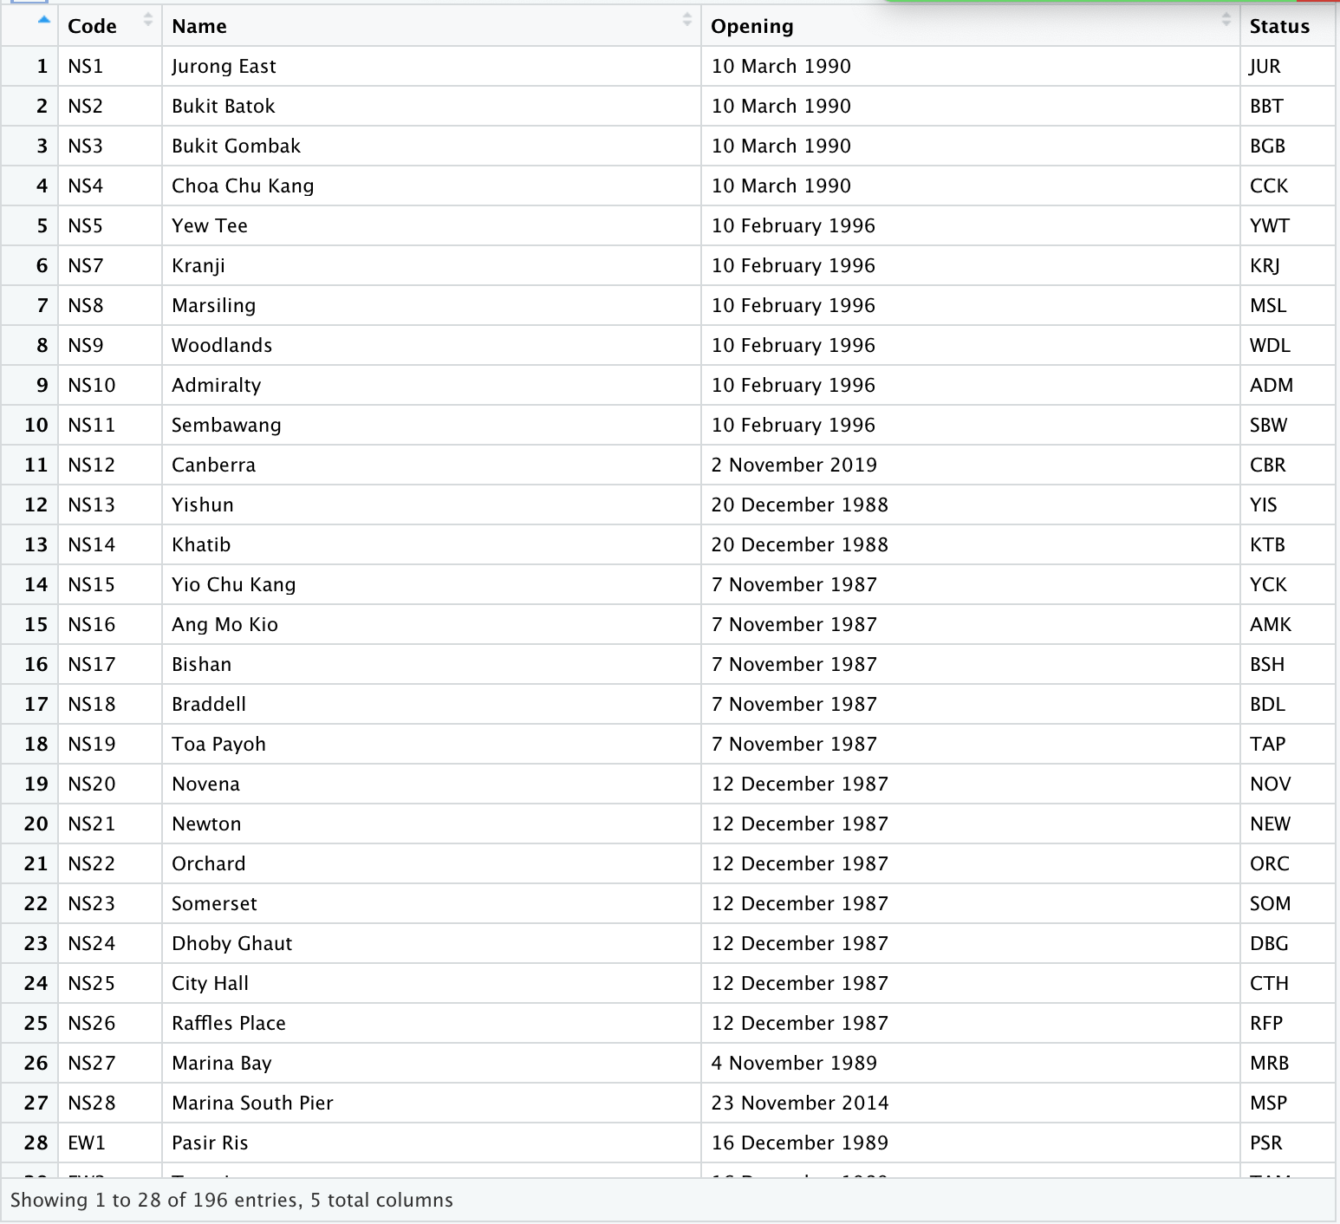
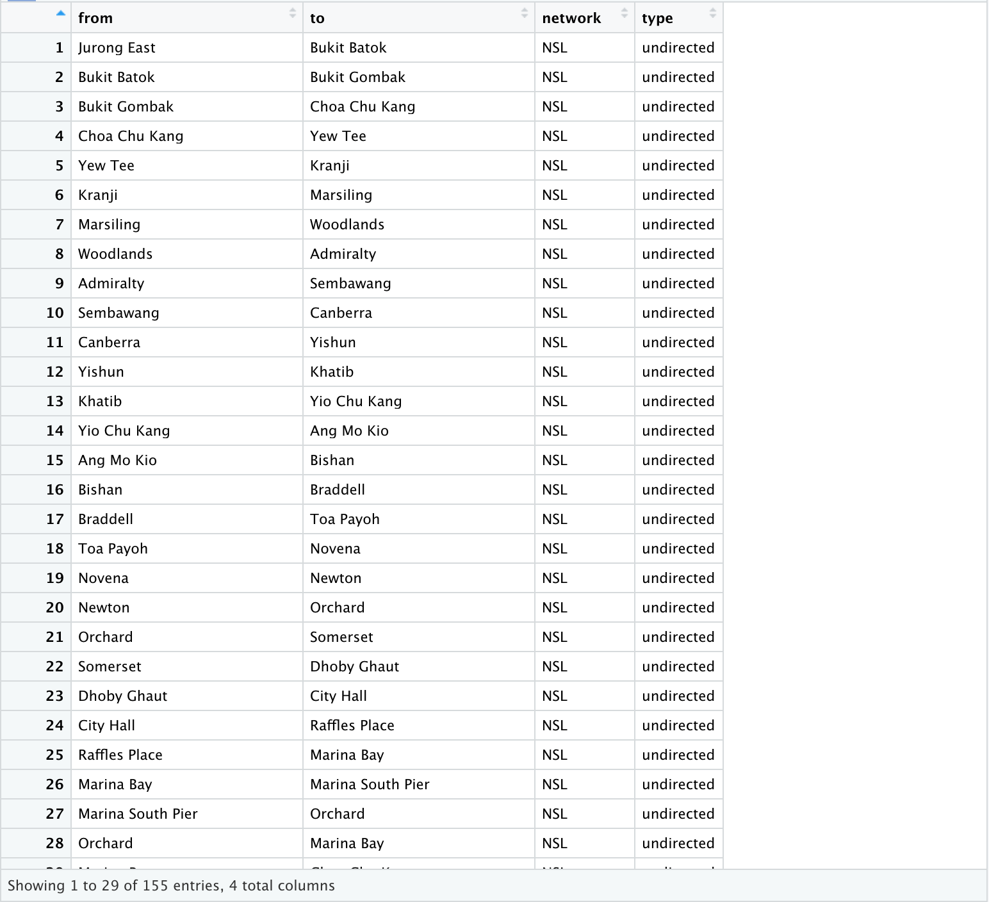
DATASET
RAW DATA
EDGELIST DATA

Slide 5
KEY VARIABLES
The variables of the dataset are:
Code (Combination of 2-character line name and station number)
Name (Name of the stations. Variable type : Varchar)
Opening (The opening date of the station. Variable type : Date)
Status (Code of the station. Variable type : Varchar)
Location (City of the station. Variable type : Varchar)

Slide 6
KEY VARIABLES
Variables used to create edge list and nodes for the graph are :
Code
Name
Code is used to create new column ‘Network’ that identifies the pair of station on a network.
The pair of stations is created by mapping station 1 to station 2 and so on until the second last station in a line. The last station is then linked to the first station in the line.

Slide 7
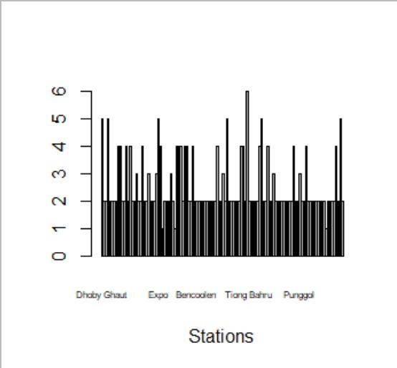
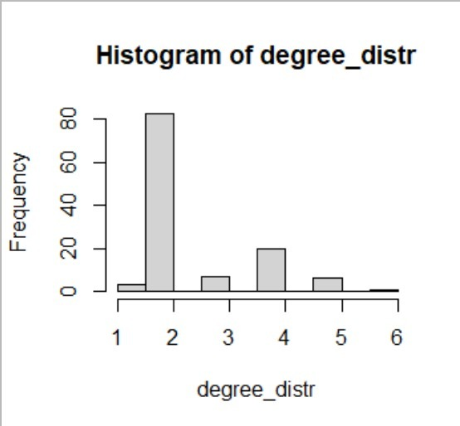
APPROACH

Slide 8
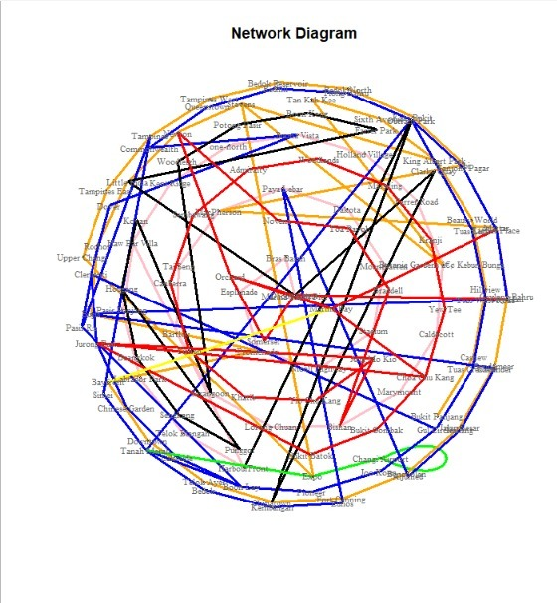
FINDINGS
Plotting basic network diagram shows the layout of the rail connections and how some stations help to connect different lines.
Nodes: Stations.
Edges: Link or route between two stations.

Slide 9
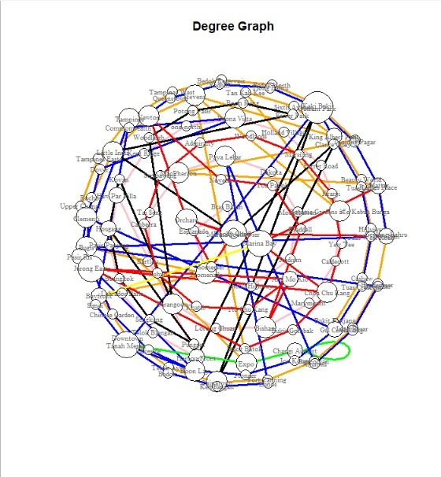
FINDINGS
Degree centrality is calculated to obtain degree of the nodes in the graph.
The node size is a visual representation in proportion to the degree of the node.
The node with the highest degree here is ‘Outram Park’.

Slide 10

FINDINGS
Closeness centrality is obtained to determine centrality in a network which is calculated as the reciprocal of the sum of the length of the shortest paths between the node and all other nodes in the graph.
Thus, the more central a node is, the closer it is to all other nodes.
The node size is a visual representation in proportion to the closeness of the node.
The node with the highest closeness here is ‘Tanah Merah’.

Slide 11
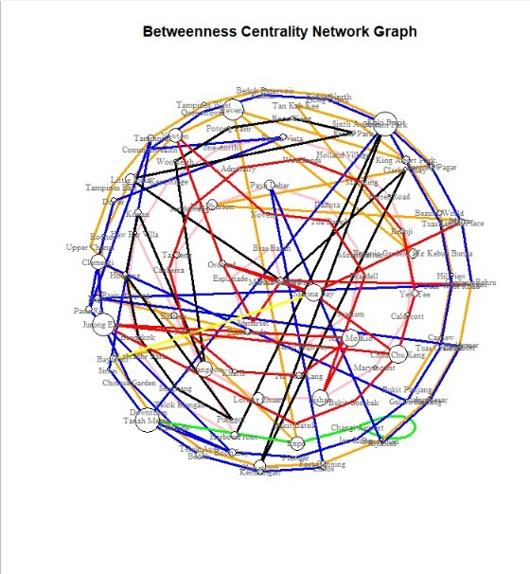
FINDINGS
Betweenness centrality is a measure of centrality in a graph based on shortest paths.
It represents the degree to which nodes stand between each other. A node with higher betweenness centrality would have more control over the network.
The node size is a visual representation in proportion to the betweenness of the node.
The node with the highest betweenness centrality is ‘Outram Park’.

Slide 12
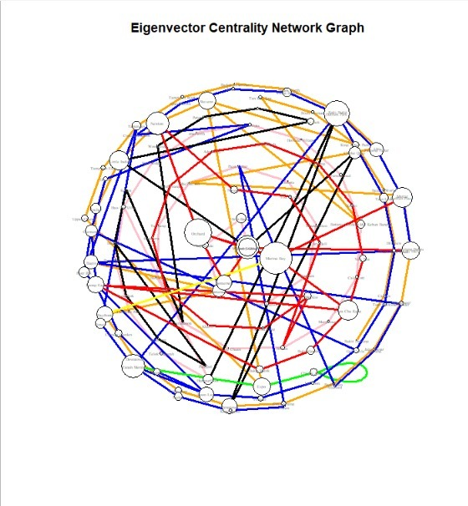
FINDINGS
Eigenvector centrality is a measure of the influence of a node in a network. A high eigenvector score indicates that the node is connected to multiple nodes who themselves have high scores.
The node size is a visual representation in proportion to the betweenness of the node.
The node with the highest eigenvector centrality is ‘Outram Park’.

Slide 13
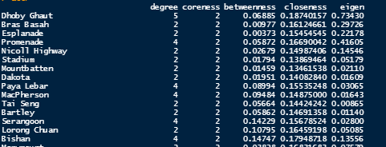
FINDINGS - STATS SUMMARY

Slide 14
RECOMMENDATIONS
From the results by using different centrality measures applied to the network, the station 'Outram Park' frequently appears as one of the significant nodes suggesting that it could likely be the most important node/station in the MRT connection
The consequences of removing such a node might break the network into different smaller networks and reduce connectivity among the network while impairing the connectivity and coverage of the MRT services defeating the purpose of the mode of transportation

Slide 15
Thank you ☺

