Slide 1
Learning Objectives
01
What is PCA
02
Background
03
How PCA Works
04
Use cases

Slide 2
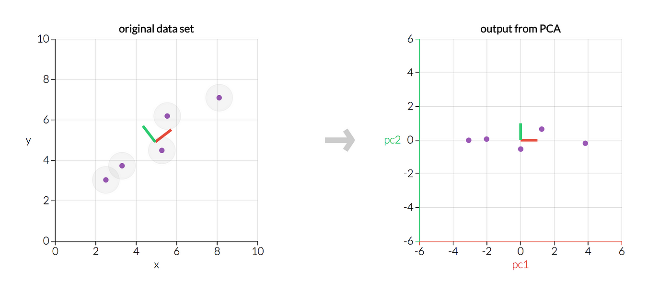
Principal Component Analysis
Principal Component Analysis is a dimensionality reduction technique used in unsupervised machine learning to transform a dataset with many variables into a smaller set that still contains most of the essential information

Slide 3
Background
Dimensionality Reduction: It is the process of reducing the number of features in a dataset while retaining as much relevant information as possible Why Dimensionality Reduction: i. As data becomes sparse models perform poorly
ii. Few features ensures less overfitting and better performance
iii. Reduces training time and computational resources
iv. Reduces and noise and captures core information
v. Less memory usage and faster I/O computation

Slide 4
Types of Dimensionality Reduction
Linear: Project data using linear transformations. Eg. LDA
Non-Linear: Preserve Structure in non-linear manifolds. Eg. tSNE, UMAP
Feature Selection: Select a subset of existing features. Eg. Filter, Wrapper
Feature Extraction: Create new features that summarize input data. Eg. Autoencoder
What about PCA?
PCA is a feature extraction method which instead of selecting the new features, creates new features that are uncorrelated capturing most variance in original data often fewer than original features.

Slide 5
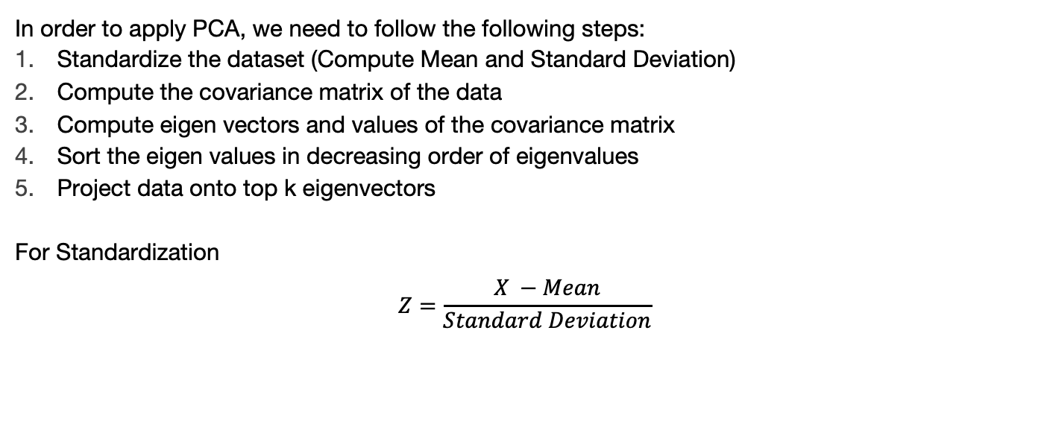
How PCA works?
In order to apply PCA, we need to follow the following steps:
Standardize the dataset (Compute Mean and Standard Deviation)
Compute the covariance matrix of the data
Compute eigen vectors and values of the covariance matrix
Sort the eigen values in decreasing order of eigenvalues
Project data onto top k eigenvectors
For Standardization
$$Z=\frac{X −Mean}{Standard Deviation}$$

Slide 6
PCA into action
House Price Prediction Dataset:
ID | Rooms | Area | Bathrooms | Age | Price
1 | 3 | 1500 | 2 | 10 | 250000
2 | 4 | 1800 | 3 | 5 | 320000
3 | 2 | 1200 | 1 | 20 | 180000
4 | 5 | 2100 | 3 | 2 | 400000
5 | 3 | 1600 | 2 | 8 | 270000
6 | 4 | 1900 | 3 | 6 | 330000
7 | 5 | 1100 | 1 | 25 | 170000
Features | Mean | Standard Deviation
Rooms | 3.29 | 1.11
Area | 1600 | 357.77
Bathroom | 2.14 | 0.90
Age | 10.86 | 7.96

Slide 7
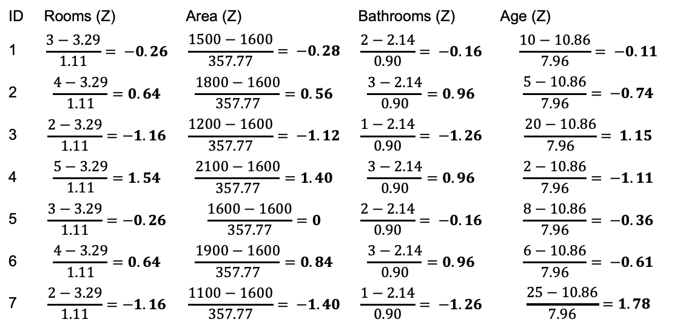
Standardized Matrix
ID | Rooms (Z) | Area (Z) | Bathrooms (Z) | Age (Z)
1 | $$\frac{3−3.29}{1.11}= −0.26$$ | $$\frac{1500−1600}{357.77}= −0.28$$ | $$\frac{2−2.14}{0.90}= −0.16$$ | $$\frac{10−10.86}{7.96}= −0.11$$
2 | $$\frac{4−3.29}{1.11}=0.64$$ | $$\frac{1800−1600}{357.77}=0.56$$ | $$\frac{3−2.14}{0.90}=0.96$$ | $$\frac{5−10.86}{7.96}= −0.74$$
3 | $$\frac{2−3.29}{1.11}=−1.16$$ | $$\frac{1200−1600}{357.77}= −1.12$$ | $$\frac{1−2.14}{0.90}= −1.26$$ | $$\frac{20−10.86}{7.96}= 1.15$$
4 | $$\frac{5−3.29}{1.11}=1.54$$ | $$\frac{2100−1600}{357.77}=1.40$$ | $$\frac{3−2.14}{0.90}=0.96$$ | $$\frac{2−10.86}{7.96}= −1.11$$
5 | $$\frac{3−3.29}{1.11}=−0.26$$ | $$\frac{1600−1600}{357.77}=0$$ | $$\frac{2−2.14}{0.90}= −0.16$$ | $$\frac{8−10.86}{7.96}= −0.36$$
6 | $$\frac{4−3.29}{1.11}=0.64$$ | $$\frac{1900−1600}{357.77}=0.84$$ | $$\frac{3−2.14}{0.90}=0.96$$ | $$\frac{6−10.86}{7.96}= −0.61$$
7 | $$\frac{2−3.29}{1.11}=−1.16$$ | $$\frac{1100−1600}{357.77}= −1.40$$ | $$\frac{1−2.14}{0.90}= −1.26$$ | $$\frac{25−10.86}{7.96}=1.78$$
We denote this as Z Matrix and n = 7

Slide 8

Computing the Covariance Matrix
$$C= \frac{1}{n−1}Z^{T}Z$$
Where $Z^{T}$ is the Transpose of Z
1.00 | 0.99 | 0.94 | -0.94
0.99 | 1.00 | 0.93 | -0.96
0.94 | 0.93 | 1.00 | -0.92
-0.94 | -0.96 | -0.92 | 1.00
C =
Because the data is standardized, diagonal entries ≈ 1.

Slide 9
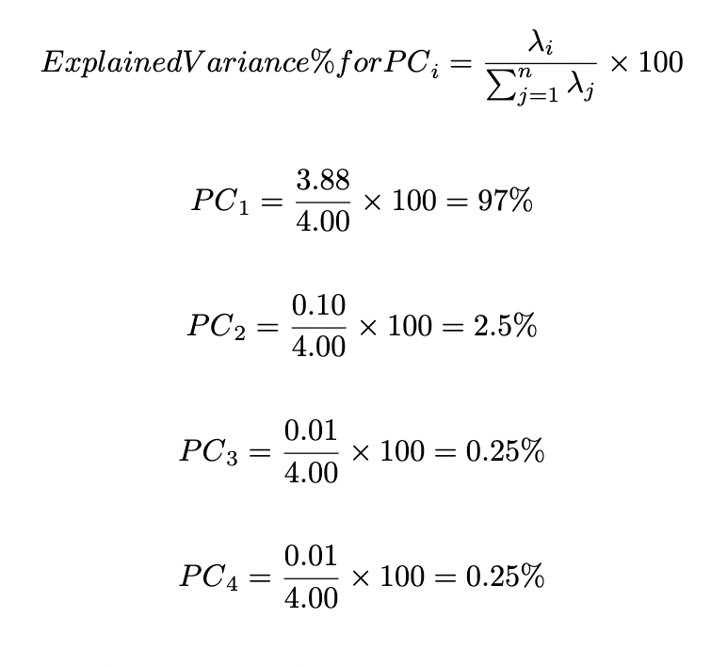

Finding the Eigen Values
Det(C - 𝛌I) = 0
1 - 𝛌 | 0.99 | 0.94 | -0.94
0.99 | 1 - 𝛌 | 0.93 | -0.96
0.94 | 0.93 | 1 - 𝛌 | -0.92
-0.94 | -0.96 | -0.92 | 1 - 𝛌
= 0
Upon Solving
​ 𝛌 =3.88, 𝛌 = 0.10, 𝛌 = 0.01, 𝛌 ​=0.01
Total Variance = 3.88 + 0.10 + 0.01 + 0.01
${PC}_{1}$+ ${PC}_{2}$ = 99.5%
∴ Optimal Value of k = 2

Slide 10

Eigen Vectors
Computing the eigen Vectors for ​ 𝛌 =3.88, 𝛌 = 0.10
​
𝛌 =3.88 𝛌 = 0.10
0.50 | −0.30
0.51 | −0.18
0.50 | 0.20
-0.49 | −0.92​​
To find eigen vectors
V =
$$\left(C − λI\right)v=0$$

Slide 11

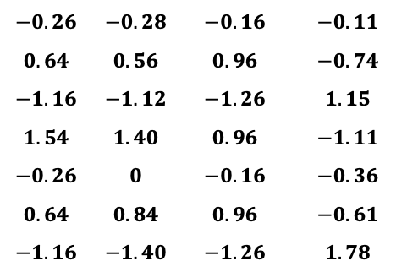
Final Dataset after PCA
Compute $Z_{projected}=Z X W$
−0.57 | ​0.21
1.21 | 0.34
−2.16 | −0.52
2.26 | −0.55
−0.34 | 0.07
1.39 | 0.20
−1.79 | 0.25
$$−0.26$$ | $$−0.28$$ | $$−0.16$$ | $$−0.11$$
$$0.64$$ | $$0.56$$ | $$0.96$$ | $$−0.74$$
$$−1.16$$ | $$−1.12$$ | $$−1.26$$ | $$1.15$$
$$1.54$$ | $$1.40$$ | $$0.96$$ | $$−1.11$$
$$−0.26$$ | $$0$$ | $$−0.16$$ | $$−0.36$$
$$0.64$$ | $$0.84$$ | $$0.96$$ | $$−0.61$$
$$−1.16$$ | $$−1.40$$ | $$−1.26$$ | $$1.78$$
0.50 | −0.30
0.51 | −0.18
0.50 | 0.20
-0.49 | −0.92​​
X
=

Slide 12
Use cases of PCA
Reducing features before applying ML models
Visualizing high dimensional data in 2D or 3D
Noise Reduction in data
Image compression

Slide 13
Summary

Slide 14
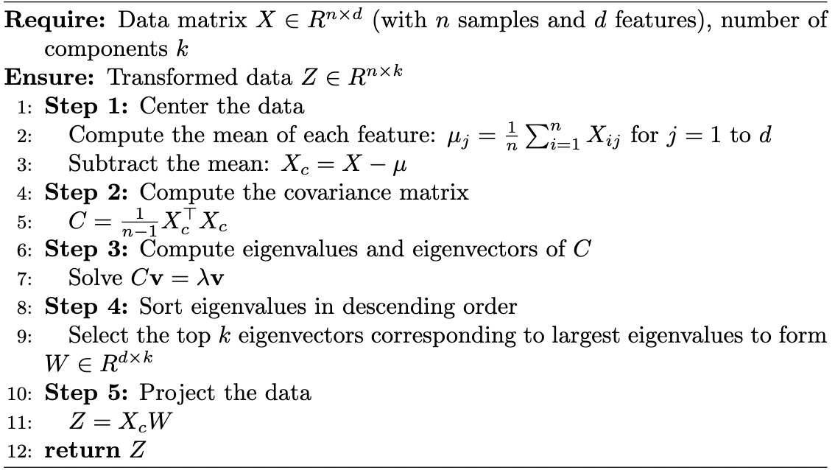
Summary
01
Define Principal Component Analysis
02
Implementation of PCA

