Slide 1

AUTOMATED EPHEMERAL PREVIEW ENVIRONMENTS
via GitOps
Accelerating Feature Delivery through Isolated, On-Demand AWS Infrastructure
TEAM
Avvaru Lakshmi Venkata Shashank B211432 · RGUKT Basar (Batch–2)
Banka Pranitharani 23KT1A05D7 · PSCMR CET (Batch–1)
Battu Siva Koushik 23KT1A05D8 · PSCMR CET (Batch–1)
Madineni Venkata Rohith O211076 · RGUKT Ongole (Batch–2)
Shaik Mehtaj O210858 · RGUKT Ongole (Batch–2)
Guided by Mrs. Sumana Bethala & Mr. Juttuka LovaBabu — APSSDC

Slide 2

1
Problem Statement: The Staging Bottleneck
AGENDA
2
Solution Overview: Dynamic Environments
The Roadmap
3
Key Features & Automation Workflow
4
AWS Services: The Technical Backbone
5
Architecture Diagram & Routing Logic
6
Future Work: Scaling to Serverless
7
Conclusion & Key Takeaways
2

Slide 3





THE PROBLEM
The “Shared Staging” Conflict
Pipeline Bottlenecks
Environment Drift
Manual Overhead
Multiple developers fighting for a single staging server.
Configuration errors caused by overlapping code deployments.
Developers manually cleaning up containers or changing ports.
Cost Inefficiency
Deployment Risks
Staging servers running 24/7 even when idle.
Lack of isolation leads to “works on staging, fails in production.”
3

Slide 4
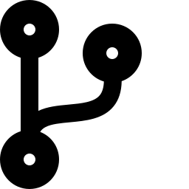
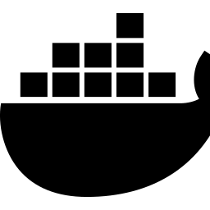


THE SOLUTION
Ephemeral Environments — Preview on Demand
GitOps Driven
Complete Isolation
Every Pull Request (PR) automatically triggers its own isolated environment.
Each feature branch runs in its own Docker container with its own database/state.
Direct Feedback
Automated Lifecycle
Provides a live, clickable URL directly on the GitHub PR page.
Creation happens on PR Open; deletion happens automatically on PR Close.
4

Slide 5

KEY FEATURES
Automation Workflow
Deterministic Port Mapping
Automatically calculates host ports (8000 + PR_ID) to avoid collisions.
Wildcard DNS Routing
Dynamic Nginx configurations route pr-X.domain.com to the correct container.
Automated Feedback Bot
CI/CD pipeline posts the live URL back to the developer for instant QA.
Garbage Collection
Automated teardown of images and containers for a zero-cost idle footprint.
5

Slide 6
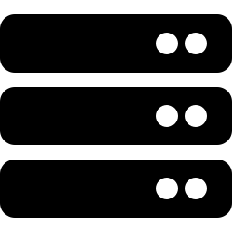


THE TECHNICAL BACKBONE
AWS Services Used
Amazon EC2 (Ubuntu)
Amazon ECR
AWS IAM
VPC & Security Groups
The primary host for Docker containers and the Nginx Master Proxy.
Secure registry for storing versioned, encrypted Docker image layers.
Role-based access control allowing GitHub Actions to securely interact with AWS.
Managed network access, strictly allowing traffic on Port 80 (HTTP) and 22 (SSH).
6

Slide 7
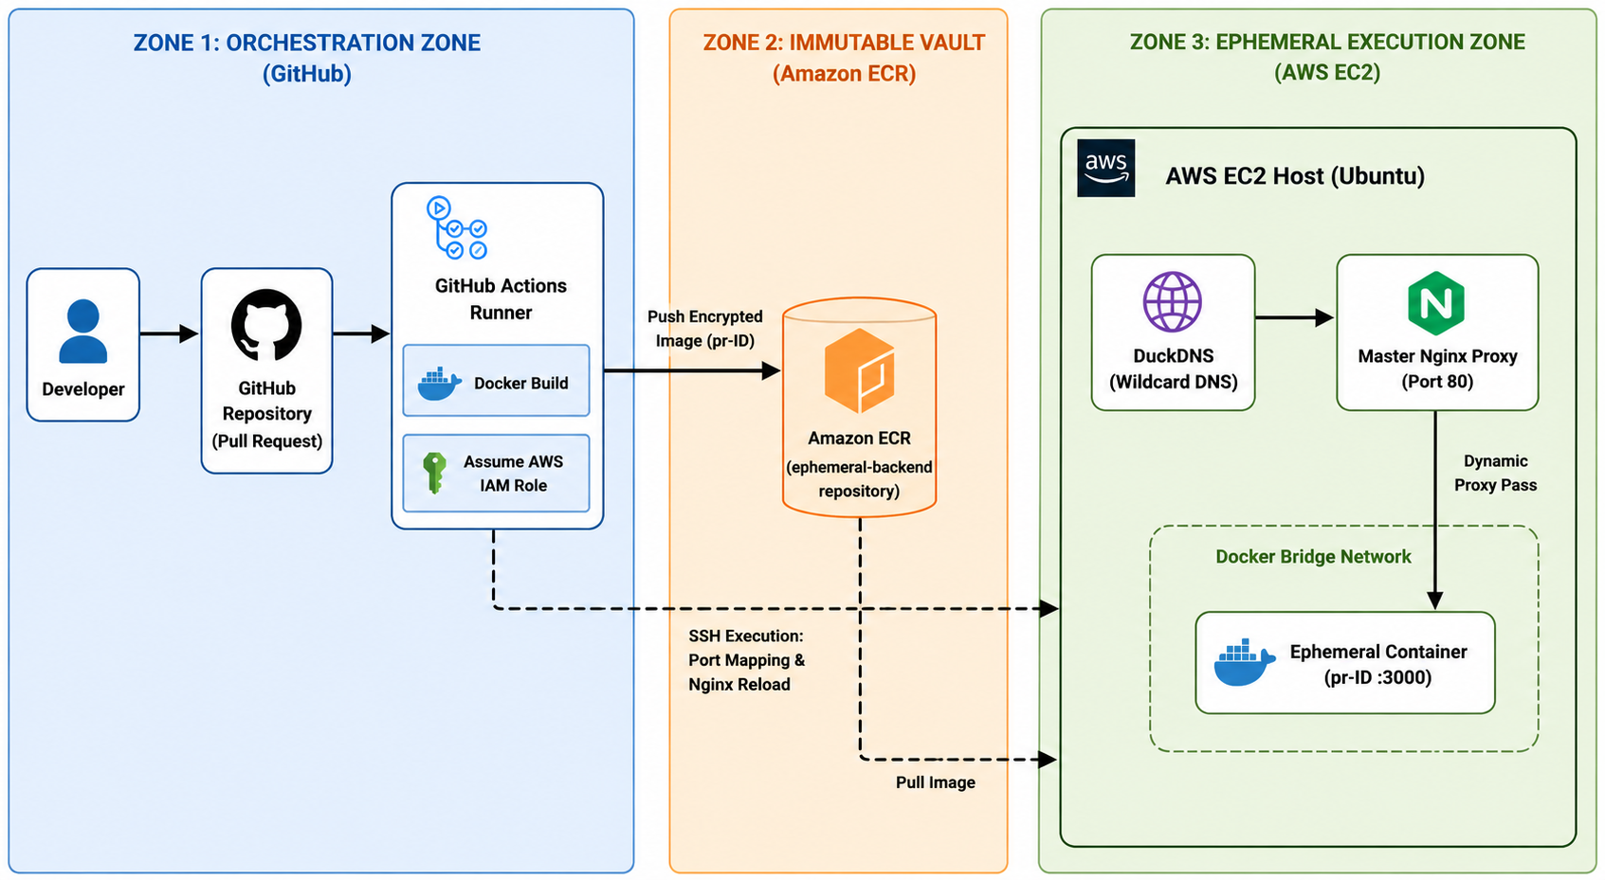
THE FLOW
Architecture Diagram
7

Slide 8
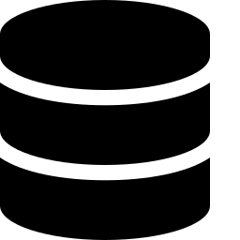
WHAT'S NEXT
Future Work
Migration to ECS/Fargate
Infrastructure as Code
Moving from EC2 to serverless containers for better scaling.
Using Terraform to provision AWS resources automatically.
SSL/TLS Automation
Database Partitioning
Integrating Let’s Encrypt to provide HTTPS for every preview URL.
Dynamically spinning up RDS snapshots for data-heavy testing.
8

Slide 9

IMPACT ACHIEVED
Conclusion
100%
Zero
Higher QA
Security First
Concurrent testing —
eliminated staging wait times
Infrastructure cost consumed
when no PRs are active
Isolated environments ensure
bug-free features before merge
IAM roles — no static
secrets stored in code
9

Slide 10
Thank You
Automated Ephemeral Preview Environments via GitOps
Questions & Discussion

