Slide 1

F1 Power BI Project Documentation.
Presented By -

Slide 2



GROUP 2
SHASHANK
VINEET
SUMEDH

Slide 3

INTRODUCTION
Our Power BI project is on the topic F1, Formula 1 is a highstake motor racing competition that features single seater cars and our project revolves around various metrics revolving around this sport.

Slide 4
INTRODUCTION
Our Power BI project is on the topic F1, Formula 1 is a highstake motor racing competition that features single seater cars and our project revolves around various metrics revolving around this sport.

Slide 5
OVERVIEW
RACE RESULTS
QUALI RESULTS
TRACK ANALYSIS
SPRINT RESULTS
In this page we have compiled visuals circling around metrics collected on a race day and what all nuances can be caught from it.
Visuals here consists of data from the Quali day and data here differs from the race and sprint result and more focused on a single lap.
Track analysis is a custom page we made consisting of visuals more centric to a particular track and various nooks and crooks from it,
This page consists charts from data collected on Sprint day and its relatively small since there have been 3 sprints as of now.

Slide 6
OVERVIEW
RACE RESULTS
SPRINT RESULTS
QUALI RESULTS
TRACK ANALYSIS
In this page we have compiled visuals circling around metrics collected on a race day and what all nuances can be caught from it.
This page consists charts from data collected on Sprint day and its relatively small since there have been 3 sprints as of now.
Visuals here consists of data from the Quali day and data here differs from the race and sprint result and more focused on a single lap.
Track analysis is a custom page we made consisting of visuals more centric to a particular track and various nooks and crooks from it,

Slide 7
OVERVIEW
01
RACE RESULTS
In this page we have compiled visuals circling around metrics collected on a race day and what all nuances can be caught from it.
SPRINT RESULTS
QUALI RESULTS
TRACK ANALYSIS
This page consists charts from data collected on Sprint day and its relatively small since there have been 3 sprints as of now.
Visuals here consists of data from the Quali day and data here differs from the race and sprint result and more focused on a single lap.
Track analysis is a custom page we made consisting of visuals more centric to a particular track and various nooks and crooks from it,

Slide 8
01
RACE RESULTS
Page here contains visual relating to the data of the Race day. Accordingly, across 14 races we have made visuals like total points accumulated by a driver and team. Important KPI like drivers who DNF race/races, and fastest lap setters according to tracks have been included in this page. With addition to this, we have used images to show top 3 driver and top 3 constructors leading the championship which beautifies the overall page.

Slide 9
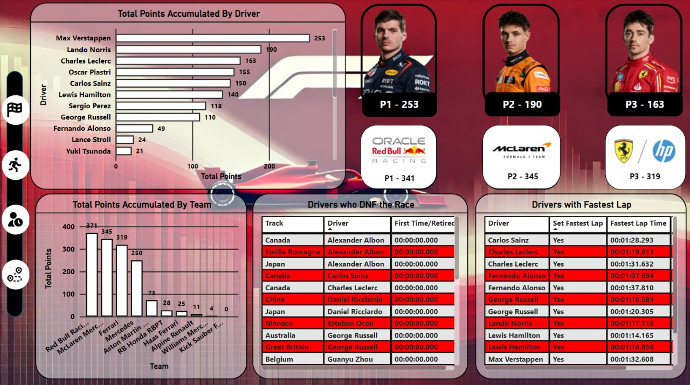

Slide 10
OVERVIEW
01
RACE RESULTS
In this page we have compiled visuals circling around metrics collected on a race day and what all nuances can be caught from it.
SPRINT RESULTS
QUALI RESULTS
TRACK ANALYSIS
This page consists charts from data collected on Sprint day and its relatively small since there have been 3 sprints as of now.
Visuals here consists of data from the Quali day and data here differs from the race and sprint result and more focused on a single lap.
Track analysis is a custom page we made consisting of visuals more centric to a particular track and various nooks and crooks from it,

Slide 11
OVERVIEW
01
RACE RESULTS
In this page we have compiled visuals circling around metrics collected on a race day and what all nuances can be caught from it.
SPRINT RESULTS
QUALI RESULTS
TRACK ANALYSIS
This page consists charts from data collected on Sprint day and its relatively small since there have been 3 sprints as of now.
Visuals here consists of data from the Quali day and data here differs from the race and sprint result and more focused on a single lap.
Track analysis is a custom page we made consisting of visuals more centric to a particular track and various nooks and crooks from it,

Slide 12
OVERVIEW
01
02
RACE RESULTS
SPRINT RESULTS
In this page we have compiled visuals circling around metrics collected on a race day and what all nuances can be caught from it.
This page consists charts from data collected on Sprint day and its relatively small since there have been 3 sprints as of now.
QUALI RESULTS
TRACK ANALYSIS
Visuals here consists of data from the Quali day and data here differs from the race and sprint result and more focused on a single lap.
Track analysis is a custom page we made consisting of visuals more centric to a particular track and various nooks and crooks from it,

Slide 13
02
SPRINT RESULTS
Sprint results page while not having much data as Sprints in a season are limited is an essential page so as to show which car and drivers are really quick since it’s a shorter format. Also constructors are also given an opportunity here to get thos bonus points apart from a normal race hence KPI’s here include a table chart showing start and final position of a driver as well as points accumulated by a team across these sprints events, same for the drivers along with their sprint times across tracks.

Slide 14
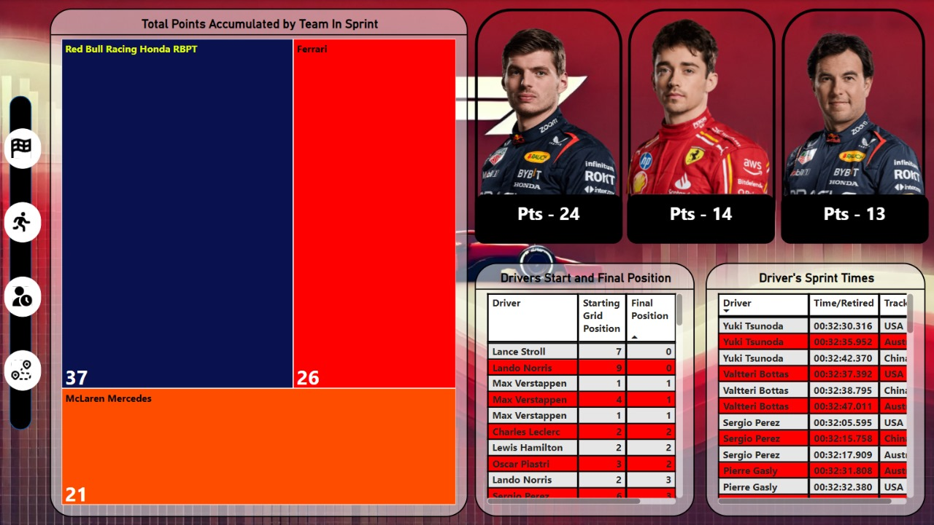

Slide 15
OVERVIEW
01
02
RACE RESULTS
SPRINT RESULTS
In this page we have compiled visuals circling around metrics collected on a race day and what all nuances can be caught from it.
This page consists charts from data collected on Sprint day and its relatively small since there have been 3 sprints as of now.
QUALI RESULTS
TRACK ANALYSIS
Visuals here consists of data from the Quali day and data here differs from the race and sprint result and more focused on a single lap.
Track analysis is a custom page we made consisting of visuals more centric to a particular track and various nooks and crooks from it,

Slide 16
OVERVIEW
01
02
RACE RESULTS
SPRINT RESULTS
In this page we have compiled visuals circling around metrics collected on a race day and what all nuances can be caught from it.
This page consists charts from data collected on Sprint day and its relatively small since there have been 3 sprints as of now.
QUALI RESULTS
TRACK ANALYSIS
Visuals here consists of data from the Quali day and data here differs from the race and sprint result and more focused on a single lap.
Track analysis is a custom page we made consisting of visuals more centric to a particular track and various nooks and crooks from it,

Slide 17
OVERVIEW
01
02
03
RACE RESULTS
SPRINT RESULTS
QUALI RESULTS
In this page we have compiled visuals circling around metrics collected on a race day and what all nuances can be caught from it.
This page consists charts from data collected on Sprint day and its relatively small since there have been 3 sprints as of now.
Visuals here consists of data from the Quali day and data here differs from the race and sprint result and more focused on a single lap.
TRACK ANALYSIS
Track analysis is a custom page we made consisting of visuals more centric to a particular track and various nooks and crooks from it,

Slide 18
03
QUALI RESULTS
Qualifying Results page differs a bit from a normal race day, 3 sections are available here i.e Q1, Q2 and Q3 and some drivers go from Q1 to Q2 and so on. We here have visuals that show frequency of drivers reaching Q2 and Q3 showing consistency of drivers. Another important metric we have captued here is maximum poles (starts from P1) and also a table matrix of grid position of each drivers.

Slide 19
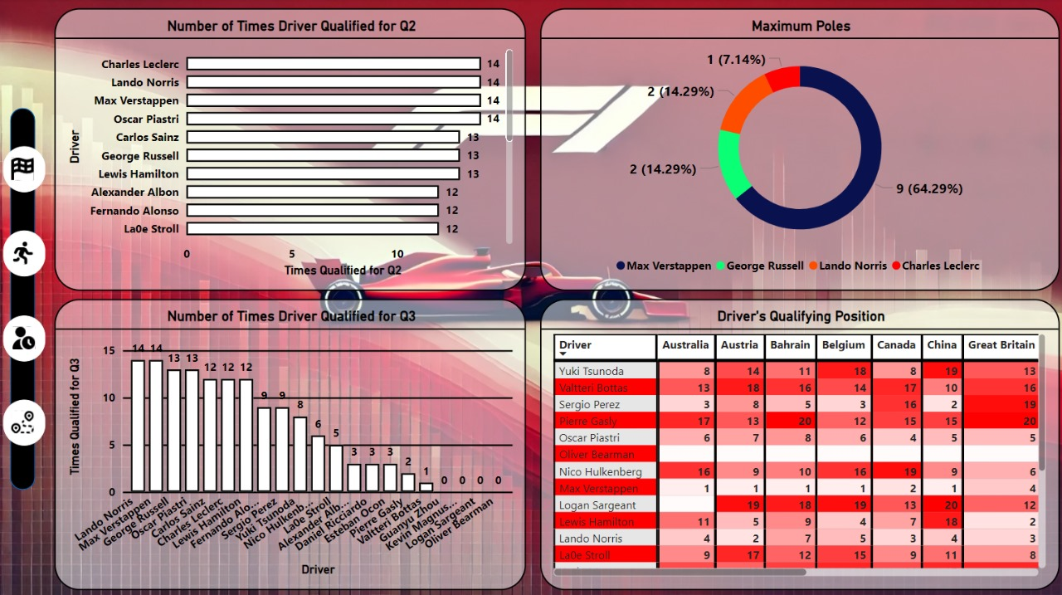

Slide 20
OVERVIEW
01
02
03
RACE RESULTS
SPRINT RESULTS
QUALI RESULTS
In this page we have compiled visuals circling around metrics collected on a race day and what all nuances can be caught from it.
This page consists charts from data collected on Sprint day and its relatively small since there have been 3 sprints as of now.
Visuals here consists of data from the Quali day and data here differs from the race and sprint result and more focused on a single lap.
TRACK ANALYSIS
Track analysis is a custom page we made consisting of visuals more centric to a particular track and various nooks and crooks from it,

Slide 21
OVERVIEW
01
02
03
RACE RESULTS
SPRINT RESULTS
QUALI RESULTS
In this page we have compiled visuals circling around metrics collected on a race day and what all nuances can be caught from it.
This page consists charts from data collected on Sprint day and its relatively small since there have been 3 sprints as of now.
Visuals here consists of data from the Quali day and data here differs from the race and sprint result and more focused on a single lap.
TRACK ANALYSIS
Track analysis is a custom page we made consisting of visuals more centric to a particular track and various nooks and crooks from it,

Slide 22
OVERVIEW
01
02
03
04
RACE RESULTS
SPRINT RESULTS
QUALI RESULTS
TRACK ANALYSIS
In this page we have compiled visuals circling around metrics collected on a race day and what all nuances can be caught from it.
This page consists charts from data collected on Sprint day and its relatively small since there have been 3 sprints as of now.
Visuals here consists of data from the Quali day and data here differs from the race and sprint result and more focused on a single lap.
Track analysis is a custom page we made consisting of visuals more centric to a particular track and various nooks and crooks from it,

Slide 23
04
TRACK ANALYSIS
A dedicated page that deals with nuances around a specific track, this page has visuals that show starting grid and final position of a driver on the particular track selected or who had the fastest lap on that track as well as points accumulation. The aim of this page is for specific teams to check stats of themselves on each track so as to improve on their remaining season i.e after the break. This page specifically caters a team’s analysis whie others are more helpful in terms of a broadcaster showing stats.

Slide 24
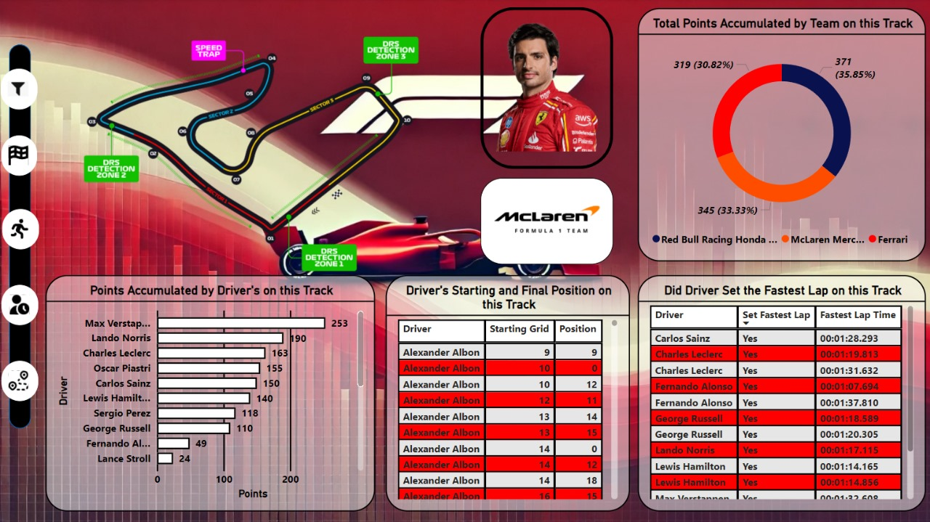

Slide 25
THANKS
Group 2 is grateful for audience’s attention feel free to ask querries.

