Slide 1
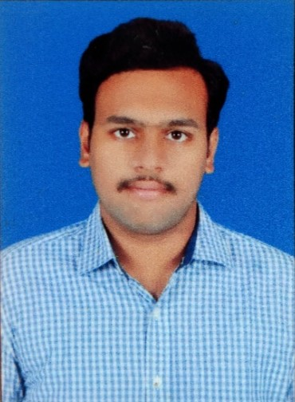


Sai Shashank Gandavarapu
Analyst/Software Engineer
ITransform L&D Left Shift Batch
Bachelor of Technlogy, Electronics and Communications : 2018 - 2022
Skills
NA
C# | Basics, OOPS, Exception Handling ,Arrays ,Collection and Generics, Delegates and Events, File Io and Serialization.
.NET Framework | ADO.NET, ASP.NET with MVC and WEB API, Entity Framework
Cloud platform | Microsoft Azure
Python | Basics, OOPs concepts, Data structures
Database | SQL SERVER
Tools | GIT,POSTMAN, Swagger
UI Technology | HTML5 ,CSS & Angular and Bootstrap Framework
Add On Skills | Leadership, Communication Skills, Team Management
sai-shashank.gandavarapu@capgemini.com
+91 8008133441
A4
Full Stack Developer
Understanding of RDMS concepts using SQL Server.
Practical understanding of C# and SQL concepts using Visual Studio and SQL Server.
Hands on experience in developing applications using .NET Framework, ADO.NET Core, ASP.NET and JWT based authentication.
Understanding of HTML5 , CSS and Angular Cli
Understanding of Azure fundamental concepts.
Online Flight Booking System Video link
Case study of Online Flight Booking System along with API Gateway, Swagger, payment, JWT Based Authentication ,responsive UI with HTML5, CSS, Bootstrap and Angular used as User Interface. This application enables a customer to book a flight reservation in advance and can cancel the booking or Check in into the flight and also an admin user can perform various administrative operations like Airport management, Flight Management and Customer management. Technologies used:
ANGULAR 14
ASP.NET CORE 6.0
Microsoft SQL Server
Check out my GitHub Repository

