Slide 1
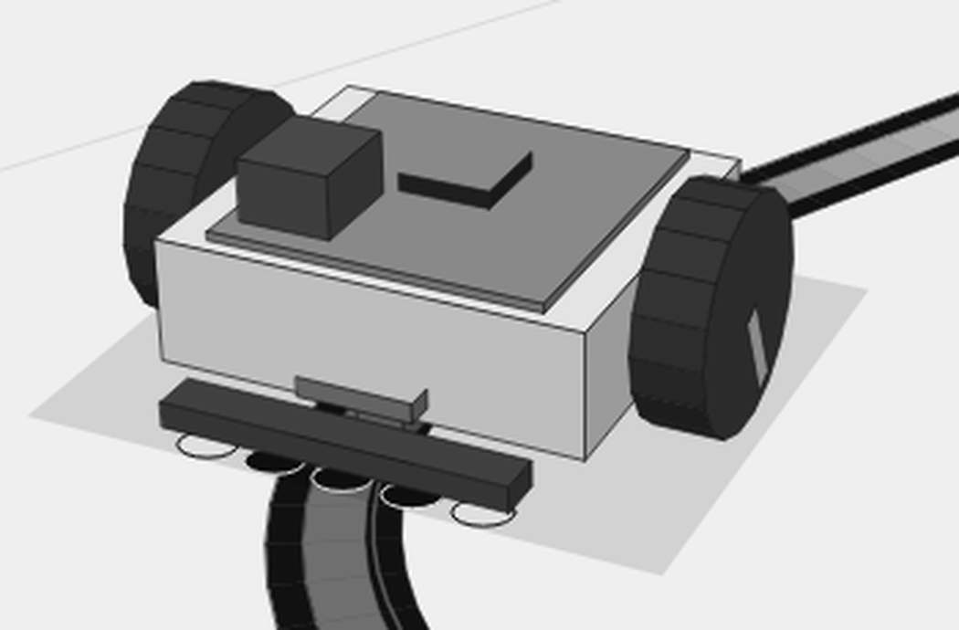
Line follower robot
A robot that reads a track, plans its speed, and learns from its sensors
Notes:
Hello. Our project is a line follower robot. It drives along a black line on the floor. We built the brain for it in C plus plus, a simulator that shows how it drives, and a set of engineering drawings. Today we will show you the idea, the four ways the robot can drive, the engineering behind it, and why we think it matters.

Slide 2
Our idea
One robot, one program, and a simulator that shows what it will do before we build it
1
4
6
brain program that runs on the robot, in the simulator and on the web page
ways to drive, from simple sensor steering to a smart curve reader
different tracks, from a gentle oval to tight hairpin bends
The question we are answering: how fast can a small robot go round a track safely, and what does it need to know to do it?
Notes:
The big idea is simple. A robot follows a line. We wanted to find out how much a robot can do with a map, and how much it can do with only its sensors. So we built four ways to drive, and we compare them fairly.

Slide 3
What makes us different
Four things most student robots do not have
One brain everywhere
Real physics
The same C plus plus code runs on the Arduino, on the computer and in the web browser. What you see is what the robot does.
The simulator models weight, grip, wheel slip, sideways slide and noisy sensors, so problems show up before we build.
A fair comparison
Honest numbers
All four modes drive the same robot, with the same noise, on the same six tracks. Any difference comes from the method.
Every estimate is written down. We say which numbers we measured and which we still have to check on a real robot.
Notes:
Most student projects write code for the robot, then test it by driving the robot. We did two things differently. First, the simulator uses the same C plus plus as the robot, so there is no gap between what we see and what the robot does. Second, we measure the things a real robot would struggle with, like grip, slip and sensor noise.

Slide 4
How the robot works, at a glance
Sensors see the line, the brain decides, the motors act
Sensors
Brain
Motors
Track
Five sensors in a row, and a second row for one mode
Reads the sensors, the map and the wheel counters, then decides
Turn the two wheels at different speeds to steer
The robot drives, and the sensors see the line again
The brain does this about 500 times every second, so it can react quickly to what it sees.
Notes:
Read this from left to right. The sensors see the black line. The brain turns that into a steering decision. The motors turn the wheels. The wheel counters tell the brain how fast each wheel is turning. A map, when we use one, tells the brain how fast to go at every point.

Slide 5
The four ways to drive
Four boards, from simplest to smartest
1
Normal PID
2
Full map (blind)
Sensors only
Map only
3
Full map plus IR
4
Double IR
Map and sensors
Two sensor rows and wheel counters
Notes:
Think of these as four boards that we can switch between. The first uses only sensors. The second uses only the map. The third uses the map and the sensors together. The fourth reads the shape of the curve as it drives. We will go through each one in detail.

Slide 6
Board 1: Normal PID
Steering from the sensors only
Uses five light sensors. It looks at how far the line is from the middle of the sensor bar, and turns the robot back toward it. It has no map, so it cannot know a corner is coming. To stay safe, it slows down when it turns hard or when the line is far away.
How it works
It only knows what it can see right now
Slows when steering effort grows
Gives up if it loses the line for 0.6 seconds
Normal PID finishes every map, but it is the slowest, because it cannot prepare for the next corner.
Notes:
This is the baseline. Every other board must beat it to be worth using.

Slide 7
Board 2: Full map (blind)
Following a plan without looking
Before the run, the brain works out the best speed for every point on the track. The fastest safe speed is slow in tight bends and fast on straights. During the run, the robot follows that plan and ignores its sensors.
How it works
It knows where it is on the track by counting distance
It uses the plan for speed and turn
Small errors grow, and it leaves the line
Blind mode derails on every map. A plan with no correction drifts off the line.
Notes:
This shows why sensors matter. A perfect plan is not enough, because the real robot never follows a perfect path.

Slide 8
Board 3: Full map plus IR
The plan, with the sensors correcting it
This board uses the same plan as blind mode, and adds a correction. The sensors measure how far the robot has drifted, and a steering loop nudges the wheels back on the line. The sensors also bridge short gaps, and spot the finish when the tape ends.
How it works
Same fast plan as blind mode
Sensors correct drift in real time
Bridges short gaps and finds the finish
Full map plus IR is our fastest board that finishes every run across the six tracks.
Notes:
The best of both: the map gives the speed, and the sensors keep the robot honest.

Slide 9
Board 4: Double IR
Reading the curve as it drives
This board needs no map. It has two rows of sensors, one in front of the wheels and one behind. The two rows tell the robot which way the line is turning. Wheel counters tell it how fast it is turning itself. Together, these give the sharpness of the bend, and the robot sets its speed to match.
How it works
Two sensor rows give the direction of the line
Wheel counters give the robot turn rate
Speed is the highest safe speed for that bend, capped at 0.4 m/s
Double IR finishes every map and every seeded run. It is slower than the map board, but it needs no map at all.
Notes:
This is the most interesting board for the real world. A robot that can read a bend without a map can work in places nobody has mapped.

Slide 10
How the four boards compare
Lap times in seconds on each track, same robot, same start
Track | Plan | Normal PID | Blind | Map plus IR | Double IR
Warm-Up Oval | 6.06 | 23.27 | derailed | 7.11 | 12.04
Chicane | 3.74 | 12.03 | derailed | 4.26 | 6.07
Hairpin Alley | 5.18 | 16.24 | derailed | 5.44 | 7.45
Dashed Line | 3.57 | 13.25 | derailed | 4.27 | 6.90
Zig-Zag | 3.99 | 10.90 | derailed | 4.17 | 4.99
Sweepers | 5.58 | 24.08 | derailed | 6.62 | 13.15
Share of runs that finished, across all six tracks and 40 different noise settings: Normal PID 98.8 percent (237 of 240 runs), Blind 0 percent, Map plus IR 100 percent, Double IR 100 percent.
Notes:
Times are in seconds, from the start to the end of each track. A dash in a box means the robot derailed. The first column is the time the racing plan expects for a perfect run. The best time in each row is the fastest finished lap on that track.

Slide 11
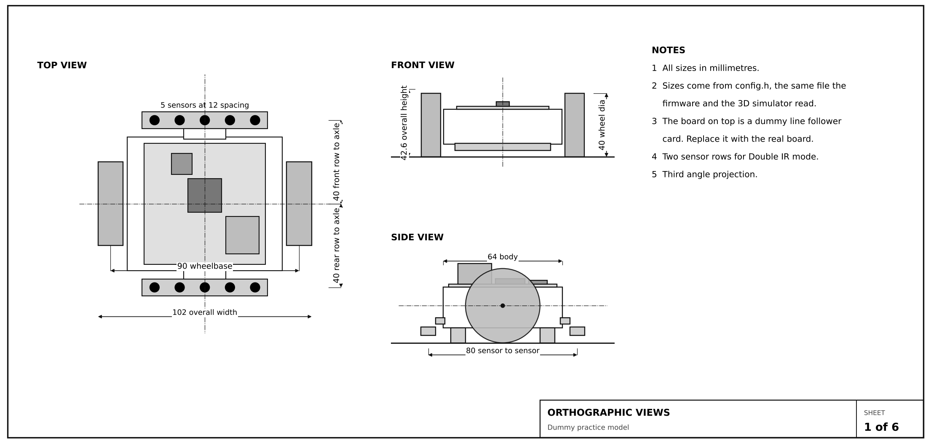
Technical 1: The robot body
Simple numbers, shown as an engineering drawing
Notes:
This drawing shows the robot from above, from the front, and from the side. The two wheels are 90 millimetres apart. The sensor bar sits 40 millimetres ahead of the wheels, so the robot sees the line before it reaches it. The rear sensor bar is for the Double IR board.

Slide 12
Technical 2: How the robot finds the line
Five sensors, and a weighted average
Five sensors, 12 millimetres apart
Each reads light or dark
The line position is the average of the dark readings
If the line is off centre, the robot steers back
Example
If only the second and third sensors see the line, the line is near the middle. If only the far left sensor sees it, the line is far to the left and the robot needs a hard turn.
Notes:
Each sensor reports light or dark. The robot takes all five readings and works out the centre of the dark part. If the centre is to the left of the middle, the line is to the left, and the robot steers left. This is the same idea as finding the centre of a balance.

Slide 13
Technical 3: The steering loop
A simple rule, applied 500 times a second
P: how far off
I: how long off
D: how fast it changes
Turn harder when the line is further away
Correct a steady error that the P part cannot clear alone
Slow down the turn when the error is closing quickly
The loop runs every 2 milliseconds. That is fast enough to correct the robot long before it drifts far from the line.
Notes:
The steering loop is called PID. It has three parts, and each one answers a simple question. How far off are we right now? How long have we been off? How fast are we getting more off? We add the three answers together to get a turn command. The gains, the three strengths, are chosen by testing.

Slide 14
Technical 4: How fast is safe in a corner
The tighter the corner, the slower the robot must go
The rule
Safe speed = square root of (grip times radius)
The map boards use a grip of 1.5 metres per second squared, with a top speed of 1 metre per second. Double IR uses a grip of 1.6, and its speed is capped at 0.4 metres per second for safety.
Notes:
There is a simple rule behind the racing plan. Grip gives a sideways limit. Speed squared divided by the radius must stay below that limit. So the safe speed is the square root of the grip times the radius. Wide bends let the robot go faster, tight bends make it slow down. This chart shows the rule for both the map board and the Double IR board.

Slide 15
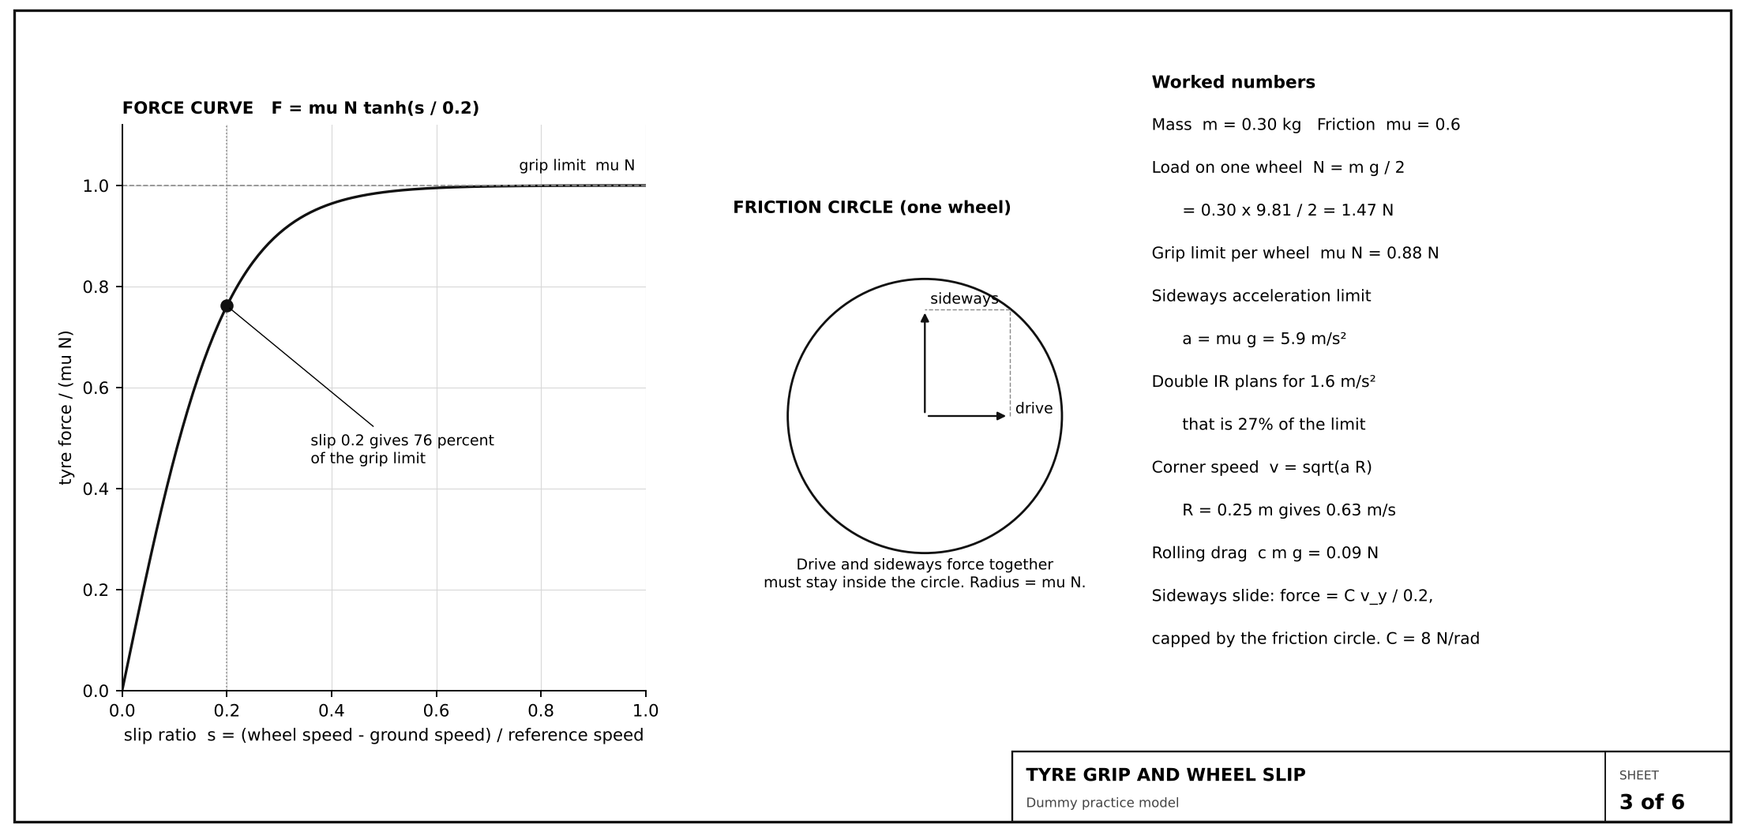
Technical 5: Grip and wheel slip
A tyre can only push so hard before it slips
Notes:
A wheel can only push the ground so hard. The limit is friction times the weight on that wheel. If the wheel spins faster than the ground moves, it slips, and it can push a little harder for a moment. Past a certain slip, the grip is used up. This drawing shows the friction limit, and the circle of drive and sideways force that a wheel can use at the same time.

Slide 16
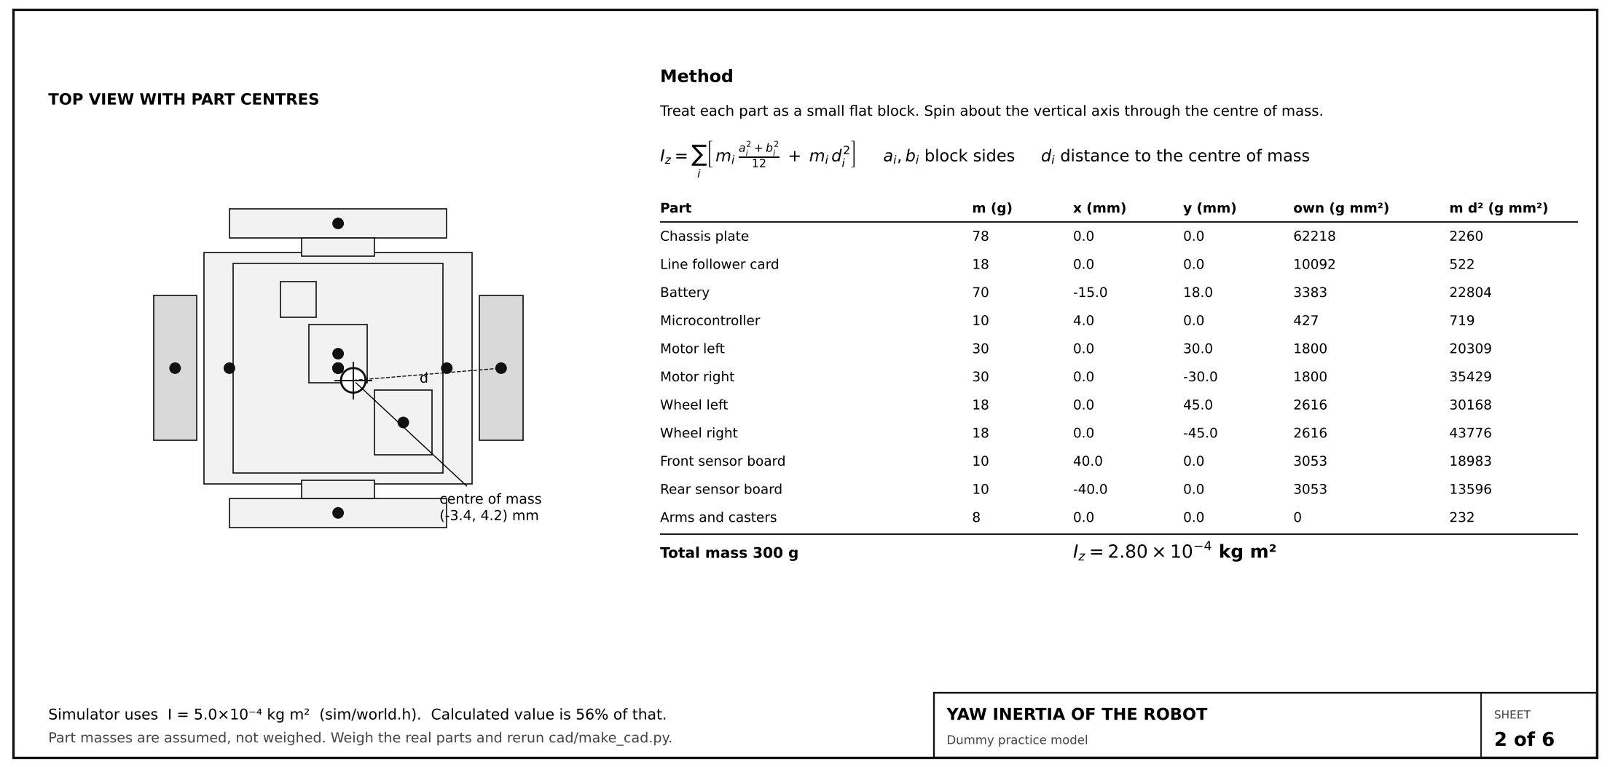
Technical 6: How hard the robot is to turn
Inertia: the heavier and wider the parts, the harder it is to spin
Notes:
Inertia tells us how much the robot resists turning. We add up each part's mass times how far it sits from the centre. Parts far from the middle count much more. The estimate from our assumed part weights is close to the value the simulator uses, and we will weigh the real parts to confirm it.

Slide 17
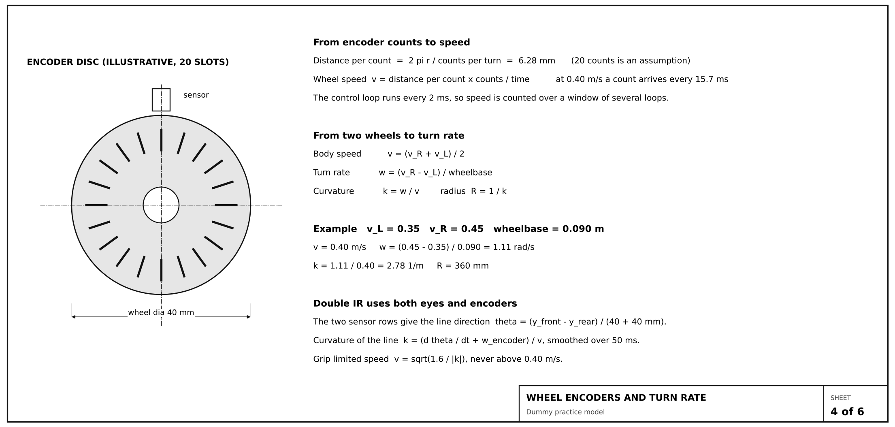
Technical 7: Counting wheel turns
Wheel counters tell us speed, and how sharply the robot turns
Notes:
An encoder counts small slots as a wheel turns. Each count is a known distance. Speed is distance per count times counts per second. If one wheel is faster than the other, the robot turns. Double IR uses this turn rate to know how sharp the bend is, even when the sensors cannot see far enough ahead.

Slide 18
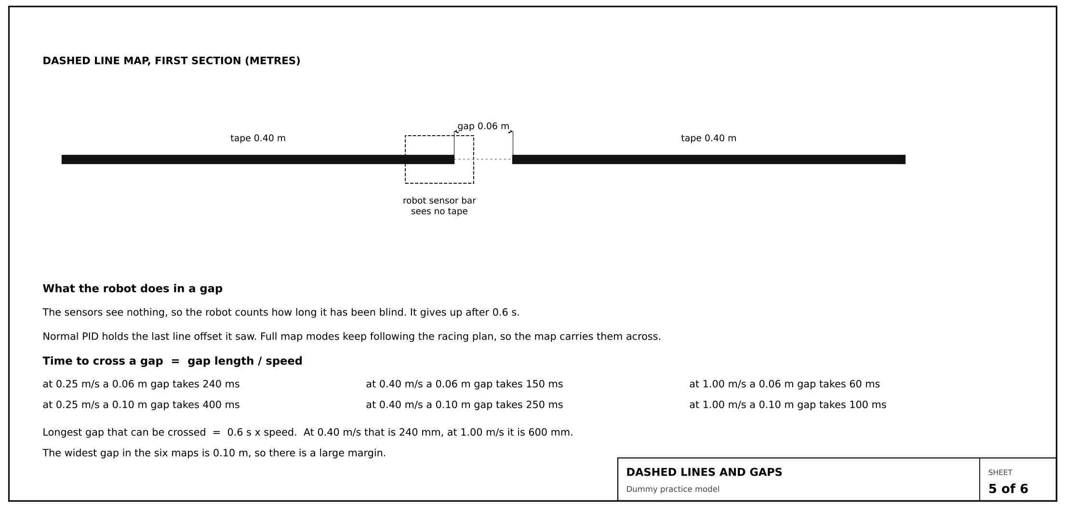
Technical 8: Dashed lines and gaps
When the line disappears, the robot keeps its nerve
Notes:
Some tracks have gaps. In a gap the sensors see only the floor. The map boards keep going because they know the plan. The plain PID board holds its last correction. If the robot is blind for more than 0.6 seconds, it stops. The widest gap on our tracks is 0.1 metres, so the robot always gets through.

Slide 19
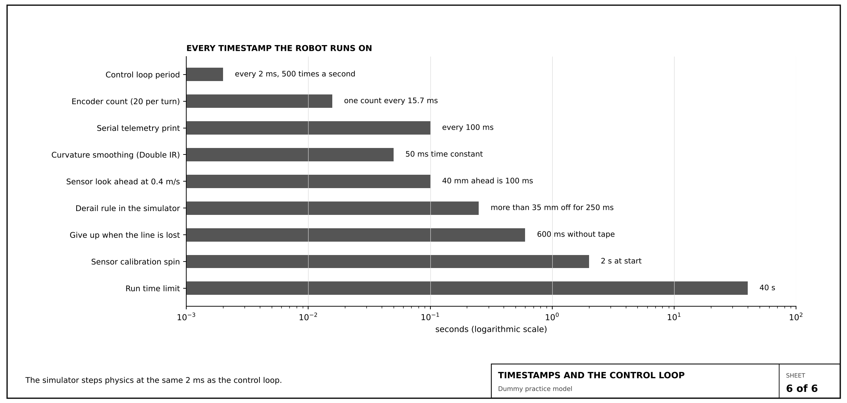
Technical 9: Timing and timestamps
Every number the robot runs on has a clock behind it
Notes:
Timing matters. The control loop runs every 2 milliseconds. The simulator uses the same step. Each rule has its own time limit, like giving up after 0.6 seconds without the line, or calling a derail after a quarter second more than 35 millimetres off the line. Getting these right stops the robot reacting too slowly or too quickly.

Slide 20
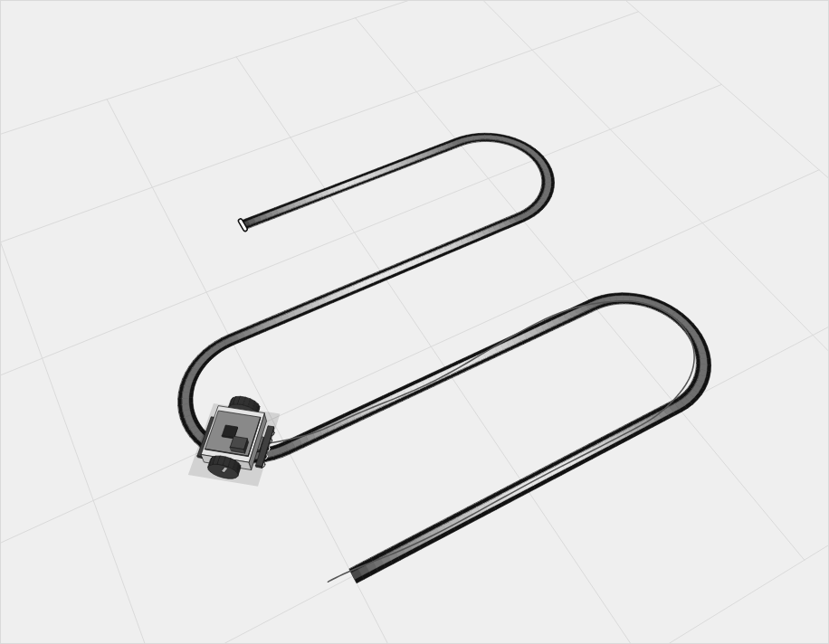
Technical 10: The simulator
We copy the real physics, then mark what is still a guess
What the simulator models
Motor pull for each wheel
Grip and wheel slip
Sideways slide in fast bends
Noisy sensors
Rolling resistance
Still to check on hardware
Friction, motor strength, the grip value and the part masses behind the inertia are estimates until we measure the real robot.
Notes:
The simulator models the robot's mass, motor strength, friction, wheel slip, sideways slide and sensor noise. Some numbers are measured, and some are estimates. We show the estimates openly, because they are the first things we will check when we have the real robot.

Slide 21
Why this matters in the real world
Line following is a small version of a very big industry
Warehouses and factories
Hospitals and labs
Carts and trucks that follow a floor line, and need to slow for turns.
Delivery robots that carry samples or meals on fixed routes.
Safety
Learning
Robots that know when to stop, instead of carrying on blind.
Control, sensing, physics and testing, all in one project.
Notes:
Line following is the same idea behind automated carts in warehouses, hospitals and factories. These machines carry goods and follow a fixed route. A robot that reads its own path, and knows when it is about to lose it, is the kind of machine those places need.

Slide 22
The serious engineering behind it
What we did to make the work reliable, not just impressive
One source of truth: sizes and tuning live in one file, used by the robot and the simulator
Repeated runs: every map was run 40 times with different sensor noise, so results are not luck
Safety rules: a robot that loses the line for 0.6 seconds stops, instead of driving on blind
Honest records: estimates are listed, with the next measurement to make for each one
Documentation: drawings, a design write-up and a plain-English guide to the code
Notes:
A robot that works once is a demo. A robot that works every time is engineering. We used the same code everywhere, so a fix in one place fixes all three. We ran each map forty times with different noise, to see how often each board works. And we wrote down every estimate, so that the next step is measurement, not guessing.

Slide 23
What we need next
A real robot, a small budget, and a teacher to check our work
1
2
3
4
Build
Measure
Compare
Improve
Assemble the real robot from the drawings and the parts list
Weigh the parts, time the motors, and check the grip on our floor
Run the same six tracks on the real robot and against the simulator
Update the simulator with the real numbers, then retune the controllers
We would welcome your guidance on the measurements, the safety rules, and the time we need in the workshop.
Notes:
Our next step is to build the real robot and check the estimates. We need a set of parts, a place to test on a real track, and a teacher to check our measurements and our method. We will report every number we measure, including the ones that disagree with the simulator.

Slide 24
Thank you
Questions and discussion
Line follower robot: one brain, four ways to drive, and a simulator that is honest about what it knows.
Notes:
Thank you for your time. We are happy to answer questions, to show the simulator running, or to walk through any of the engineering drawings in more detail.

