Slide 1
ONLINE QUIZ APPLICATION
CAPSTONE PROJECT
Presented By:
Shashank
Seshadripuram Degree College Mysore
BCA
AICTE Internship Student ID:STU67d8260c8b4671742218764

Slide 2
OUTLINE
Problem Statement (Should not include solution)
System Development Approach (Technology Used)
Algorithm & Deployment (Step by Step Procedure)
Result
Conclusion
Future Scope(Optional)
References

Slide 3
Problem Statement
Traditional quizzes are time-consuming and require manual effort for creation, distribution, and evaluation.
Teachers/instructors struggle to manage large groups of students and track their performance effectively.
Students do not get instant feedback, which slows down learning and improvement.
Maintaining records and analyzing results manually is prone to errors and inefficiency.

Slide 4
System Approach
Frontend Technologies:
HTML5 – Structure of the webpage
CSS3 – Styling and responsive layouts
JavaScript – Dynamic interactivity (cart, filtering, total calculation)
Design Approach:
Clean and user-friendly interface
Mobile-responsive design
Modular separation of HTML, CSS, and JS files

Slide 5
Algorithm & Deployment
Product Catalog Creation
Define product categories and details (image, price, description).
Frontend Design
Layout using HTML and CSS (grid & cards).
Interactive Features
Add-to-Cart, Remove-from-Cart functions in JavaScript.
Real-time total price calculation.
Product filtering by category.
Modal views for product details.
Testing
Cross-browser compatibility
Mobile responsiveness
Deployment
Host using GitHub Pages / Netlify for free and easy access.

Slide 6
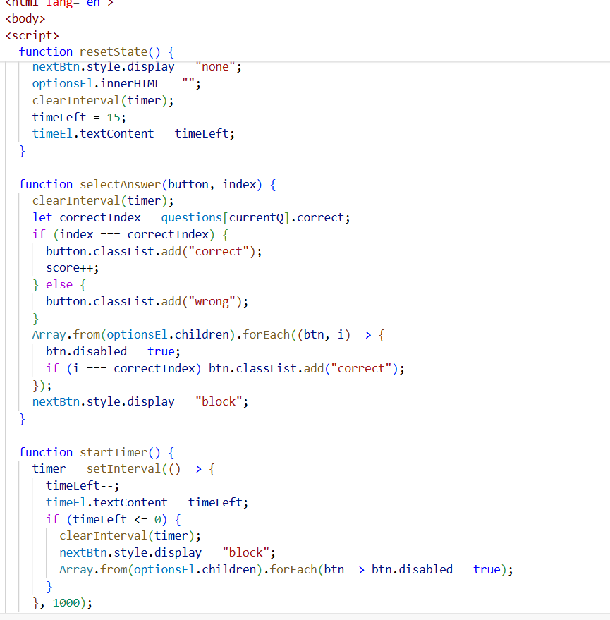
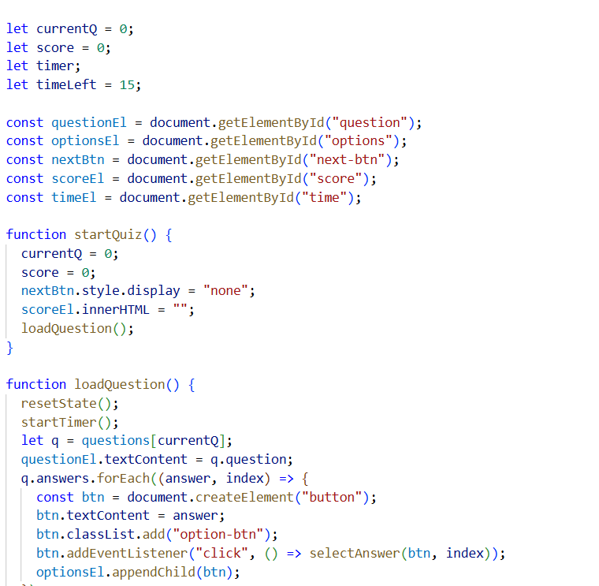
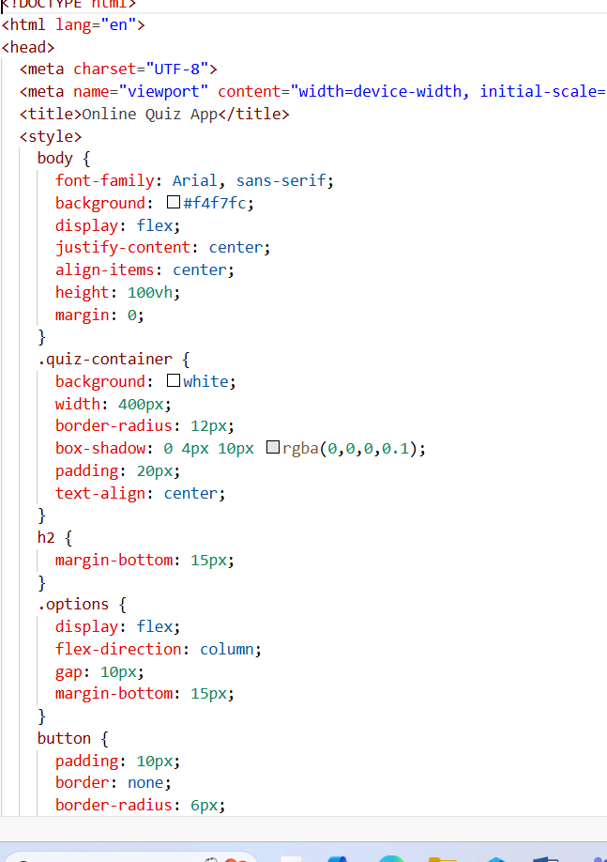
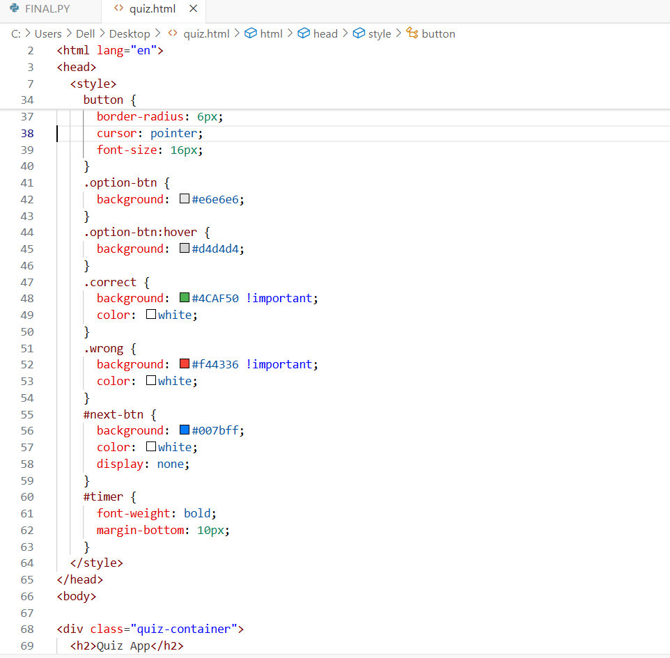
Result

Slide 7
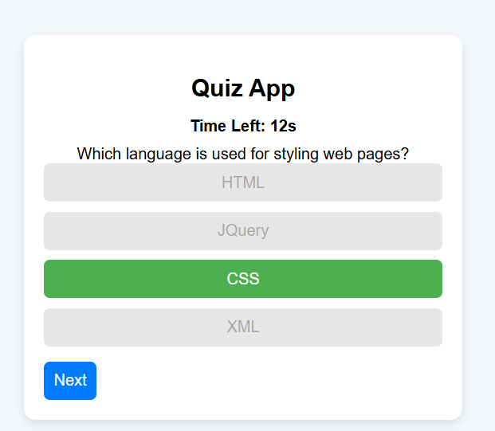
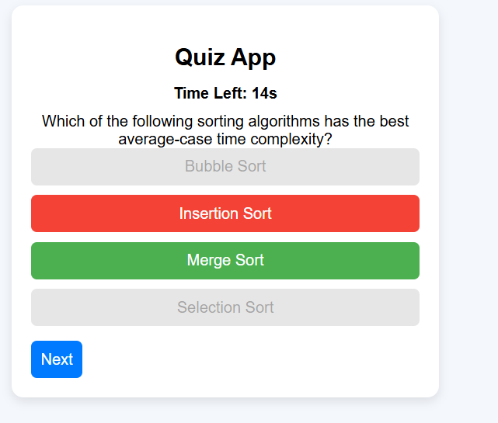
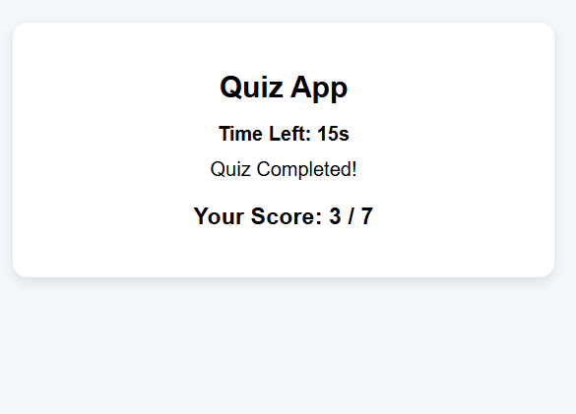
Result

Slide 8
GITHUB LINK
Github link :

Slide 9
Conclusion
An Online Quiz Application provides a modern, efficient, and scalable solution to traditional assessment challenges.
It reduces the manual workload of instructors by automating quiz creation, distribution, and evaluation.
Students benefit from instant feedback and improved learning through interactive and accessible assessments.
The system ensures accuracy, transparency, and easy record management for long-term use..
It supports remote and flexible learning, which aligns with the growing trend of digital education and training.
Overall, the application bridges the gap between traditional assessments and modern e-learning needs, making
the process faster, fairer, and more effective

Slide 10
Future scope(Optional)
AI-based Question Generation – Automatically create quiz questions based on study material or uploaded content.
Adaptive Quizzes – Difficulty level adjusts based on the student’s performance in real time.
Gamification Features – Leaderboards, badges, and rewards to make quizzes more engaging.
Mobile App Integration – Dedicated Android/iOS apps for better accessibility.
Data Analytics & Insights – Advanced reports to track individual and group performance trends.
Cloud Integration – Store quizzes and results securely, enabling global accessibility.
Proctoring & Security Features – Webcam monitoring, time tracking, and anti-cheating measures.

Slide 11
References
Google developers web fundamentals-guided the creation of a responsive and user-friendly interface,following web accessibility best practices.
Design inspiration-adapted common features and ui patterns from popular task management apps to enhance usability and interactivity.

Slide 12
THANK YOU

