Slide 1
Capstone Project
Predicting Best Insurance Plan
Shashen Wijesinghe
Batch 04
Reg. No-203

Slide 2
Contents
Introduction
Data
Methodology
Results
Discussion
Future Works

Slide 3
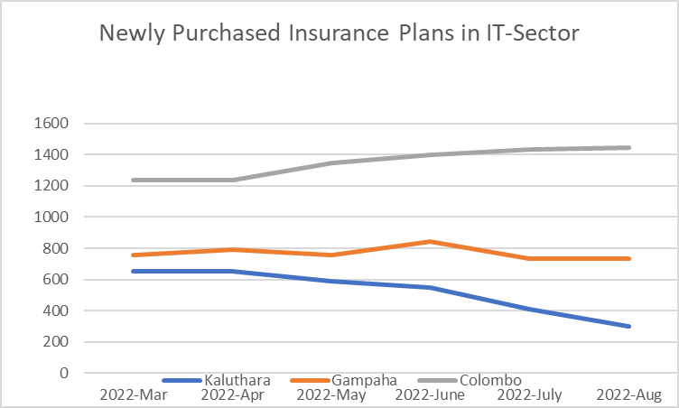
Introduction
Climax Insurance (Pvt) Ltd experienced lack of interest when purchasing new insurance plans of employees in IT-sector, Kaluthara.
Need to emphasize the best insurance plan for their customers.

Slide 4
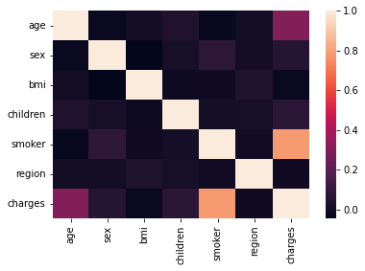
Data
index | age | bmi | children | charges
count | 1338 | 1338 | 1338 | 1338
mean | 39.20703 | 30.6634 | 1.094918 | 13270.42227
std | 14.04996 | 6.098187 | 1.205493 | 12110.01124
min | 18 | 15.96 | 0 | 1121.8739
25% | 27 | 26.29625 | 0 | 4740.28715
50% | 39 | 30.4 | 1 | 9382.033
75% | 51 | 34.69375 | 2 | 16639.91252
max | 64 | 53.13 | 5 | 63770.42801
Data Field | Description | Data Type
Age | Age of the Customer | Int64
Sex | Gender of the Customer | Object
bmi | Body Mass Index calculated from the wight and height of the employee | Float64
children | No. of children for the Customer | Int64
smoker | Whether customer is smoking or not | Object
region | Region in the district | Object
charges | Requested plan by the Customer | Float64
age variable scaled due to high range compared to other variables
Bmi variable removed after preprocessing
Correlation of variables
Segregated Customers in to 4 PLANs based on charges

Slide 5
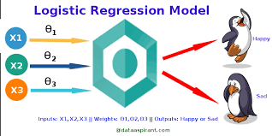
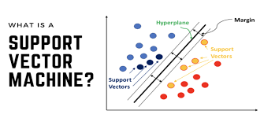
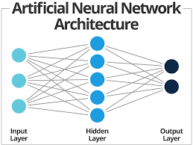
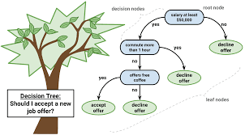
Methodology
4 Machine Learning Algorithms are used after preprocessing

Slide 6
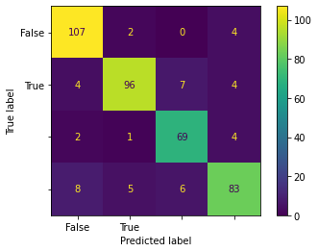
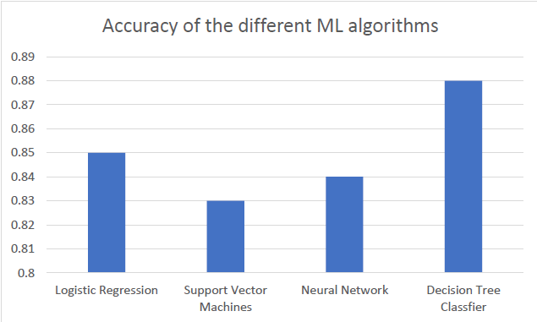
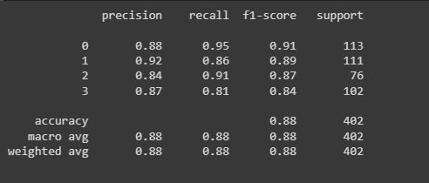
Results
Confusion Matrix of Decision Tree Classifier
Classification Report of Decision Tree Classifier

Slide 7
Discussion
Based on the Accuracy and F1-score, Decision Tree Classifier is the best model to predict the insurance plan.
SVM has less accuracy compared to all the ML algorithms

Slide 8
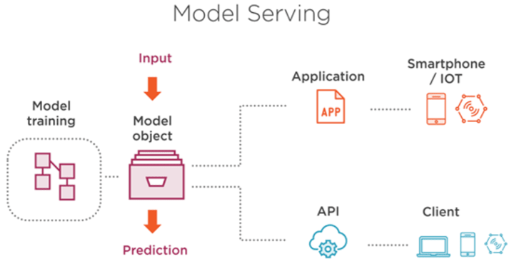
Future Works

Slide 9
Thank you

